Slide 1

ELECTRON MICROPROBE AND ELECTRON MICROSCOPE
CRIS LANA
STELLENBOSCH UNIVERSITY

Slide 2
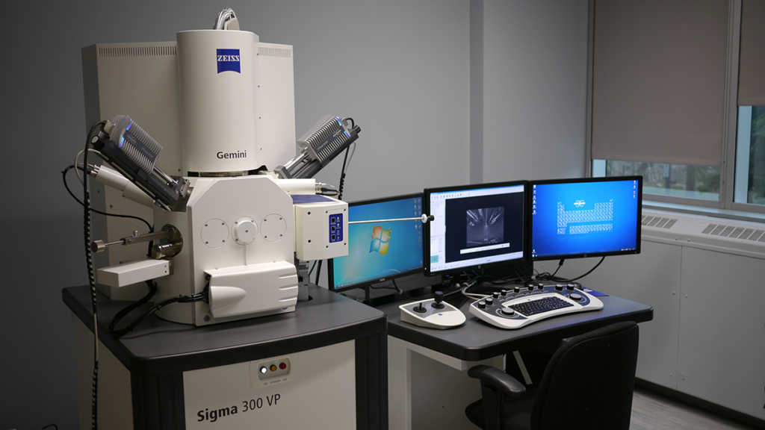
A Scanning Electron Microscope (SEM) is an advanced tool for imaging surfaces at a very high resolution, typically at the micro or nanoscale. Here’s an in-depth explanation of how it works and its capabilities:

Slide 3
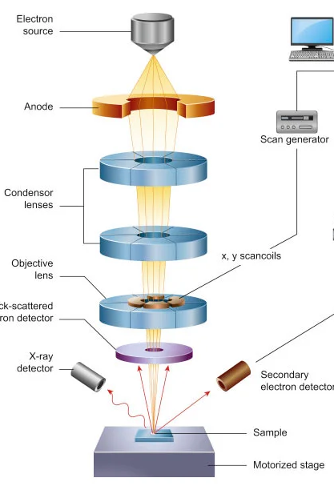
KEY COMPONENTS
1. Electron Source:
Located at the top of the SEM.
It is a metal filament generally made of Tungsten, housed by metal chamber that creates beam looking down.
The filament emits a focused beam of electrons, which is the primary tool used for imaging the sample.
The electron source typically operates under high voltage to create the beam.
2. Lenses and Scanning Coils:
Condenser lenses and objective lenses shape and focus the electron beam.
Scan coils guide and direct the beam across the surface of the sample in a raster pattern, ensuring systematic coverage of the area being imaged.
3. Sample Stage:
The sample is mounted on a motorized stage, which can move the sample under the electron beam for precise positioning.
The stage can often be adjusted in multiple axes (x, y, z) to change the angle and focus.

Slide 4
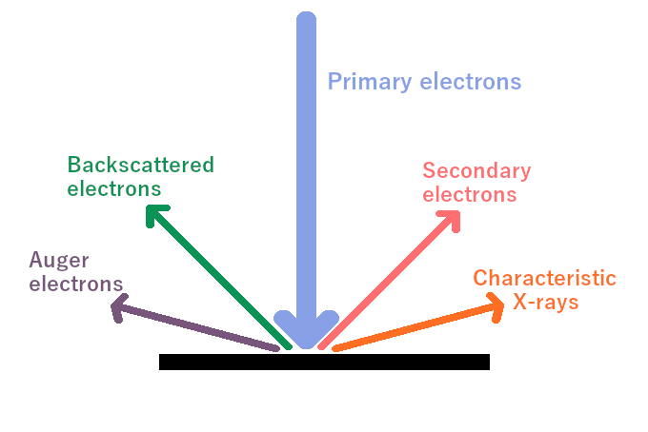
Interaction with the Sample:
When the electron beam hits the sample, it causes interactions with the atoms in the material, leading to the emission of different types of signals:
  Secondary electrons (SE): Emitted from the surface atoms of the sample when excited by the electron beam. These are used for high-resolution topographical imaging.
  Backscattered electrons (BSE): These electrons are reflected from the sample and provide contrast based on atomic number differences (heavier elements appear brighter).
  X-rays: Emitted due to the interaction of the electron beam with the inner shells of atoms. X-rays are used for elemental analysis through Energy Dispersive X-ray Spectroscopy (EDS/EDX).

Slide 5
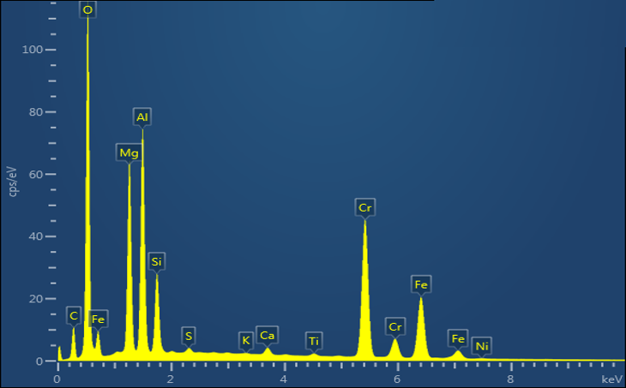

Slide 6
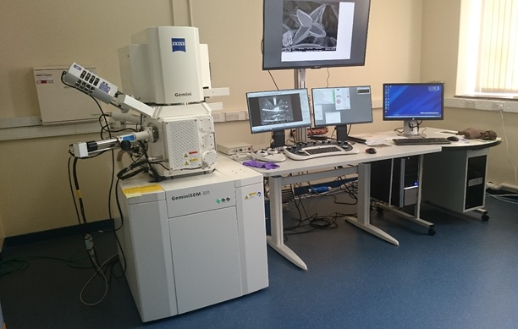

Slide 7
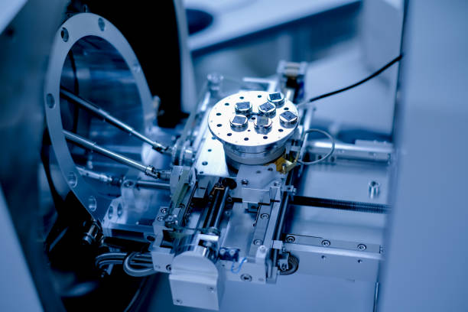

Slide 8

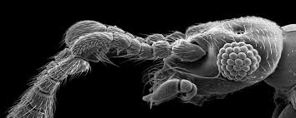

Slide 9
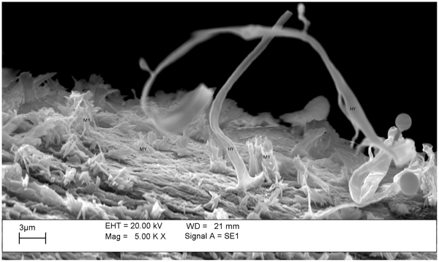
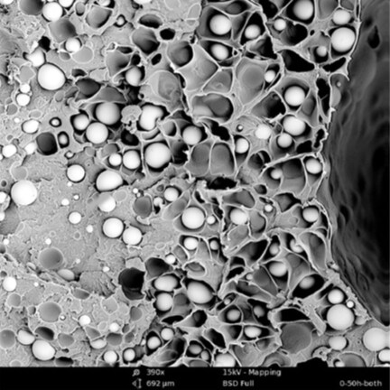
1. Soil and Sediment Studies
Visualising grain morphology, porosity, and mineral coatings.
Identifying clay minerals, heavy metals, and microstructures associated with pollution.
Understanding weathering processes and soil formation.
2. Airborne Particulates and Pollution
Characterisation of particulate matter (PM10, PM2.5), including dust, soot, and industrial emissions.
Determining morphology and elemental composition of aerosols for source tracking.
Assessing health-related particles like asbestos fibres or nanoparticles.
3. Water and Marine Systems
Studying biofilms, diatoms, and microorganisms on aquatic surfaces.
Analysing microplastics: shape, surface degradation, and attached contaminants.
Detecting mineral precipitates from acid mine drainage or hydrothermal systems.

Slide 10
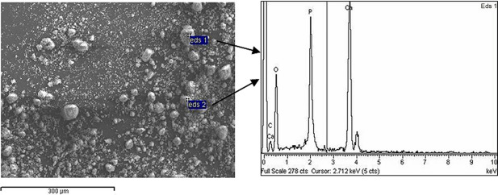
4. Waste Management and Remediation
Characterising fly ash, slag, and industrial residues.
Tracking the immobilisation of heavy metals in treated soils or engineered barriers.
Evaluating nanomaterials used in environmental clean-up.

Slide 11
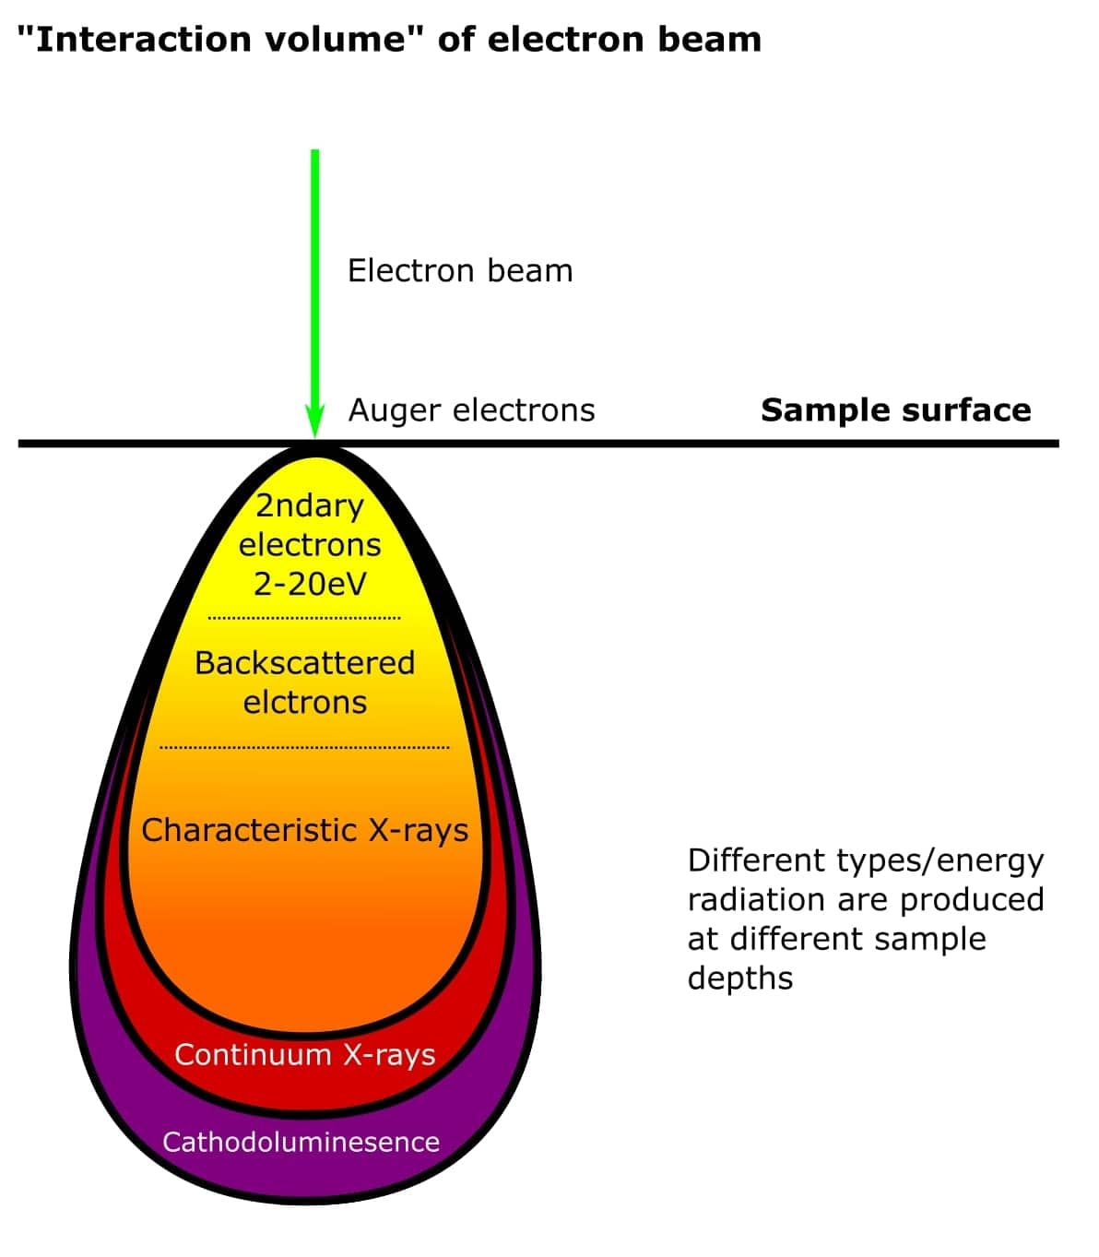
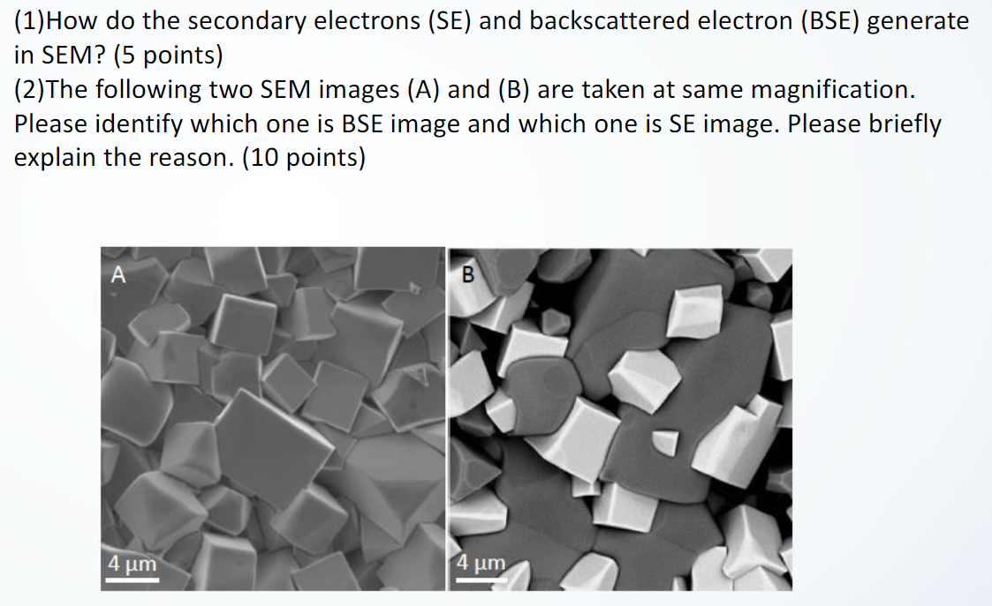
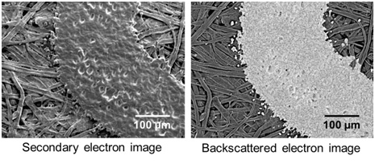

Slide 12
FOUR MAIN DETECTORS
A cathodoluminescence (CL) detector captures the luminescent light emitted by minerals when they are bombarded by an electron beam, revealing internal structures and growth zoning invisible under normal light
A backscatter (BSE) detector measures electrons reflected from the sample surface, providing contrast based on atomic number differences and revealing compositional variations.
An EDX detector identifies characteristic X-rays emitted from a sample when bombarded by an electron beam, allowing for elemental composition analysis and mapping.
A WD (Wavelength Dispersive) detector measures the wavelength of X-rays emitted from a sample to provide highly precise and accurate elemental composition analysis, typically used in Wavelength Dispersive X-ray Spectroscopy (WDS).

Slide 13
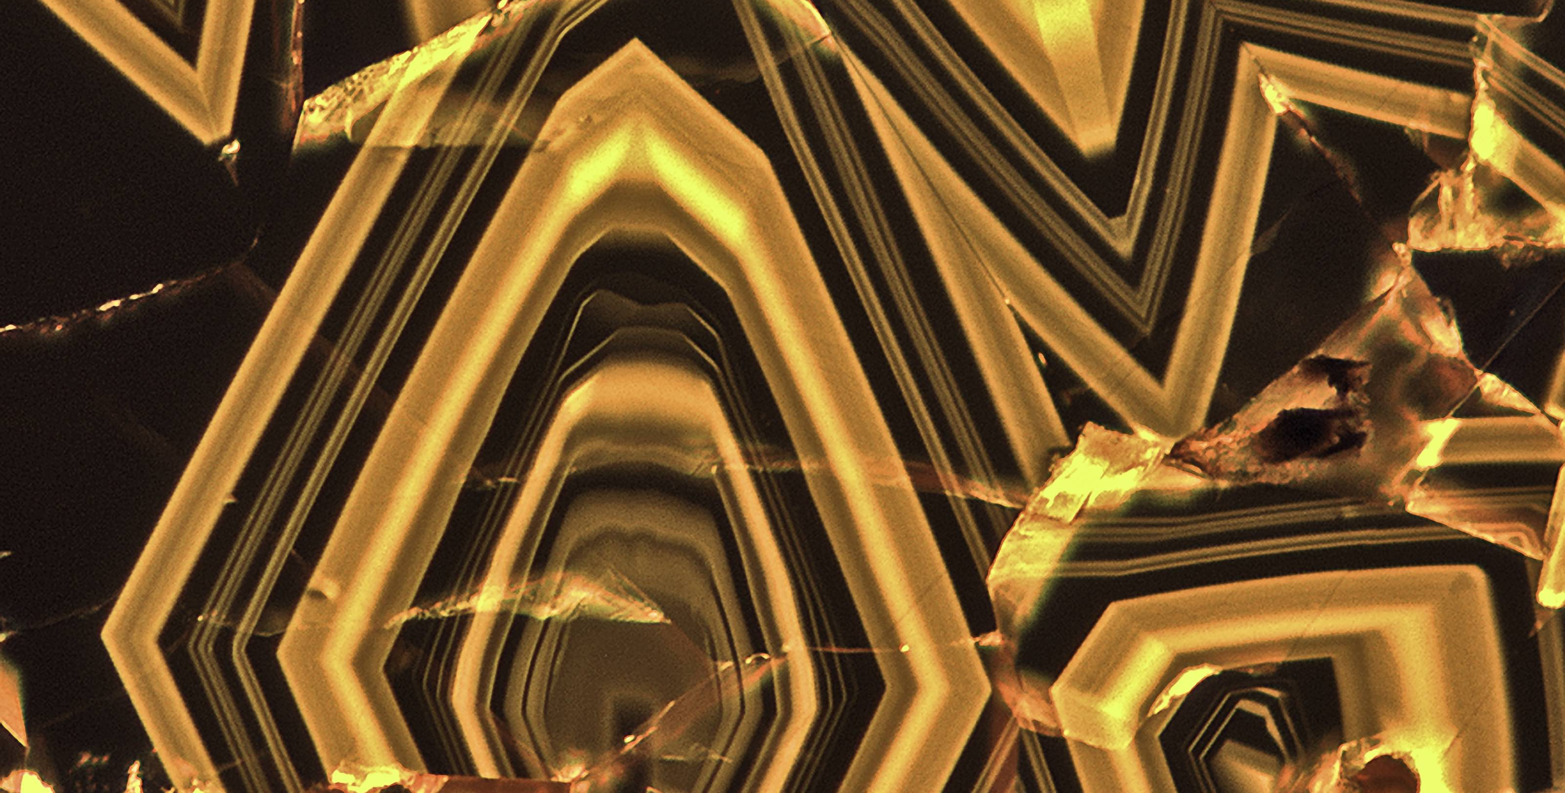
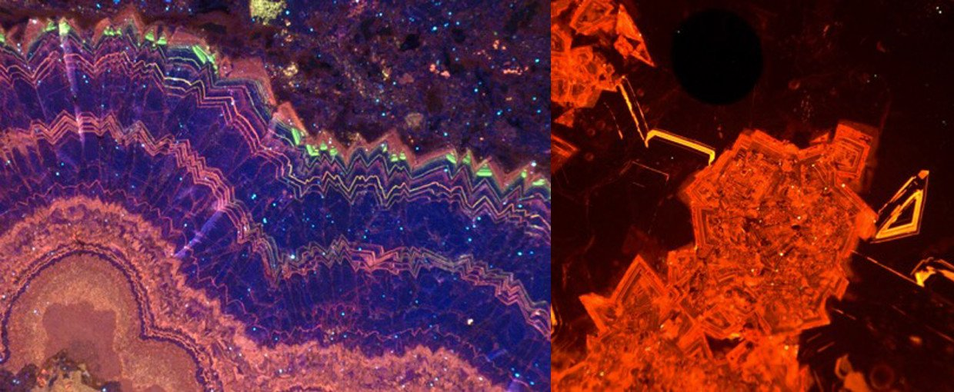
Cathodoluminescence (CL) imaging collects and measures the light generated by an electron beam directed at a material. The fastest and simplest method to obtain CL imaging is by performing intensity mapping. This method records the CL intensity for every beam position using a single-pixel light detector.

Slide 14
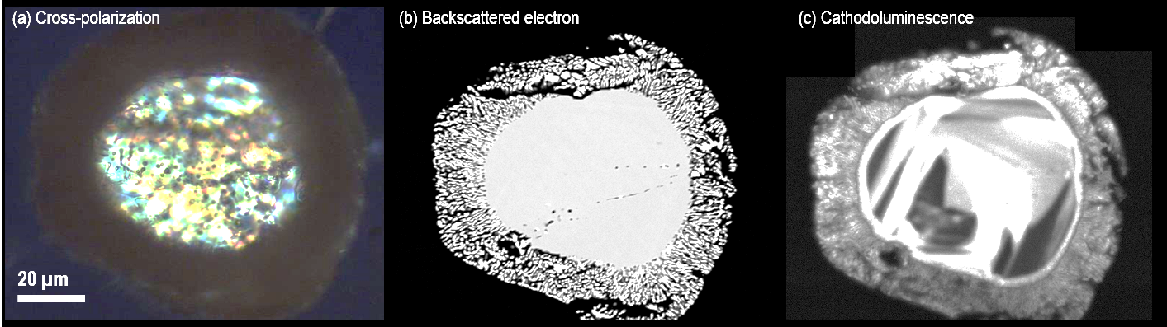
Cross-polarization (a): This image, taken under a cross-polarized microscope, reveals the internal structure of the sample using polarized light. The colorful interference patterns are indicative of different crystal orientations and mineral phases, providing insights into the sample's crystallography.
Backscattered electron (b): The second image is from a backscattered electron (BSE) detector in a scanning electron microscope (SEM). It contrasts areas of the sample based on atomic number, with lighter regions indicating elements with higher atomic numbers and denser compositions. This image shows clear structural differences between the core and rim of the grain.
Cathodoluminescence (c): The third image is from cathodoluminescence (CL) imaging, which highlights different luminescent properties of minerals when they are bombarded by an electron beam. It reveals growth zoning within the mineral, indicating variations in chemical composition during formation. This technique is especially useful for identifying trace elements and growth patterns not visible under normal light.

Slide 15
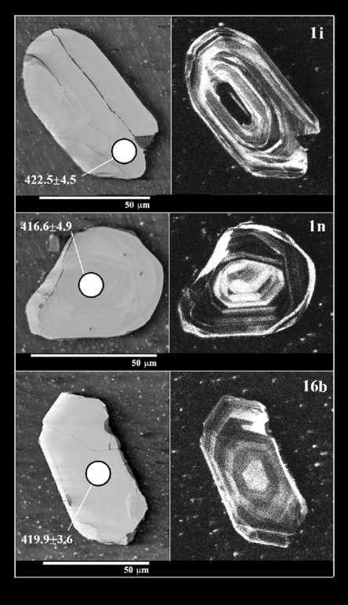
Three sets of paired micrographs, each showing a combination of backscattered electron (BSE) and cathodoluminescence (CL) images for individual mineral grains. These techniques are often used together to study the internal structure, chemical zoning, and growth history of minerals, particularly zircons or other geochronologically important minerals.

Slide 16
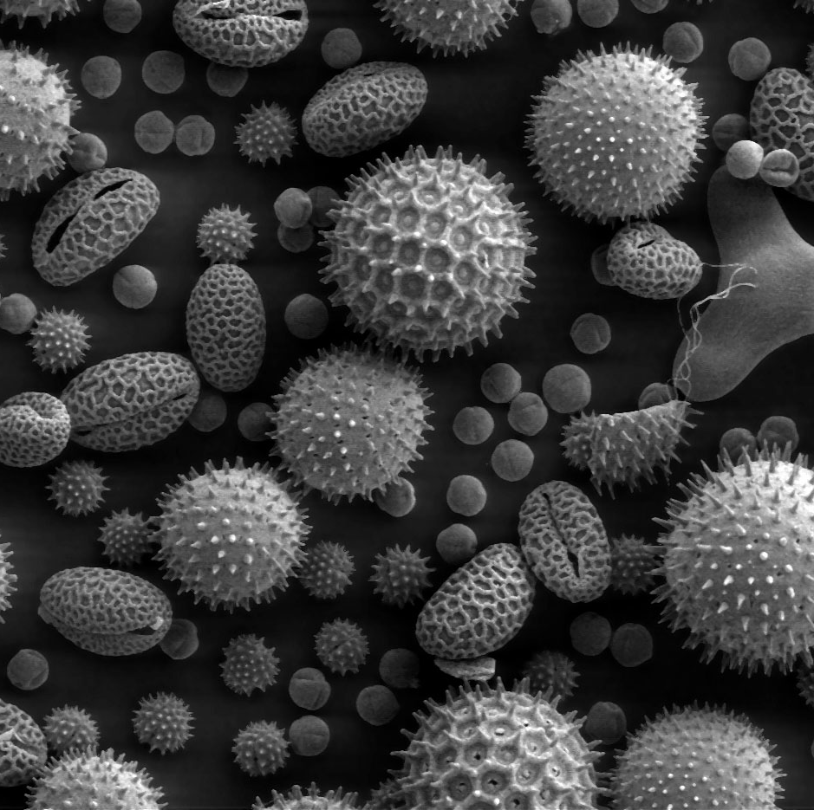
Backscattered Electron Images:
Backscattered electron (BSE) imaging provides contrast based on the average atomic number of the material. Brighter regions represent areas with higher atomic numbers (denser materials or elements), while darker regions correspond to lower atomic numbers.

Slide 17
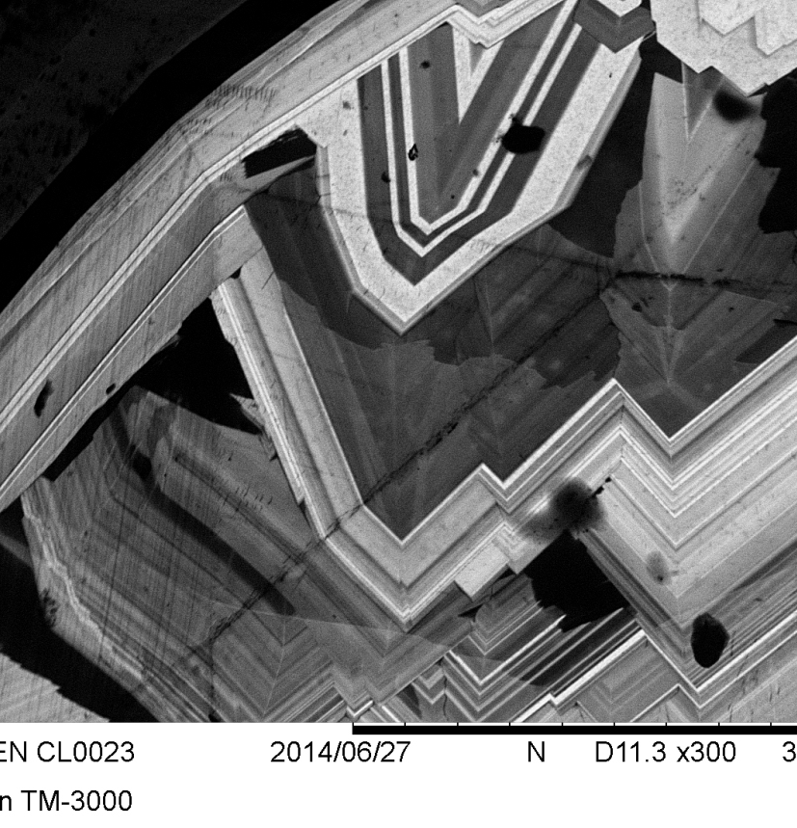
Cathodoluminescence
Cathodoluminescence (CL) images show the luminescence emitted by the minerals when exposed to an electron beam. This technique is particularly useful for identifying growth zoning and compositional variation that is invisible in traditional optical microscopy or BSE imaging.
The CL images in the right display well-defined concentric zoning patterns. These zones represent changes in the composition of the mineral during its growth, possibly due to changes in the environment of formation (e.g., temperature, pressure, or fluid composition).
The zoning in these images likely reflects variations in trace element concentrations (such as REEs) or changes in oxidation states during the mineral's crystallization.

Slide 18
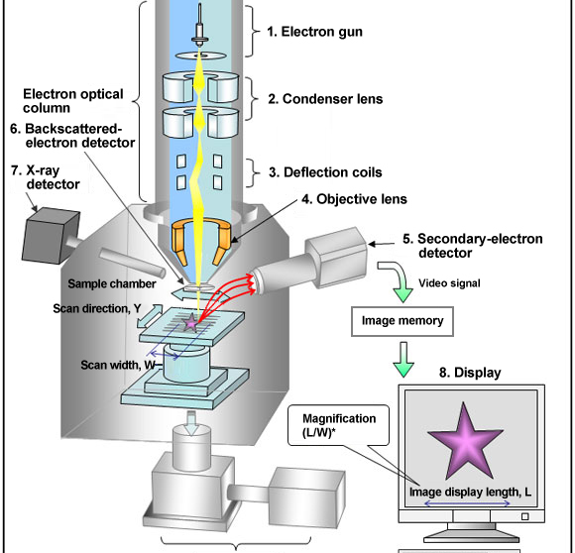

Slide 19
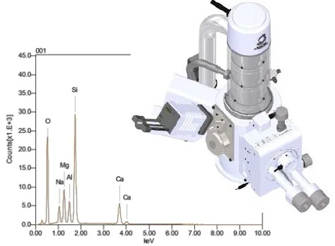
The X-rays emitted during the process are collected by a silicon drift detector, which measures the signal and interprets it using software. In essence, the chemical information can be visualized in several ways including elemental mapping and line scans. In this way, X-rays can be used to identify each element that exists in a sample.
EDX can be used for both qualitative and quantitative analysis, enabling users to identify both the type of elements that are present as well as the percentage of each element’s concentration within the sample. And as with traditional SEM, the technique requires little to no sample preparation and is non-destructive, meaning that it doesn’t damage the sample.

Slide 20
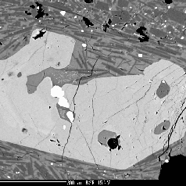
What can we get with an image?

Slide 21
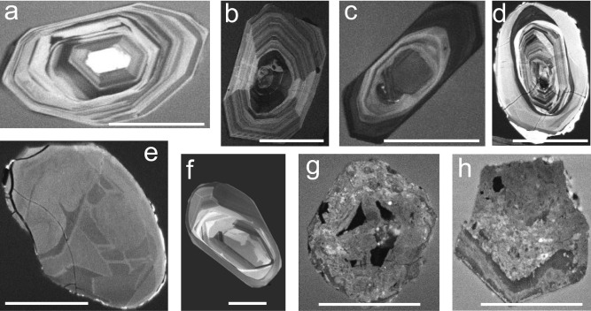

Slide 22
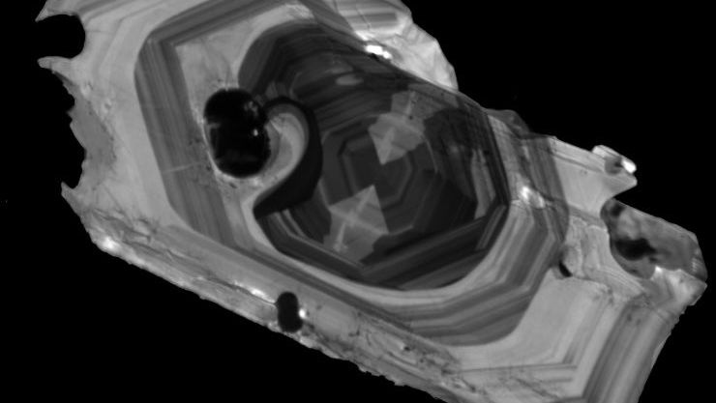

Slide 23
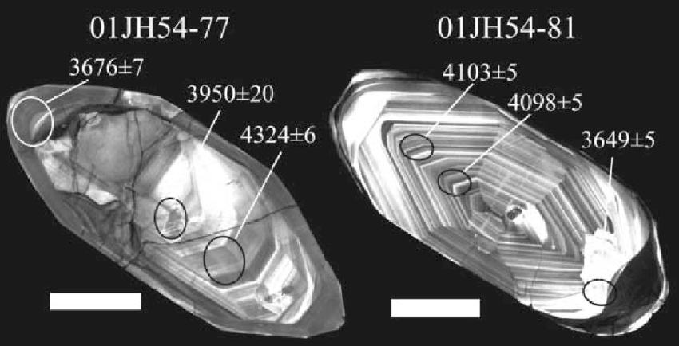

Slide 24
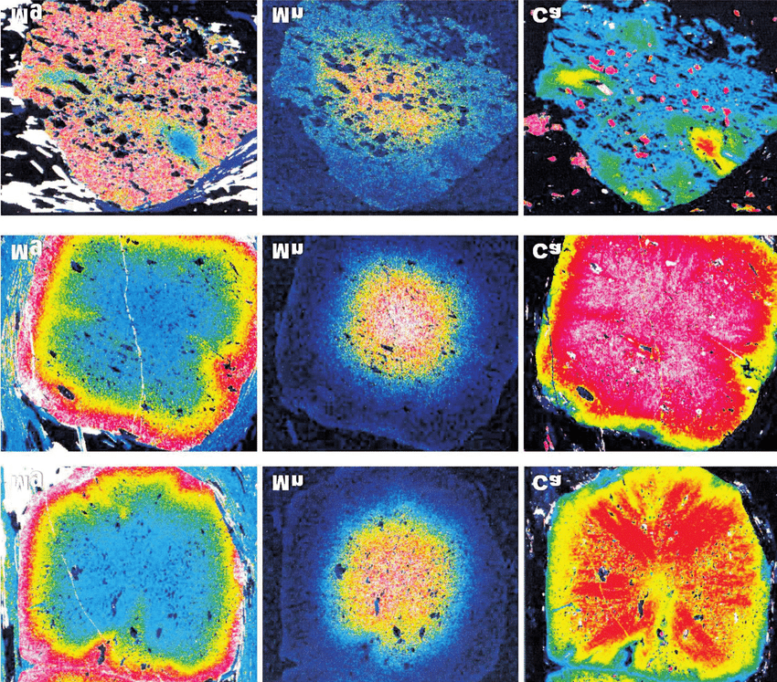
The image shows elemental distribution maps for minerals, illustrating the concentrations of magnesium (Mg), manganese (Mn), and calcium (Ca) across several mineral grains. These maps are likely generated using Electron Probe
Microanalysis (EPMA) or Energy Dispersive X-ray Spectroscopy (EDS), techniques that map the spatial distribution of elements within a sample.

Slide 25
Mg Map (left): The distribution of magnesium shows a gradient from the center (low Mg, blue) to the edges (higher Mg, red and yellow). This pattern indicates that Mg was more concentrated towards the outer rims during the mineral’s growth or later alteration phases.
Mn Map (middle): The core of the grain is enriched in manganese (yellow and red), with a surrounding halo of lower concentration (blue). This could suggest that Mn was incorporated early in the mineral's formation and depleted towards the rim.
Ca Map (right): Calcium is more concentrated towards the edges (yellow to red) and less in the center (blue), which may suggest zoning patterns where Ca-rich minerals formed during the later stages of crystal growth.

Slide 26
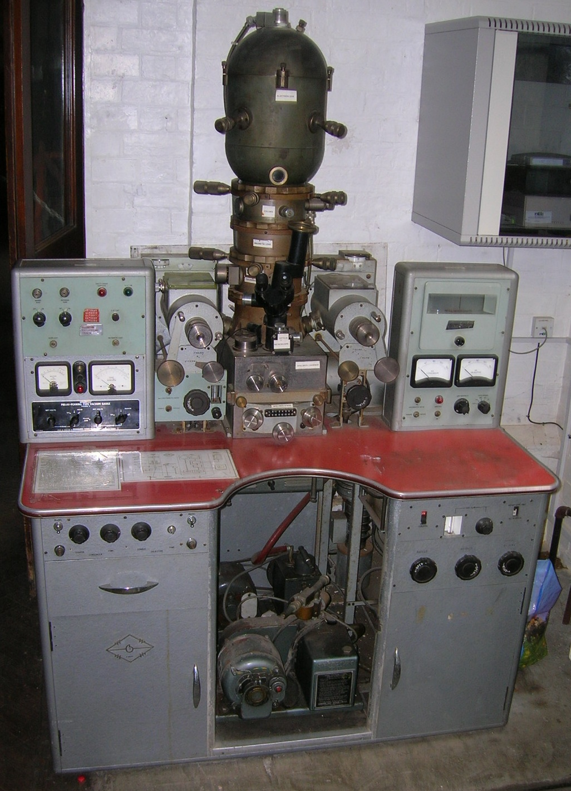
An electron microprobe (EMP), also known as an electron probe microanalyzer (EPMA) or electron micro probe analyzer (EMPA), is an analytical tool used to non-destructively determine the chemical composition of small volumes of solid materials. It works similarly to a scanning electron microscope: the sample is bombarded with an electron beam, emitting x-rays at wavelengths characteristic to the elements being analysed.
The Cambridge Scientific Instrument Microscan is an early version of the electron microprobe developed by Cambridge Scientific Instruments in the late 1950s and early 1960s. This model, known for its pioneering role in microanalysis, was one of the first electron microprobes commercially available. It enabled geologists and materials scientists to perform precise elemental analysis at the micron scale by using a focused electron beam to generate characteristic X-rays from the sample. These machines were cutting-edge technology in their time, marking a significant advancement in geochemistry and material sciences. Given this context, the Microscan in the image is likely from the early to mid-1960s, when Cambridge Scientific Instruments introduced their first series of these electron microprobes.

Slide 27
Electon Microprobes
An electron microprobe (EMP), also known as an electron probe microanalyzer (EPMA) or electron micro probe analyzer (EMPA), is an analytical tool used to non-destructively determine the chemical composition of small volumes of solid materials. It works similarly to a scanning electron microscope: the sample is bombarded with an electron beam, emitting x-rays at wavelengths characteristic to the elements being analysed.

Slide 28
The Cambridge Scientific Instrument Microscan is an early version of the electron microprobe developed by Cambridge Scientific Instruments in the late 1950s and early 1960s. This model, known for its pioneering role in microanalysis, was one of the first electron microprobes commercially available.
It enabled geologists and materials scientists to perform precise elemental analysis at the micron scale by using a focused electron beam to generate characteristic X-rays from the sample.
These machines were cutting-edge technology in their time, marking a significant advancement in geochemistry and material sciences.

Slide 29
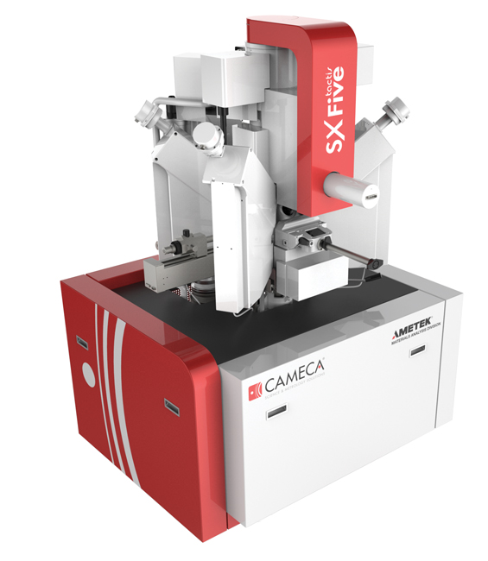
Cambridge Instruments Company (CAMICA) microprobes, known for their reliability and accuracy, became a cornerstone in laboratories worldwide, contributing to developments in geology, metallurgy, and semiconductor research.

Slide 30
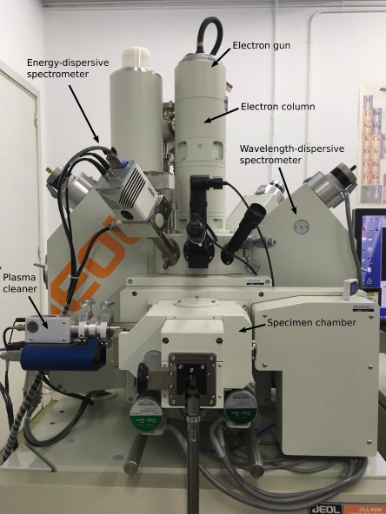
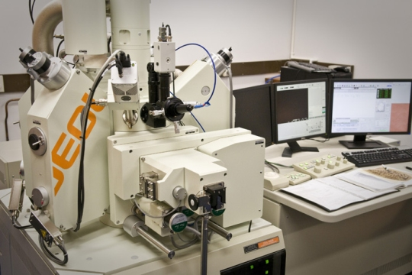
JEOL (Japan Electron Optics Laboratory) is a leading manufacturer of electron microprobes, recognized for its contributions to microanalysis and electron microscopy since the 1960s. JEOL microprobes are equipped with advanced electron beam technology that allows for precise elemental analysis at the micrometer scale, making them invaluable for studies in geology, materials science, and metallurgy.

Slide 31
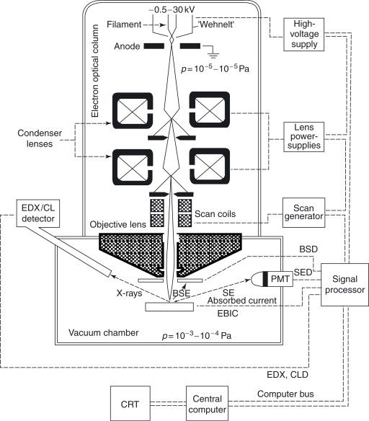
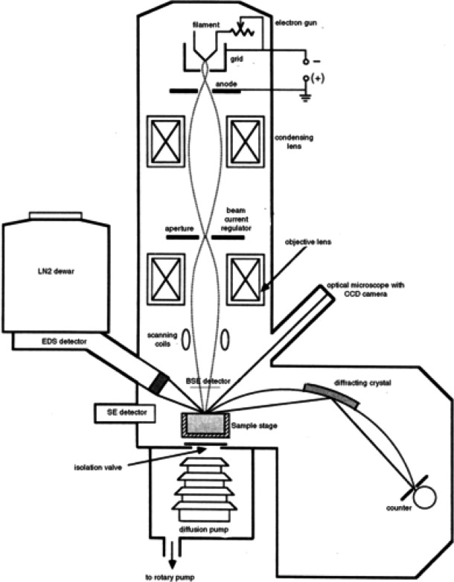

Slide 32
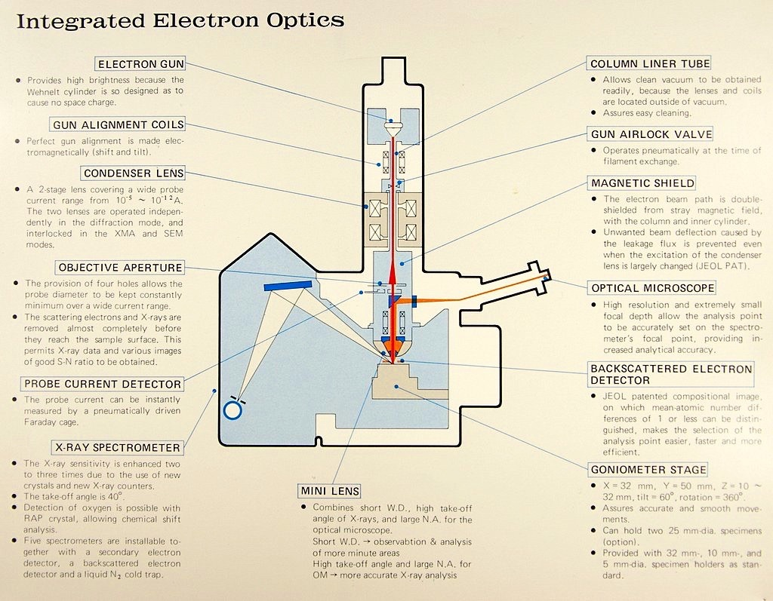

Slide 33
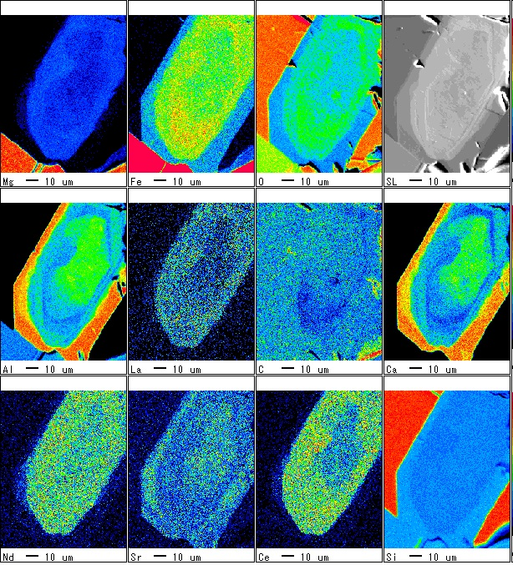
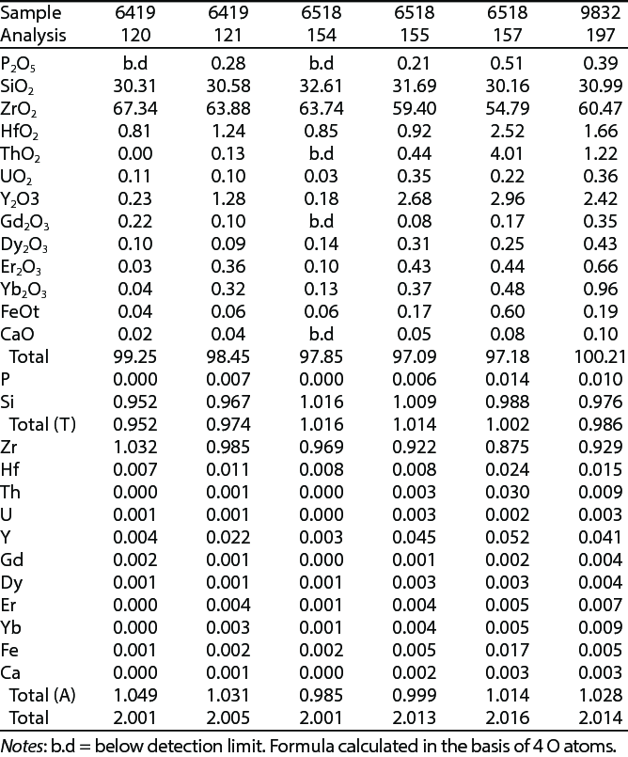
Representative electron-microprobe analyses and formulae of zircon

Slide 34
