Slide 1
Xrf fluorescence
Cris lana
Stellenbosch University

Slide 2
What is it for?
X-ray fluorescence (XRF) is an analytical technique used to determine the elemental composition of materials.
It is widely applied in various fields such as geology, material science, environmental analysis, and even in industrial applications for quality control.
We will dive into this technique to understand:
      what it is made of
      what it is used for
      how to work with it

Slide 3
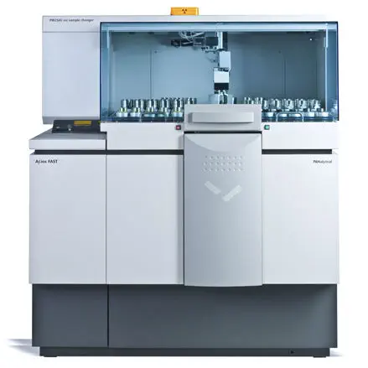
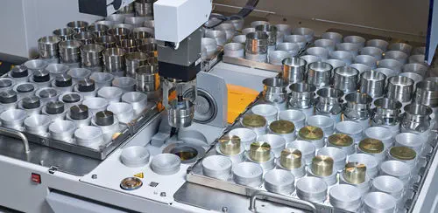
Main Components
X-ray Tube
High-Voltage Generator
Control Console
Automated Sample Holder

Slide 4


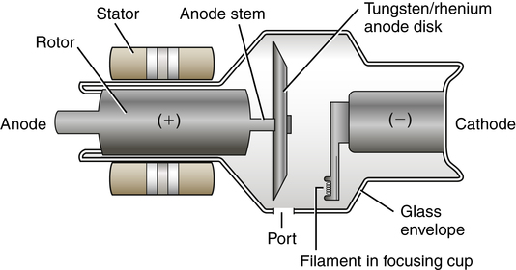
Main Components
X-ray Tube
The X-ray tube is the primary component responsible for generating X-rays. It is made up of an anode and a cathode.
When high voltage is applied across the cathode and anode, electrons are emitted and accelerated towards the anode. The sudden deceleration of these electrons at the anode produces X-rays.

Slide 5
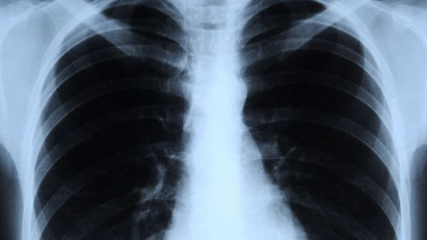
X rays?

Slide 6
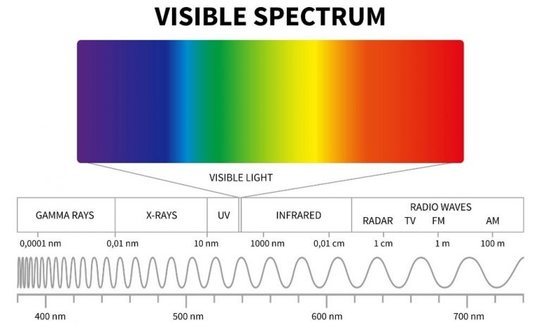
X-rays:
X-rays are a form of electromagnetic radiation with very short wavelengths, typically between about 0.01 nanometres (nm) and 10 nm (which corresponds to very high frequencies and energies).
Properties:
Highly penetrating, capable of passing through most materials.
Shorter wavelength → higher energy photons.
Can ionise atoms, making them useful but also potentially harmful.
Uses:
Medical imaging (X-ray scans, CT scans).
Material analysis (XRD, XRF).
Security scanning (airport luggage checks).
Scientific research (probing atomic structures).

Slide 7
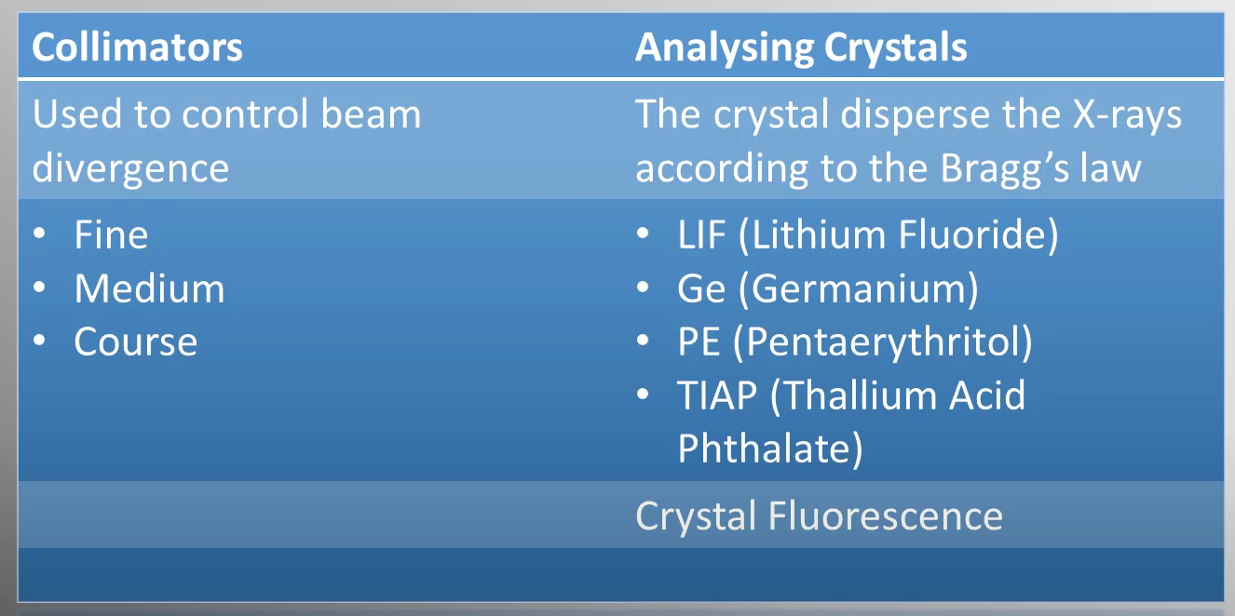
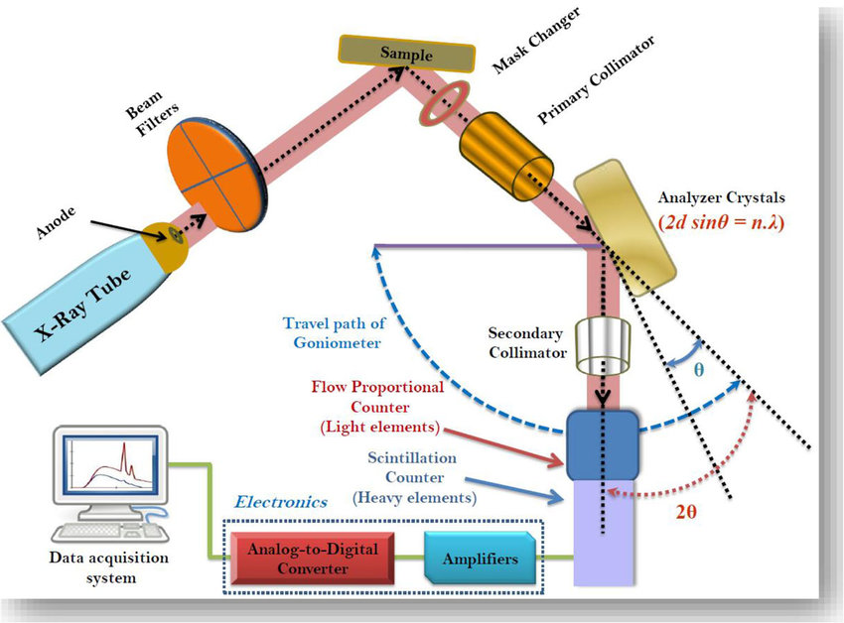
Bragg’s law : equation that explains how X-rays (or neutrons, electrons) diffract when they interact with the regularly spaced planes of atoms in a crystal lattice

Slide 8
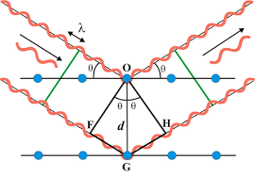
nλ=2dsinθ
Where:
n = order of reflection (1, 2, 3 …)
λ = wavelength of the incident radiation
d = spacing between crystal planes (interplanar spacing)
θ = angle of incidence (the Bragg angle, measured between the incident ray and the crystal plane)

Slide 9
X-ray diffraction (XRD) and X-ray fluorescence (XRF)
X-ray diffraction (XRD) and X-ray fluorescence (XRF) are both analytical techniques that use X-rays, but they serve very different purposes.

Slide 10
Xrd vs xrf
1. Principle
XRD: Based on Bragg’s law. It measures how X-rays are diffracted by the crystal lattice of a material.
XRF: Based on characteristic X-ray emission. When atoms are excited by X-rays, they emit secondary (fluorescent) X-rays at energies characteristic of each element.
2. Information Obtained
XRD: Reveals crystalline structure – unit cell parameters, crystallinity, mineral identification, phase composition, and orientation.
XRF: Reveals elemental composition – qualitative and quantitative analysis of which elements are present and in what concentrations.

Slide 11
Xrd vs xrf
3. Sample Requirements
XRD: Requires crystalline material (amorphous phases give broad, weak signals). Finely powdered samples are ideal for random orientation.
XRF: Works on almost any solid, liquid, or powder; crystallinity is irrelevant. However, for bulk rock compositions we need highly homogenised powder.
4. Depth of Analysis
XRD: Probes a shallow layer of the crystal lattice (~µm scale) but gives structural information.
XRF: Penetrates more deeply (mm scale depending on material and X-ray energy) and gives bulk composition.

Slide 12
Applications
XRD:
  Identifying unknown minerals
  Determining lattice parameters
  Studying polymorphism (e.g., calcite vs. aragonite)
  Quantifying phase mixtures
XRF:
  Major, minor, and trace element analysis of rocks, soils, and sediments
  Environmental monitoring
  Quality control in metallurgy, cement, ceramics, etc.

Slide 13
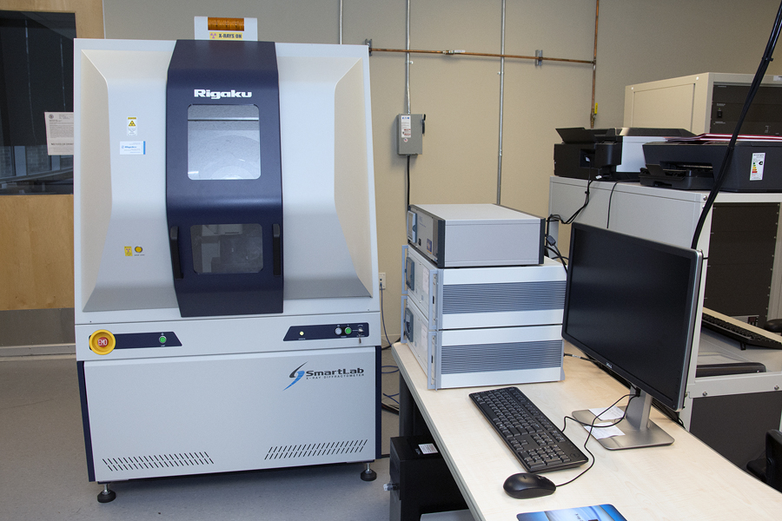
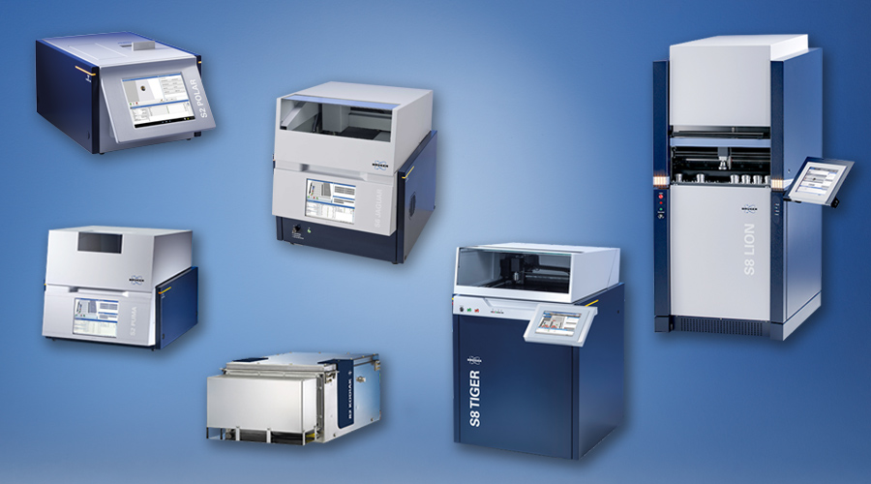
Shapes and sizes

Slide 14
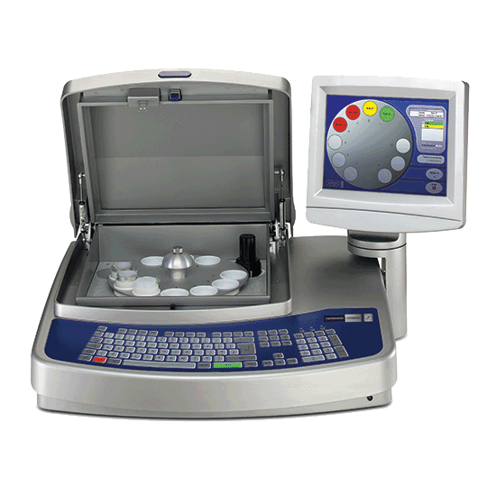
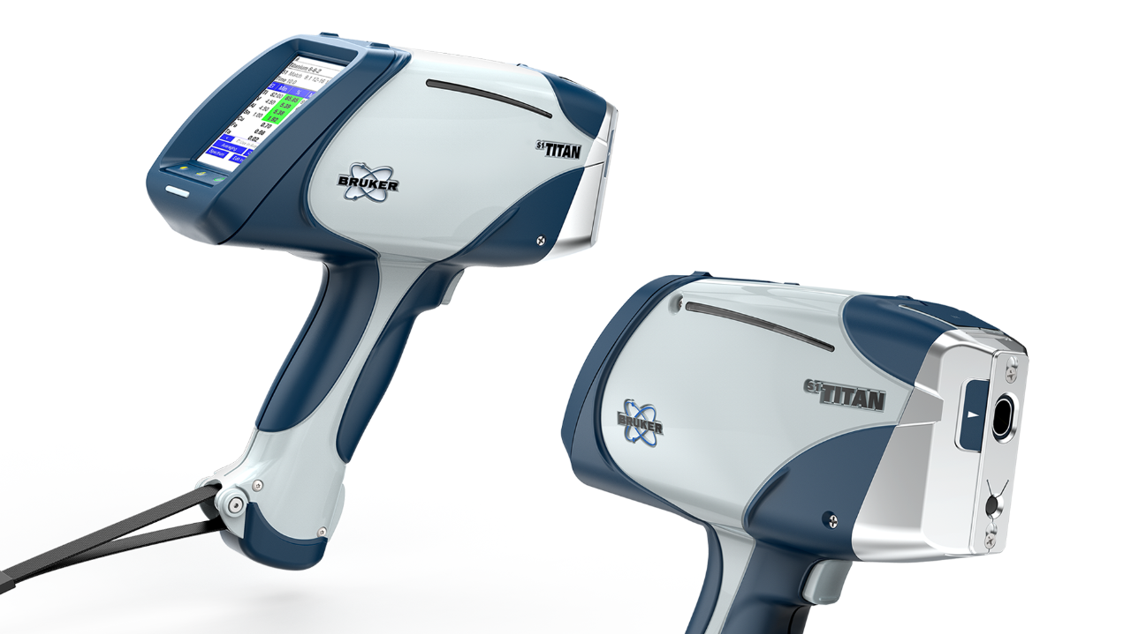
Shapes and sizes

Slide 15
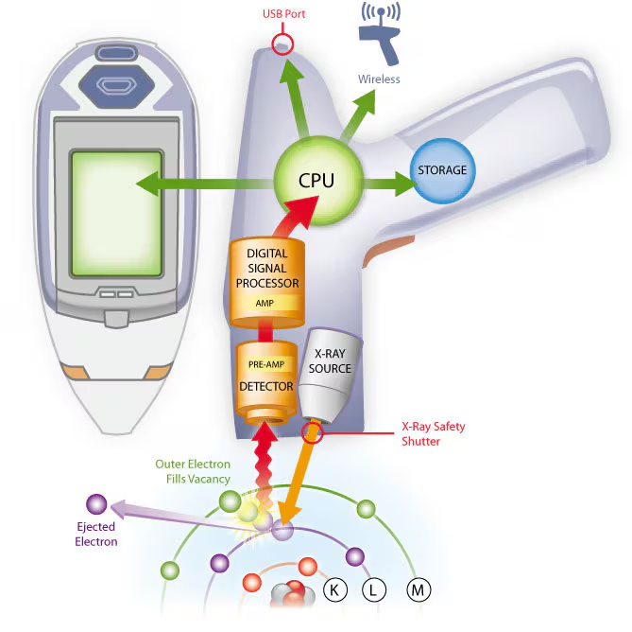
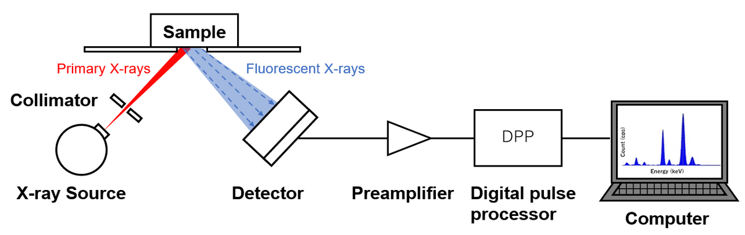
How things work inside

Slide 16
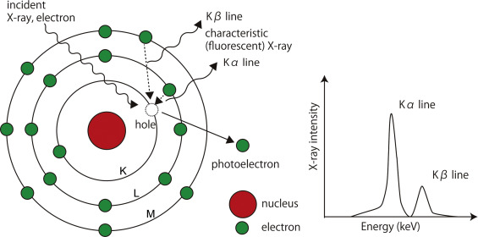

Slide 17
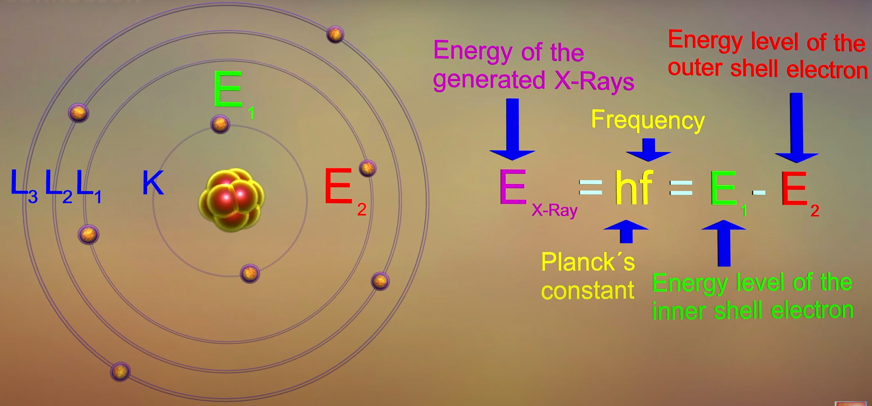

Slide 18
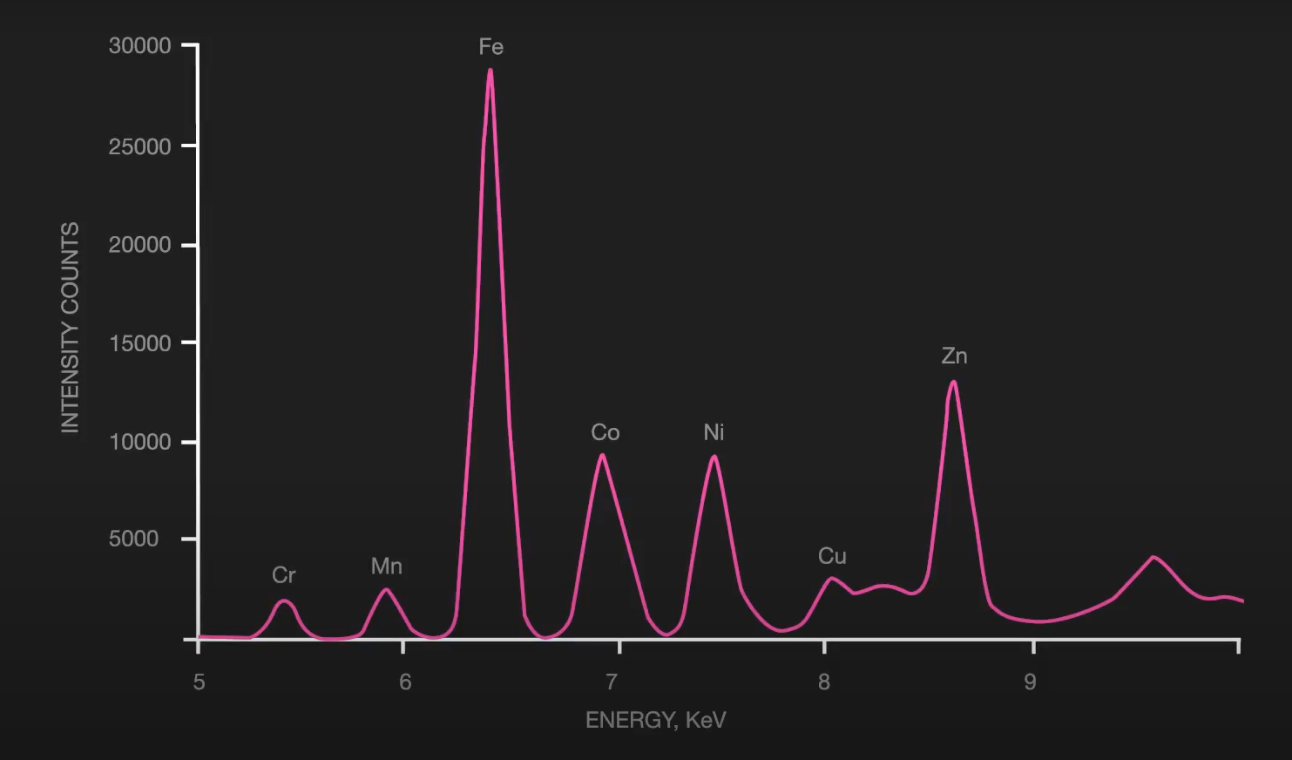

Slide 19
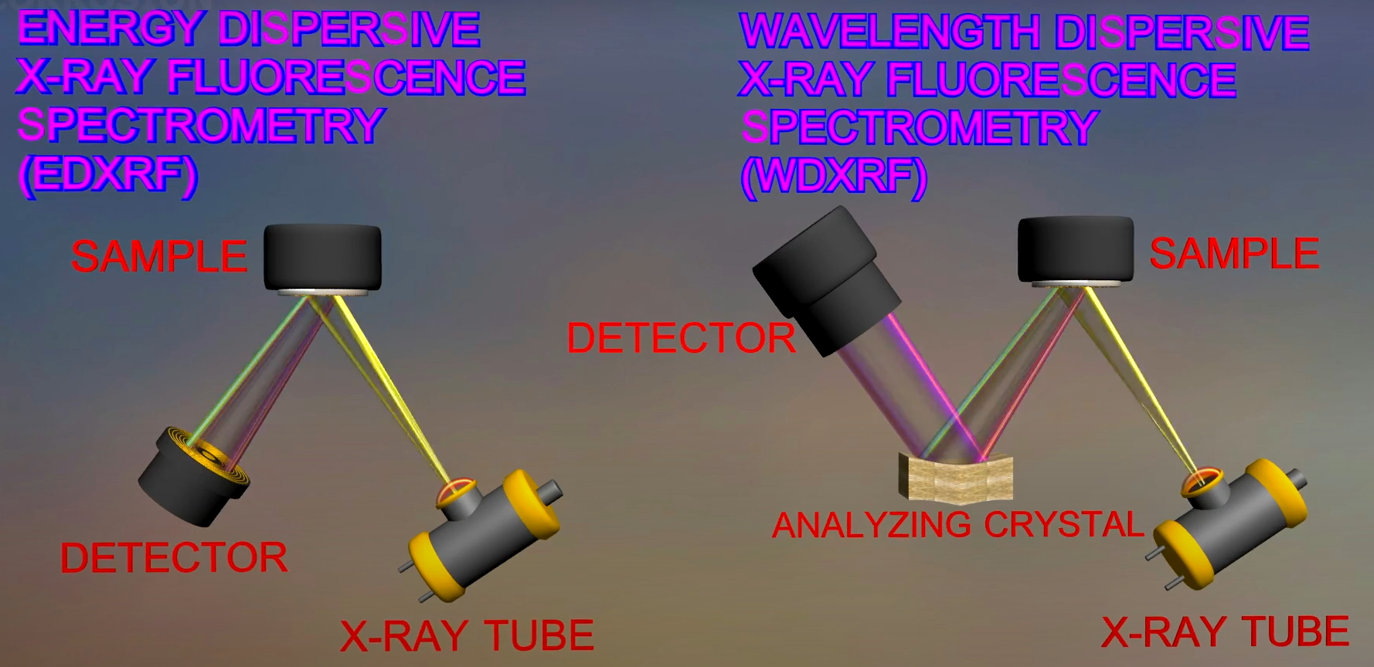
Two possible detectors

Slide 20
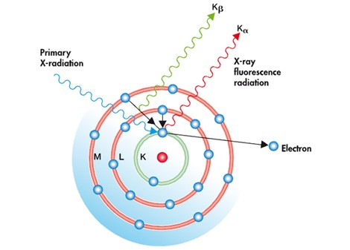
Energy Dispersive X-ray Fluorescence (EDXRF)
X-ray Excitation:
A sample is irradiated with a beam of primary X-rays, typically generated from an X-ray tube or a radioactive source.
These high-energy X-rays excite the atoms in the sample by knocking out inner-shell electrons (usually from the K or L shells).

Slide 21
Energy Dispersive X-ray Fluorescence (EDXRF)
Characteristic X-ray Emission:
As the electron drops to the lower energy level, it emits energy in the form of secondary X-rays. The energy of this emitted X-ray is unique to the specific element, making it possible to identify which elements are present in the sample.

Slide 22
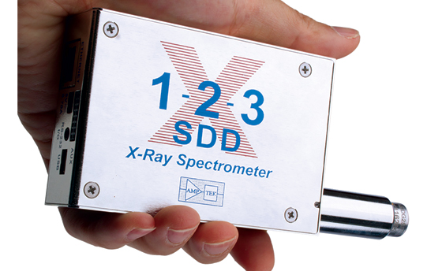
Energy Dispersive X-ray Fluorescence (EDXRF)
Energy Dispersive Detection:
In EDXRF, the emitted X-rays are detected by an energy-dispersive detector, such as a silicon drift detector (SDD).

Slide 23
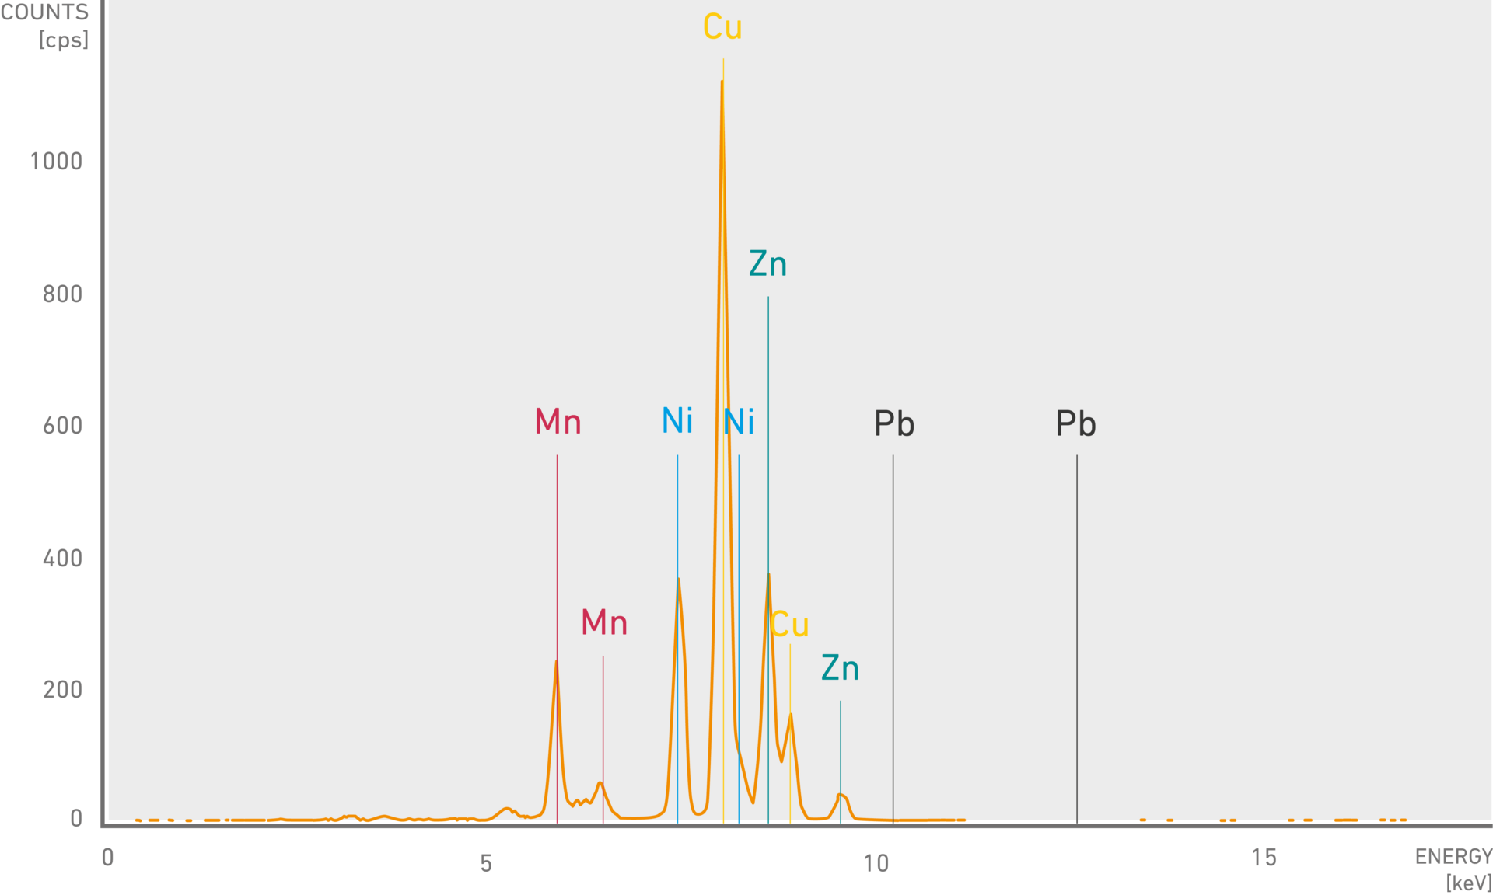
The detector measures the energy of the incoming X-rays, and this energy is directly related to the specific elements present.
The intensity of the X-rays at specific energy levels correlates with the concentration of the corresponding element in the sample.

Slide 24
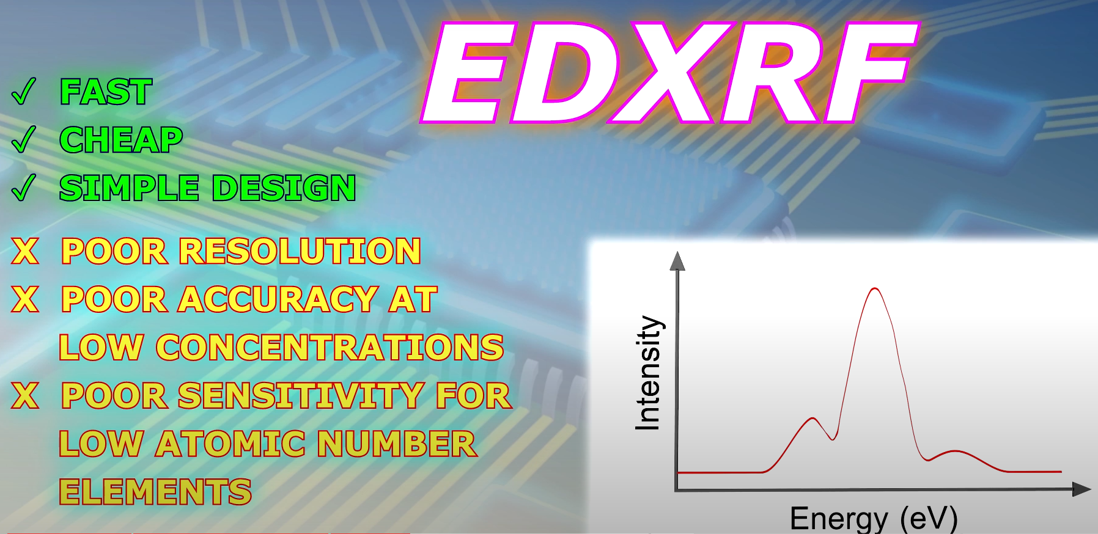

Slide 25
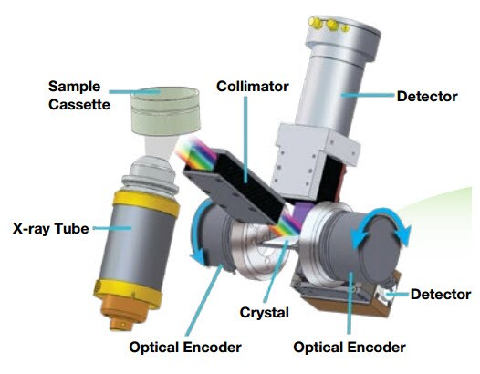
Wavelength Dispersive X-ray Fluorescence (WDXRF)
Instead of directly measuring the energy of the emitted X-rays (as in EDXRF), WDXRF uses a diffraction process to separate the X-rays by their wavelength.

Slide 26
Wavelength Dispersive X-ray Fluorescence (WDXRF)
A crystal analyser (usually made from lithium fluoride or other specific materials) is used to diffract the emitted X-rays. The crystal acts like a prism, dispersing X-rays based on their wavelength according to Bragg's Law.
By adjusting the angle of the crystal, X-rays of specific wavelengths can be isolated and measured one at a time.

Slide 28
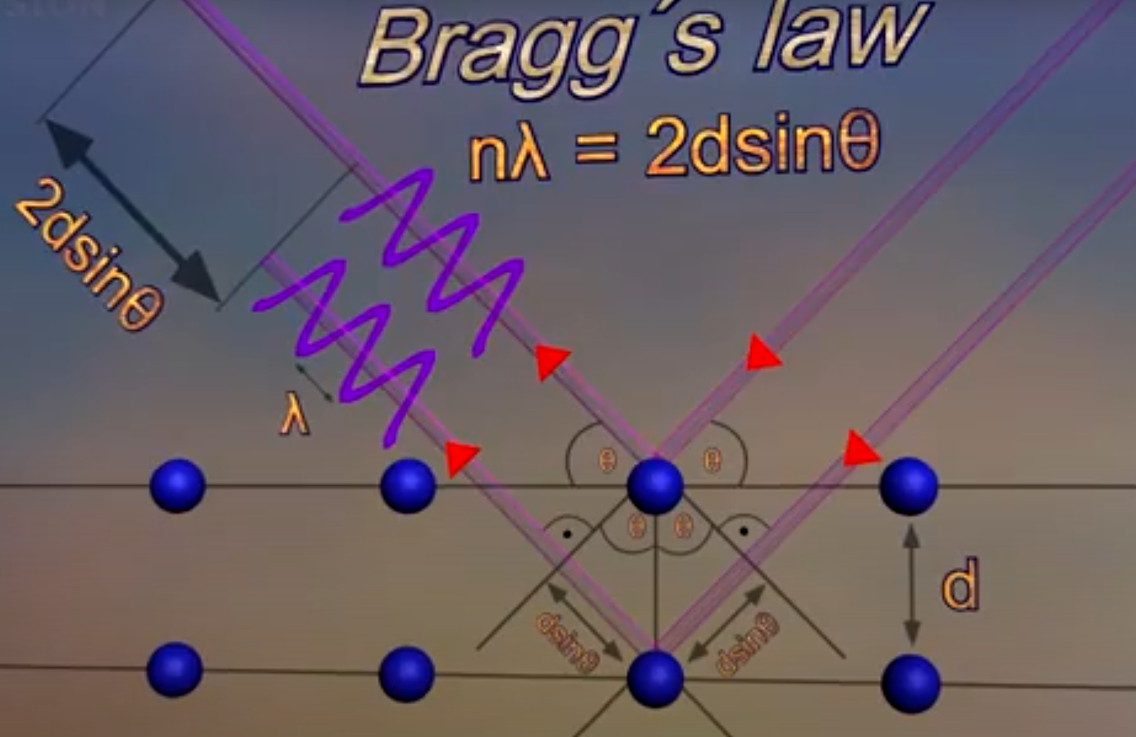

Slide 29
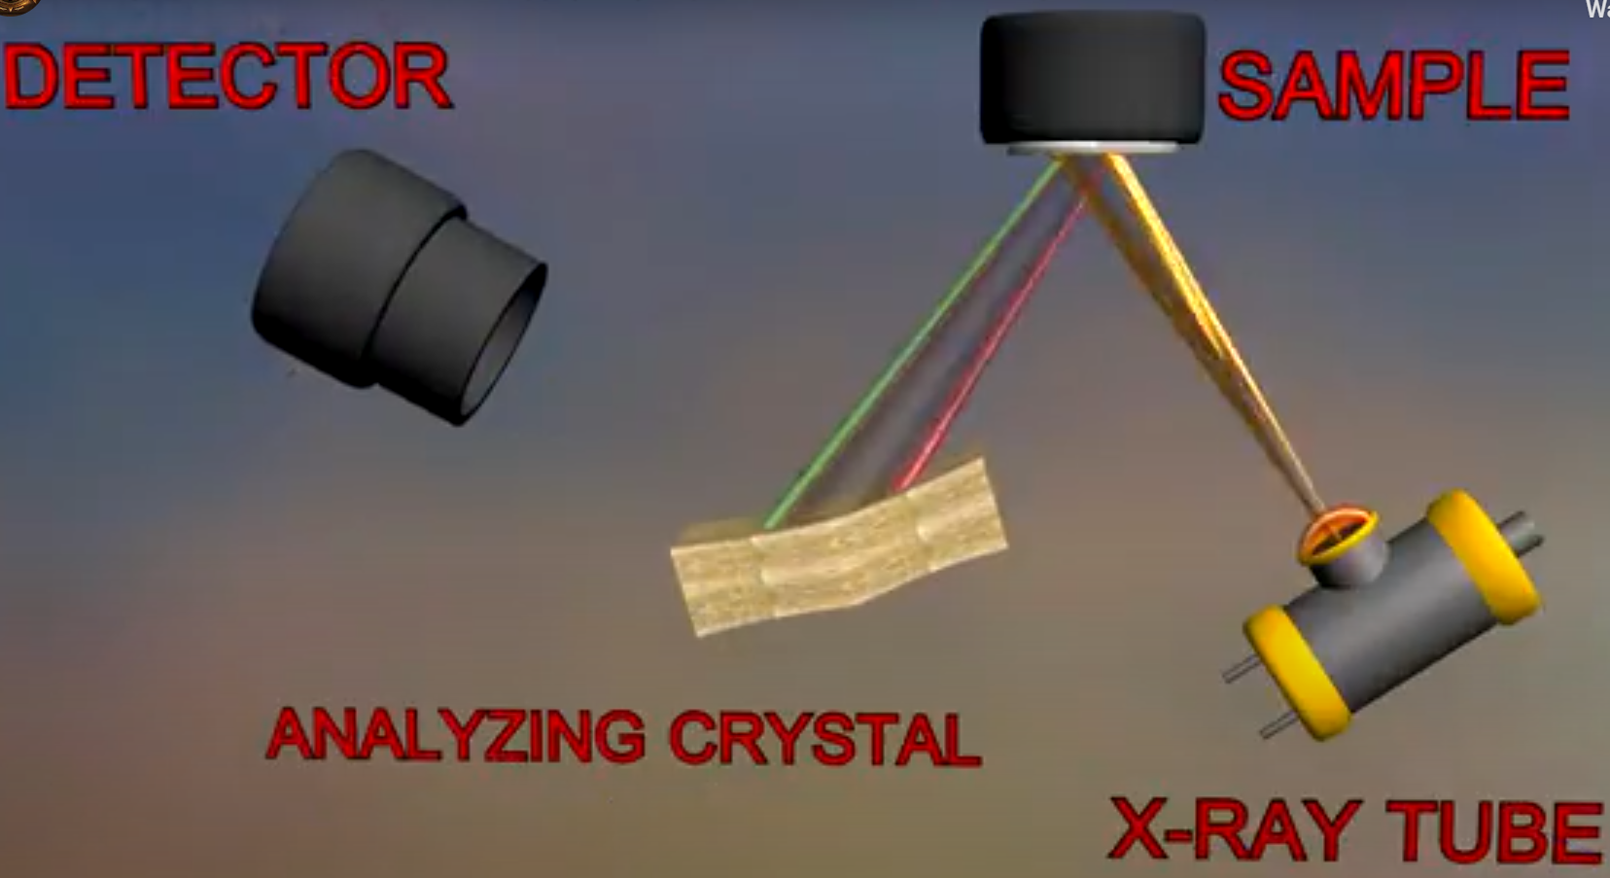
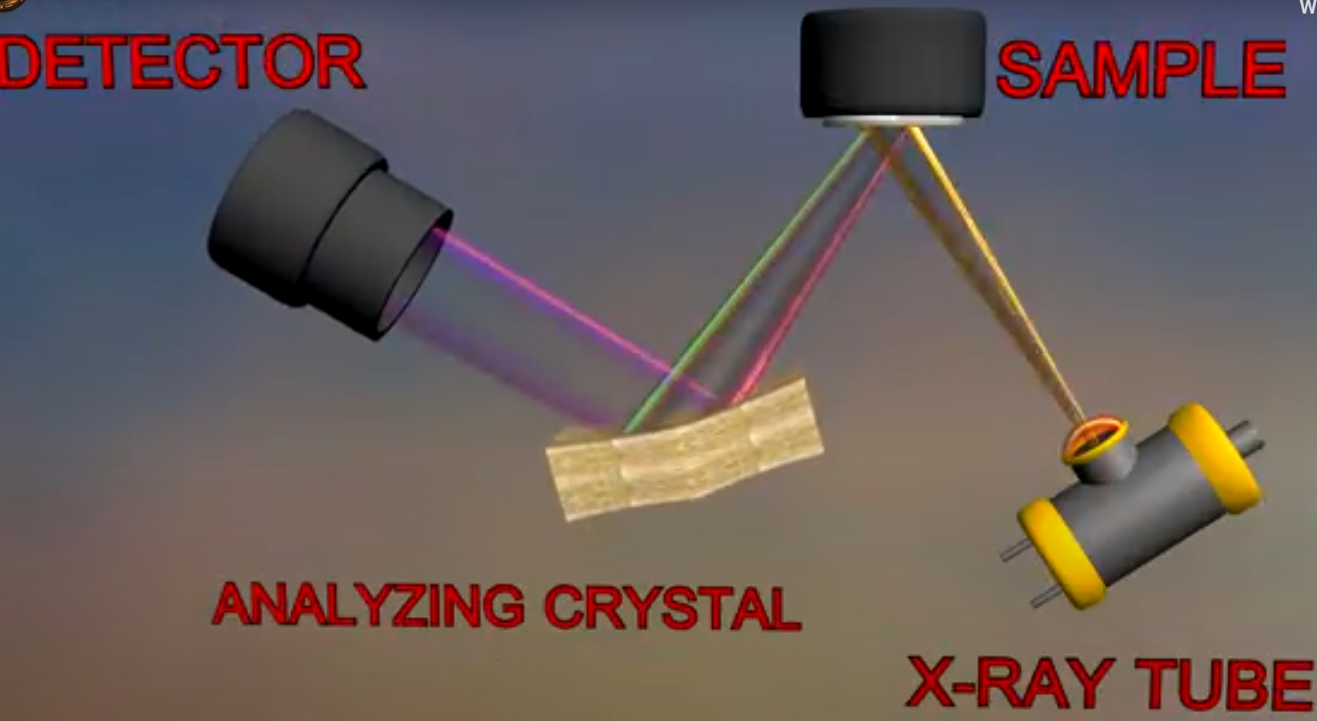
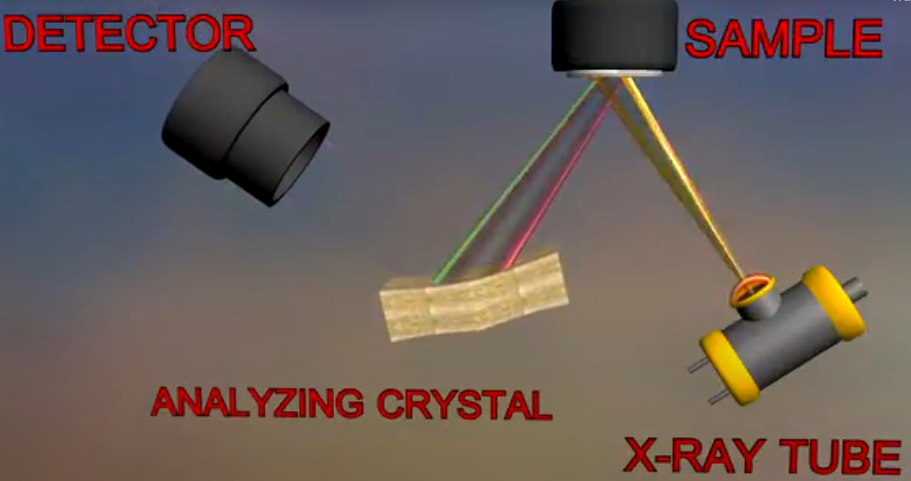
Move the detector change the angle

Slide 30
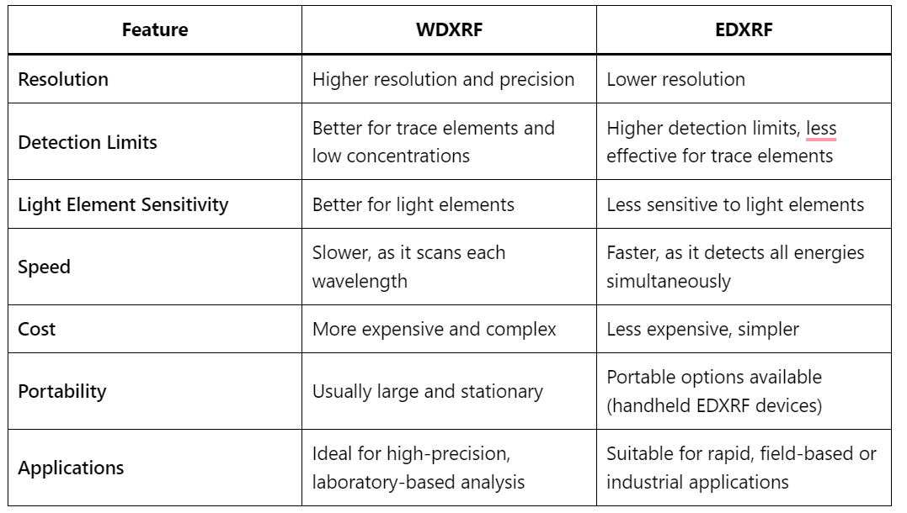

Slide 31
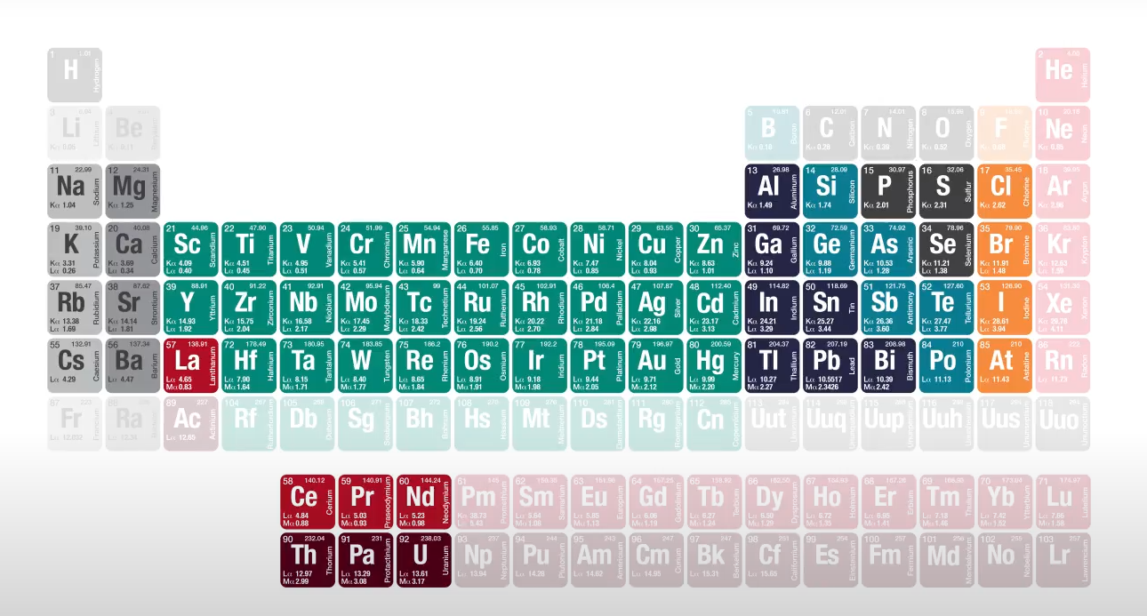
Typically analyses a range of elements from Na to U
In concentrations of ppm to high percent

Slide 32
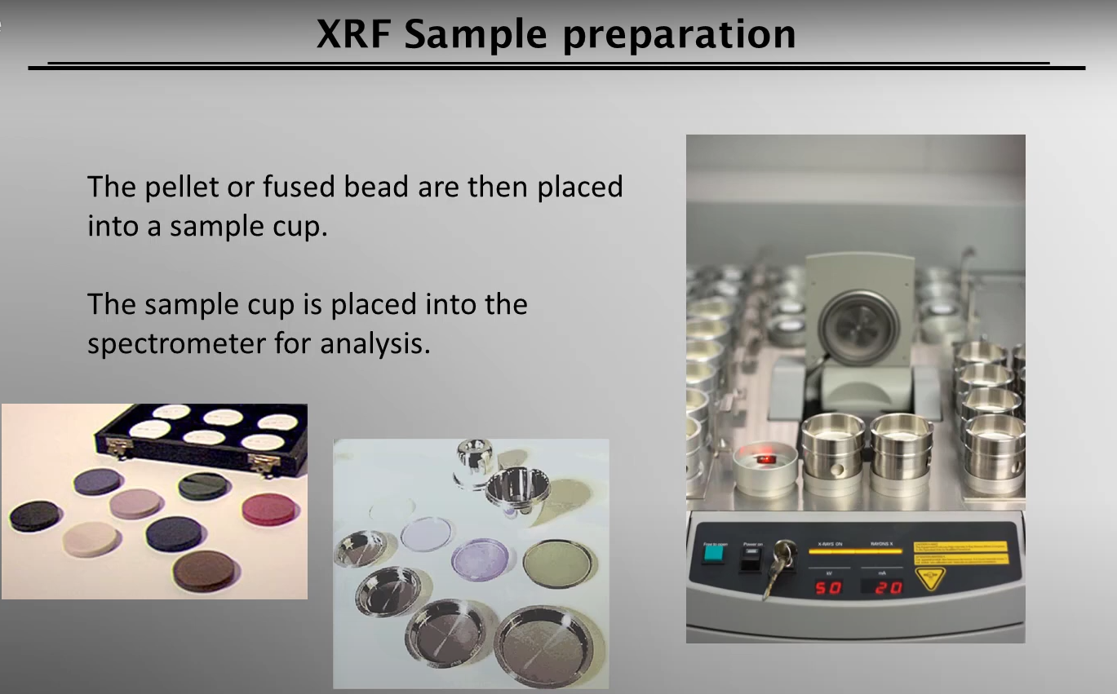

Slide 33
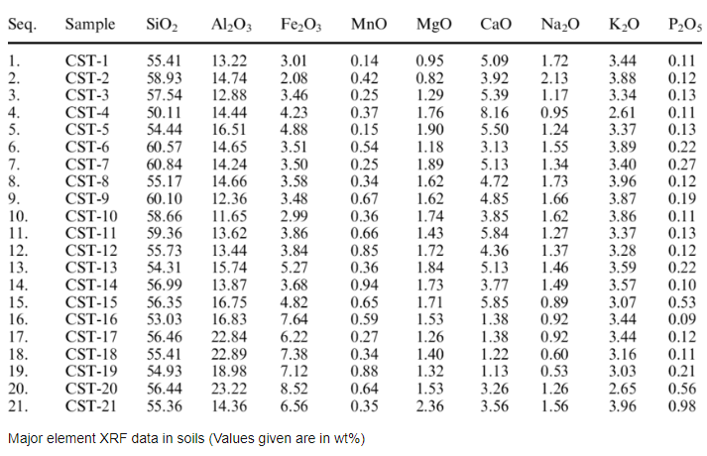

Slide 34
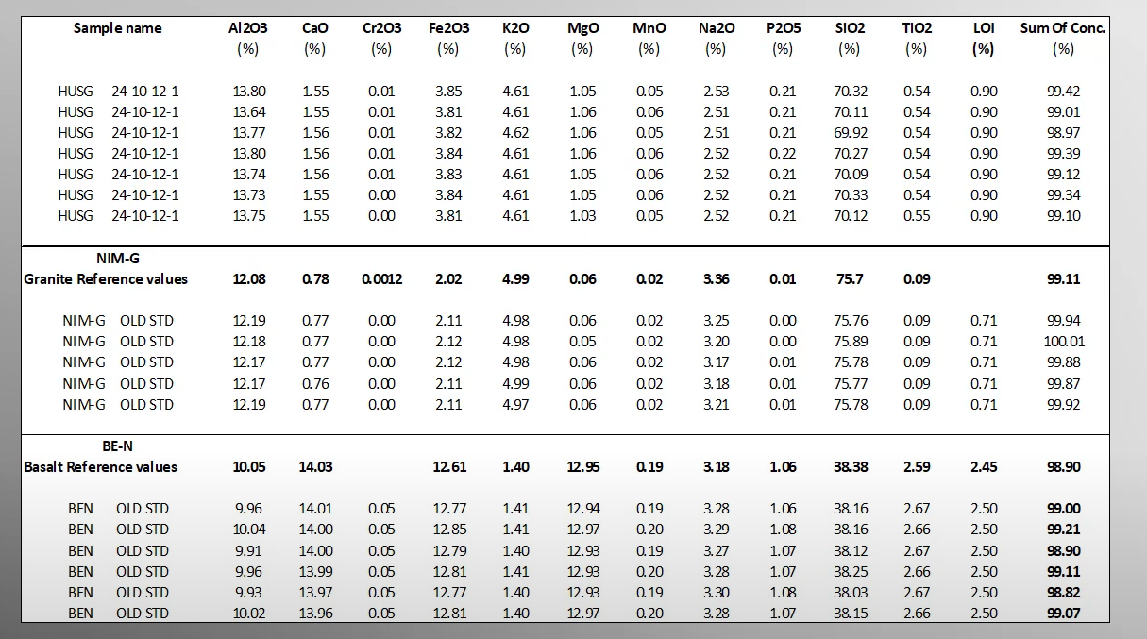

Slide 35
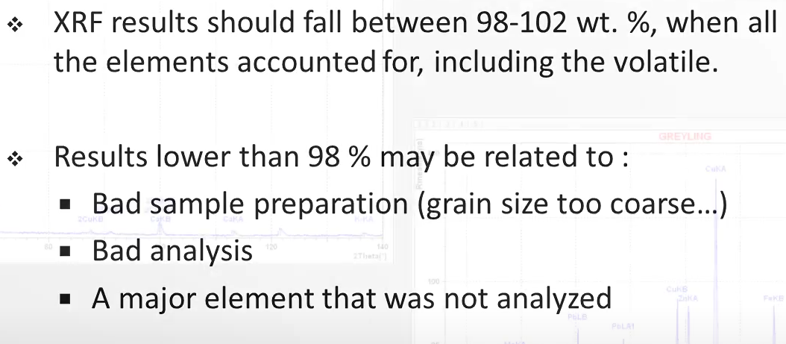

Slide 36
Applications of XRF:
Geology and Mineralogy: Used for determining the elemental composition of rocks, ores, and sediments. XRF can help in identifying mineral phases and providing data for geochemical analysis.
Environmental Analysis: Commonly used for analysing soils and detecting heavy metals and pollutants.
Archaeology: For studying the elemental composition of artefacts, ceramics, and ancient materials, helping to trace origins and manufacturing techniques.
Material Science: For quality control in manufacturing processes, particularly in industries dealing with metals, cement, and ceramics.
Forensics: Used in criminal investigations to analyse substances or trace elements found at crime scenes.

Slide 37
Advantages of XRF:
  Non-destructive: Since no sample preparation is required beyond placing it in the XRF instrument, the technique does not damage or alter the sample.
  Rapid Analysis: Measurements are quick, often taking just a few minutes per sample.
  Versatile: It can analyse solid, liquid, and powder samples, making it useful for various materials such as rocks, metals, soils, and even archaeological artifacts.
  Portable Systems Available: Handheld XRF devices allow for in-situ measurements, making it particularly useful in field applications such as geology and mining.

Slide 38
Limitations of XRF:
Surface Sensitivity: The technique primarily analyses the surface or near-surface layers of a sample, so deeper composition may not be detected unless the sample is specifically prepared.
Light Elements: XRF struggles to detect very light elements (like hydrogen, helium, and lithium) due to their low atomic numbers, and it can be less accurate for elements with low X-ray fluorescence energies (such as carbon, nitrogen, and oxygen).
Matrix Effects: The composition of the surrounding material (matrix) can affect the measurement, requiring calibration and correction techniques to ensure accuracy.

