Slide 1

SIMS and TIMS Geochronology – Theory, Applications, and Data Interpretation

Slide 2
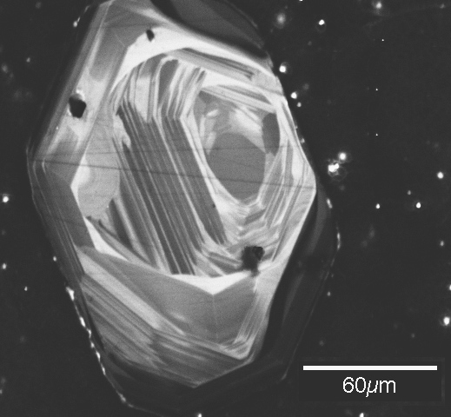
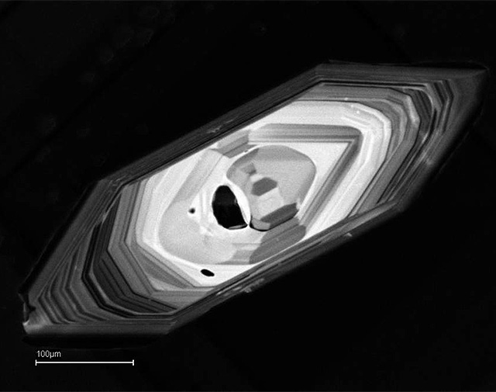

Slide 3
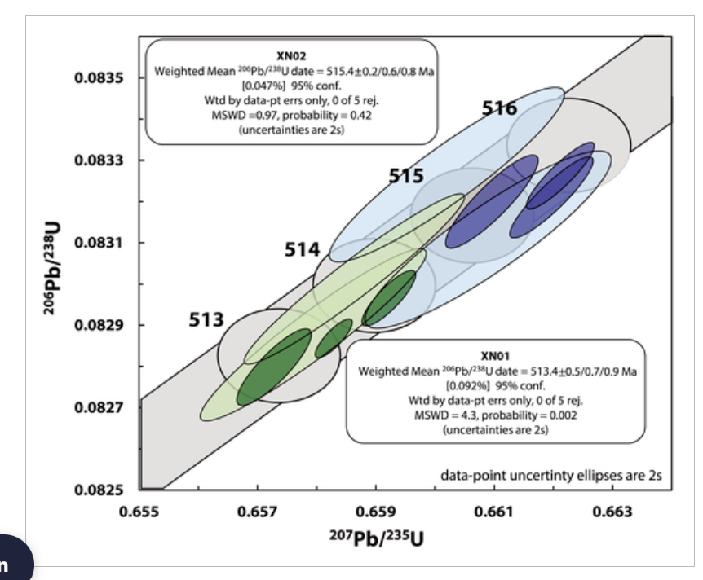
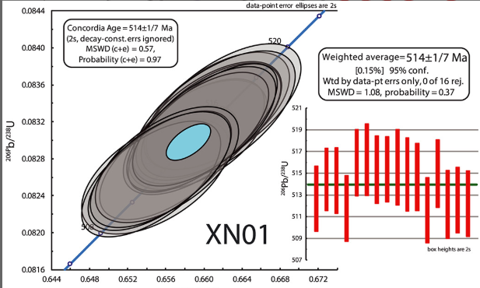

Slide 4
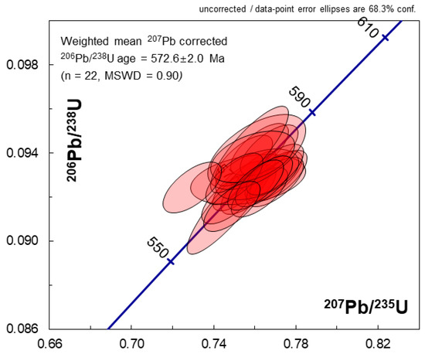
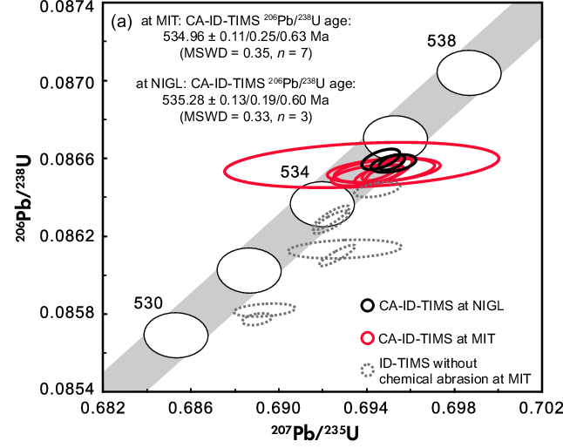

Slide 5
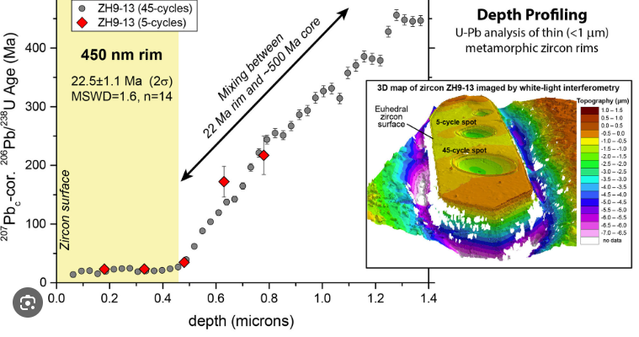

Slide 6

By the end of the lecture, you will:
Understand the fundamental principles of SIMS and TIMS.
Know about sample preparation techniques for optimal SIMS and TIMS analysis.
Understand about data acquisition and processing.
Critically evaluate results for SIMS and TIMS

Slide 7
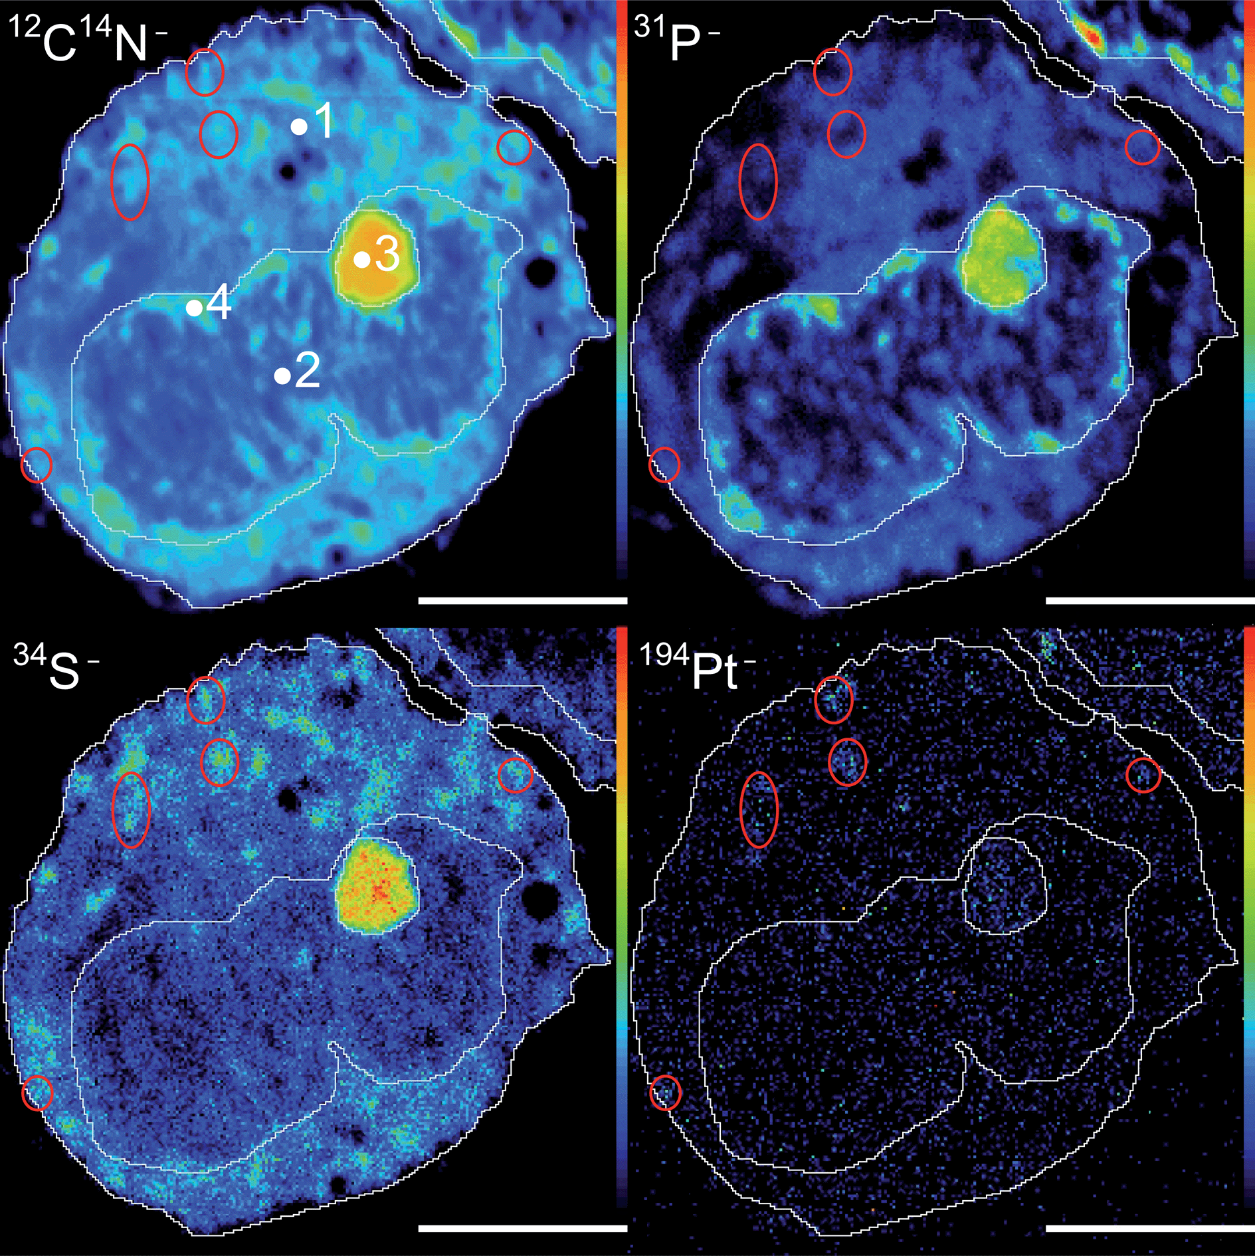
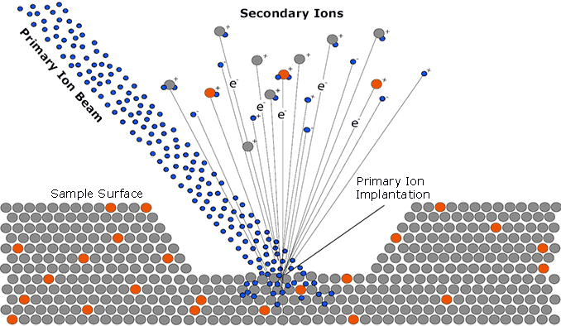
Secondary-ion mass spectrometry (SIMS)
SIMS is a technique used to analyze the composition of solid surfaces and thin films by sputtering the surface of the specimen with a focused primary ion beam and collecting and analyzing ejected secondary ions.
1940s–1950s: The concept of ion sputtering emerged, where primary ions bombarded a sample, releasing secondary ions.

Slide 8
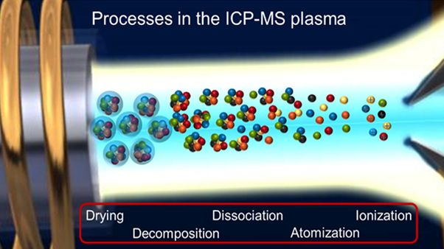
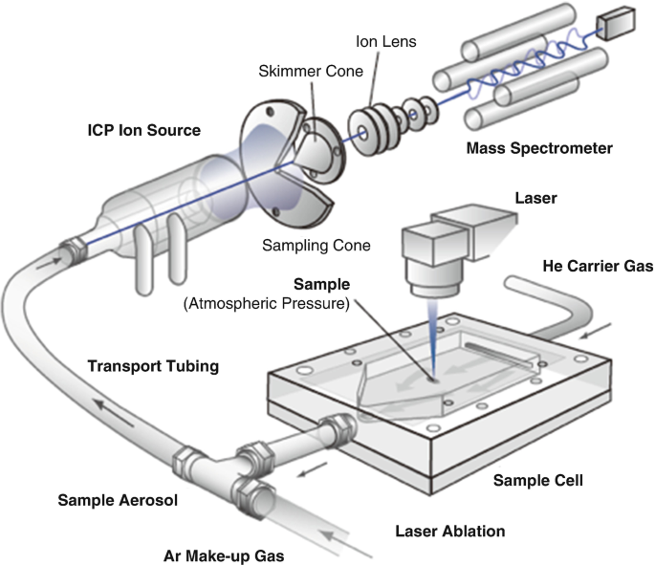

Slide 9
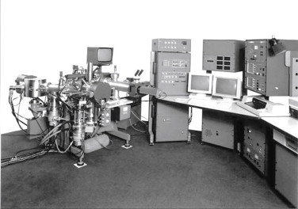
Castaing and Slodzian Introduced the idea of an ion microprobe in 1962, enabling localized micro-scale analysis.
1967: The first commercial SIMS instrument was built by Cameca, allowing researchers to analyze surface chemistry at high spatial resolution.
SIMS was mainly used in materials science, not really in geology
Castaing and Slodzian seminal work was first published in 1962, in French, in the Journal de Microscopie, which limited access to the scientific community at large.
Notes:
Just a little bit of history. Just for us to understand where these things come from.
The development of SIMS as a high-resolution analytical tool can be traced back to 1962 with the pioneering work of Castaing and Slodzian in 1962,
They introduced the concept of an ion microprobe for localized micro-scale analysis.
Their seminal work, published in French, initially limited its accessibility to the broader scientific community. It wasn’t until 1967 that the first commercial SIMS instrument was built by Cameca, revolutionizing surface chemistry analysis with high spatial resolution.
Interestingly, while SIMS quickly gained traction in materials science, its application in geology took longer to develop. Let’s explore how this breakthrough paved the way for modern geochemical studies.

Slide 10
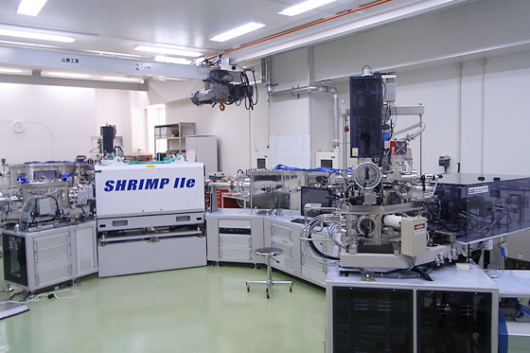
The Birth of SHRIMP (1970s–1980s) Bill Compton & colleagues (1975): Pioneered SIMS U-Pb zircon dating using an early prototype.
William Compston & the ANU group (1978): Developed the first Sensitive High-Resolution Ion Microprobe (SHRIMP) at the Australian National University (ANU).
This instrument had:
A large-radius electrostatic-magnetic sector mass spectrometer for high mass resolution.
A high-intensity oxygen ion beam for effective sputtering of U and Pb from zircons.
The ability to measure U-Pb ages in single zircon domains reduces the need for chemical digestion.
Sensitive High-Resolution Ion Microprobe (SHRIMP)

Slide 11
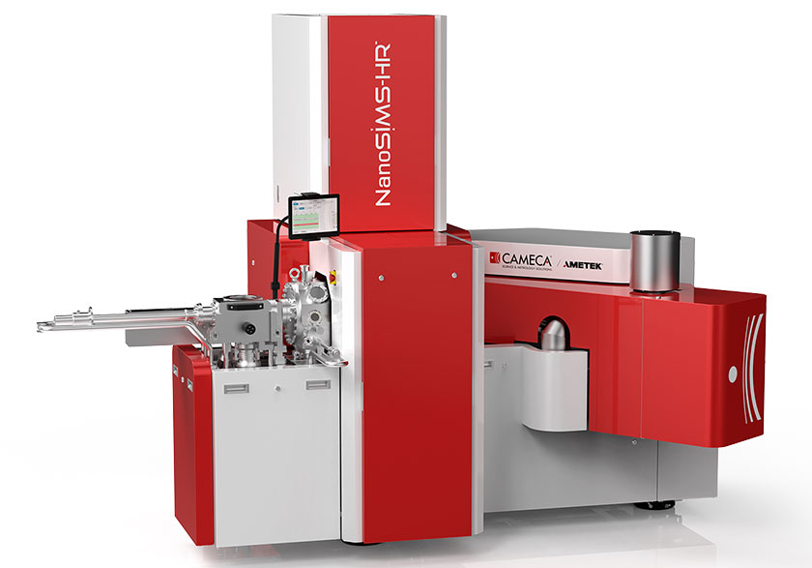
As SIMS technology evolved, the need for even higher spatial resolution and improved sensitivity led to the development of NanoSIMS
It uses a finely focused ion beam to generate detailed elemental and isotopic maps

Slide 12
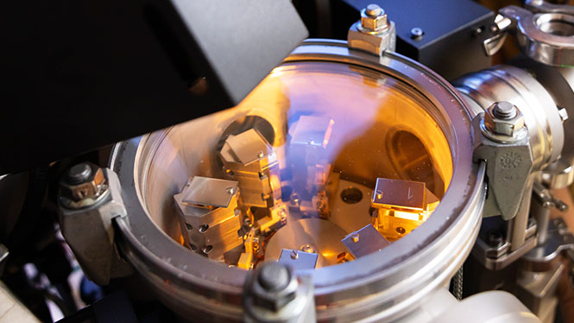

Slide 13
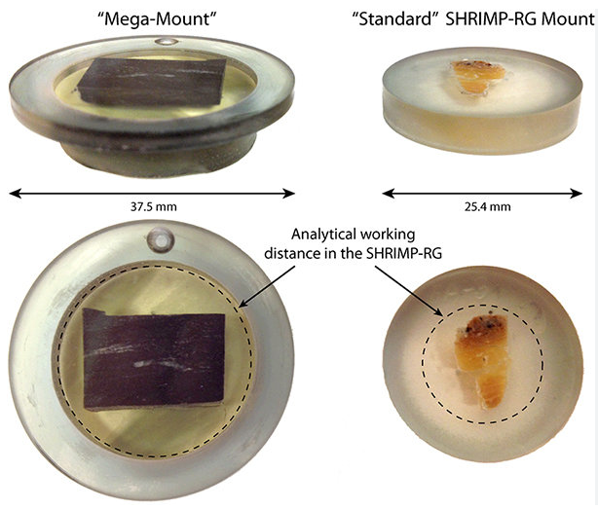

Slide 14
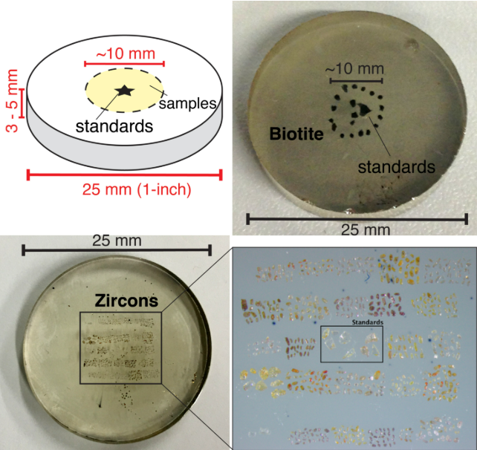

Slide 15
Secondary-ion mass spectrometry (SIMS)
Sensitive High-Resolution Ion Microprobe (SHRIMP)
SHRIMP and SIMS operate under the same principles and produce nearly identical datasets.
Secondary Ion Mass Spectrometry (SIMS) and Sensitive High-Resolution Ion Microprobe (SHRIMP) are both ion microprobe techniques used for in situ isotopic and trace element analysis, particularly in geochronology.
SIMS offers high spatial resolution and is capable of analyzing small domains within minerals, making it ideal for detecting isotopic heterogeneities.
SHRIMP, a specialized type of SIMS, is optimized for U-Pb geochronology. It features a large-radius magnetic sector that enhances precision in measuring isotopic ratios while maintaining moderate spatial resolution.
Though both techniques rely on sputtering a sample with a primary ion beam, SIMS is more versatile for a range of isotope systems, whereas SHRIMP is primarily used for high-precision U-Pb dating in zircon and other accessory minerals.

Slide 16
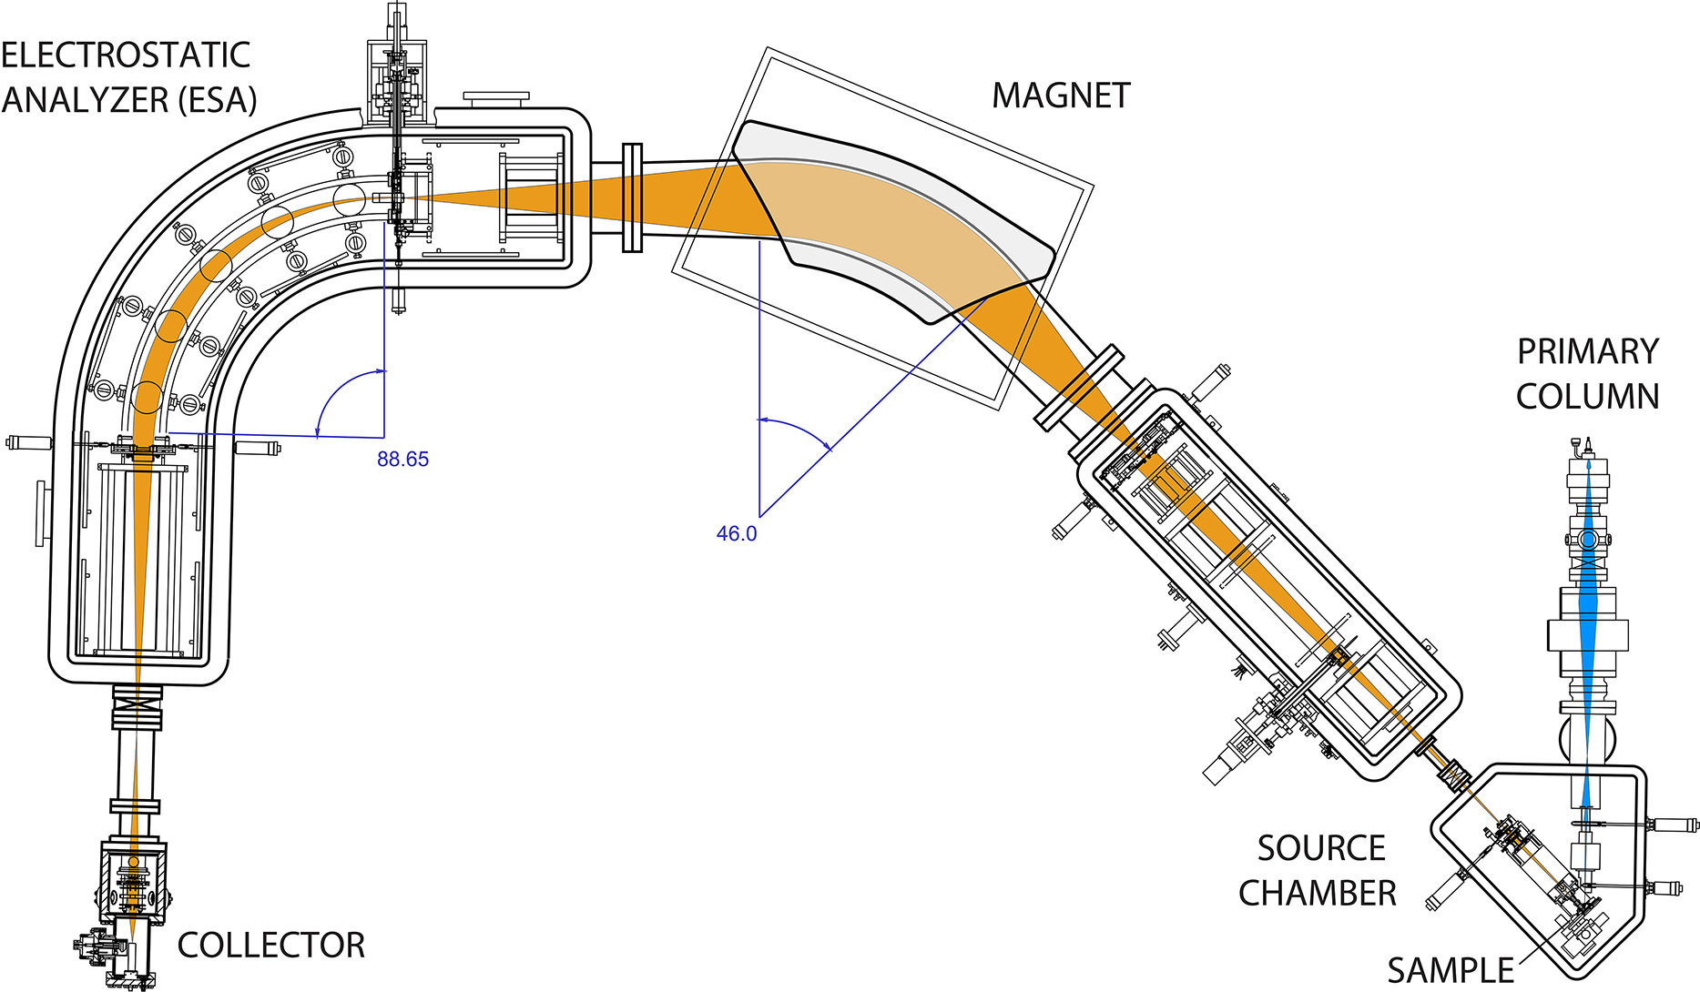
The internal structure and ion optics of the SHRIMP

Slide 17
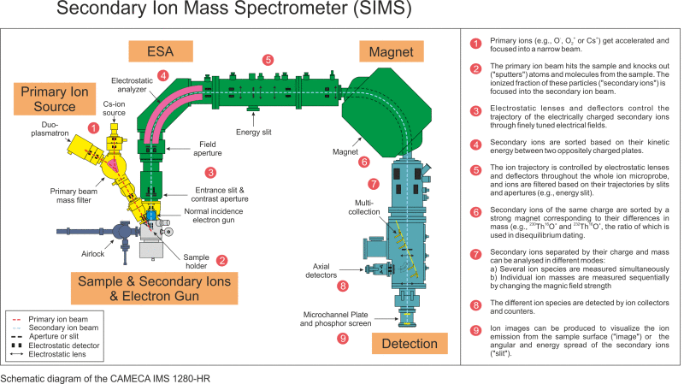

Slide 18
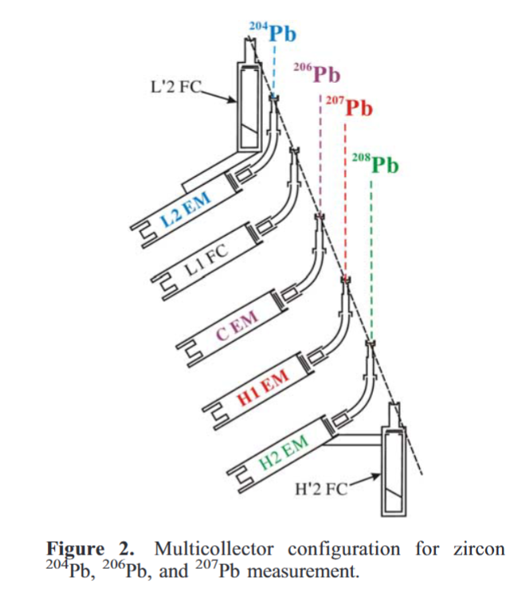
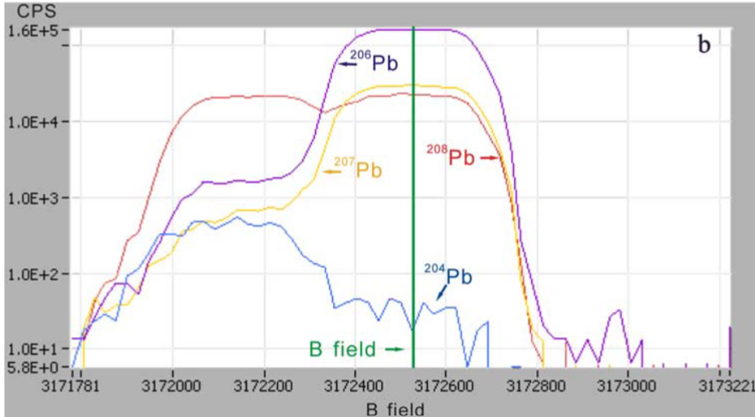

Slide 19

HANDLING DATA

Slide 20
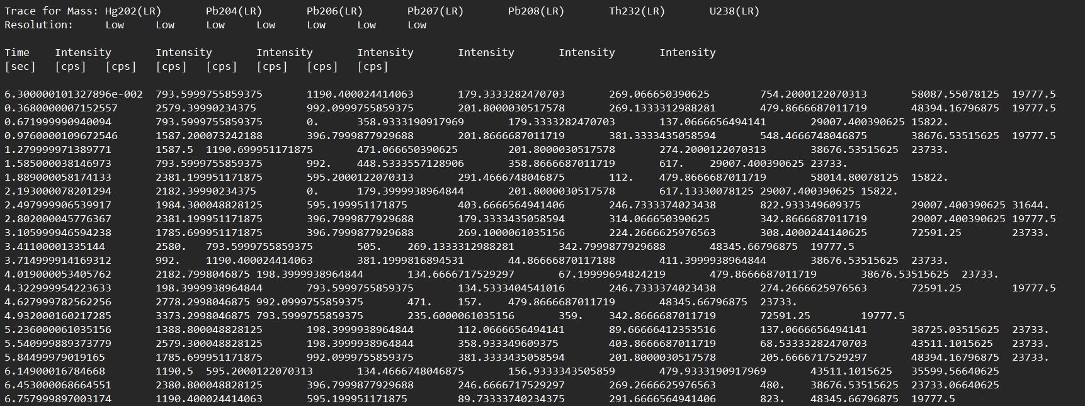
This is what the raw data looks like

Slide 22
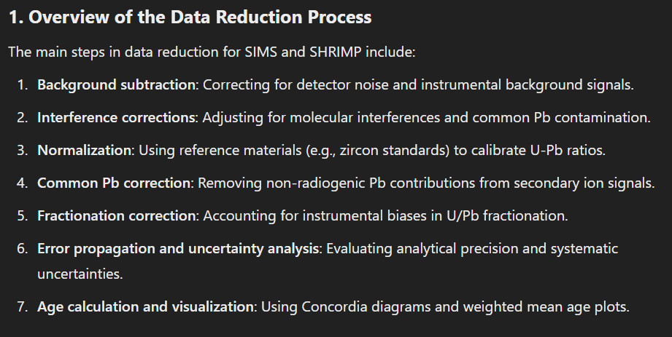

Slide 23
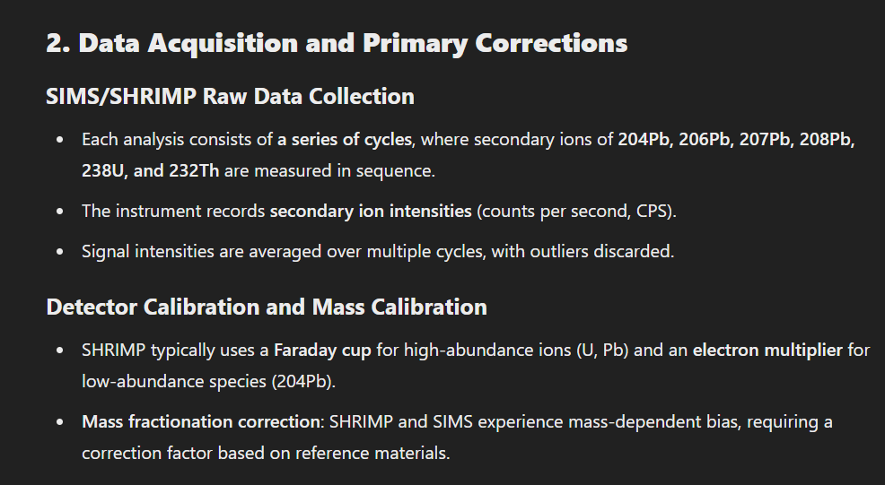

Slide 24
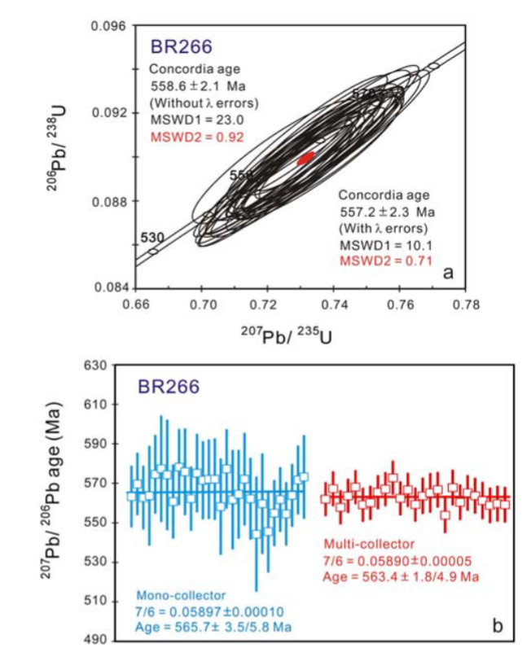
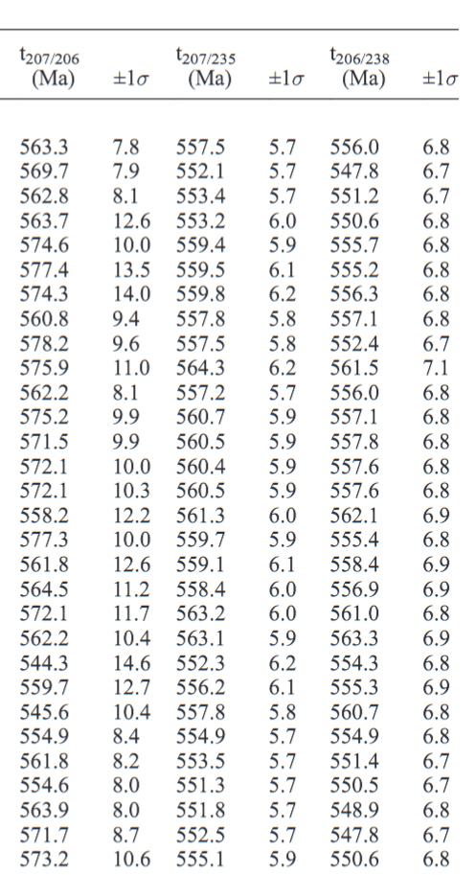

Slide 25
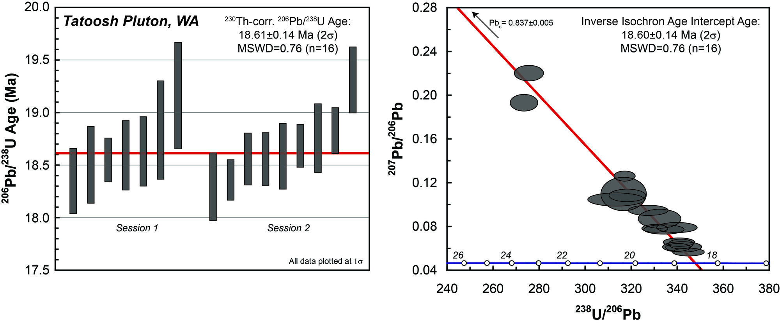

Slide 26
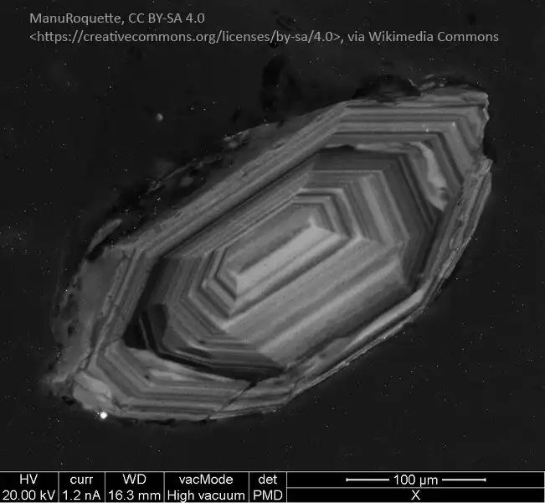
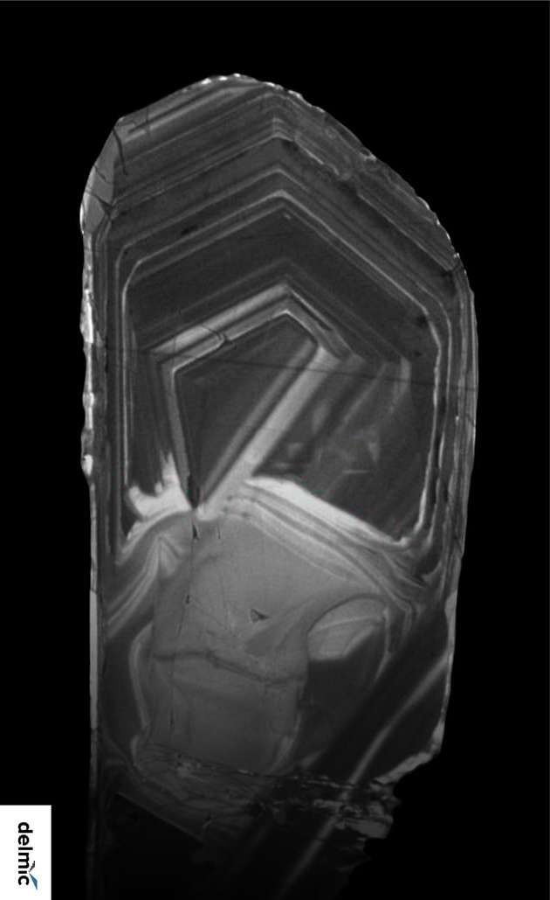

Slide 27
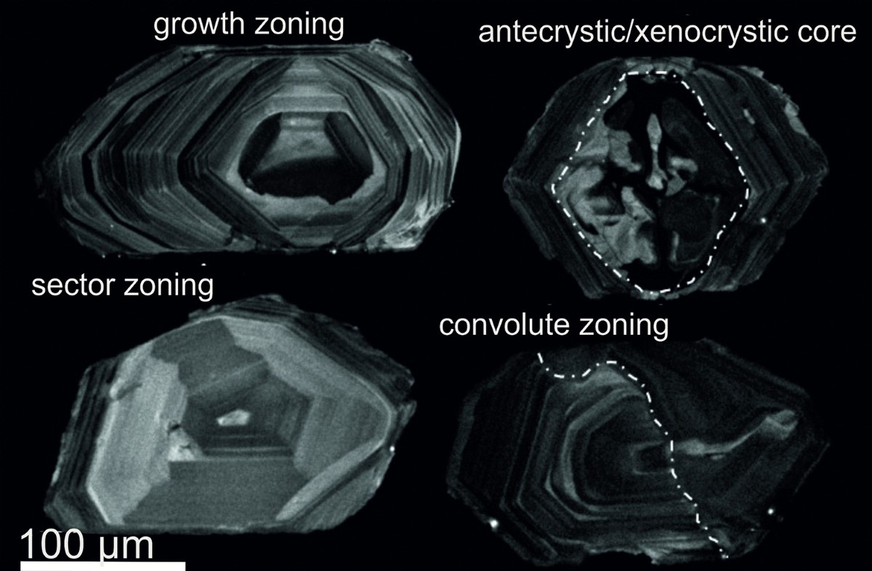

Slide 28
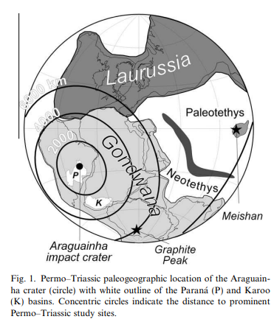
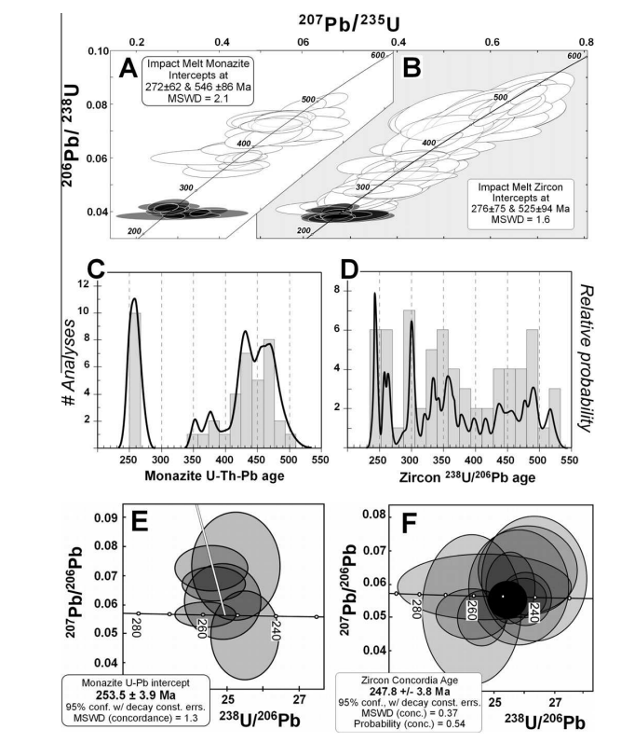
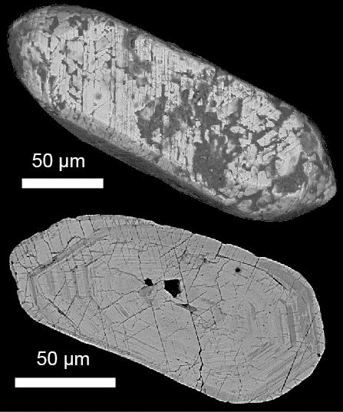

Slide 29
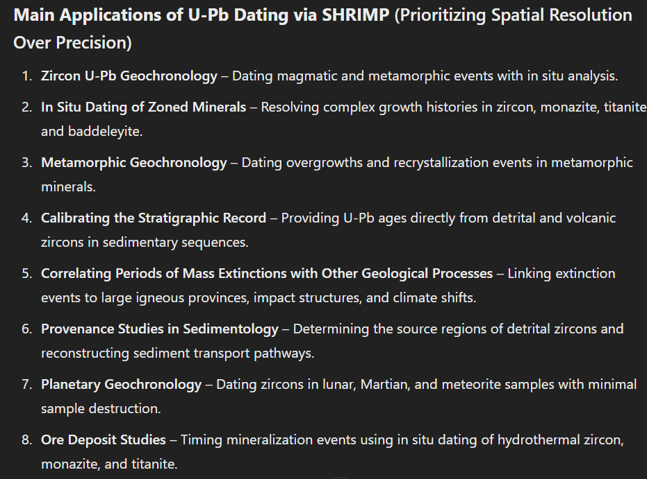

Slide 30
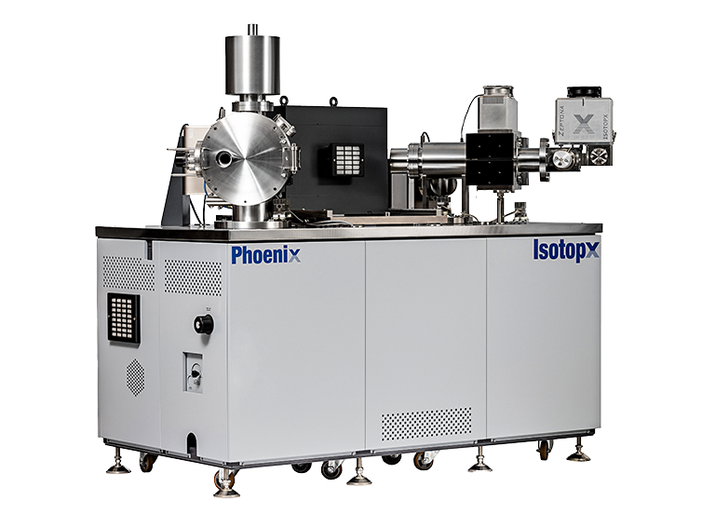
ID TIMS
Isotope dilution thermal ionization mass spectrometry (ID-TIMS) is a technique that uses a thermal ionization mass spectrometer (TIMS) to measure the age of rocks and minerals. It is considered the gold standard of geochronology
Notes:
Isotope Dilution Thermal Ionization Mass Spectrometry (ID-TIMS) remains the gold standard in geochronology due to its unparalleled precision in isotopic measurements.
By utilizing thermal ionization for isotope analysis, this technique provides highly accurate age determinations for rocks and minerals, making it a cornerstone in high-precision geochemistry.
Unlike in situ methods like SIMS and SHRIMP, ID-TIMS requires complete sample digestion but offers superior analytical precision, making it indispensable for absolute age dating

Slide 31
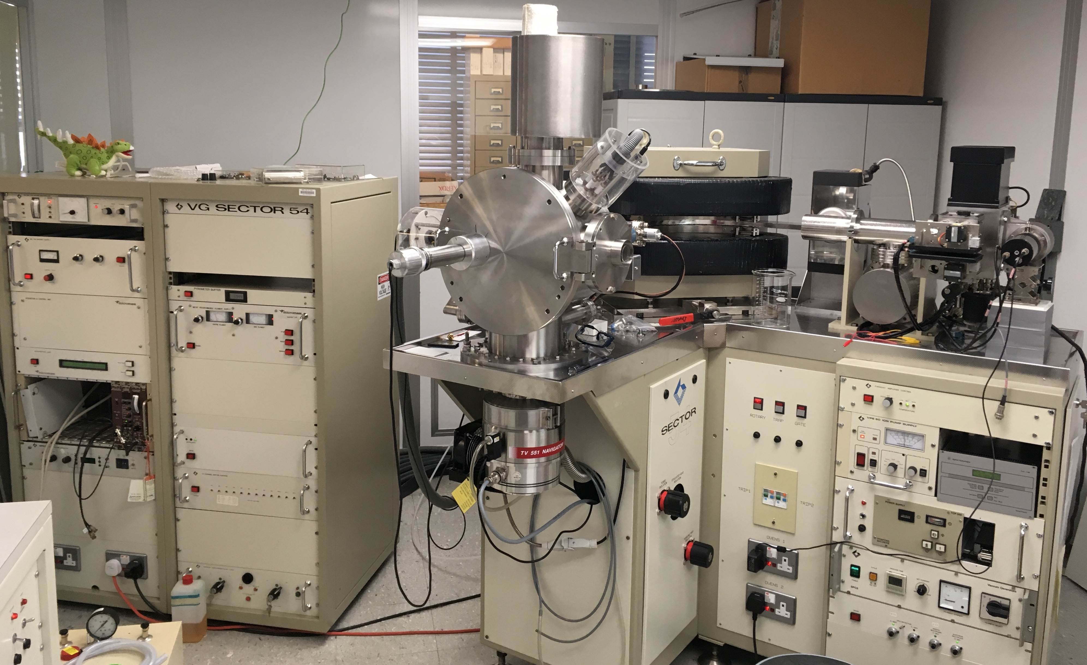
TIMS development: TIMS was developed in the mid-20th century by mass spectrometry pioneers.
ID-TIMS application: ID-TIMS is used to determine the age of minerals, such as zircon, with high precision and accuracy.
ID-TIMS use in geochronology: ID-TIMS is used to determine the age of rocks and minerals, which helps to understand the timing of geological events.
Notes:
Thermal Ionization Mass Spectrometry (TIMS) has played a pivotal role in high-precision isotope geochemistry since its development in the mid-20th century.
The origins of TIMS trace back to the early advancements in mass spectrometry, when researchers sought to improve the accuracy of isotopic measurements.
By the 1950s and 1960s, pioneers in radiogenic isotope geochemistry recognized its potential for dating geological materials, leading to the refinement of isotope dilution techniques and the development of ID-TIMS.
The method gained traction due to its unparalleled precision in U-Pb, Rb-Sr, Sm-Nd, and Pb-Pb dating systems, fundamentally transforming our understanding of Earth's history.
Unlike in situ techniques like SIMS and SHRIMP, TIMS requires complete dissolution of minerals, eliminating matrix effects and ensuring high analytical accuracy. T
Today, ID-TIMS remains the gold standard for absolute age determination, allowing geologists to reconstruct the timing of magmatic, metamorphic, and sedimentary processes with unprecedented detail."

Slide 32
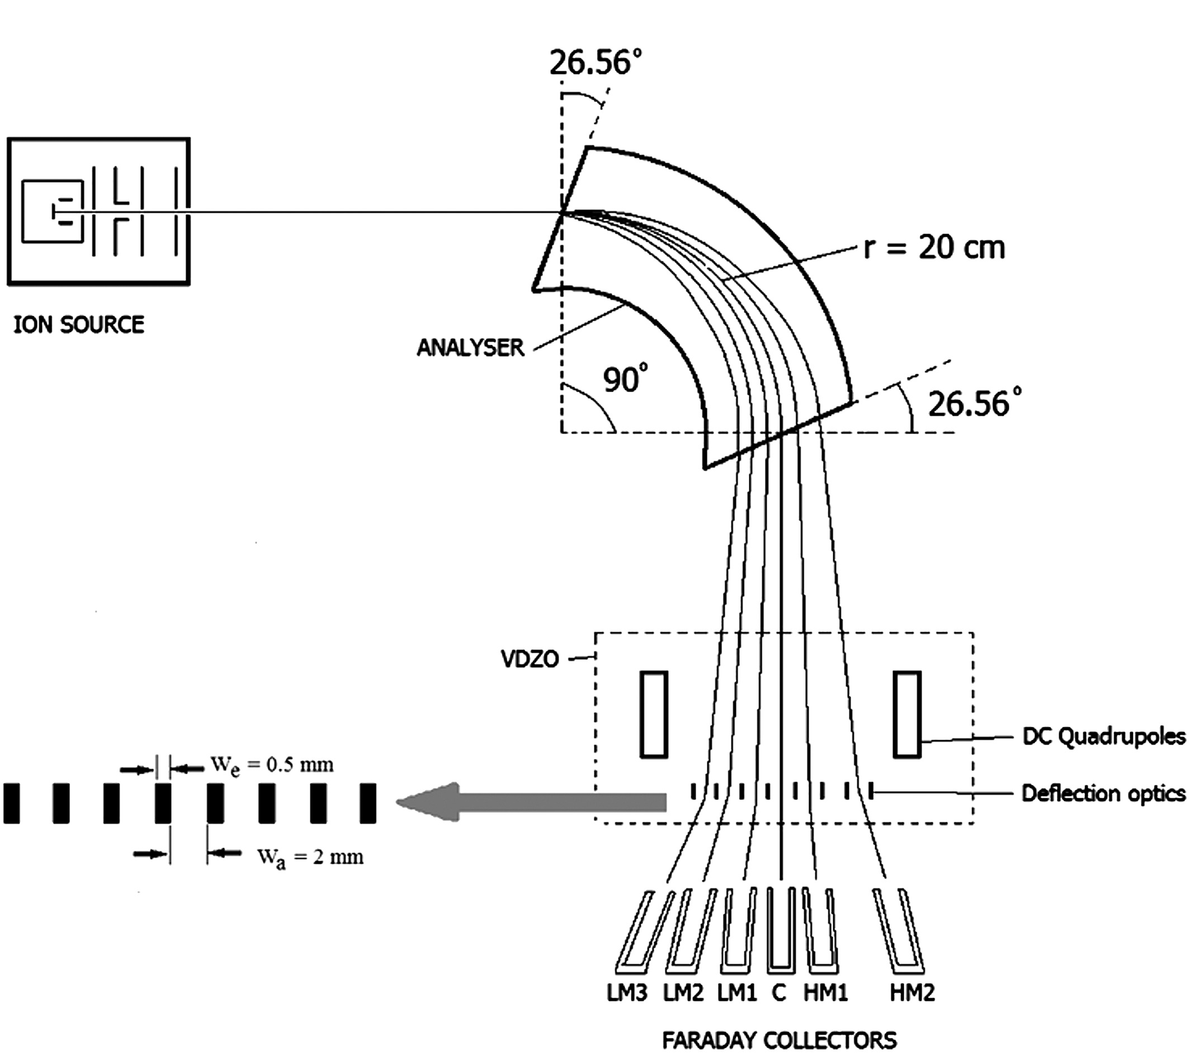
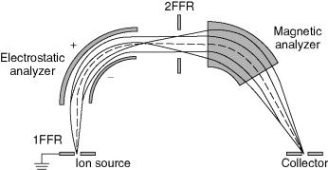

Slide 33
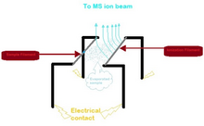
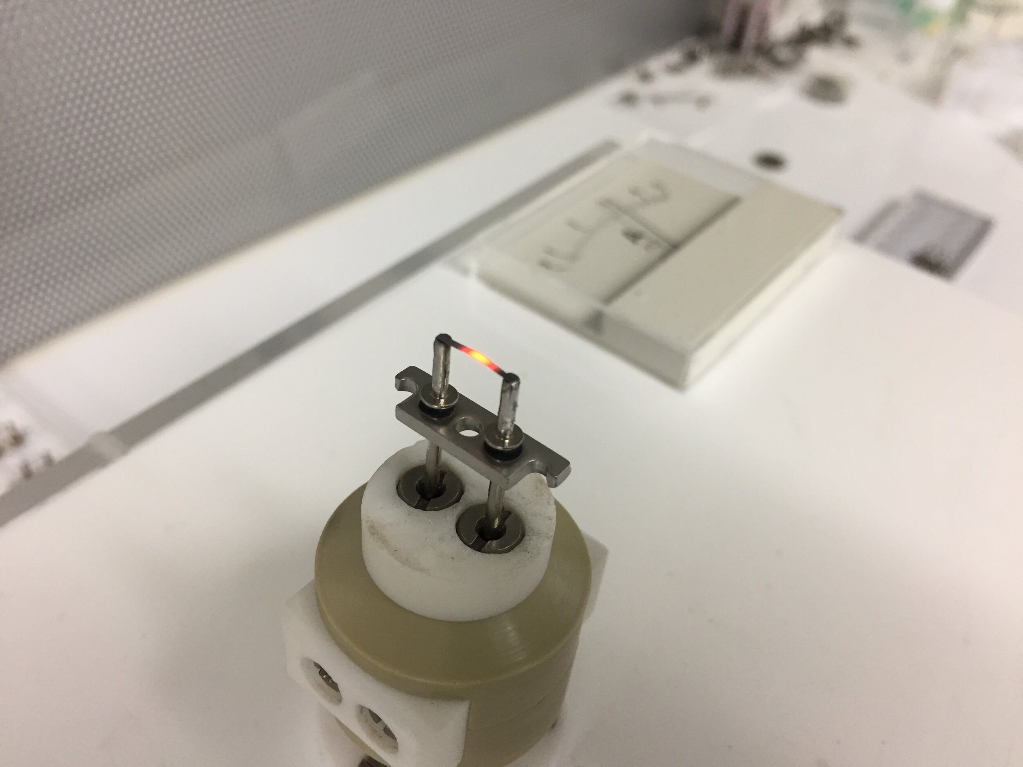
The filaments used are made from tantalum (Ta), tungsten (W), platinum (Pt) or rhenium (Re).
Conventionally, there are two filaments used in TIMS. One filament is for the sample and is called the sample filament.
Subsequently, these evaporated analytes land on the other filament, also known as the ionization filament, where it is ionized.
Two filaments in thermal ionization mass spectrometry
The single filament method is also possible. Once the sample evaporates, the analytes can settle back down onto the same filament to get ionized.

Slide 34
TIMS (Thermal Ionization Mass Spectrometry) is one of the most precise methods for U-Pb, Sr, Nd, Hf, and Pb isotope geochronology.
Unlike SIMS and SHRIMP, TIMS requires chemical separation and total sample digestion, making it a high-precision bulk analysis technique.

Slide 35
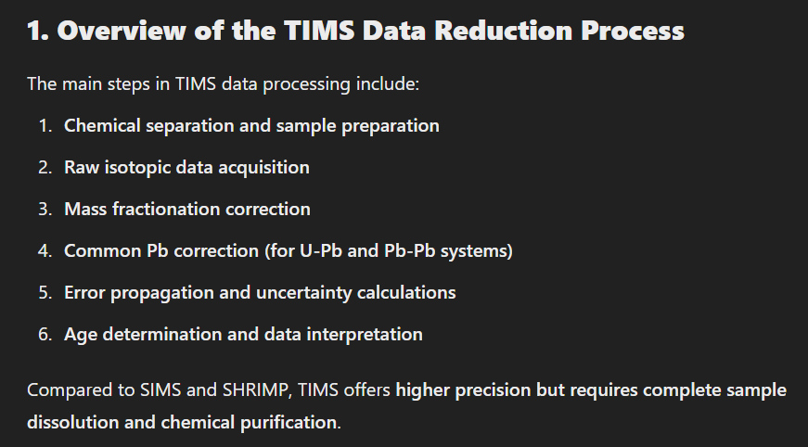
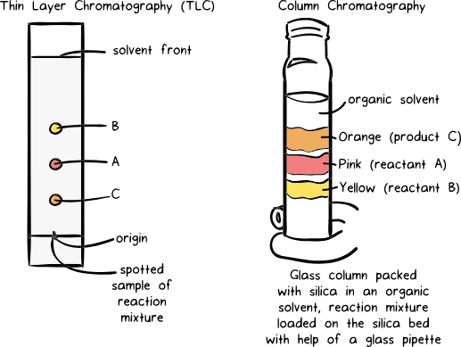

Slide 36
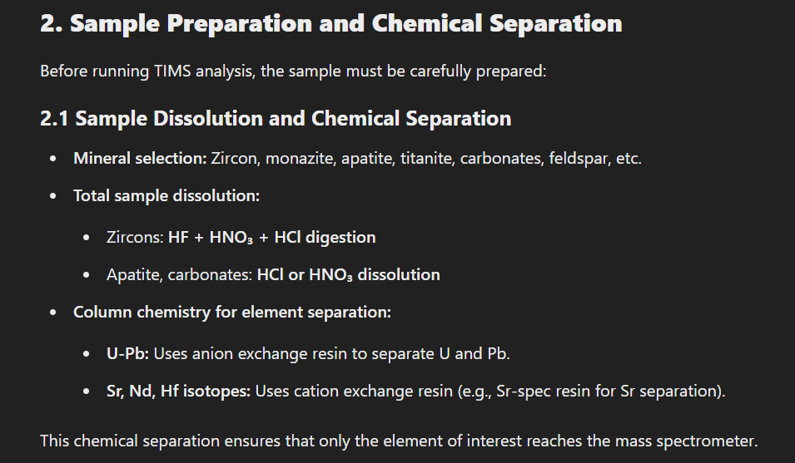

Slide 37
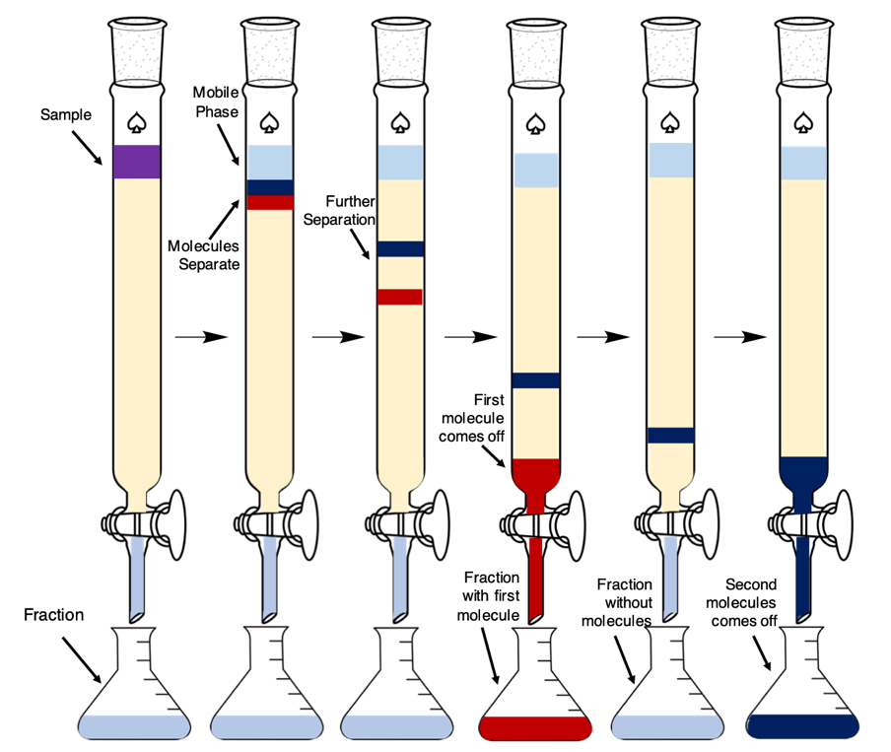
U-Pb Separation Using Ion Exchange Chromatography
Step 1: Load the Sample onto the Column, The dissolved sample (in 6N HCl) is pipetted onto the resin bed. U and Pb ions interact with the resin beads.
Step 2: Pb Elution (First Fraction) - Pb does not strongly bind to the resin in HCl and is eluted first. A small amount of 1N HBr or 6N HCl is used to wash out matrix elements. Pb is collected in clean Teflon beakers and dried down for analysis.
Step 3: U Retention and Elution (Second Fraction) - U forms strong anionic complexes (UO₂Cl₄²⁻) in HCl, binding strongly to the resin. To elute U, a reducing agent (e.g., H₂O₂ or HNO₃) is used to change U to a neutral state. U is then collected in a separate fraction.

Slide 38
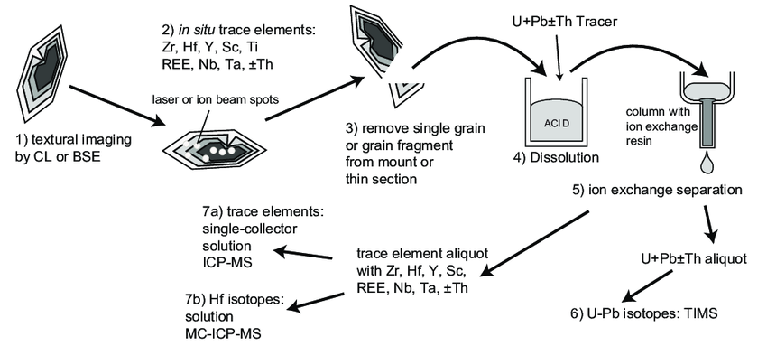

Slide 39
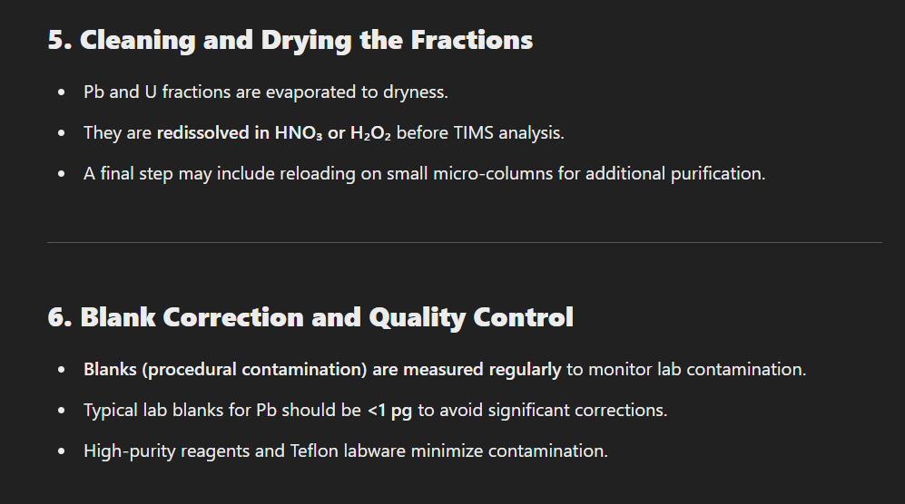

Slide 40
HANDLING DATA

Slide 41
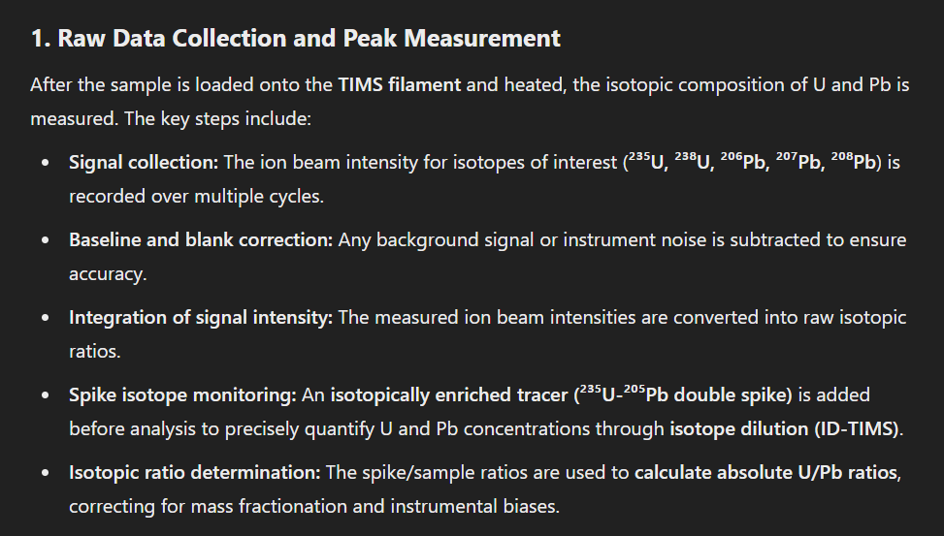

Slide 42
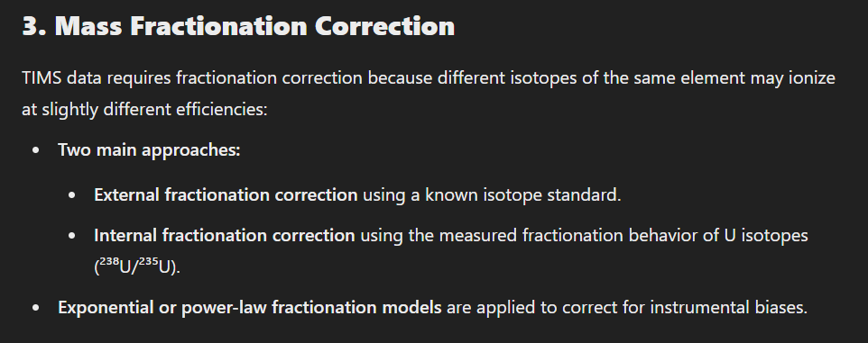

Slide 43
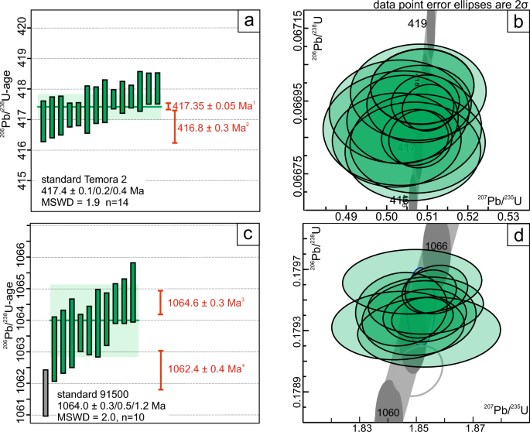
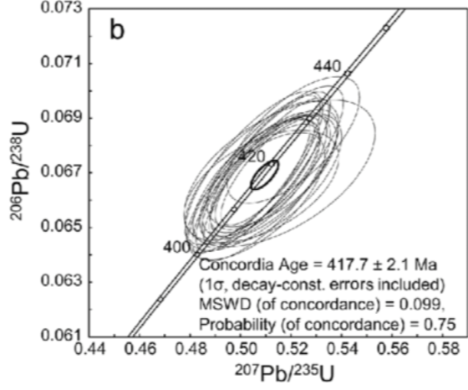


Slide 44



Slide 45




Slide 46


