Slide 1

Sampling Protocols
Cris Lana

Slide 2
1. Introduction
Sampling forms the foundation of any geochemical or mineralogical investigation. The accuracy and reliability of analytical results depend critically on how well the sample represents the system being studied.
Poor sampling design or contamination during collection can lead to misleading interpretations, regardless of the sophistication of the analytical techniques that follow. It is therefore essential to implement correct and stringent sampling protocols to obtain meaningful results in ore characterisation and geochemical studies.

Slide 3
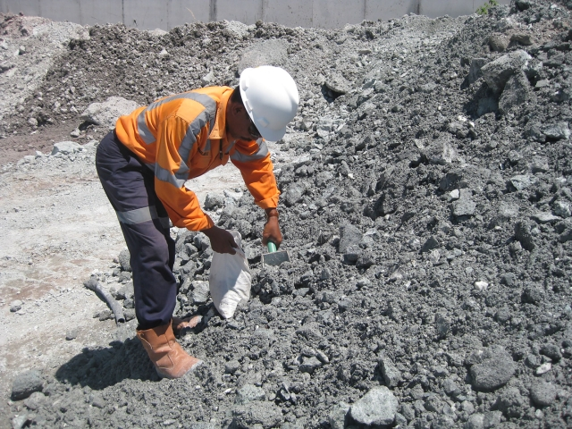
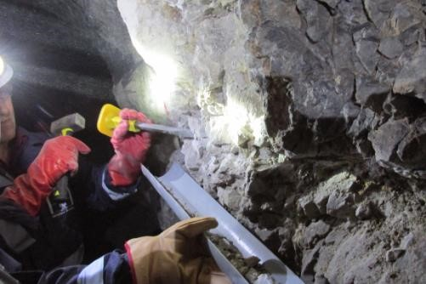


Slide 4

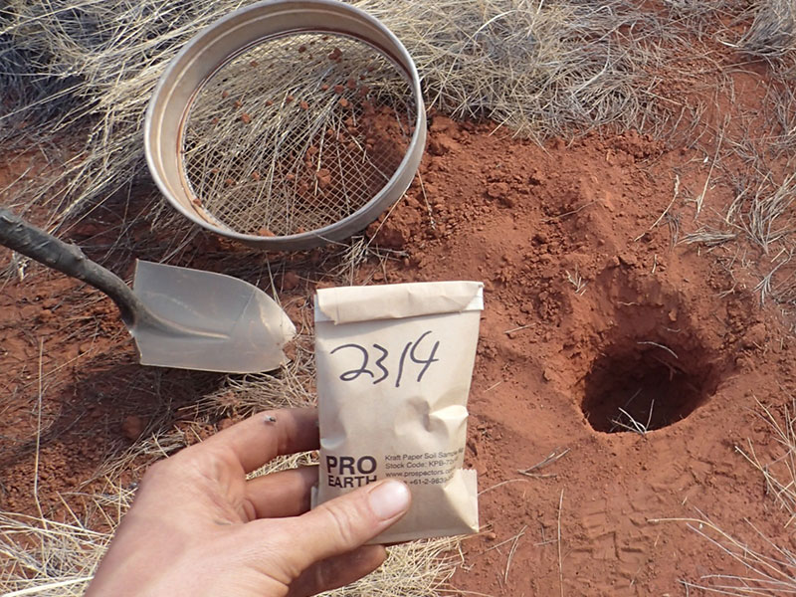

Slide 5
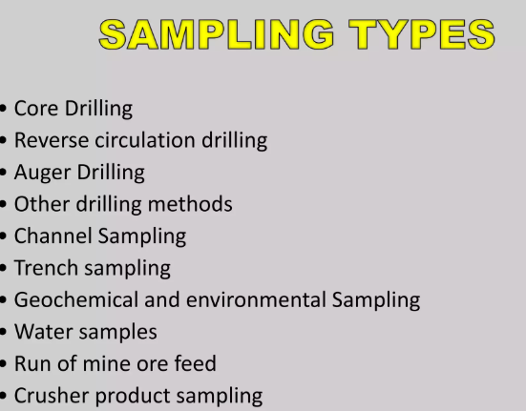


Slide 6
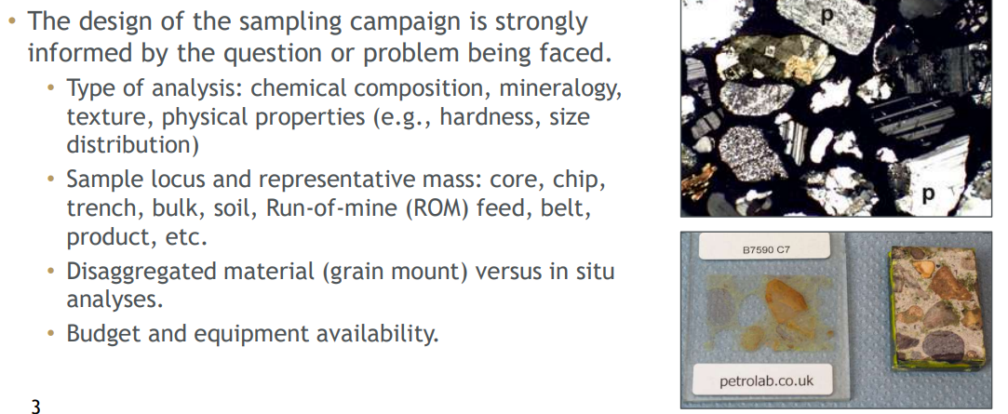

Slide 7
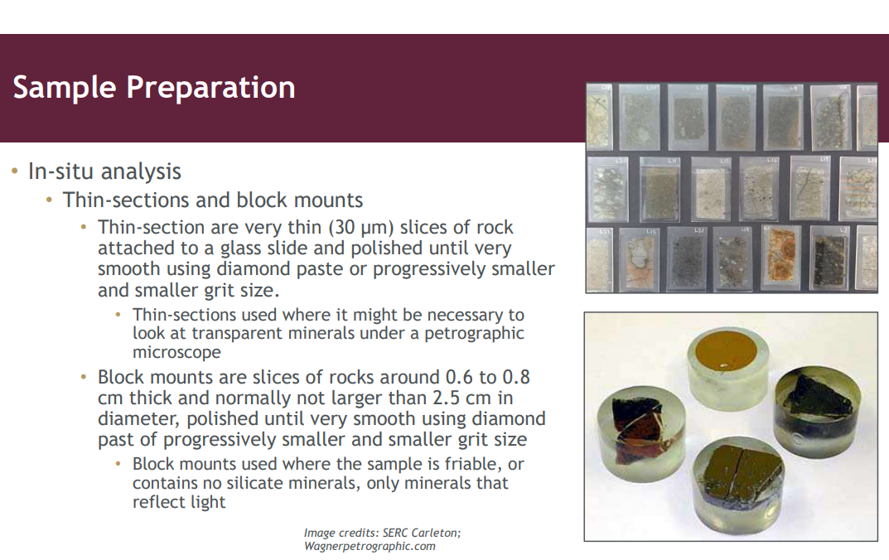

Slide 8
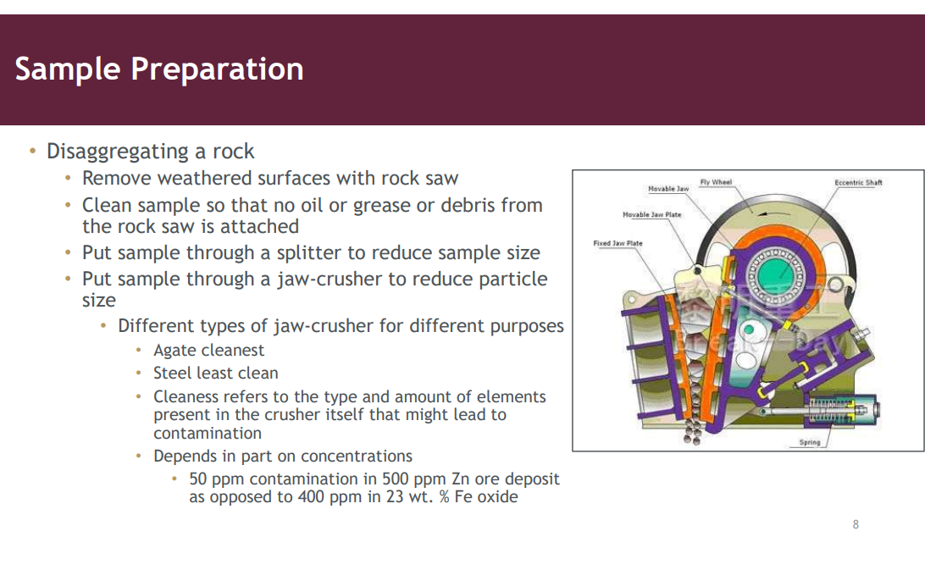

Slide 9
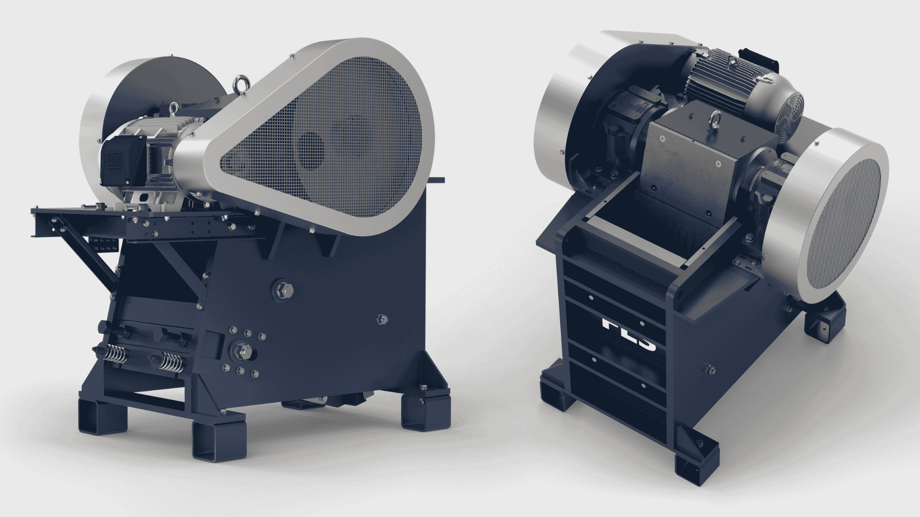

Slide 10
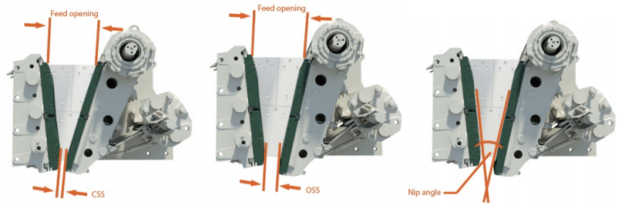


Slide 11
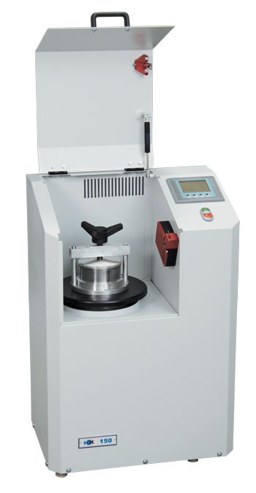
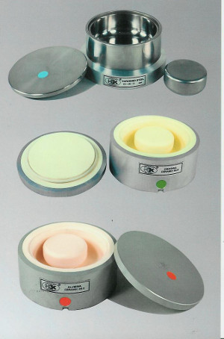


Slide 12
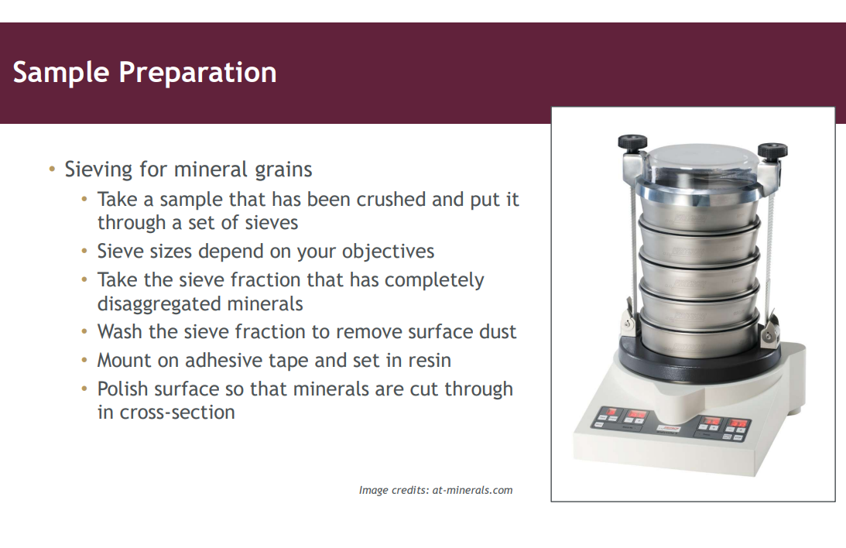

Slide 13
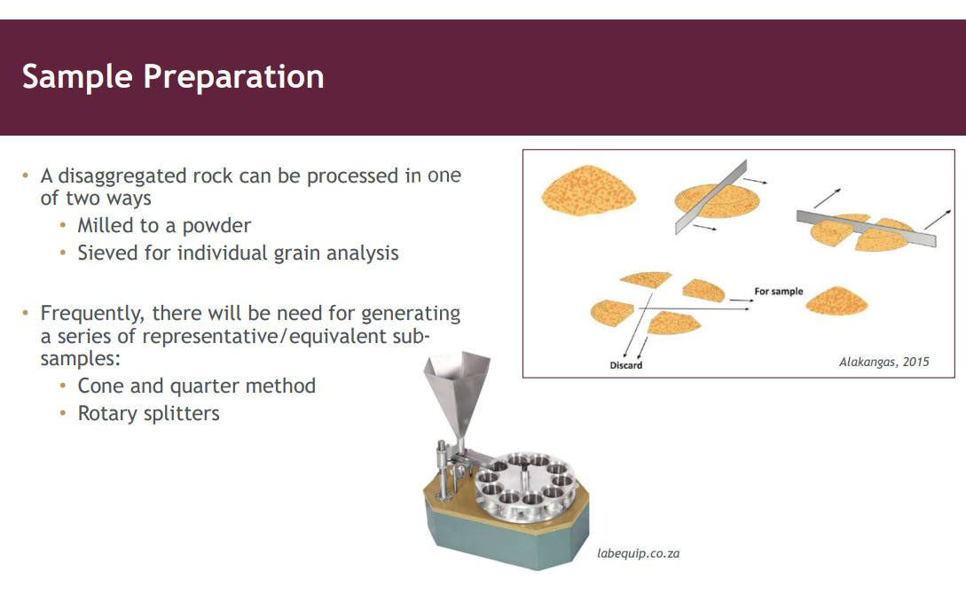

Slide 14
Quality Control (QC) and Quality Assurance (QA)
While sampling protocols ensure representativeness and reliability at the field stage, QA/QC practices safeguard data integrity from sampling through to analysis and interpretation.
Together, they provide confidence that results are both accurate and reproducible.
Distinction Between QA and QC
Quality Assurance (QA)QA refers to the systematic framework of policies, procedures, and documentation that governs how sampling and analysis are conducted. It focuses on preventing errors by defining standards and ensuring that all processes follow recognised guidelines.
Quality Control (QC)QC involves the practical checks and measurements used to detect and correct errors during analysis. It is implemented throughout laboratory and field operations to verify that results remain within acceptable limits.

Slide 15
Quality Assurance encompasses:
Standard Operating Procedures (SOPs): Clearly defined sampling, handling, and analytical methods that ensure consistency between operators and laboratories.
Training and Competency: Personnel should be trained and regularly assessed to maintain high standards of performance.
Documentation and Traceability: All steps—from sample collection to data reporting—must be fully documented to enable auditability.
Instrument Calibration and Maintenance: Regular calibration against certified standards guarantees analytical reliability.
Inter-laboratory Comparisons: Participation in proficiency testing or round-robin exercises ensures that results are comparable across laboratories.

Slide 16
4. QC in Sampling and Analysis
Quality Control activities are applied at each analytical stage to verify data reliability. These typically include:
Field Duplicates: Parallel samples collected to test the reproducibility of sampling.
Blanks: Used to monitor contamination during preparation and analysis.
Certified Reference Materials (CRMs):
Samples of known composition analysed alongside unknowns to assess accuracy.
Internal Standards: Added to correct for instrumental drift or matrix effects.
Replicates and Repeats: Reanalysis of samples to test analytical precision.

Slide 17
