Slide 1
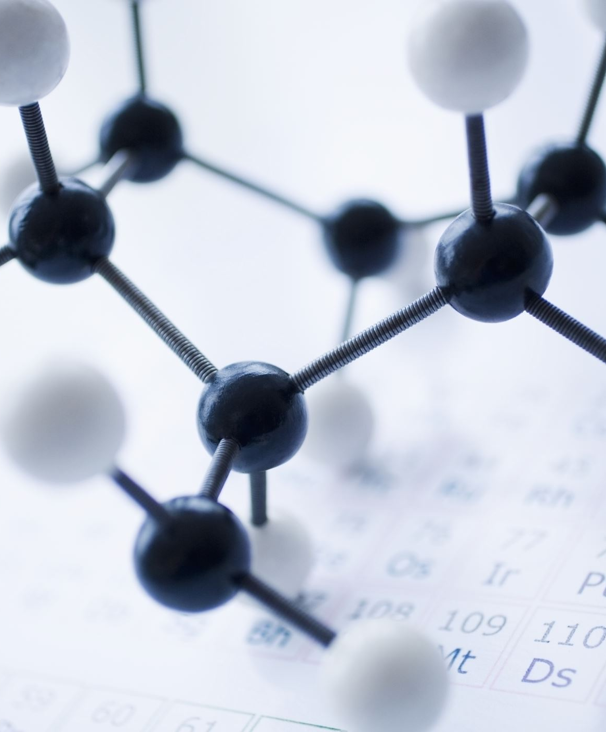
Introduction to Isotope Geochemistry
Prof. Cris Lana
BIOGRIP SWAN, Earth Science Department, Stellenbosch University

Slide 2
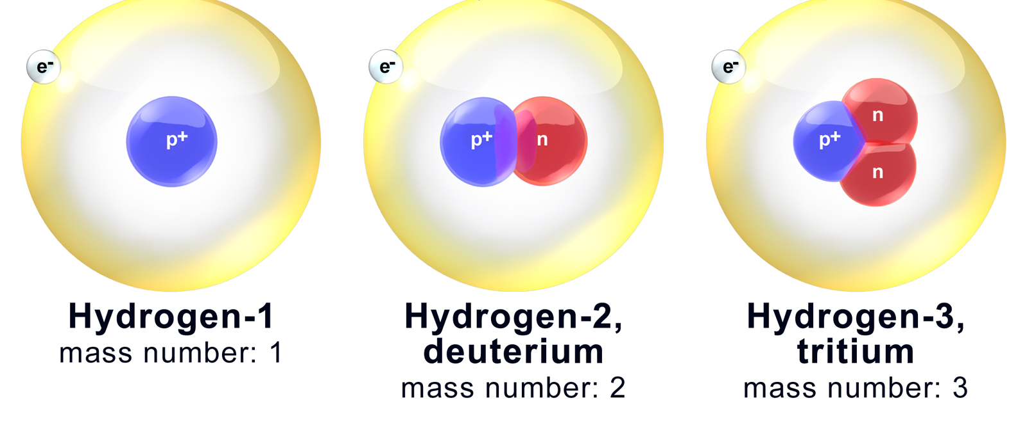
What Are Isotopes?

Slide 3
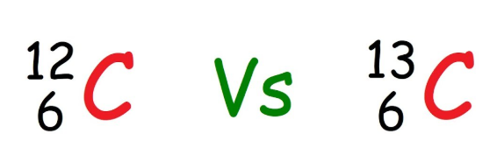
What defines the properties of a Chemical Element?
An Important Step in Isotope Geochemistry is to understand the chemical properties and behaviour of elements

Slide 4
What Defines a Chemical Element?
What defines the properties of a Chemical Element?
A chemical element is defined by the number of protons in the nucleus of its atoms — atomic number (Z).
Each element on the Periodic Table has a unique Z:
Hydrogen (Z = 1), Carbon (Z = 6), Oxygen (Z = 8), Uranium (Z = 92).
The number of electrons in a neutral atom equals the number of protons, defining its chemical behaviour.
The neutrons, however, can vary — and this is where isotopes arise.

Slide 5
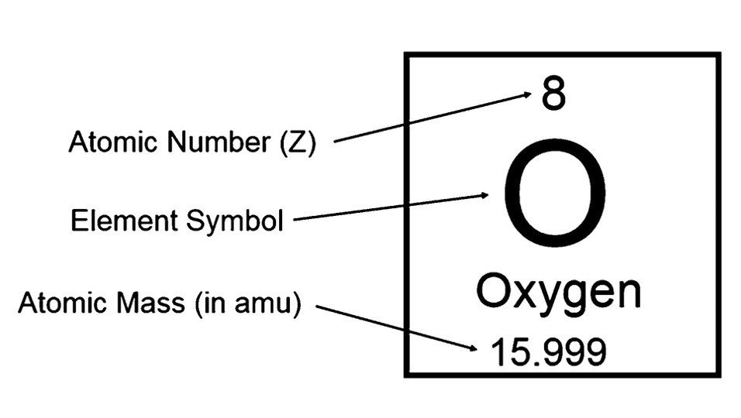
Atomic Mass of an Element
The atomic mass shown on the periodic table is a weighted average of all naturally occurring isotopes, based on their abundance.
Oxygen atomic mass ≈ 15.999 is an average of ¹⁶O (99.76%), ¹⁷O (0.04%), and ¹⁸O (0.20%).
This explains why atomic masses are not whole numbers.
Natural Abundance ?

Slide 6
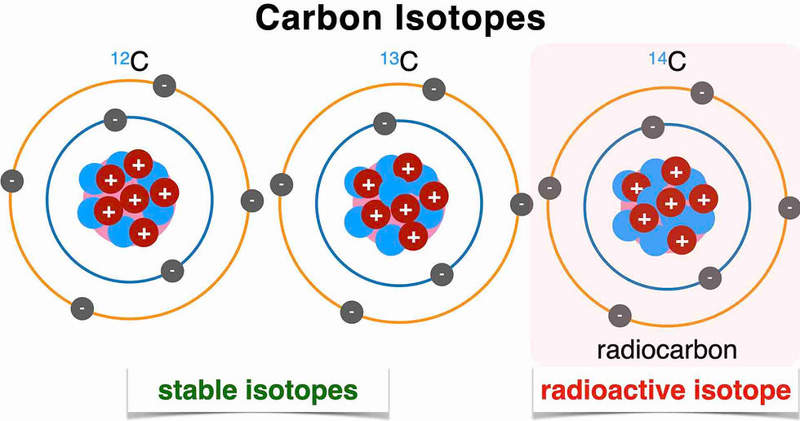
Natural abundance is the relative proportion of each isotope of an element found in nature.
In other words, it tells us how much of each isotope occurs naturally in a given sample of that element, expressed as a percentage of the total atoms.
Carbon-12 (¹²C): ~98.93%
Carbon-13 (¹³C): ~1.07%
Carbon-14 (¹⁴C): trace amounts (~10⁻¹²%)

Slide 7
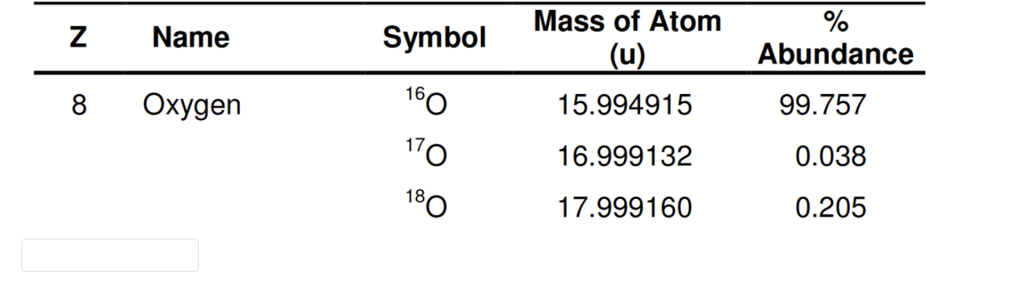
atomic mass ≠ isotope mass
Mass of an Isotope = Number of Protons + Neutrons
    ¹²C and ¹³C (different neutron numbers)
    Mass of an isotope = mass of its protons + neutrons (slightly adjusted by nuclear binding energy).
    Mass of an Isotope: mass of a specific nuclide: ¹²C = 12.000 u; ¹³C = 13.003 u
Atomic Mass of an Element = a weighted average of all naturally occurring isotopes
    Oxygen atomic mass ≈ 15.999 is an average of ¹⁶O (99.76%), ¹⁷O (0.04%), and ¹⁸O (0.20%).
Each isotope has a slightly different total mass due to:
The different number of neutrons in the nucleus.
The nuclear binding energy, which means the total mass is not just the sum of protons and neutrons — some mass is converted into binding energy.

Slide 8
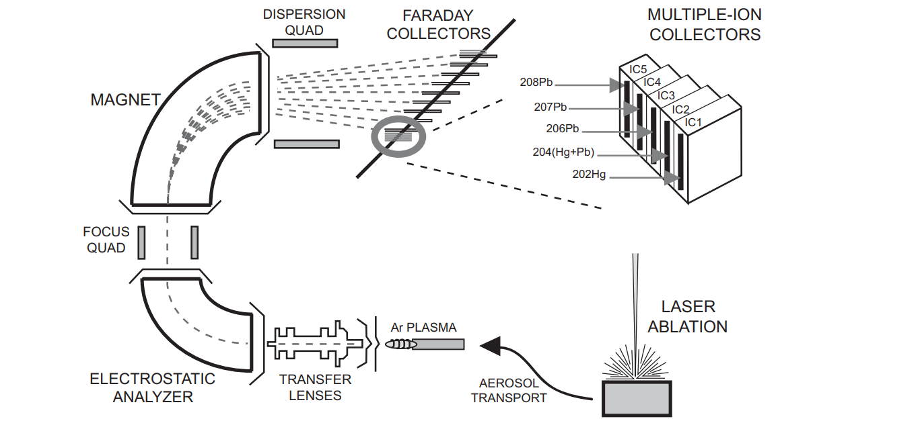
Measuring Isotopes

Slide 9
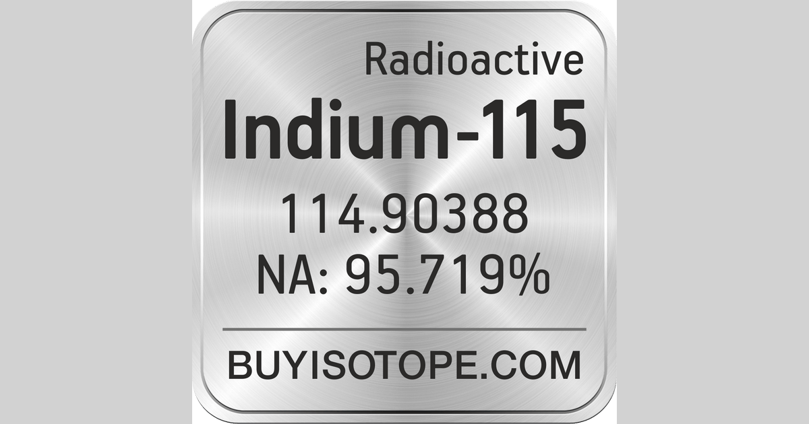
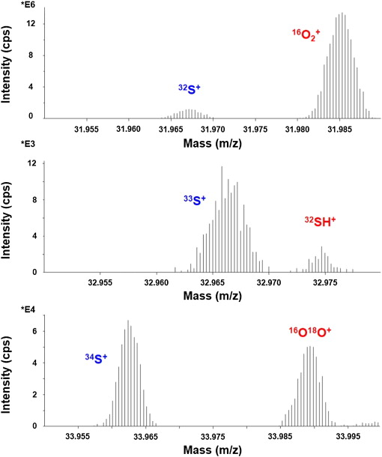
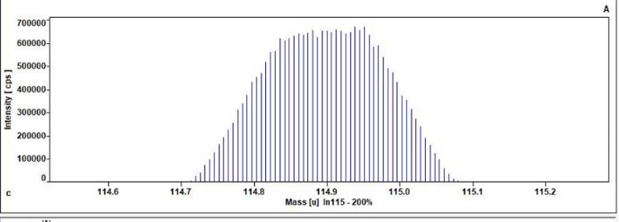

Slide 10
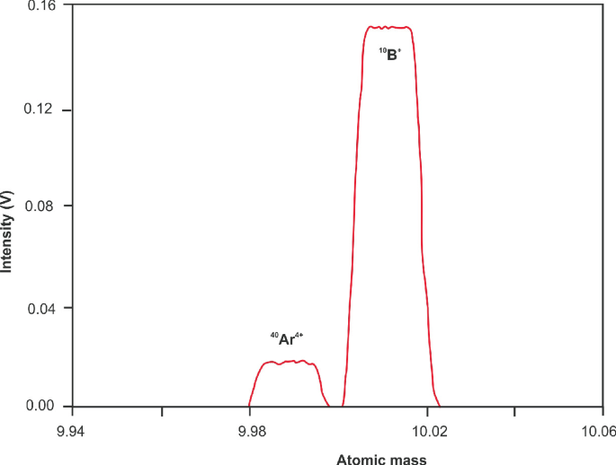
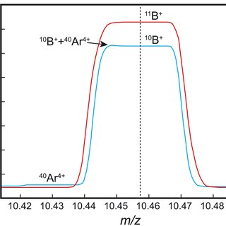
Peak Overlap and Mass Interference

Slide 11
Mass Interference Pb and Hg

Slide 12
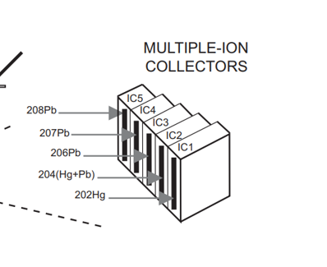
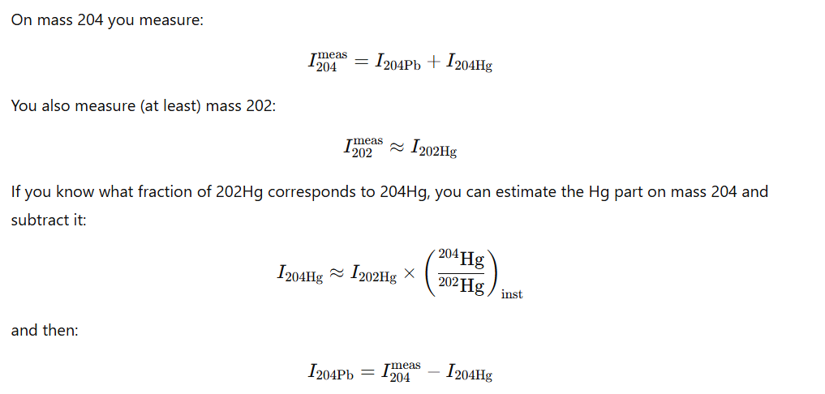

Peak Overlap and Mass Interference

Slide 13
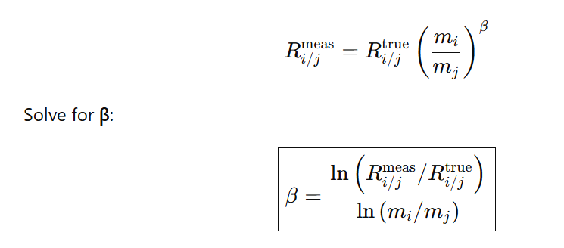
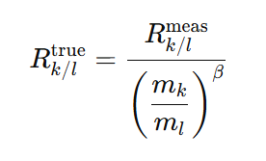
Peak Overlap and Mass Interference

Slide 14
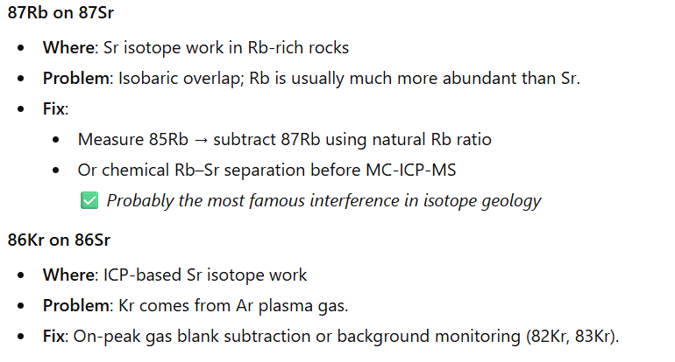
Peak Overlap and Mass Interference

Slide 15
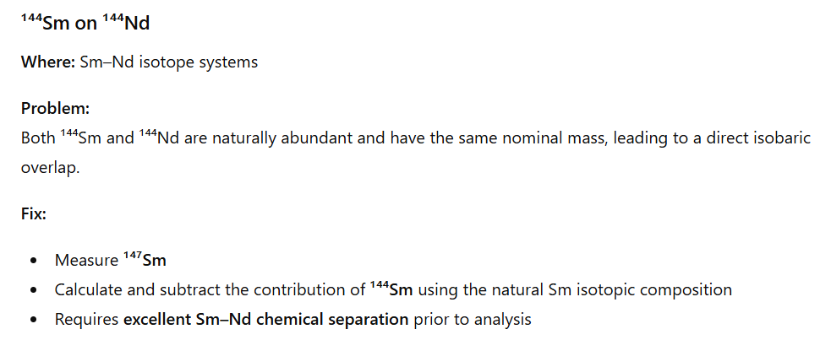
Peak Overlap and Mass Interference

Slide 16
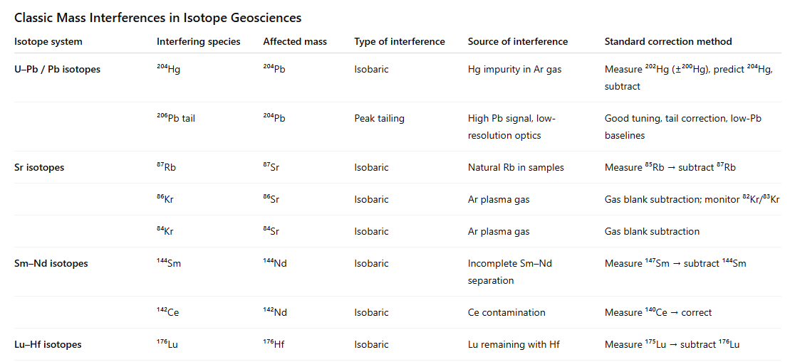

Slide 17
Do isotopes behave the same way?

Slide 18
Same chemistry, different physics.
Same electrons → same chemistry
Different mass → slightly different reaction rates, diffusion, bond strengths

Slide 19
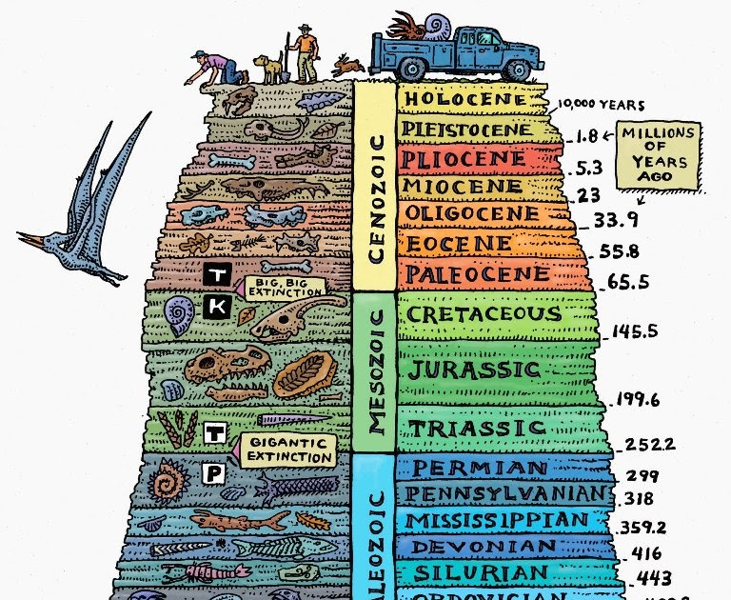
Radiogenic vs Stable Isotopes
Radiogenic Isotopes – Measure Time
Stable Isotopes – Trace Natural Processes

Slide 20
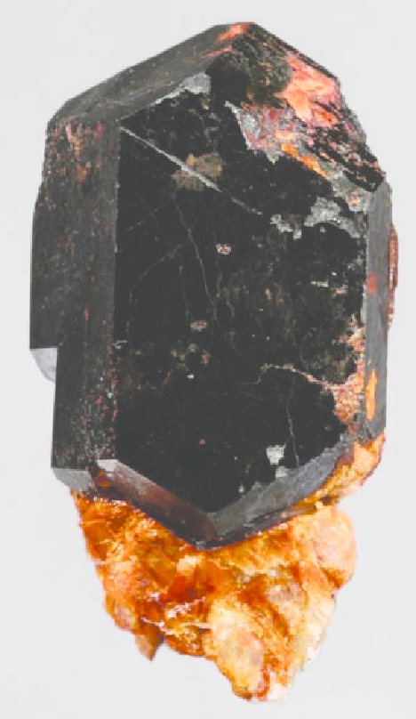
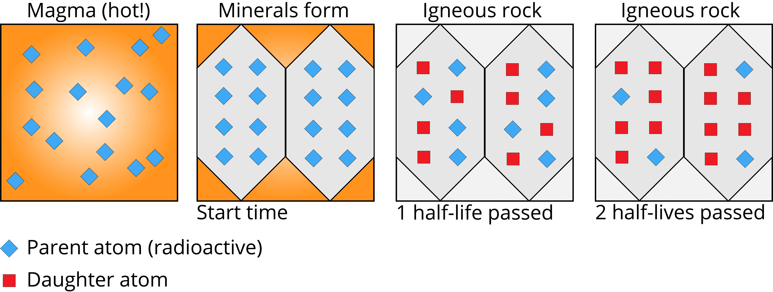
Radiogenic Isotopes

Slide 21
What Do Radiogenic Isotopes Tell Us?
Radiogenic isotopes are produced by the decay of unstable (parent) isotopes into stable (daughter) isotopes over time.
Their ratios (e.g. ²⁰⁶Pb/²³⁸U, ⁸⁷Sr/⁸⁶Sr, ¹⁴³Nd/¹⁴⁴Nd, ¹⁷⁶Hf/¹⁷⁷Hf) change predictably through radioactive decay.
They act as geological clocks and tracers for processes such as:
  Dating rocks and minerals (U–Pb, Rb–Sr, Sm–Nd, Lu–Hf systems)
  Tracing magma sources and crustal evolution (Sr–Nd–Hf isotopes)
  Determining timing of metamorphism and alteration (Rb–Sr, U–Pb in minerals)
  Tracking fluid movement and ore formation (Sr, Pb isotopes in veins and carbonates)
They provide quantitative ages and geochemical fingerprints that reveal Earth’s history, crustal growth, and mantle evolution.

Slide 22
What Do Stable Isotopes Tell Us?
Stable isotope ratios (e.g. δ¹³C, δ¹⁸O, δ²H) vary with temperature, metabolic pathways, and environmental conditions.
They act as natural fingerprints for tracing processes such as:
  Climate change (ice cores, shells, fossils)
  Water sources and cycles (hydrology, rainfall origin)
  Biological activity (photosynthesis, respiration, food webs)
  Diagenesis and metamorphism (fluid–rock interaction)
They provide clues about Earth’s past environments, biogeochemical cycles, and life processes.

Slide 23
In Isotope Geochemistry, we work with ratios
In Isotope Geochemistry, we work with ratios
Because we compare the proportion of one isotope to another rather than absolute concentrations.
These ratios reflect natural variations in isotopic composition caused by physical, chemical, or radioactive processes.

