Slide 1
Radiogenic vs Stable Isotopes
Stable isotopes trace processes
Radiogenic isotopes tell time.
Together, they unlock Earth’s past

Slide 2
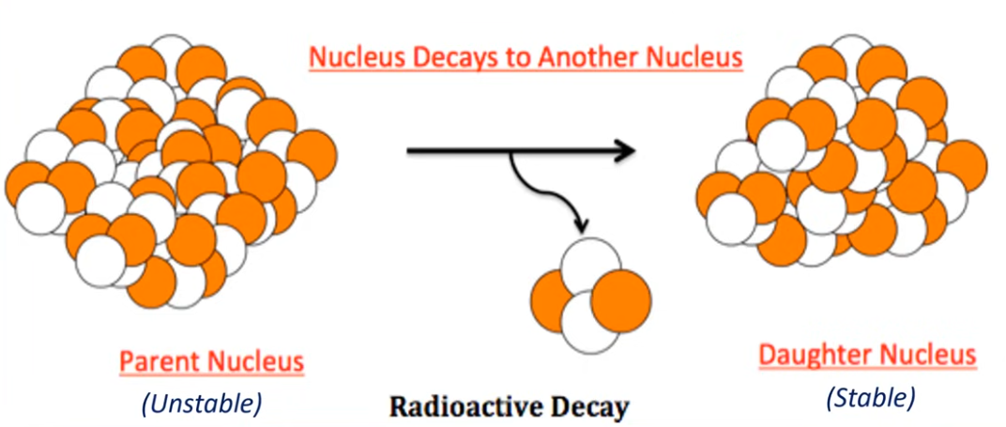

Slide 3
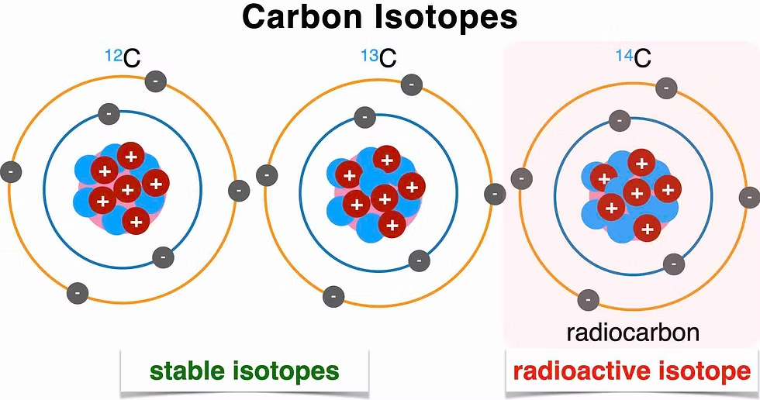
¹²C – Stable Isotope
6 protons + 6 neutrons
Makes up about 99% of all carbon on Earth
¹³C – Stable Isotope
6 protons + 7 neutrons
Slightly heavier but also stable (does not decay). Its relative abundance (≈1%)
¹⁴C – Radioactive Isotope (Radiocarbon)6 protons + 8 neutrons.
Unstable (radioactive): decays over time to nitrogen-14 (¹⁴N) by beta decay.
Half-life: ~5,730 years

Slide 4
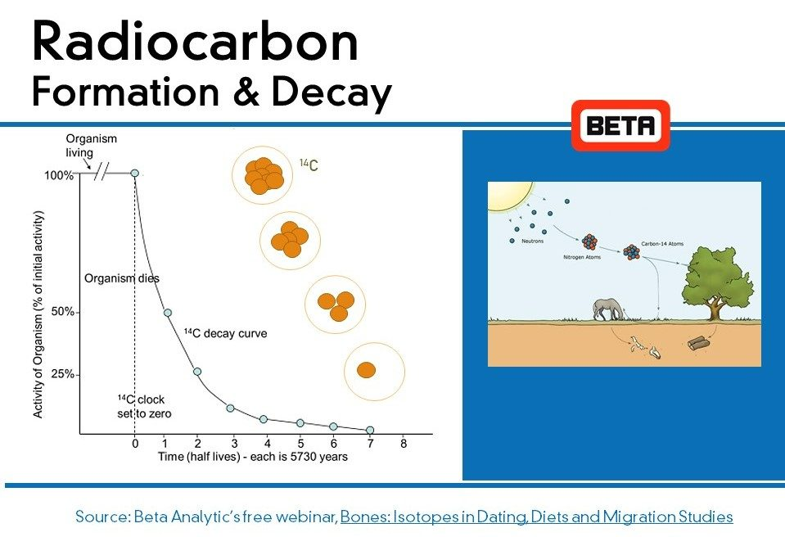

Slide 5
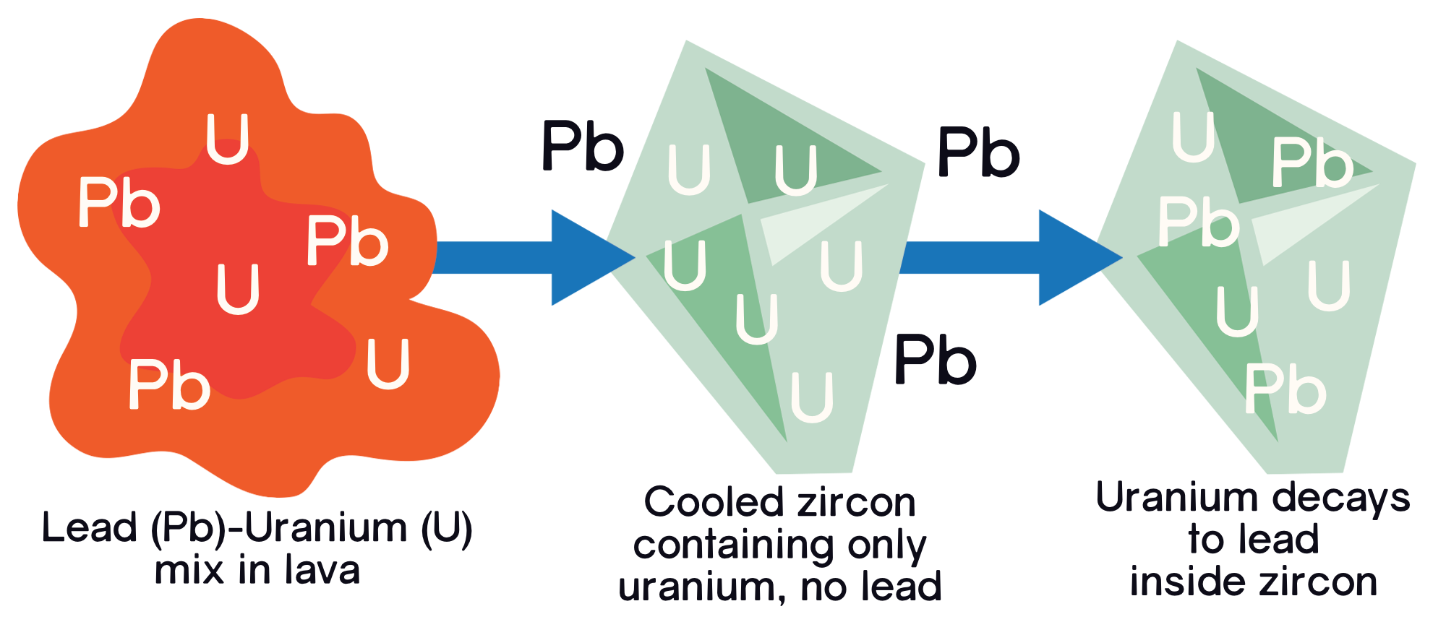
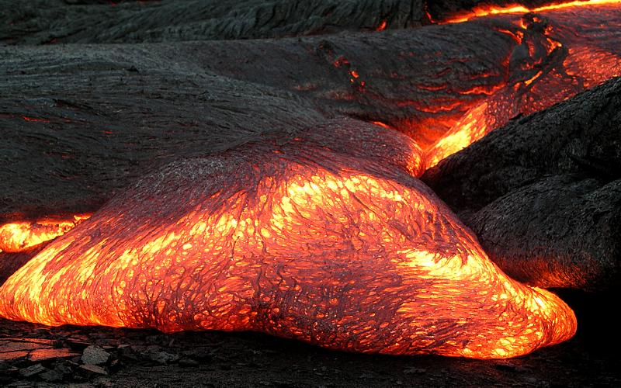
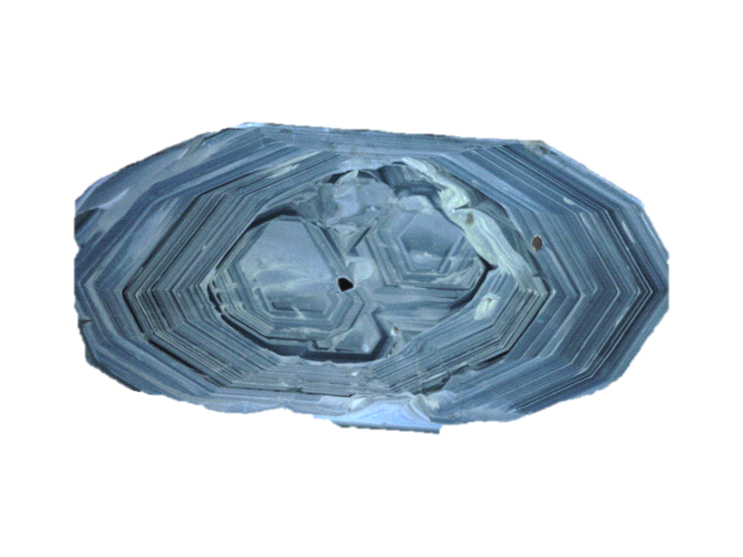
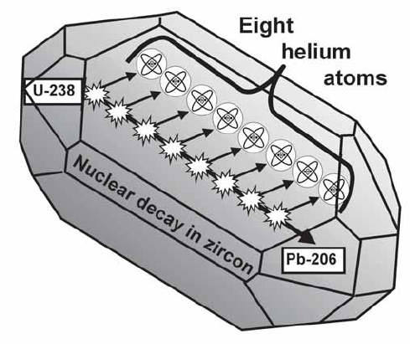
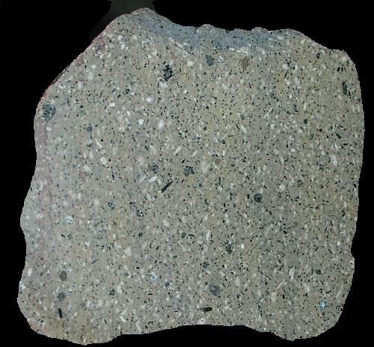

Slide 6
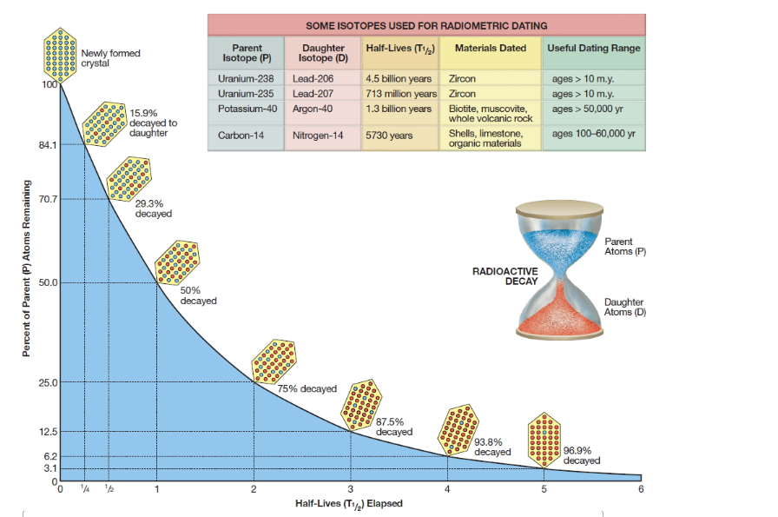
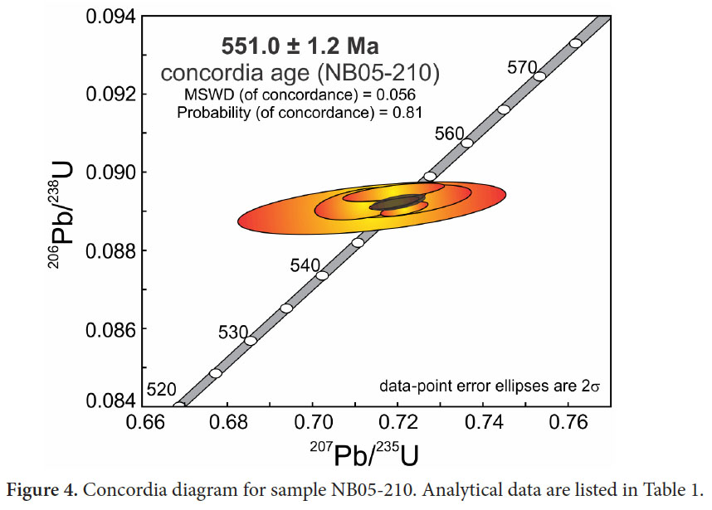

Slide 7

Why do we have radioactive decay?

Slide 8
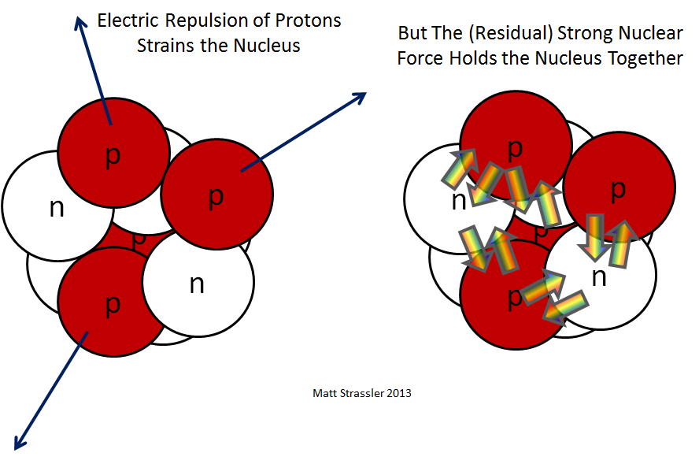
Inside the Nucleus:
Two main forces act within the nucleus —
one that binds it together, and one that pushes it apart
Competing Forces that make the atom unstable

Slide 9
Nuclear vs Electrostatic
The Nuclear (Strong) Force — the Glue
Acts between all nucleons (protons and neutrons).
It’s a very strong, attractive force, but it acts only over very short distances (about the size of a nucleus).
The Electrostatic (Coulomb) Repulsion — the Push
Acts only between protons, because they all have a positive charge (+).
This is a long-range repulsive force, always pushing protons apart.
As the number of protons increases (in heavier elements), repulsion grows stronger and threatens nuclear stability.

Slide 10
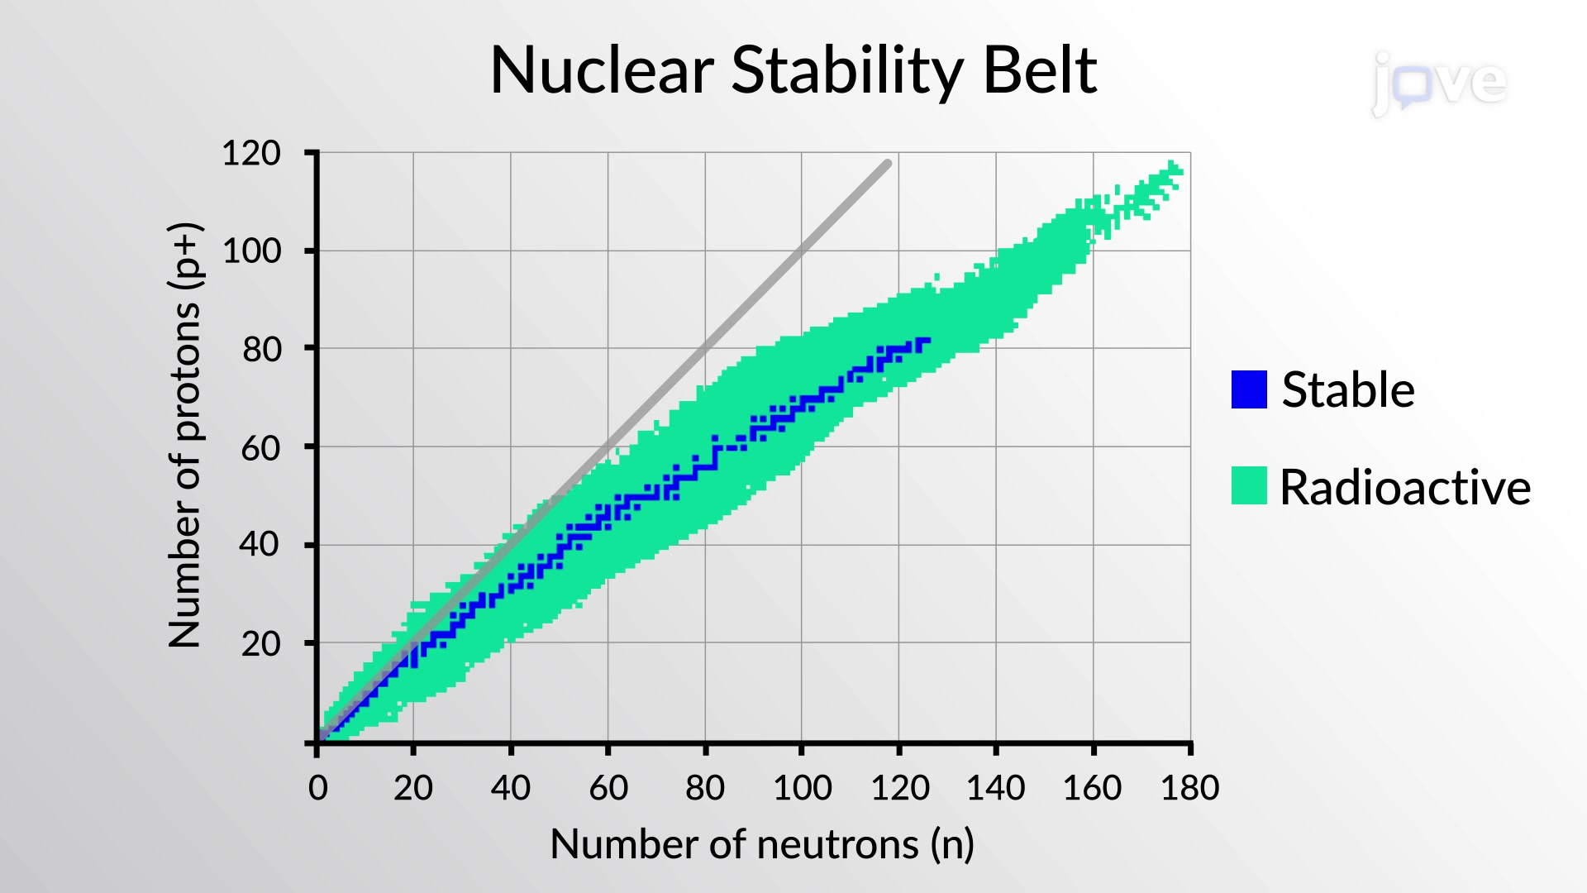
The band of stability represents the optimal balance between protons and neutrons
Radioactive Isotopes are unstable and undergo radioactive decay (α, β, or γ decay) to move toward stability.
Too many neutrons → β⁻ decay (neutron → proton).
Too many protons → β⁺ decay or electron capture (proton → neutron).

Slide 11
For light elements, stable isotopes generally have equal numbers of protons and neutrons (n ≈ p)
For small nuclei, the strong nuclear force (which binds protons and neutrons) is strong enough to balance the repulsion between protons when n = p.
As nuclei get heavier, more neutrons are needed to stabilise the increasing proton–proton
repulsion, so the ratio shifts to n > p

Slide 12
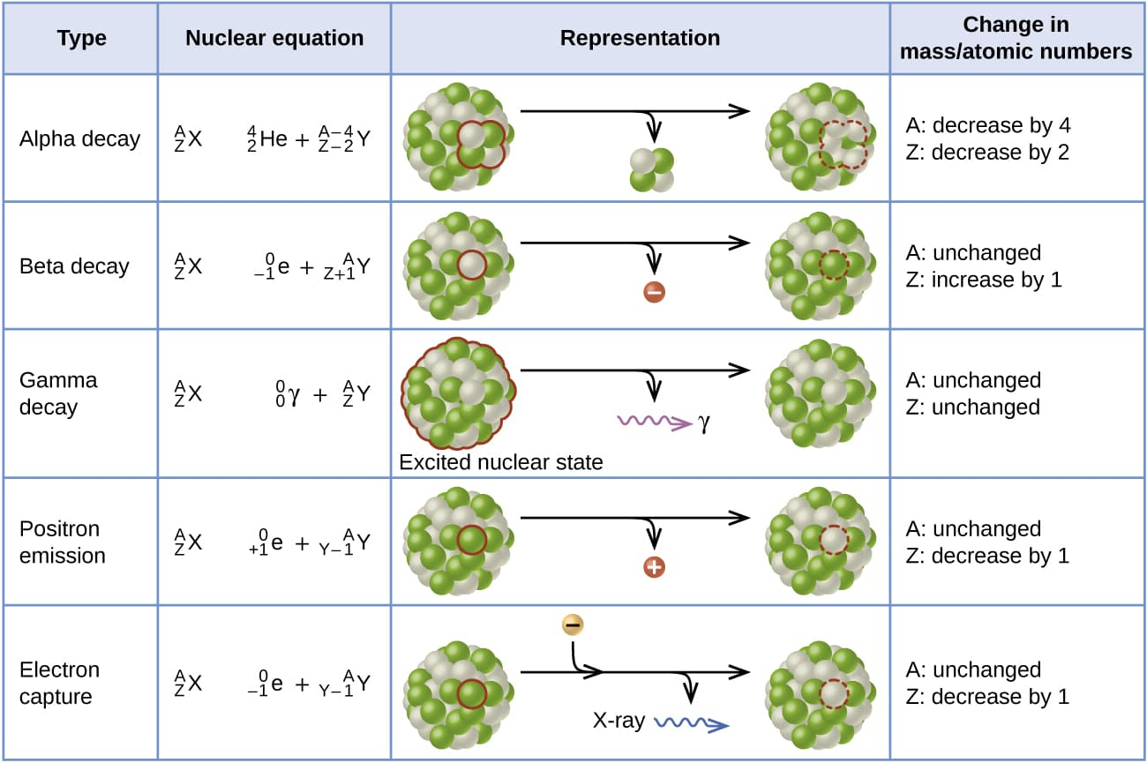
Remove 2 Neutrons and 2 Protons
Convert 1 Neutron to 1 Proton
Convert 1 Proton to 1 Neutron
Convert 1 Proton to 1 Neutron

Slide 13
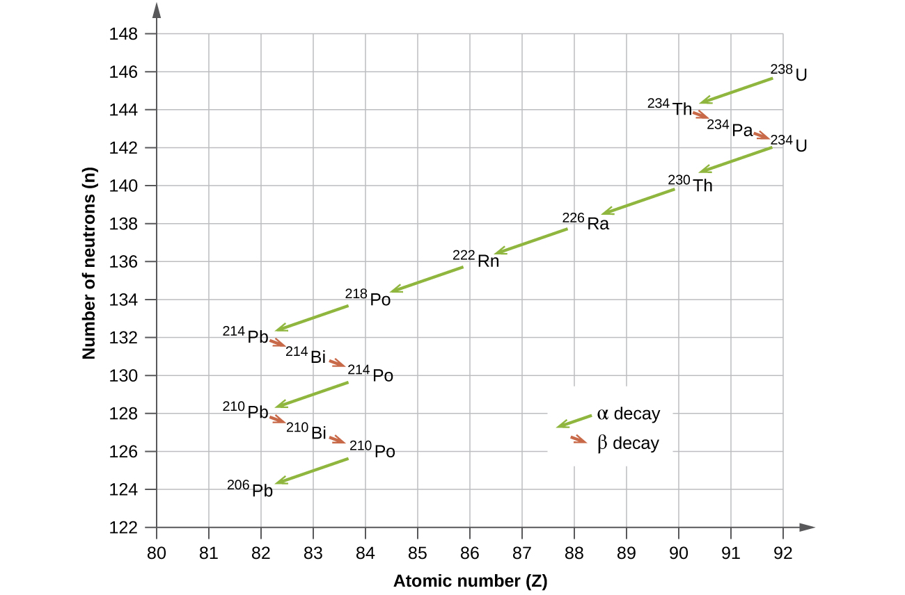

Slide 15
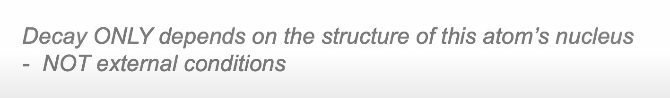
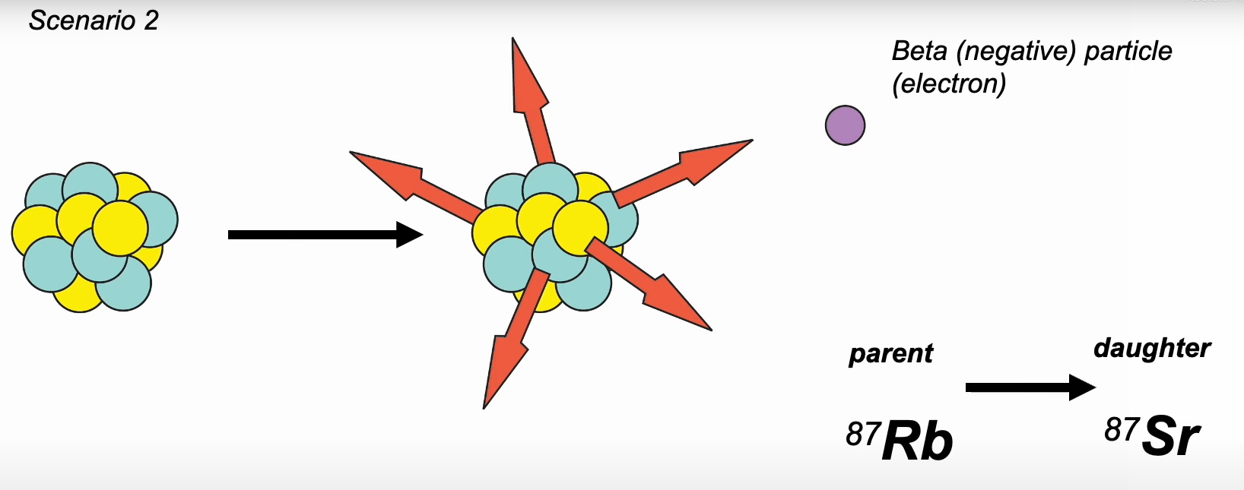

Slide 16
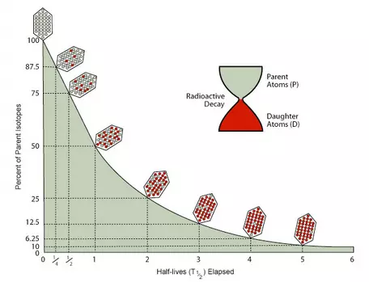
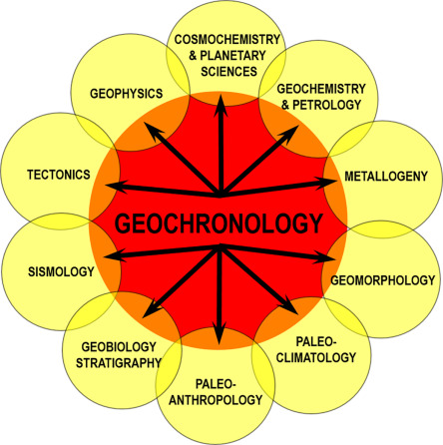
Back to the Core of Geochronology

Slide 17
Back to Geochronology
It’s all about the method.
But first, we must know what we want to date.
Every method tells a different story. To choose the right one, we must first know what we’re dating — and why.

Slide 18
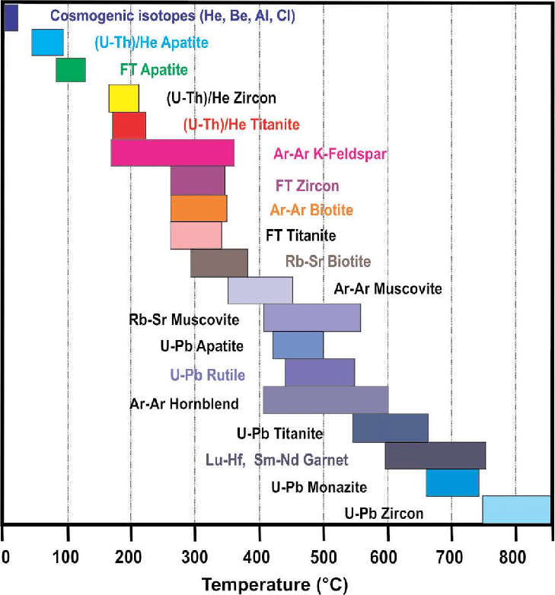
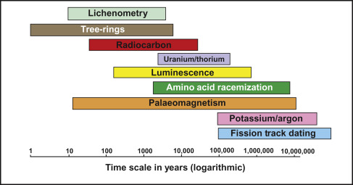
What to date and how?
Let’s figure this out.

Slide 19
Short-Timescale Methods (up to ~50,000 years)
Method | Typical Use | Comments
Dendrochronology | Tree rings | Annual resolution; excellent calibration tool for radiocarbon.
Radiocarbon (¹⁴C) | Organic matter | Up to ~50 ka; depends on carbon preservation.
Lichenometry | Rock surfaces | Used for glacial & landslide dating (hundreds–thousands of years).
Lichenometry is done by measuring the diameter of the largest lichen thalli growing on a rock surface of known exposure.
Dendrochronology is done by counting and measuring annual growth rings in trees to determine their age and to date past environmental events. Each ring represents one year of growth.

Slide 20
Intermediate Range (~10³–10⁶ years)
Method | Typical Use | Comments
Luminescence (OSL/TL) | Sediments | Measures last exposure to sunlight; useful for aeolian/fluvial deposits.
Cosmogenic nuclides | Rock exposure | Dates surface exposure or erosion; e.g., ¹⁰Be, ²⁶Al.
U-series (U-Th) | Carbonates, corals | Covers 1–500 ka; key for cave deposits and corals.

Slide 21
Long-Timescale Methods (>10⁶ years)
Method | Typical Use | Comments
Fission Track | Apatite, zircon, glass | Tracks thermal history (10⁵–10⁸ yr).
K–Ar / Ar–Ar | Volcanic rocks, micas | 10⁴–10⁹ yr; major tool for igneous chronology.
Palaeomagnetism | Basalts, sediments | Global magnetic polarity timescale; complements isotopic methods.

Slide 22
Conventional Geochronology Methods
Method | System & Parent–Daughter Pair | Typical Materials | Useful Age Range | Applications / Notes
Rb–Sr | ⁸⁷Rb → ⁸⁷Sr | Micas, K-feldspar, whole rocks, carbonates | ~10 Myr – >3 Ga | Excellent for dating metamorphism and fluid-related processes; susceptible to open-system Sr mobility.
Sm–Nd | ¹⁴⁷Sm → ¹⁴³Nd | Garnet, whole rocks, pyroxene, apatite | ~50 Myr – >4.5 Ga | Robust to alteration; widely used for crustal evolution, source tracing, and model ages (T_DM).
U–Pb | ²³⁸U → ²⁰⁶Pb, ²³⁵U → ²⁰⁷Pb | Zircon, monazite, titanite, calcite | ~1 Myr – >4.5 Ga | Gold standard for absolute dating; dual decay schemes allow concordia control of Pb loss.
Pb–Pb (Isochron or model) | ²⁰⁶Pb/²⁰⁷Pb or ²⁰⁶Pb/²⁰⁴Pb | Sulfides, carbonates, whole rocks, meteorites | ~10 Myr – >4.5 Ga | No parent isotope measured directly; relies on common Pb correction; used for early Earth and meteorites.
Lu–Hf | ¹⁷⁶Lu → ¹⁷⁶Hf | Garnet, zircon, whole rocks | ~10 Myr – >4.5 Ga | Resistant to metamorphism; powerful tracer of mantle evolution and crustal recycling; complements Sm–Nd.

Slide 23
Conventional Geochronology Methods
Isotope System | Parent → Daughter | Main Minerals | Typical Host Rocks | Key Geochemical Controls
Rb–Sr | ⁸⁷Rb → ⁸⁷Sr | Biotite, Muscovite, K-feldspar, Plagioclase, Whole-rock | Granites, Gneisses, Schists, Pegmatites | Rb substitutes for K; Sr for Ca; sensitive to alteration and metamorphism
Sm–Nd | ¹⁴⁷Sm → ¹⁴³Nd | REE-bearing phases: Monazite, Allanite, Garnet, Pyroxene, Amphibole, Whole-rock | Mafic to felsic igneous rocks, Metamorphic rocks | REE-compatible behaviour; Sm/Nd ratio preserved during metamorphism; robust system
Lu–Hf | ¹⁷⁶Lu → ¹⁷⁶Hf | Garnet, Rutile, Whole-rock | Igneous and Metamorphic rocks (especially felsic and high-grade) | Lu–Hf fractionated during zircon crystallisation; resistant to later resetting
Combined (Sm–Nd–Lu–Hf) | — | Garnet, Zircon, Monazite, Xenotime | Metamorphic rocks, granitoids, TTG suites | Integrated REE–HFSE system for crust–mantle evolution studies
Accessory Minerals for Multi-system Use | — | Apatite (Sr, Nd), Titanite (Sm–Nd, Lu–Hf), Epidote (Sm–Nd), Feldspar (Rb–Sr) | Granites, pegmatites, skarns, amphibolites | Record magmatic and metamorphic ages; variable element compatibility

Slide 24
Rb–Sr Geochronology Overview
Parent–Daughter System:
Parent isotope: ⁸⁷Rb (Rubidium) – radioactive
Daughter isotope: ⁸⁷Sr (Strontium) – radiogenic product
Decay Scheme:
⁸⁴Sr (0.56%), ⁸⁶Sr (9.86%), ⁸⁷Sr (7.0%) and ⁸⁸Sr (82.58%)
Rubidium (37Rb) has 35 known isotopes, from ⁷²Rb to ¹⁰⁶Rb,
Only two naturally occurring rubidium: stable ⁸⁵Rb (72.2%) and radioactive ⁸⁷Rb (27.8%).
Decay constant (λ):
λ = 1.42 × 10⁻¹¹ yr⁻¹

Slide 25
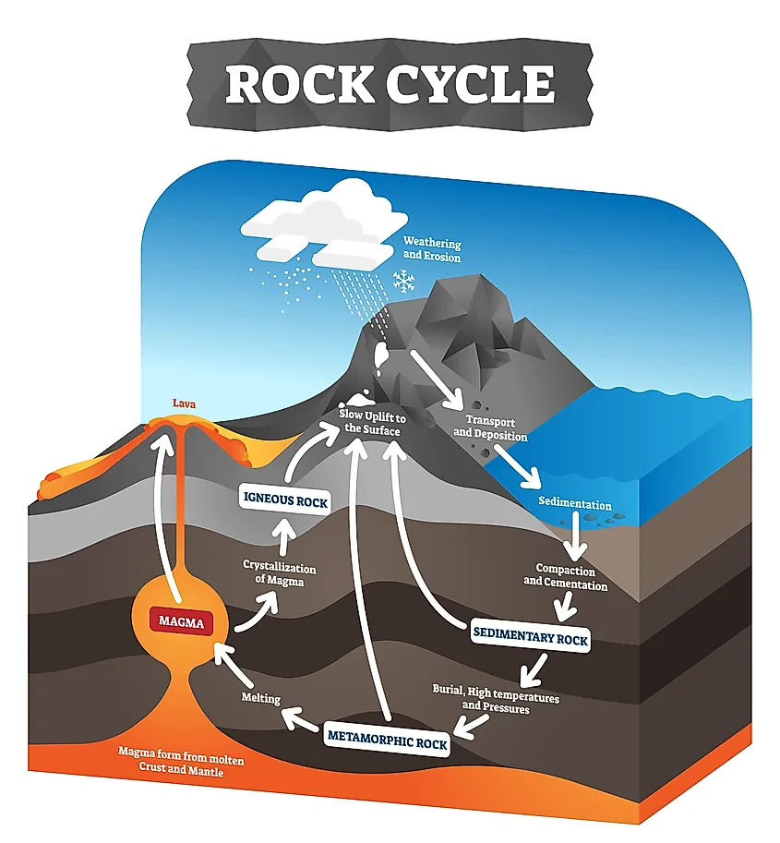
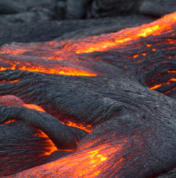

Slide 26
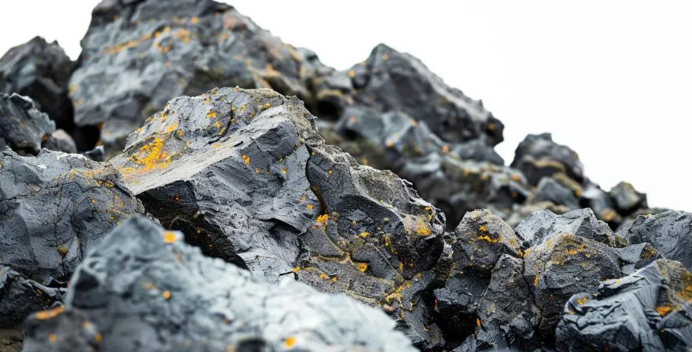
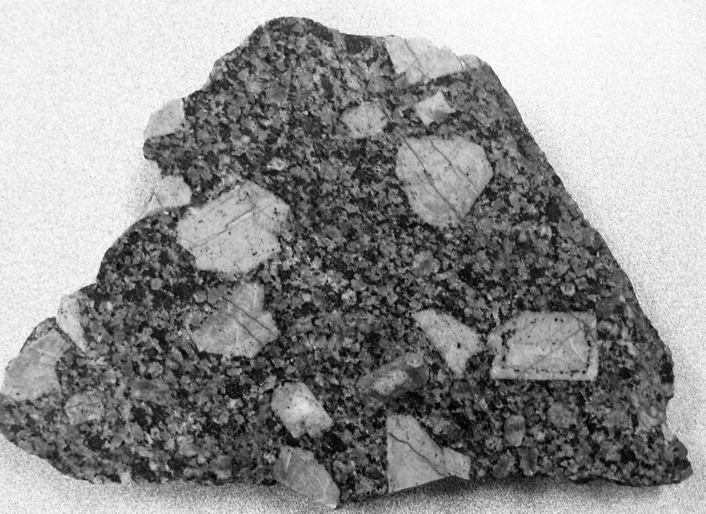
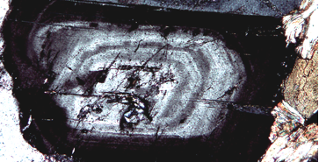
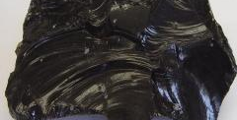

Slide 27
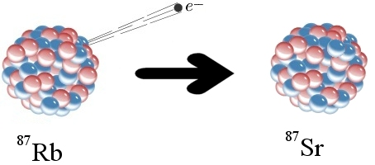

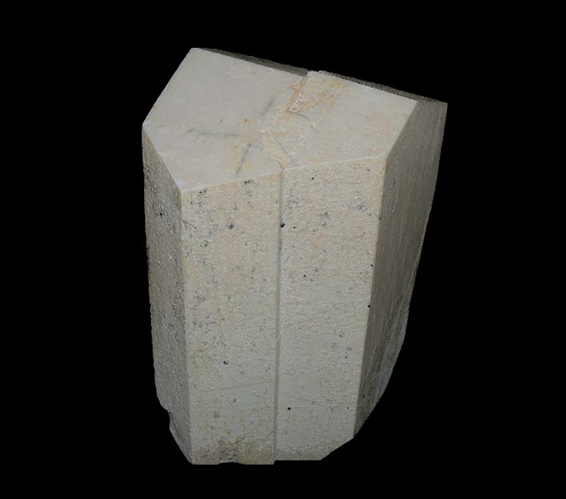
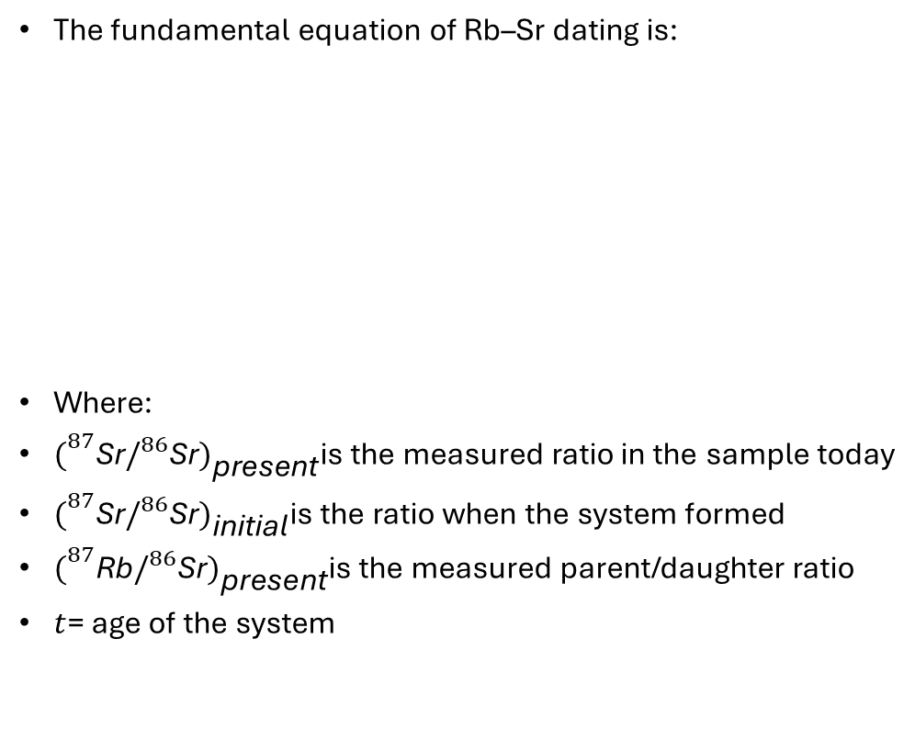
The fundamental equation of Rb–Sr dating is:
Where:
${\left.(\right.}^{87}\text{Sr}/^{86}\text{Sr}{\left.)\right.}_{\text{present}}$is the measured ratio in the sample today
${\left.(\right.}^{87}\text{Sr}/^{86}\text{Sr}{\left.)\right.}_{\text{initial}}$is the ratio when the system formed
${\left.(\right.}^{87}\text{Rb}/^{86}\text{Sr}{\left.)\right.}_{\text{present}}$is the measured parent/daughter ratio
$t$= age of the system
87Sr₀
88Sr₀
86Sr₀
87Rb₀
84Sr₀
85Rb₀
87Sr*

Slide 28
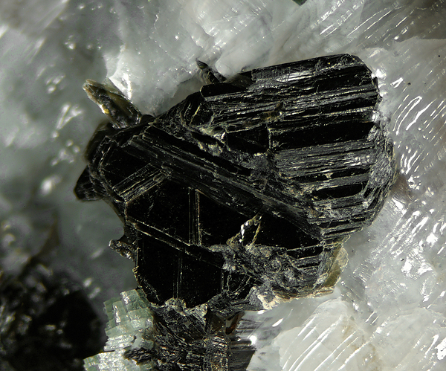
87Sr₀
88Sr₀
86Sr₀
87Rb₀
84Sr₀
85Rb₀
87Sr*

Slide 29
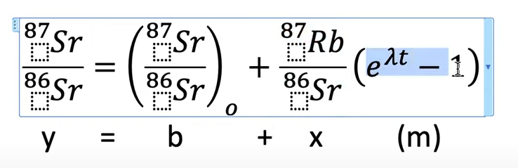
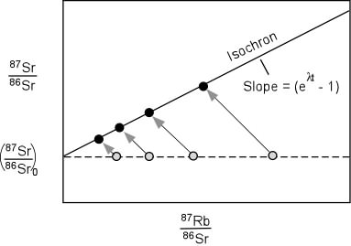


Slide 30
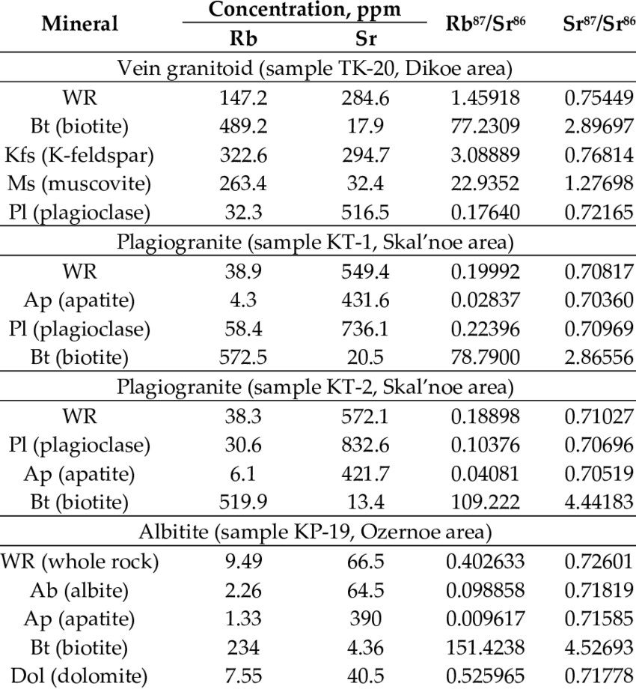
Let’s understand this table

Slide 31
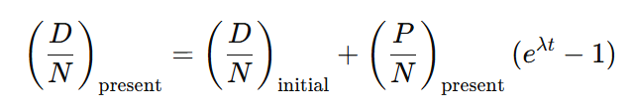
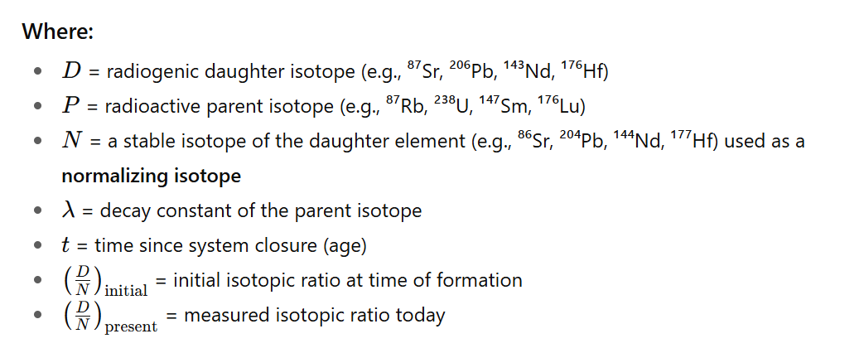
Conventional Radiometric Geochronology Methods
General Isochron Equation

Slide 32
Conventional Radiometric Geochronology Methods
Radioactive decay law:
How do we get to this ?

Slide 33

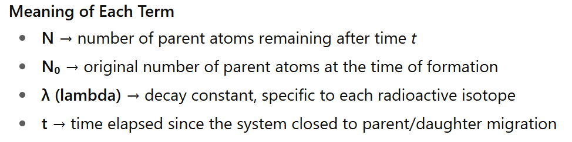
Conventional Radiometric Geochronology Methods
Radioactive decay law:
This equation describes exponential decay — the number of radioactive parent atoms decreases over time at a predictable rate.

Slide 34

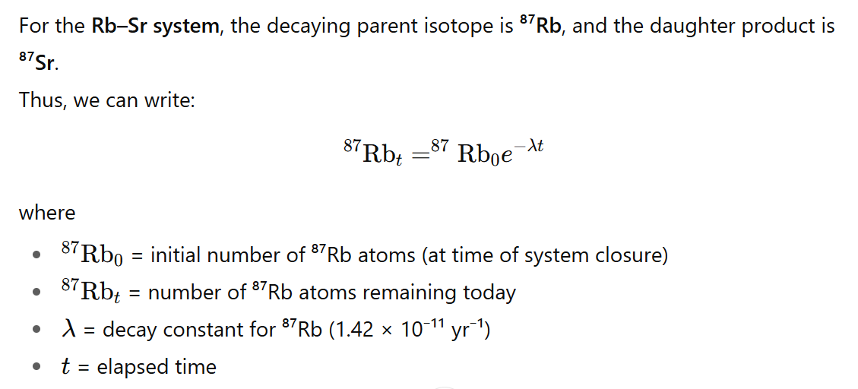
Conventional Radiometric Geochronology Methods
This shows that ⁸⁷Rb decreases exponentially through time as it decays into ⁸⁷Sr.

Slide 35
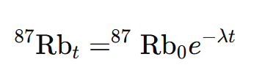


Slide 36





?

Slide 37
⁸⁷Sr_{t} = ⁸⁷Sr₀ + ⁸⁷Sr*
⁸⁷Sr_{t} = ⁸⁷Sr₀ +

Slide 38

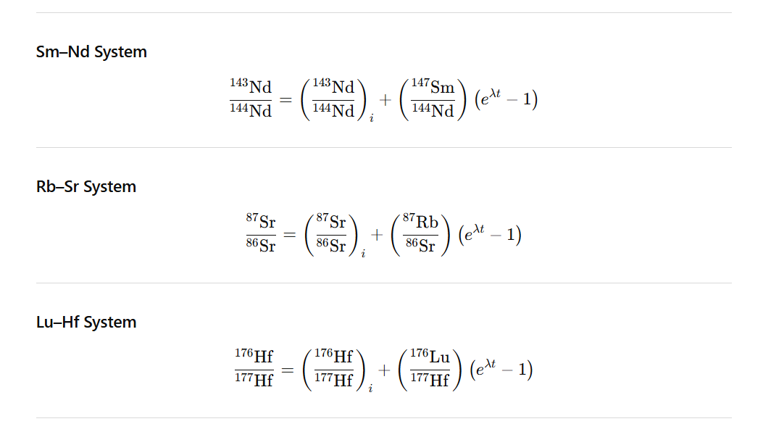

Slide 39

Evolution of the Radiogenic Systems

Slide 40
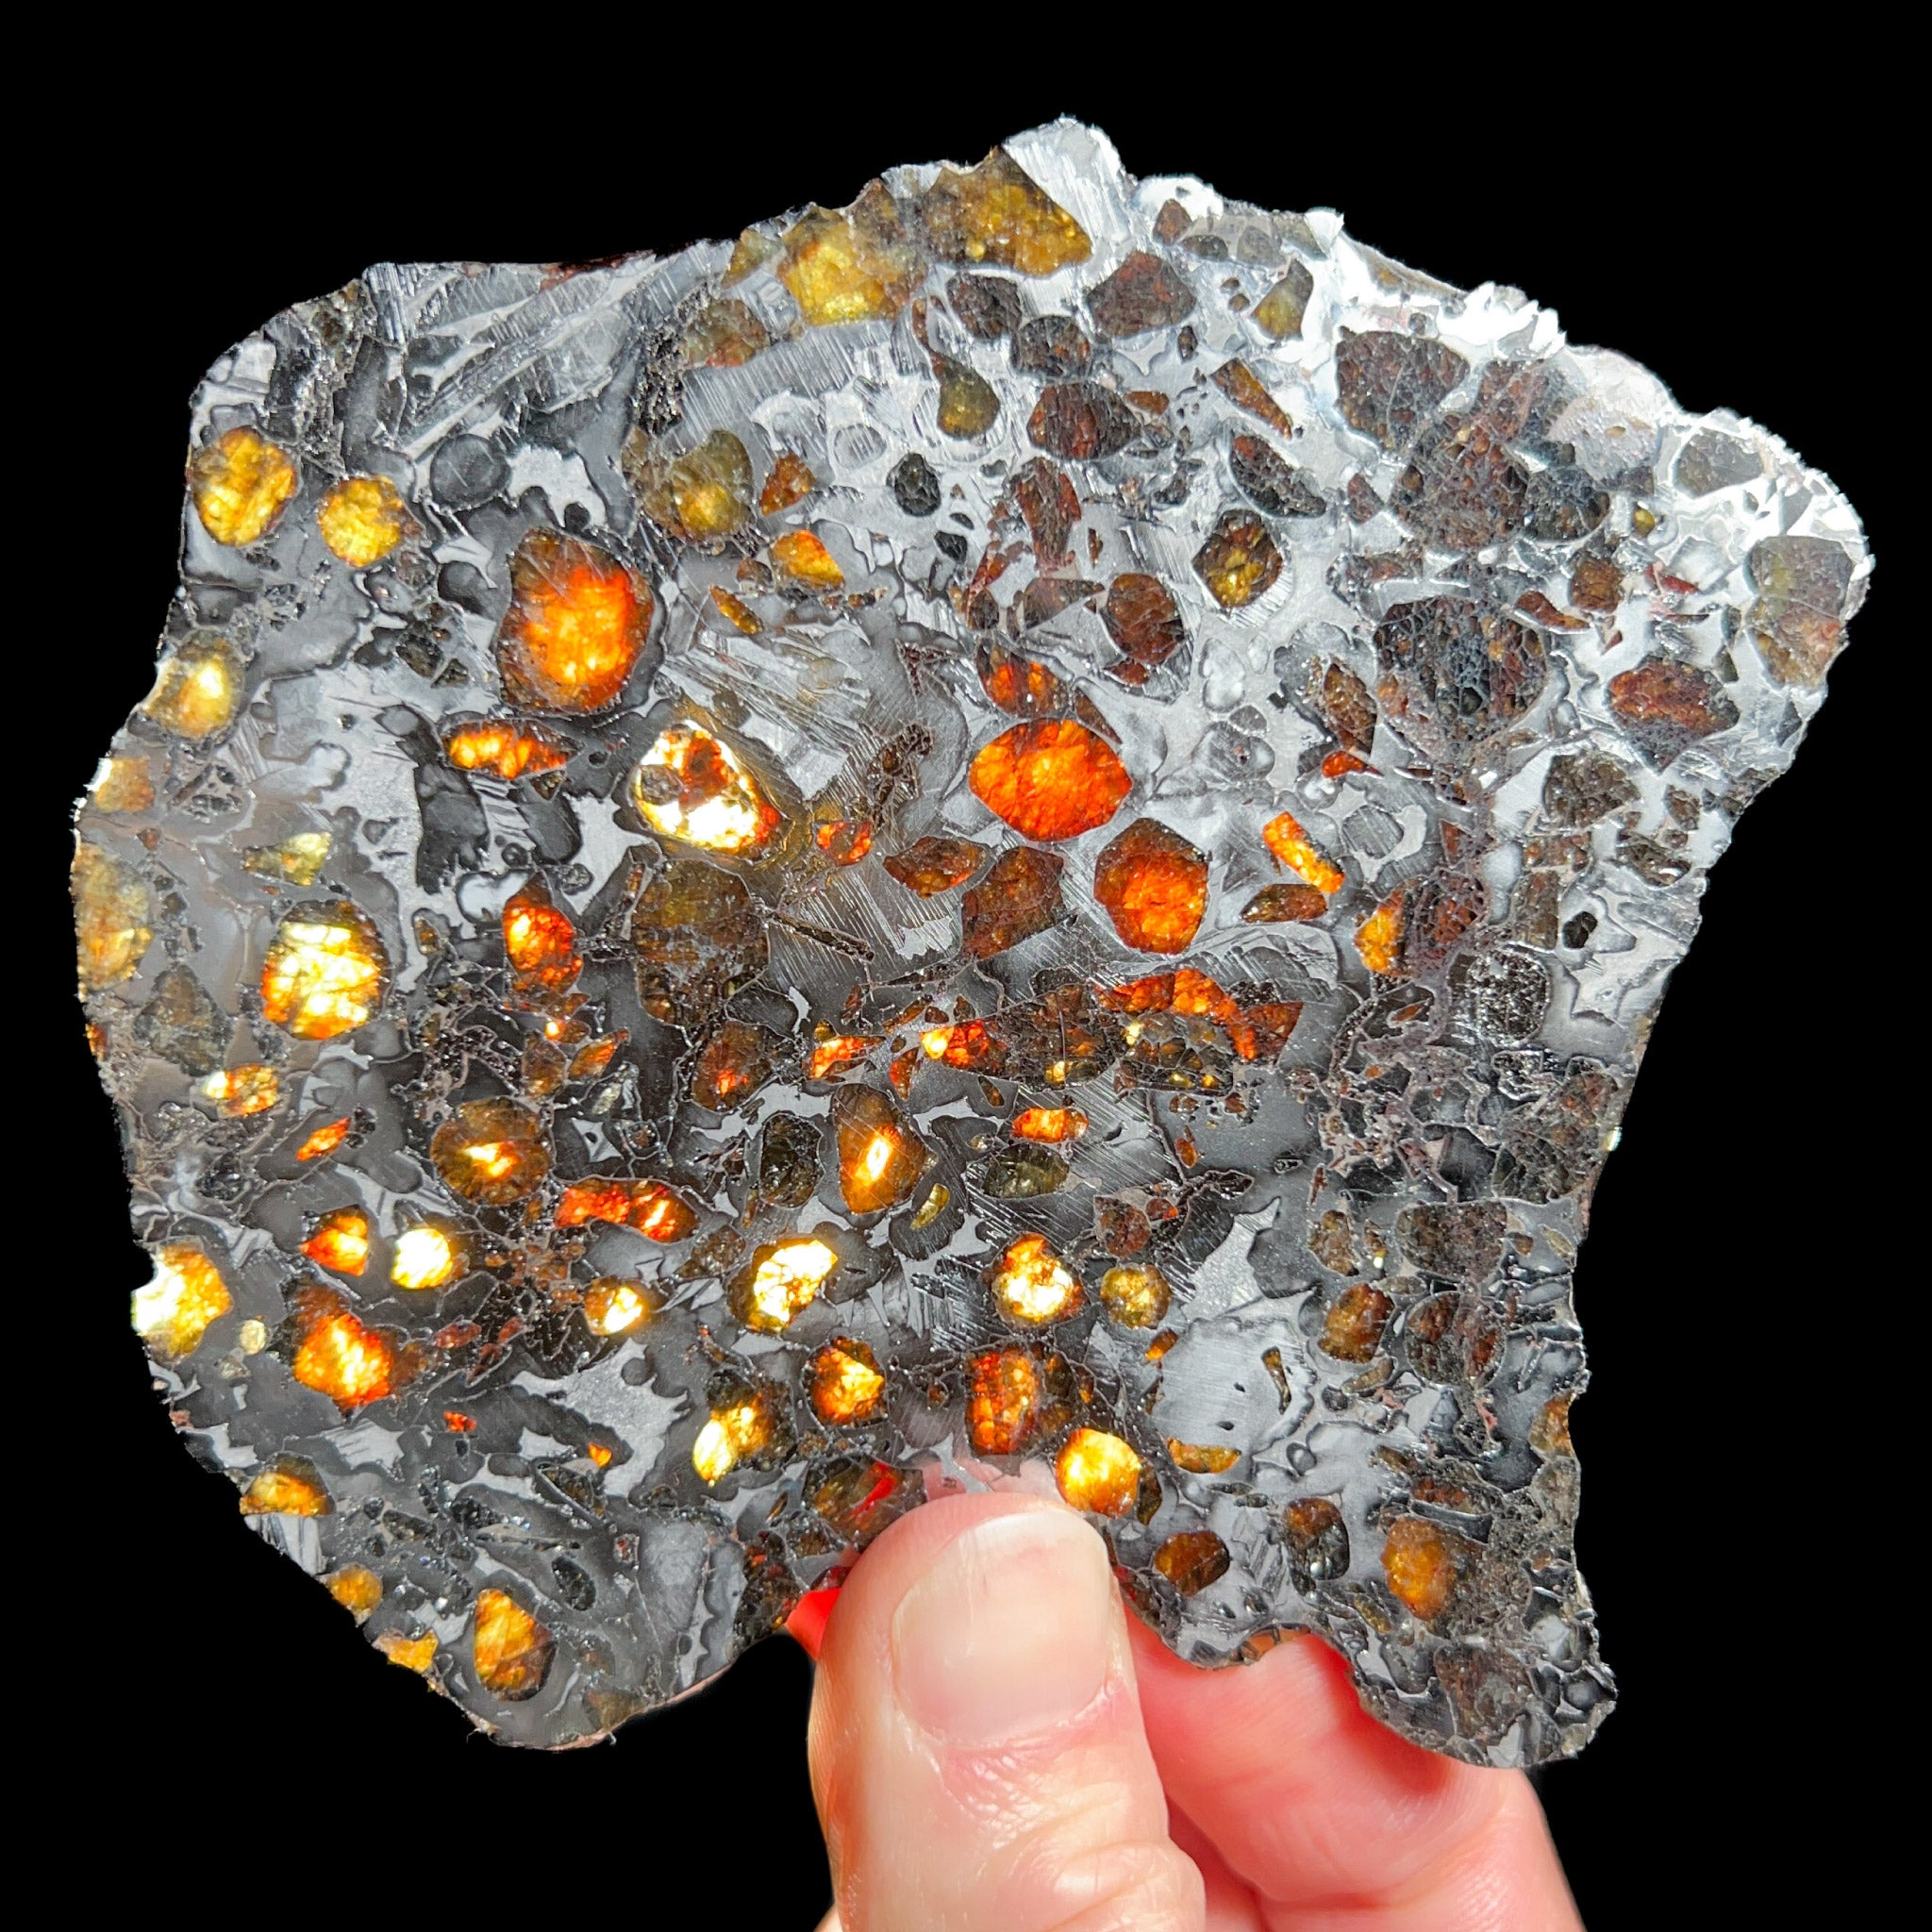
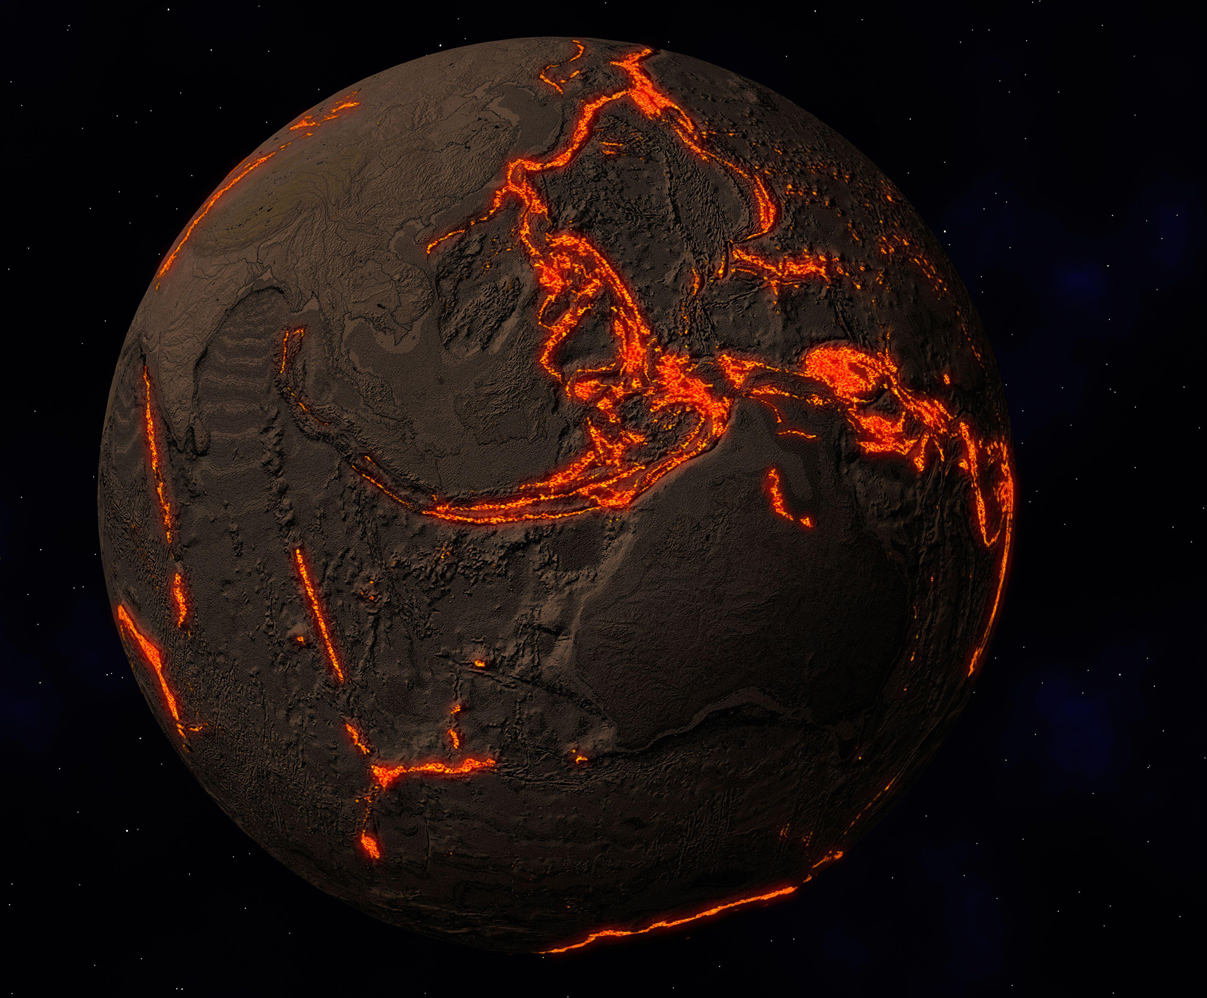
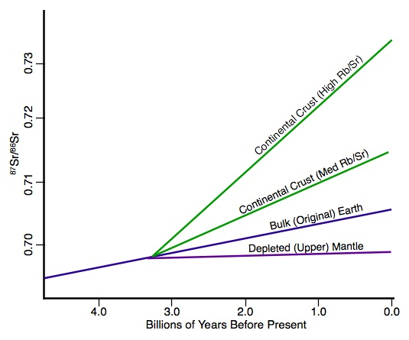
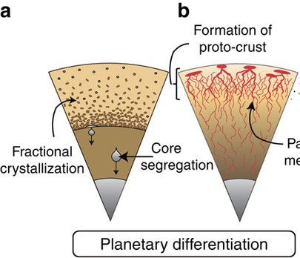

Slide 41
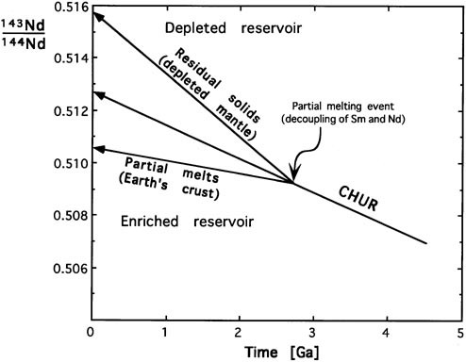

Slide 42
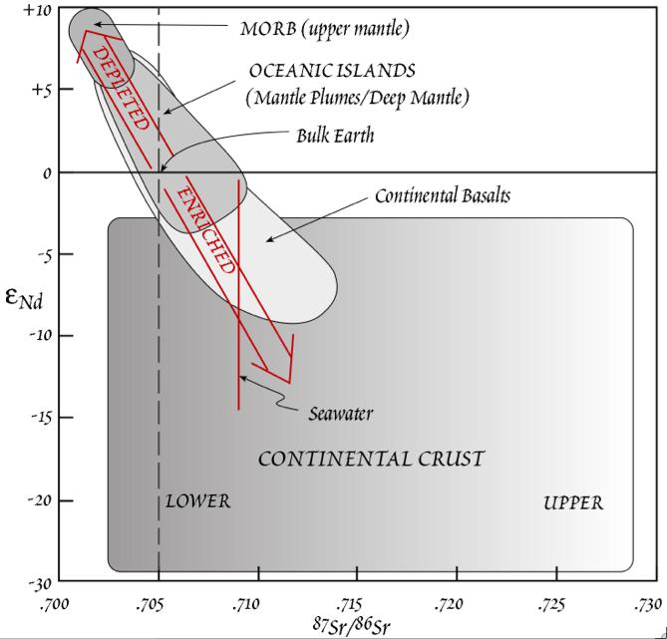
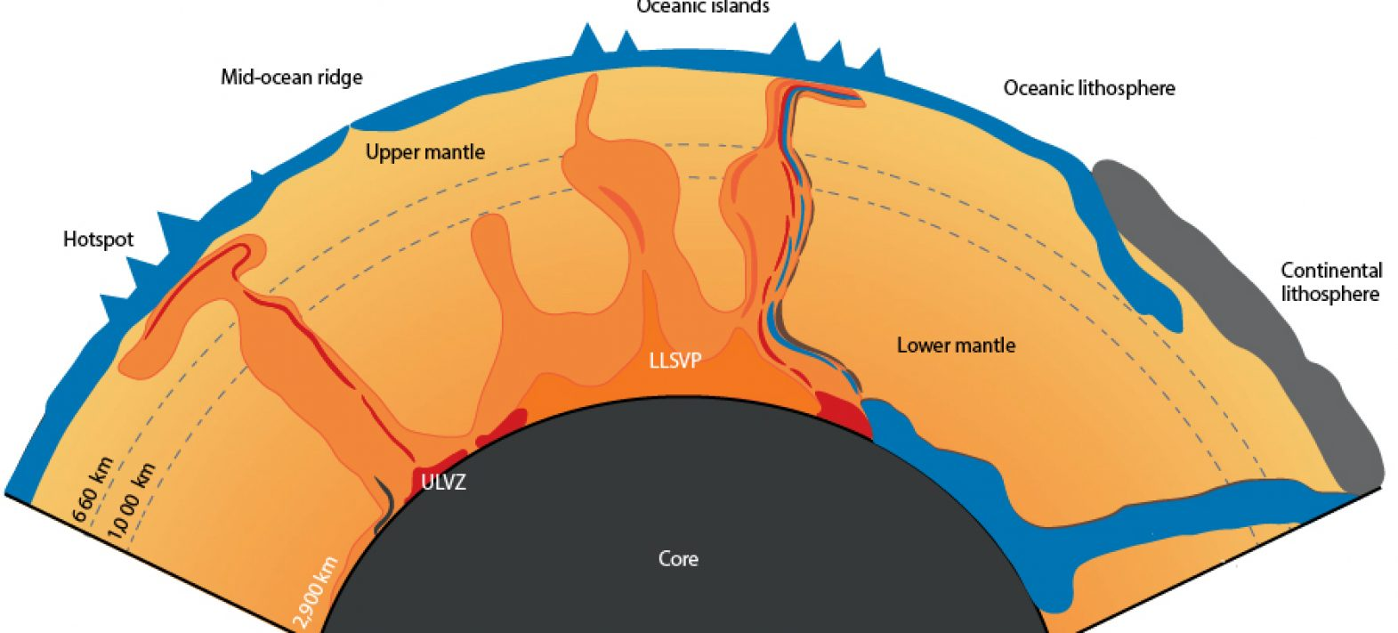

Slide 43
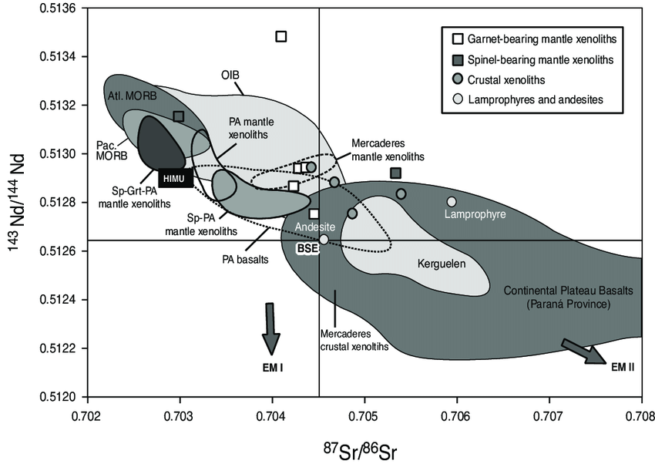
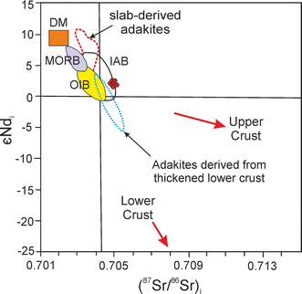

Slide 44
U-Pb Geochronology
U–Pb geochronology is one of the most robust and widely used radiometric dating methods in Earth sciences.
It relies on the decay of uranium isotopes (238U → 206Pb and 235U → 207Pb) in accessory minerals that incorporate uranium but exclude lead during crystallisation.
The technique provides high-precision ages for igneous crystallisation, metamorphic events, and diagenetic processes.

Slide 45
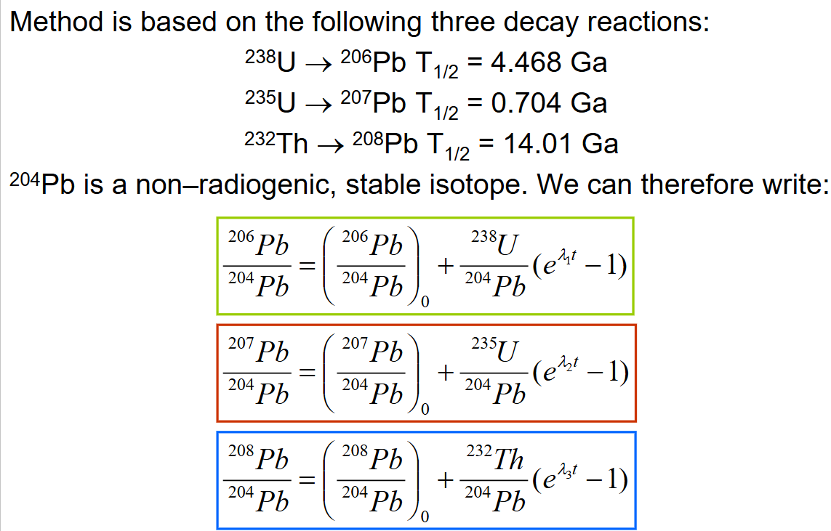

Slide 46
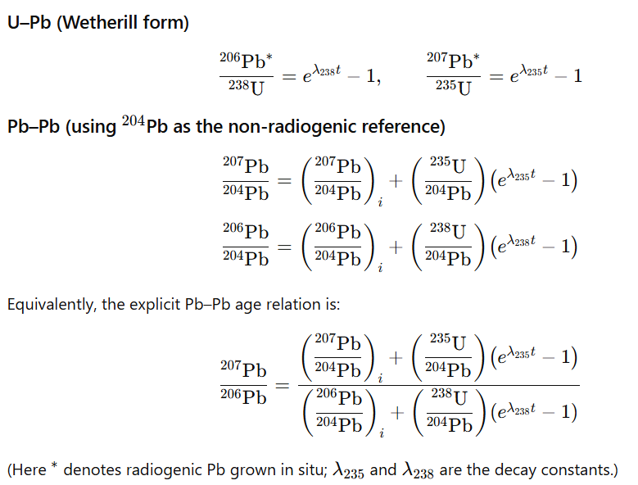

Slide 47




Slide 48



Slide 49


Slide 50


Slide 51






Slide 52



Slide 53


Slide 54



Complex Samples

Slide 55


Slide 56


Slide 57


Slide 58


Slide 59


Slide 60


