Slide 1
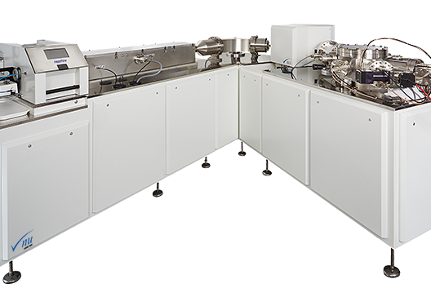
Mass Spectrometry
Cris Lana
Mass spectrometry (MS) is an analytical technique that separates ionized atoms, molecules, or clusters based on the differences in their mass-to-charge ratios (m/z).
This method allows for the determination of isotopes and their abundances.

Slide 2
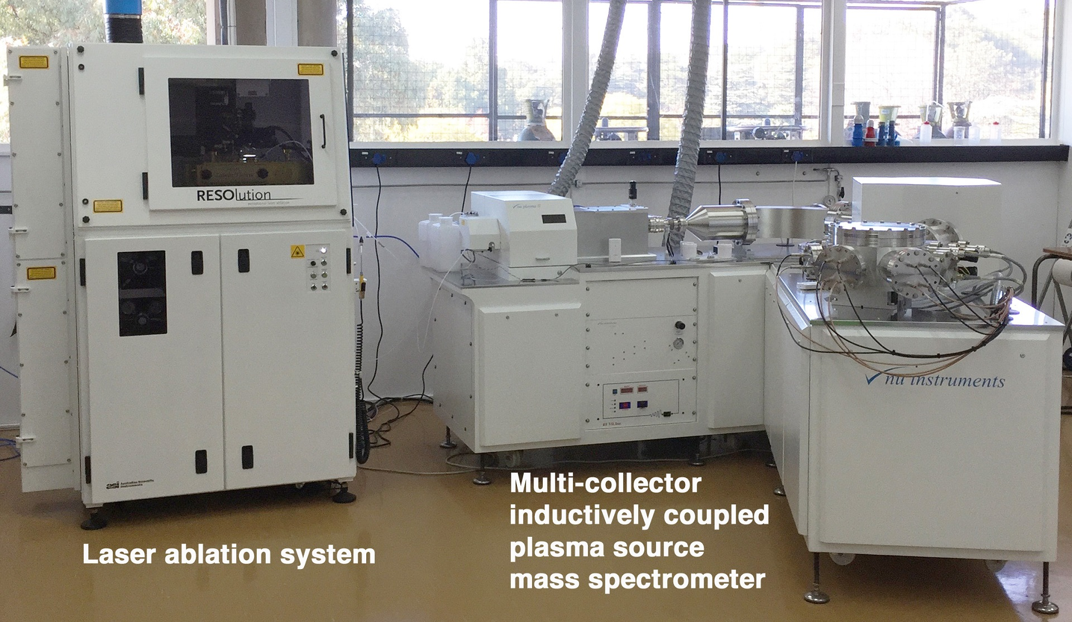
Multi-Collector ICP-MS (MC-ICP-MS)

Slide 3
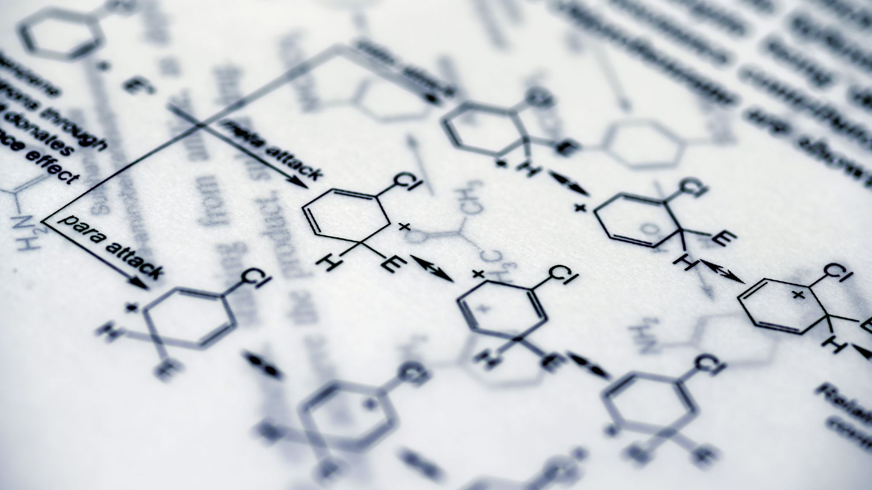
Some Applications
Geochronology: By measuring isotopic ratios of radioactive parent and daughter isotopes (e.g., U-Pb, Rb-Sr systems), researchers can determine the age of rocks, minerals, and meteorites.
Paleoclimatology: The ratios of stable isotopes (e.g., oxygen and carbon isotopes) are used to reconstruct past climate conditions, as isotopic fractionation in natural processes records temperature and environmental changes over time.
Biogeochemistry: Isotopic analyses help trace nutrient cycles in ecosystems, track pollutant sources, and study metabolic pathways in biological systems.
Forensic Science: Isotope ratios can be used to trace the origin of materials, such as food products or drugs, and assist in criminal investigations by linking evidence to specific geographic locations.

Slide 4

IONIZATION TYPES
1. Electron Ionization (EI)
2. Chemical Ionization (CI)
3. Electrospray Ionization (ESI)
4. Matrix-Assisted Laser Desorption/Ionization (MALDI)
5. Inductively Coupled Plasma (ICP) Ionization
6. Photoionization (PI)
7. Fast Atom Bombardment (FAB)
8. Thermal Ionization (TI)
9. Ion Beam Induced Ionization

Slide 5
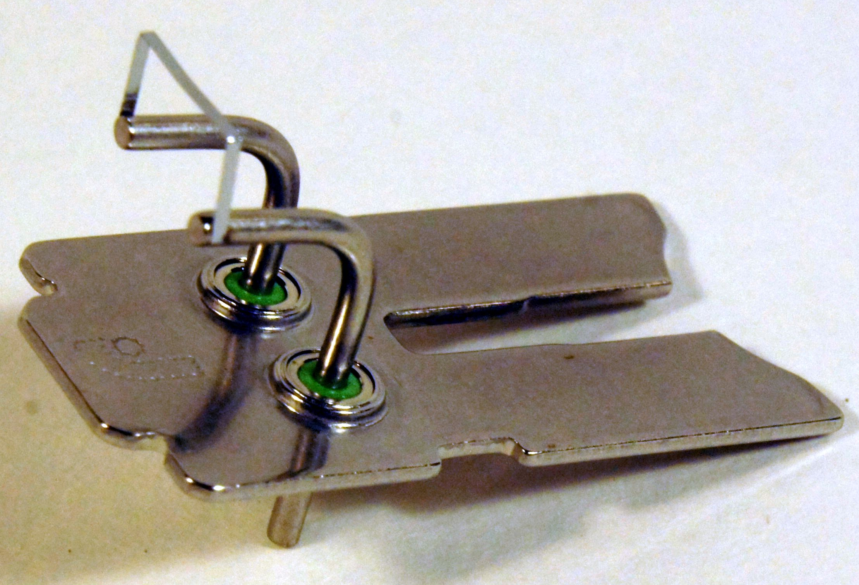
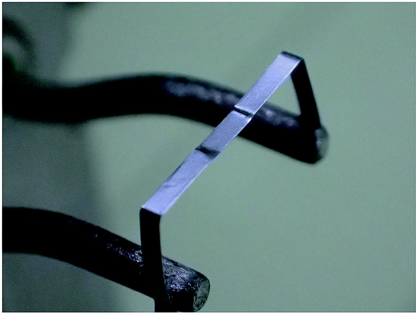
THERMAL IONIZATION
Thermal ionization is a technique used in mass spectrometry to ionize atoms by heating a sample on a metal filament, typically made of materials like rhenium or tantalum.
As the sample is heated to high temperatures, often exceeding 1,500°C, atoms in the sample are vaporized and ionized as they lose or gain electrons.
Thermal ionization is widely used in isotopic ratio studies, such as uranium-lead (U-Pb) and strontium-neodymium (Sr-Nd) dating in geochronology, due to its high precision and sensitivity.

Slide 6
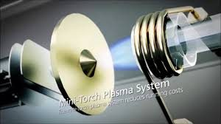
PLASMA IONIZATION
In this method, a sample is introduced into a high-temperature plasma (typically argon), which is generated by an electromagnetic field.
The intense heat of the plasma, reaching temperatures around 9,727°C, causes the sample to atomize and ionize, efficiently converting it into charged particles (ions).
ICP ionization is highly effective for detecting a wide range of elements.

Slide 7
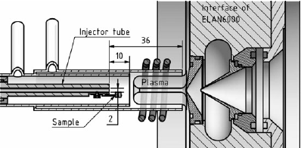
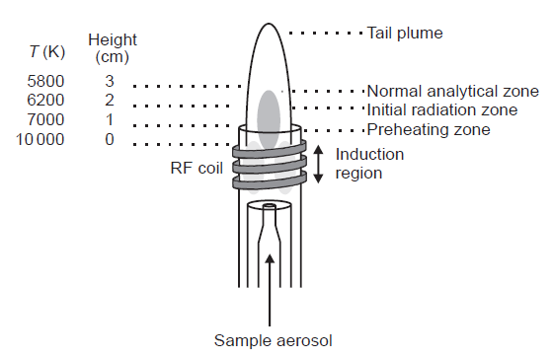
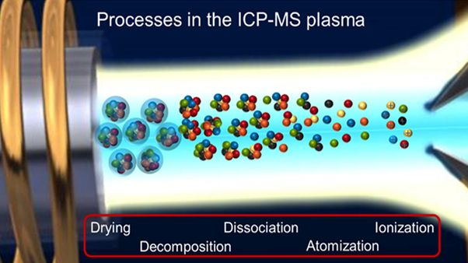

Slide 8
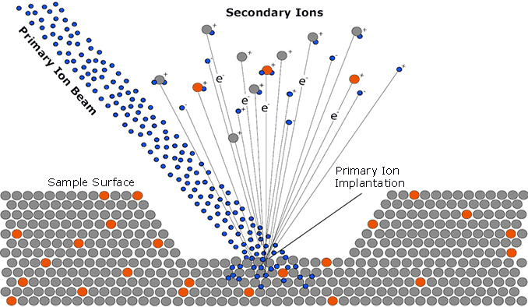
A primary ion beam (e.g. Cs⁺ or O⁻) impacts the sample surface.
The impact creates a collision cascade in the near-surface region.
Atoms and clusters are sputtered from the surface.
A small fraction of sputtered species are emitted as secondary ions (positive or negative).
Electrons are also released during the sputtering process.

Slide 9
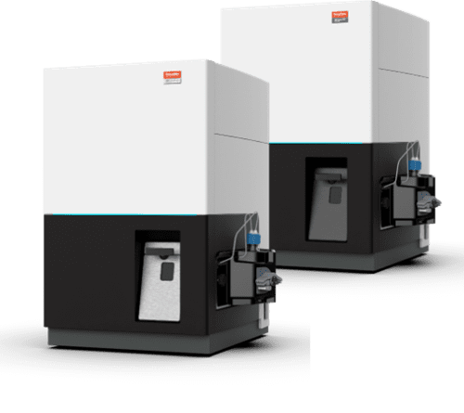
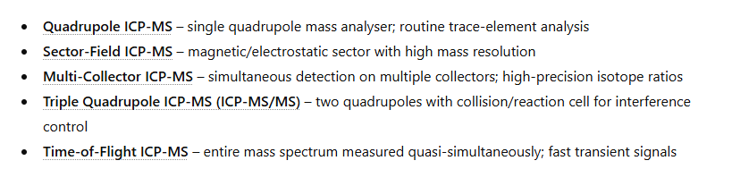
Types of ICP MS

Slide 10
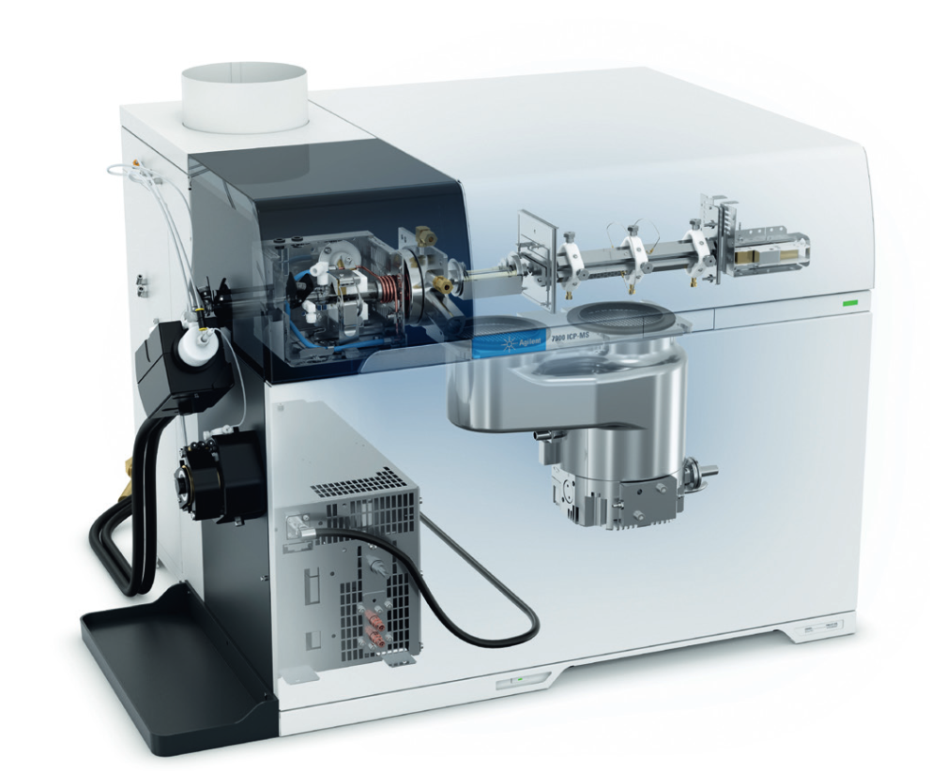
Quadrupole
ICP MS

Slide 11
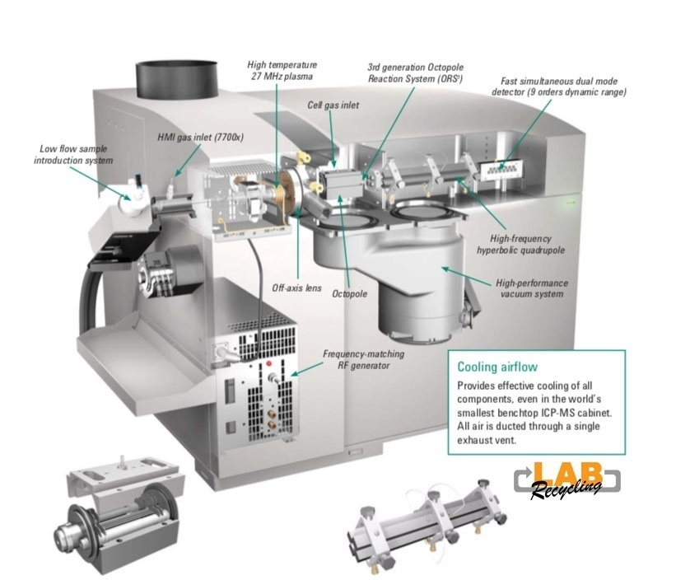

Slide 12
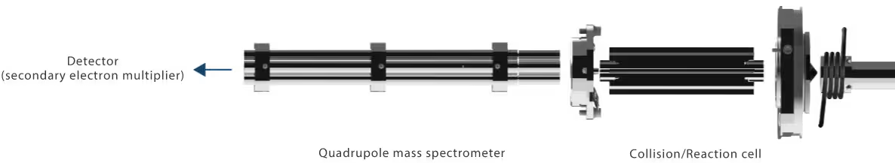
Quadrupole
ICP MS

Slide 13
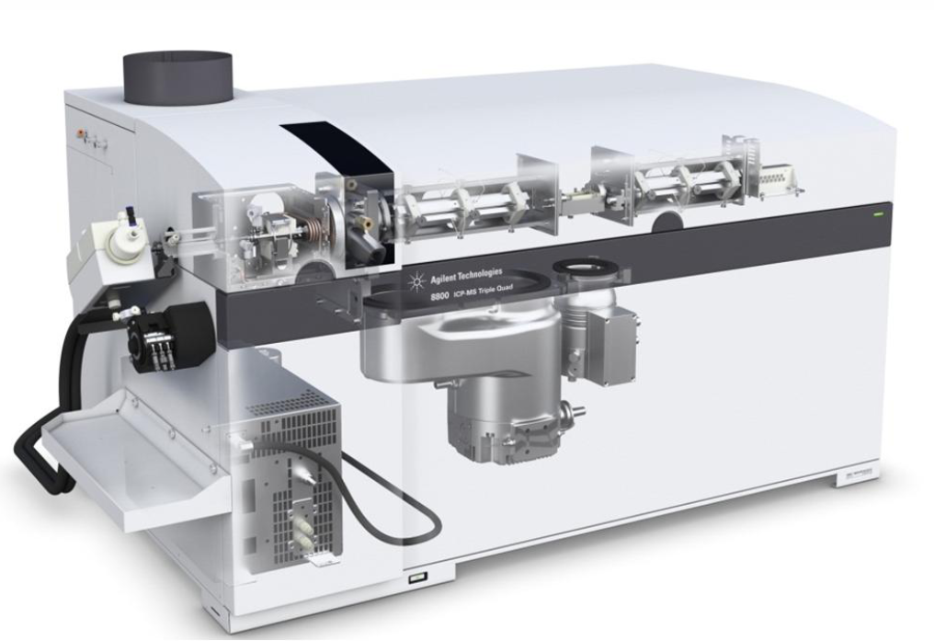
Triple Quadruple ICP-MS

Slide 14
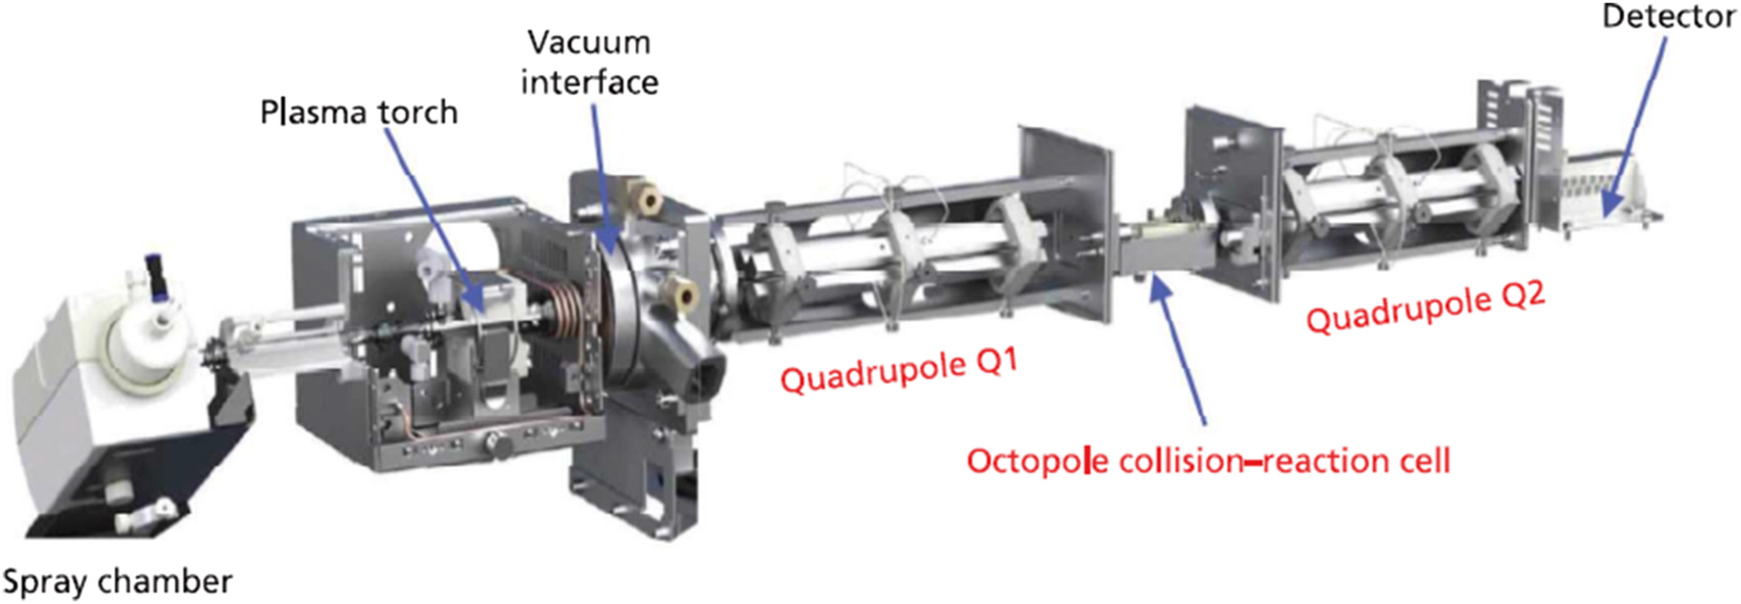
Types of ICP MS

Slide 15
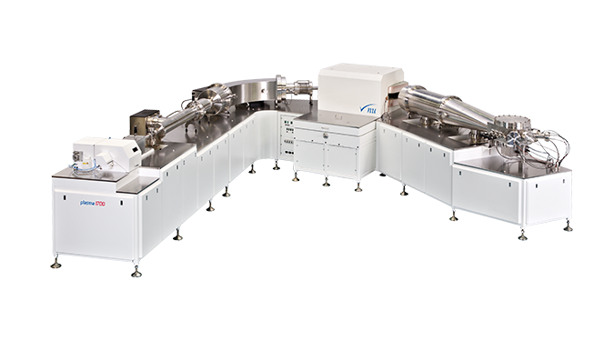
Types of ICP MS
Inductively Coupled Plasma Mass Spectrometer

Slide 16
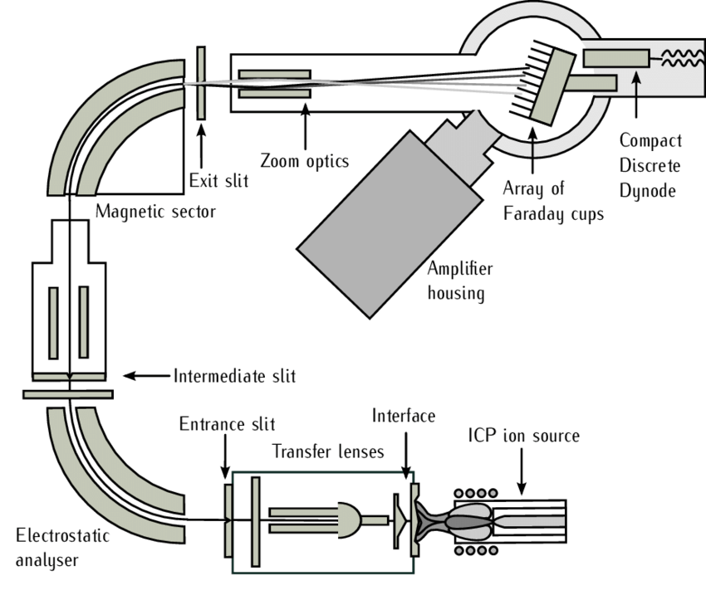
Inductively Coupled Plasma Mass Spectrometer

Slide 17
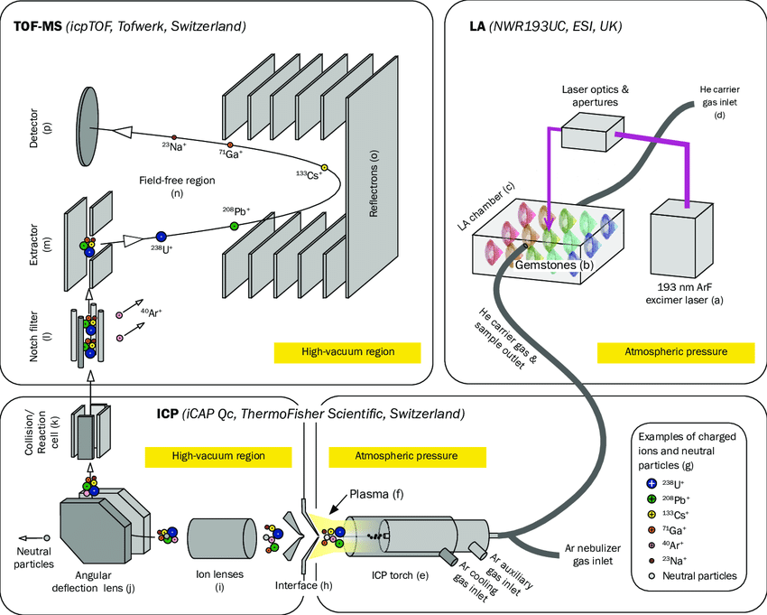
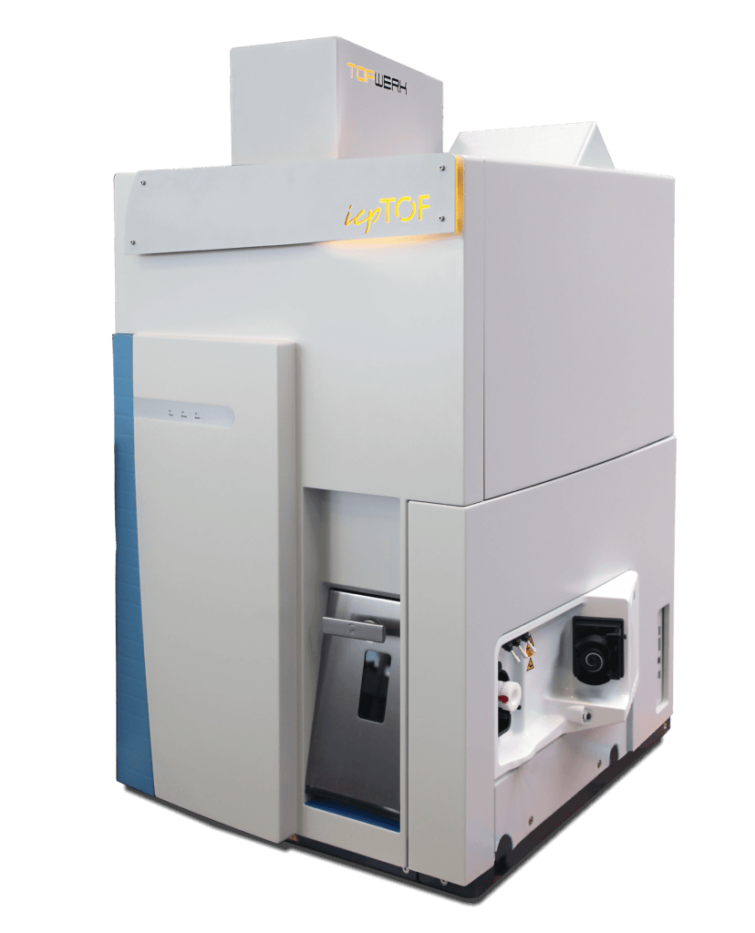

Slide 18
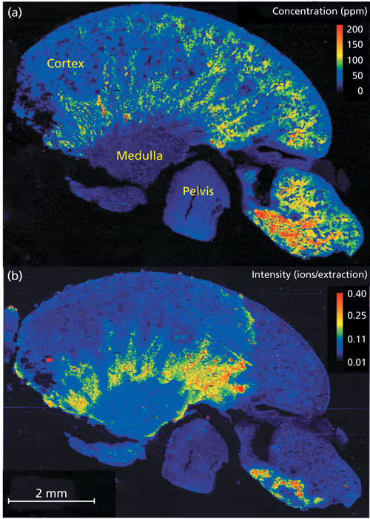
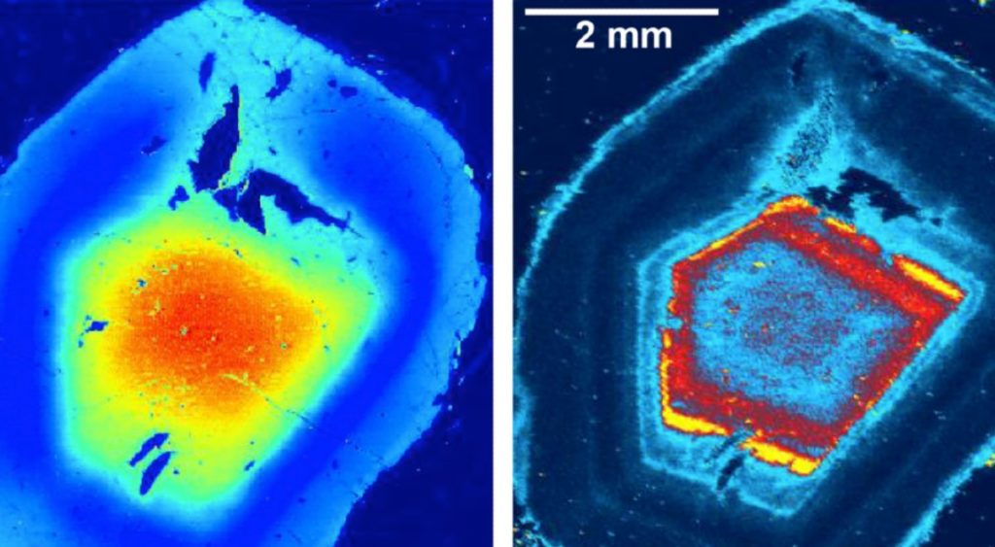

Slide 19
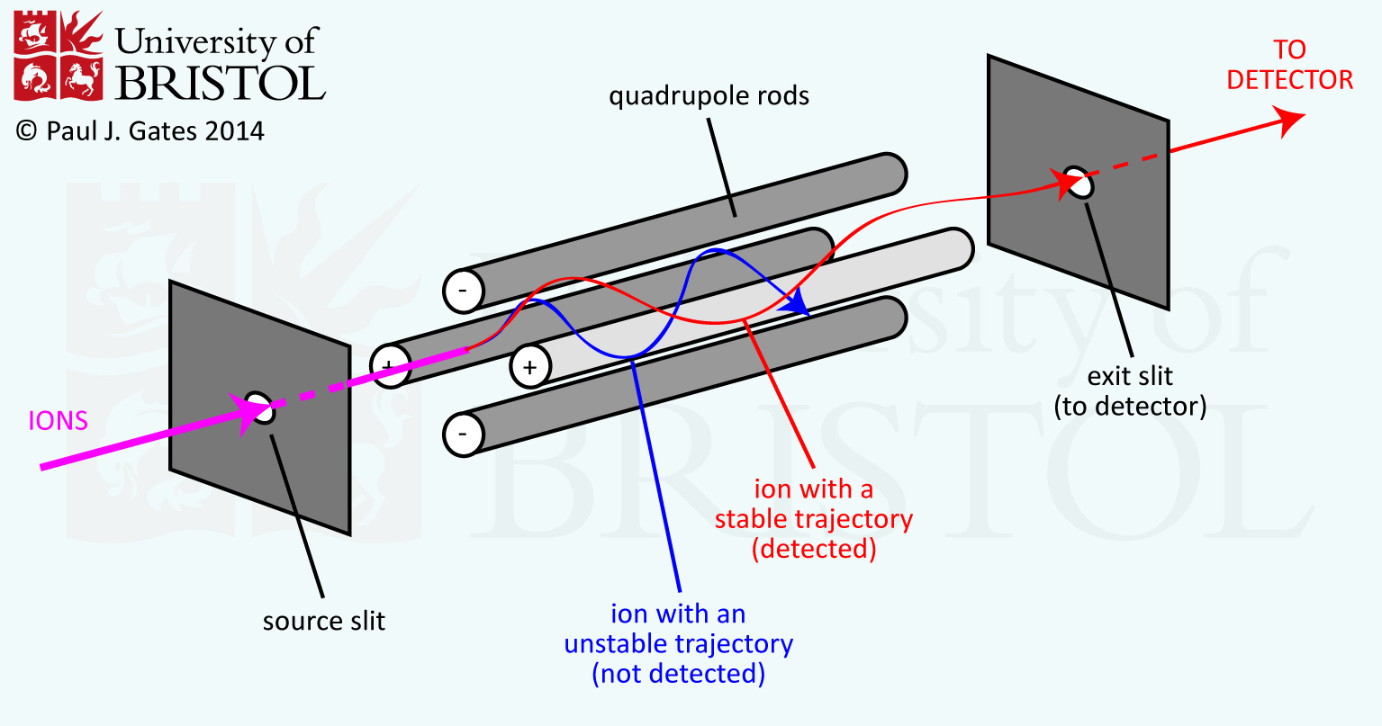
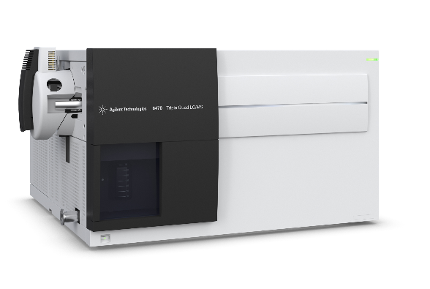
How does it work?
Inductively Coupled Plasma Mass Spectrometer

Slide 20
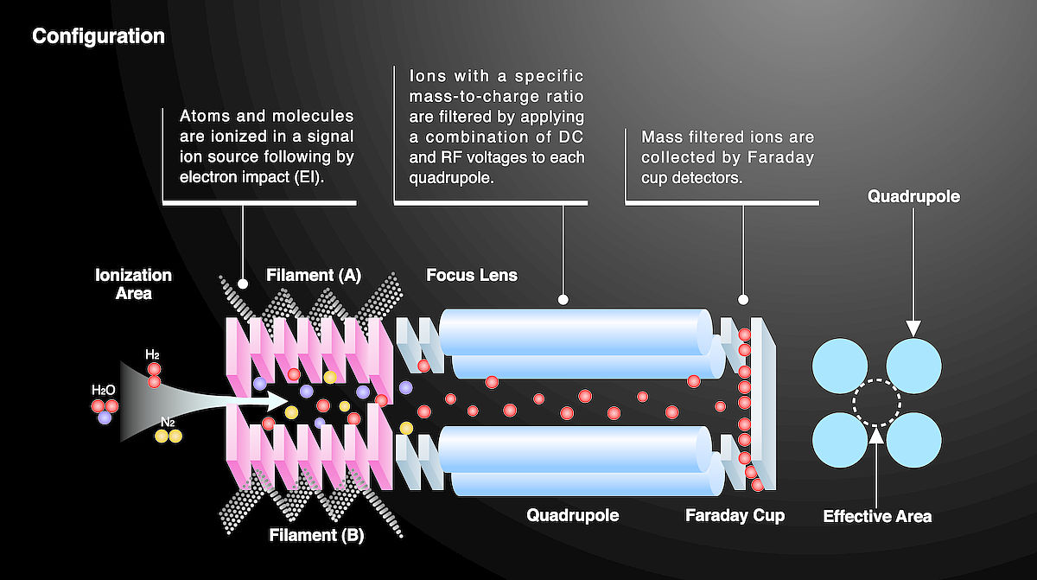
Inductively Coupled Plasma Mass Spectrometer

Slide 21

SIMS and TIMS Geochronology – Theory, Applications, and Data Interpretation

Slide 22
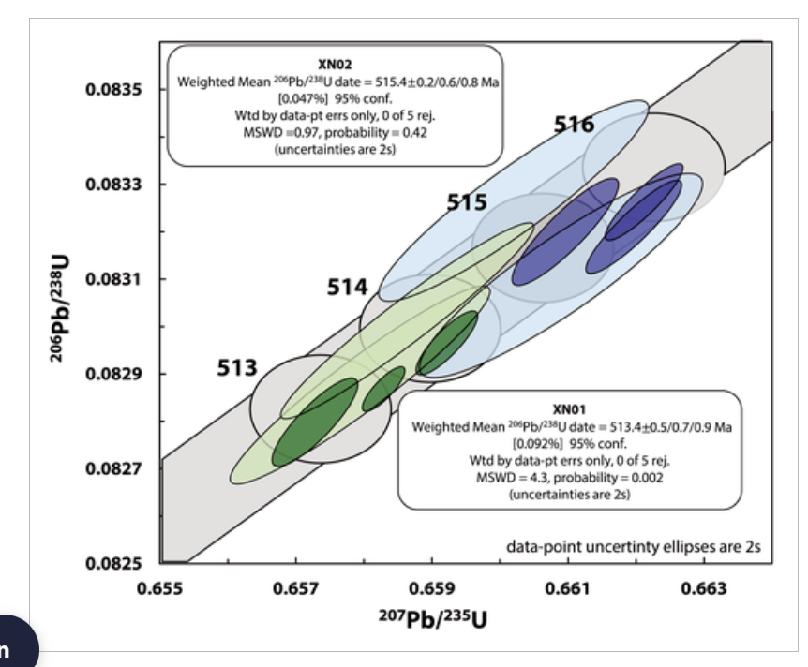
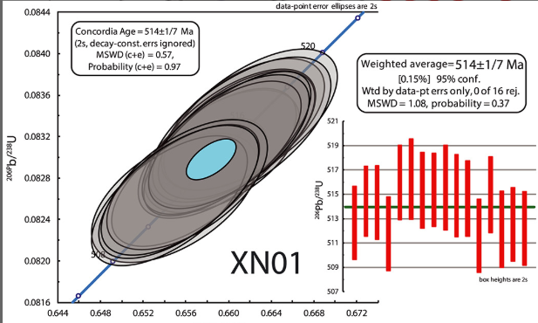

Slide 23
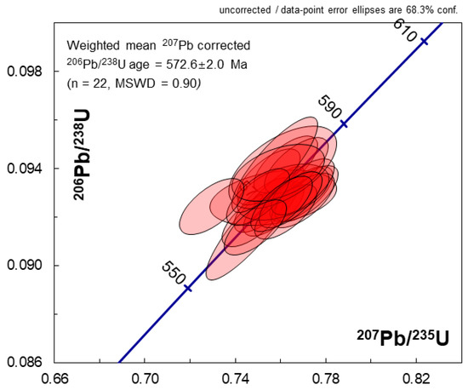
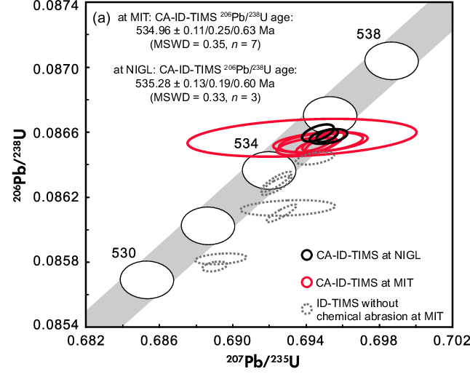

Slide 24
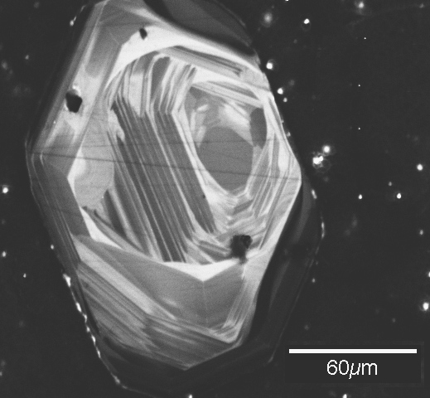
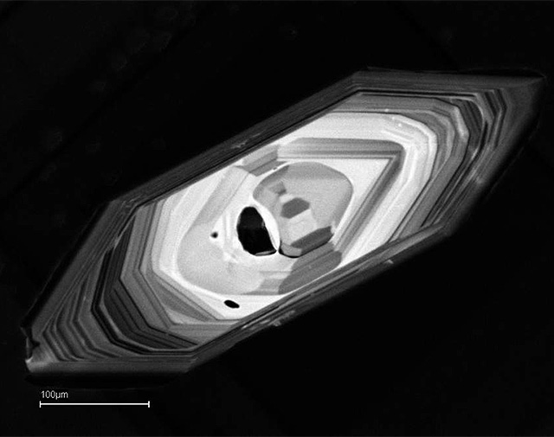

Slide 25
Secondary-ion mass spectrometry (SIMS)
Sensitive High-Resolution Ion Microprobe (SHRIMP)
SHRIMP and SIMS operate under the same principles and produce nearly identical datasets.
Secondary Ion Mass Spectrometry (SIMS) and Sensitive High-Resolution Ion Microprobe (SHRIMP) are both ion microprobe techniques used for in situ isotopic and trace element analysis, particularly in geochronology.
SIMS offers high spatial resolution and is capable of analyzing small domains within minerals, making it ideal for detecting isotopic heterogeneities.
SHRIMP, a specialized type of SIMS, is optimized for U-Pb geochronology. It features a large-radius magnetic sector that enhances precision in measuring isotopic ratios while maintaining moderate spatial resolution.
Though both techniques rely on sputtering a sample with a primary ion beam, SIMS is more versatile for a range of isotope systems, whereas SHRIMP is primarily used for high-precision U-Pb dating in zircon and other accessory minerals.

Slide 26
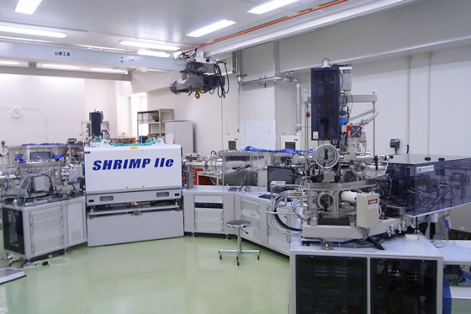
The Birth of SHRIMP (1970s–1980s) Bill Compton & colleagues (1975): Pioneered SIMS U-Pb zircon dating using an early prototype.
William Compston & the ANU group (1978): Developed the first Sensitive High-Resolution Ion Microprobe (SHRIMP) at the Australian National University (ANU).
This instrument had:
A large-radius electrostatic-magnetic sector mass spectrometer for high mass resolution.
A high-intensity oxygen ion beam for effective sputtering of U and Pb from zircons.
The ability to measure U-Pb ages in single zircon domains reduces the need for chemical digestion.
Sensitive High-Resolution Ion Microprobe (SHRIMP)

Slide 27
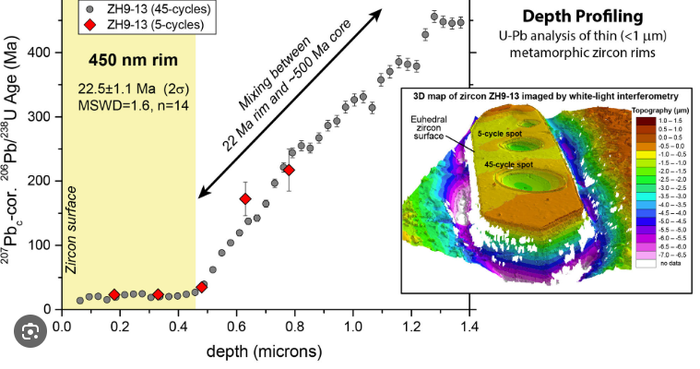

Slide 28
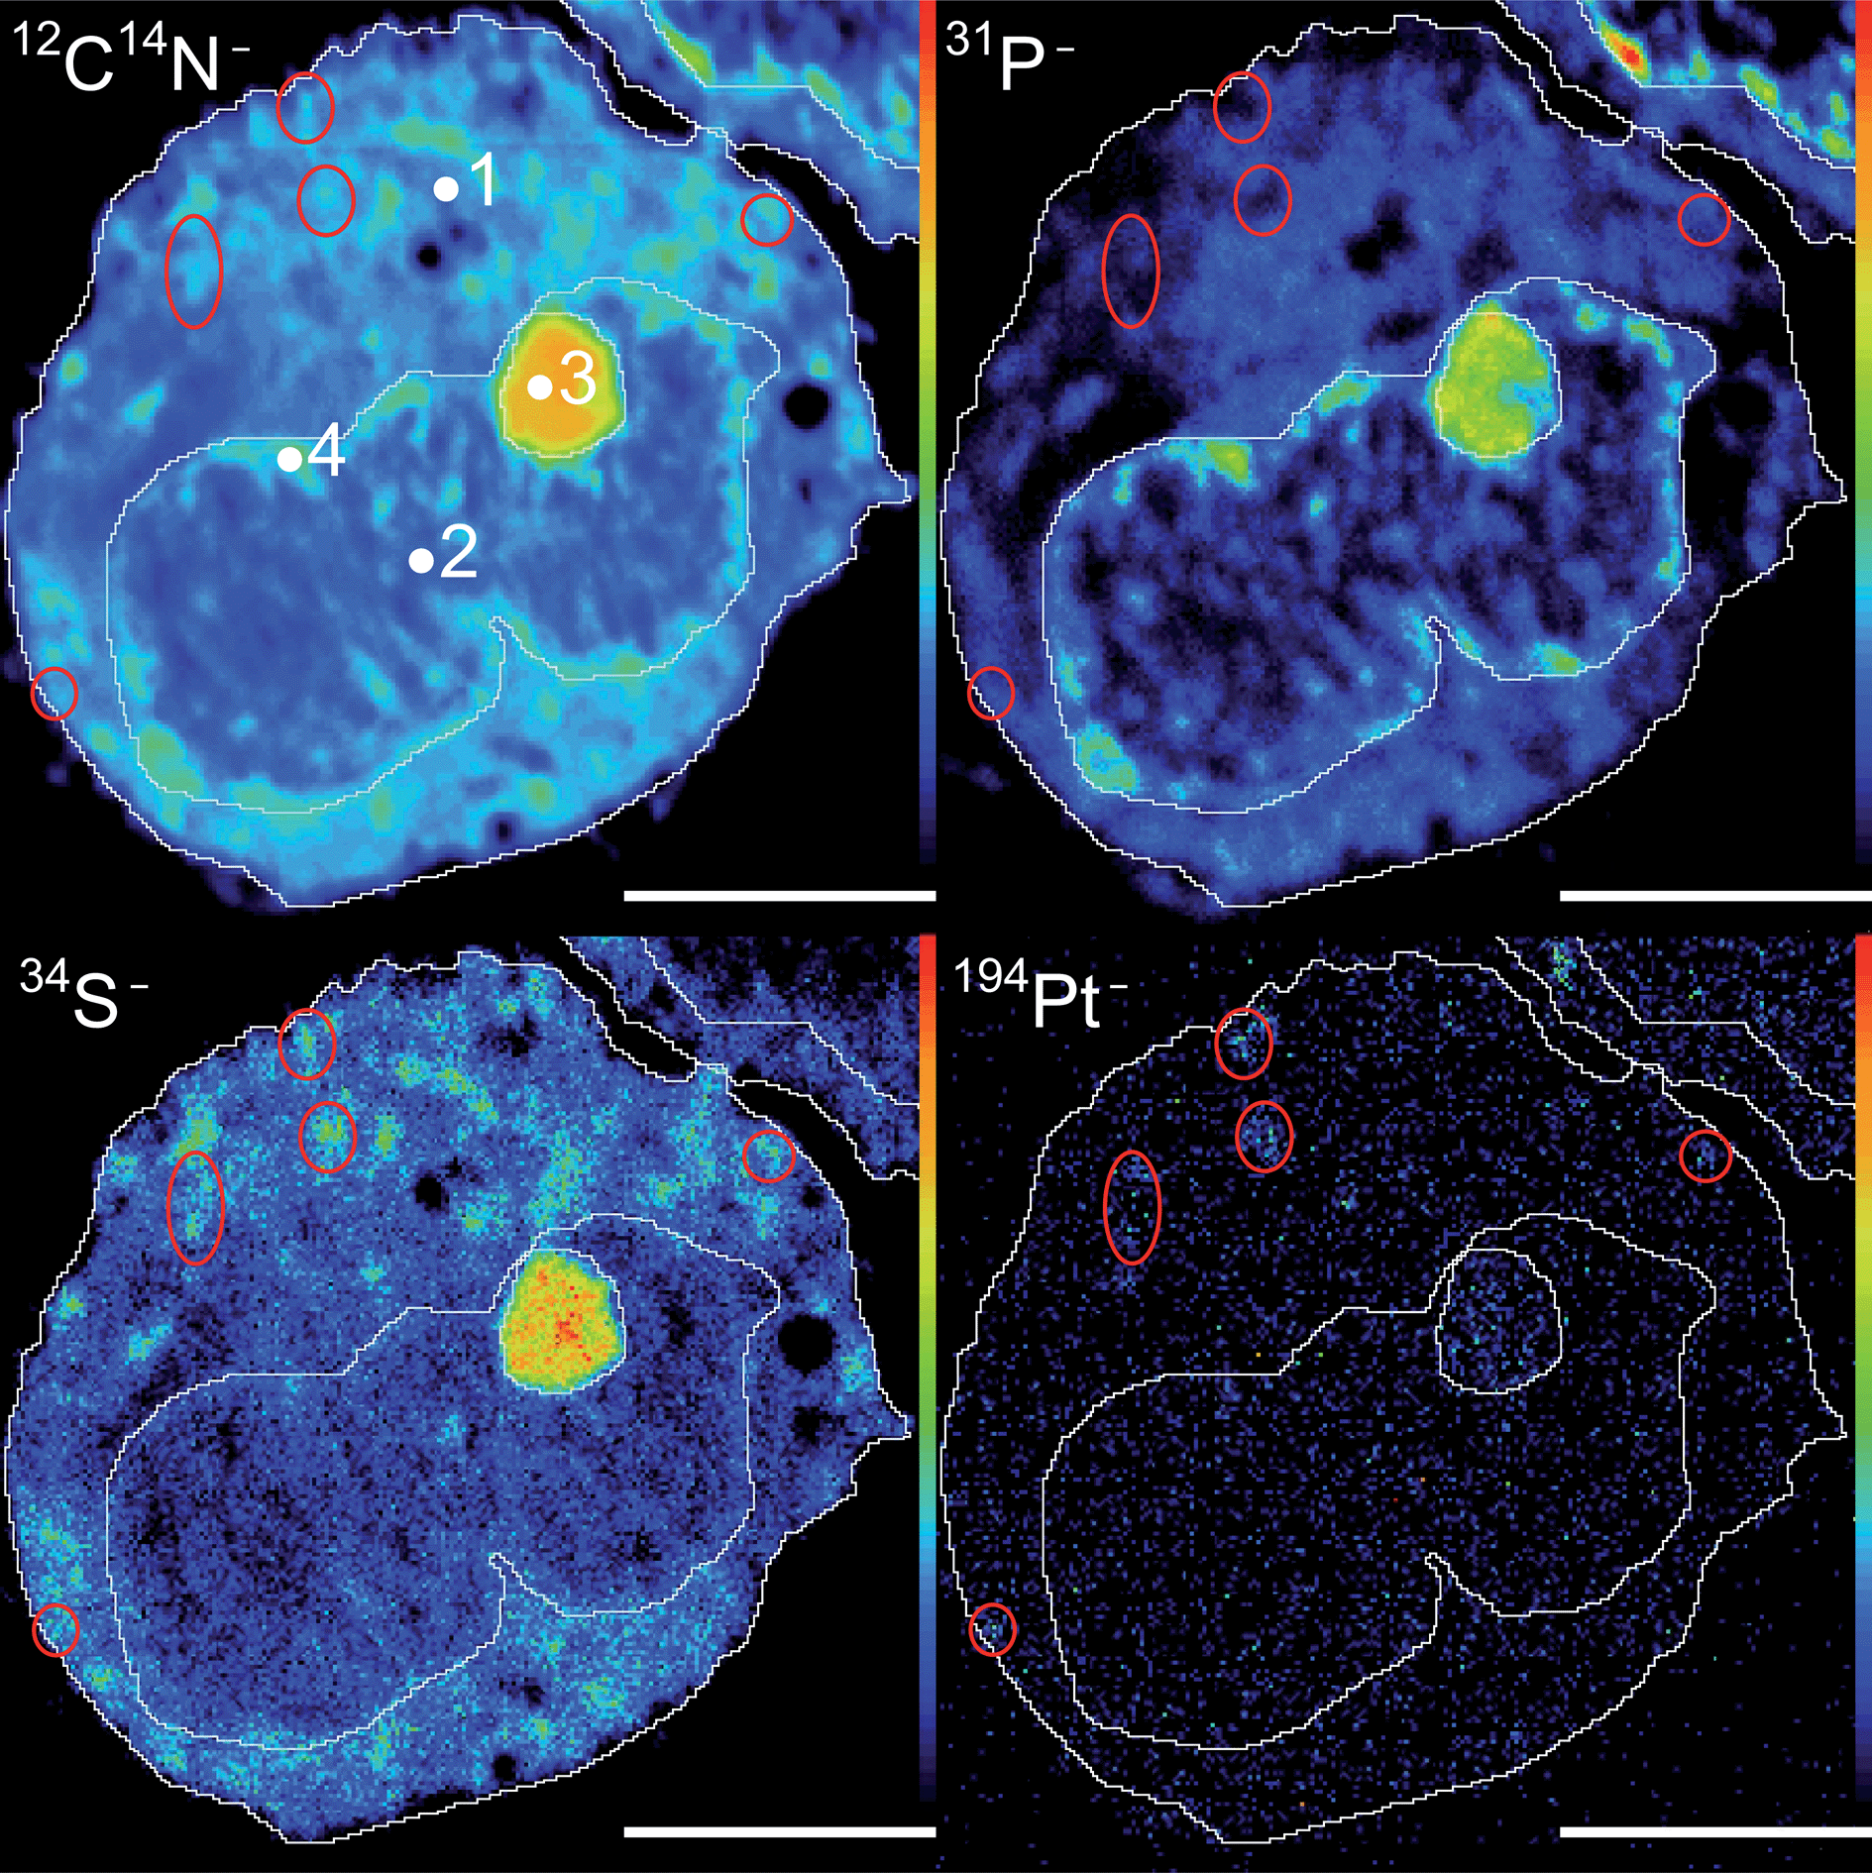
Secondary-ion mass spectrometry (SIMS)
SIMS is a technique used to analyze the composition of solid surfaces and thin films by sputtering the surface of the specimen with a focused primary ion beam and collecting and analyzing ejected secondary ions.
1940s–1950s: The concept of ion sputtering emerged, where primary ions bombarded a sample, releasing secondary ions.

Slide 29
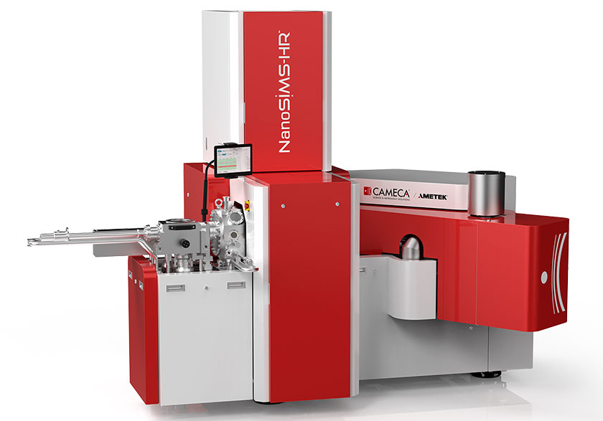
As SIMS technology evolved, the need for even higher spatial resolution and improved sensitivity led to the development of NanoSIMS
It uses a finely focused ion beam to generate detailed elemental and isotopic maps

Slide 30
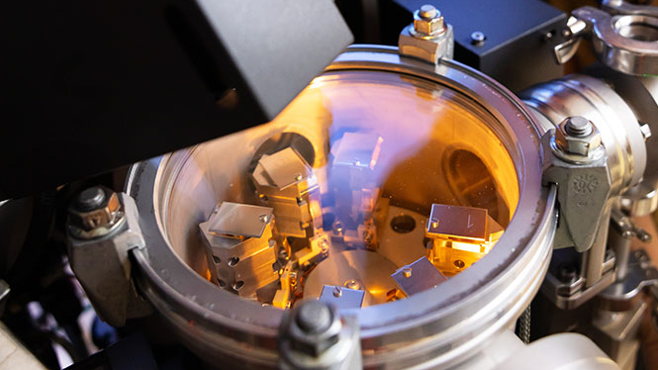

Slide 31
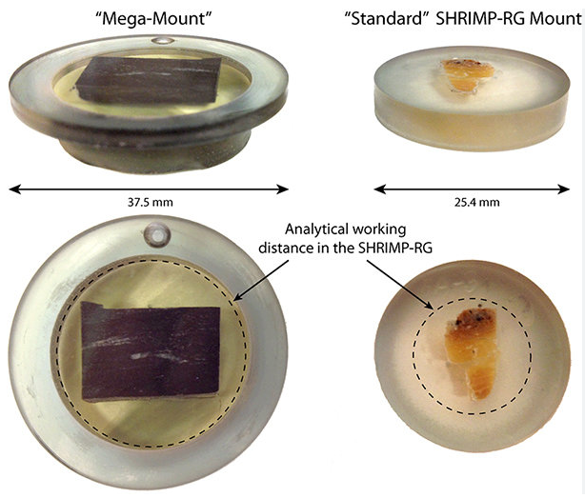

Slide 32
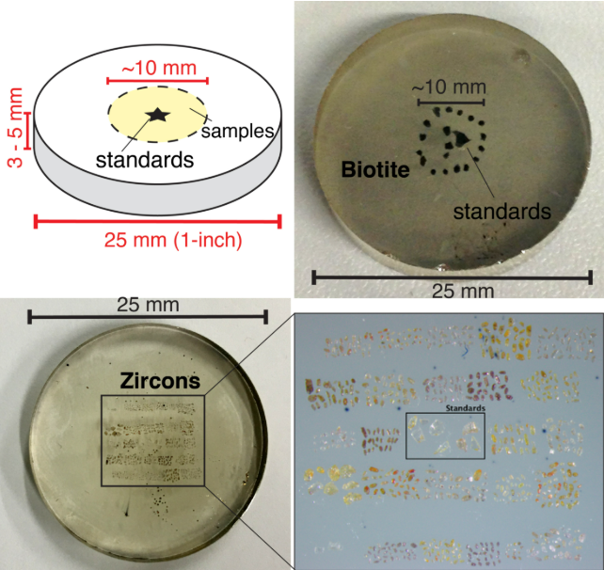

Slide 33
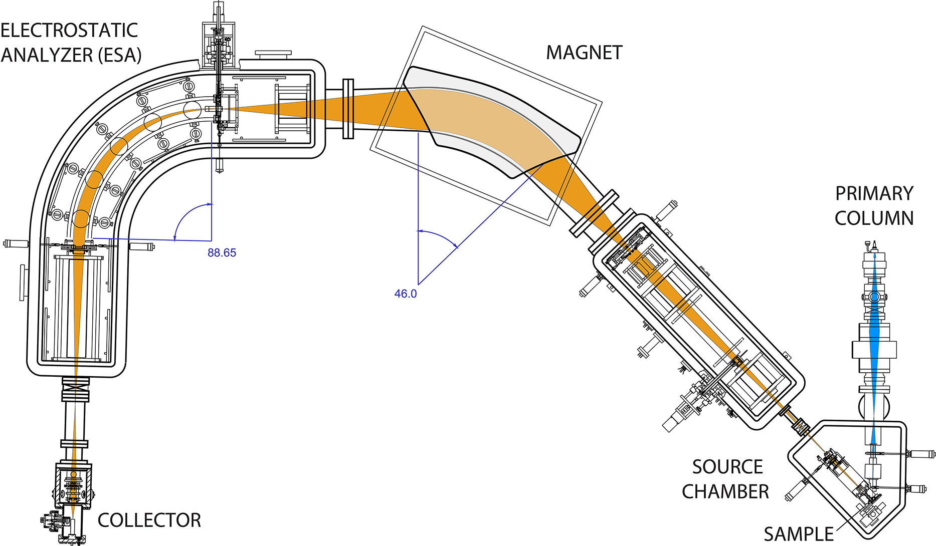
The internal structure and ion optics of the SHRIMP

Slide 34
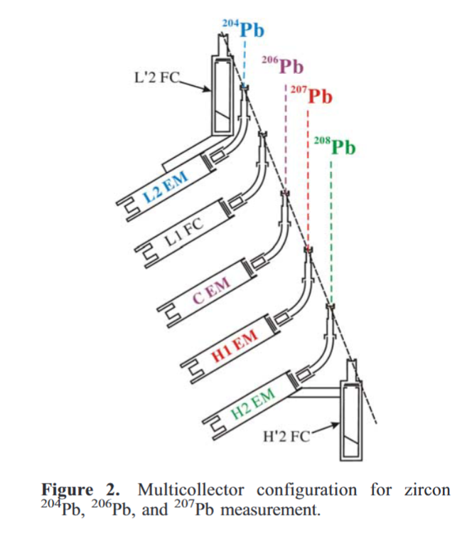
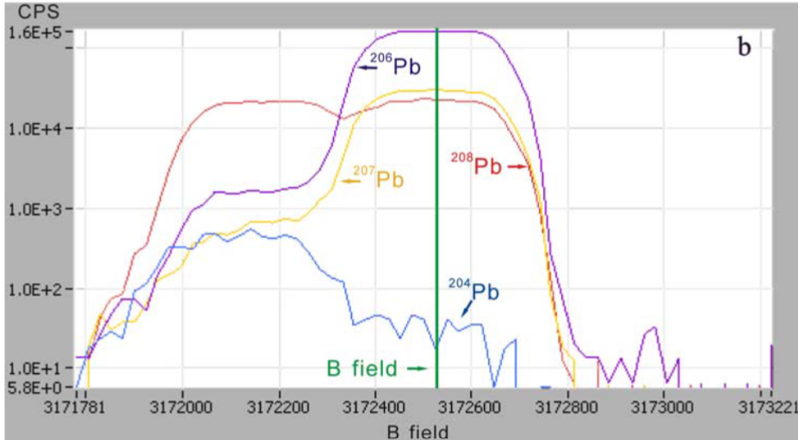

Slide 35

HANDLING DATA

Slide 36
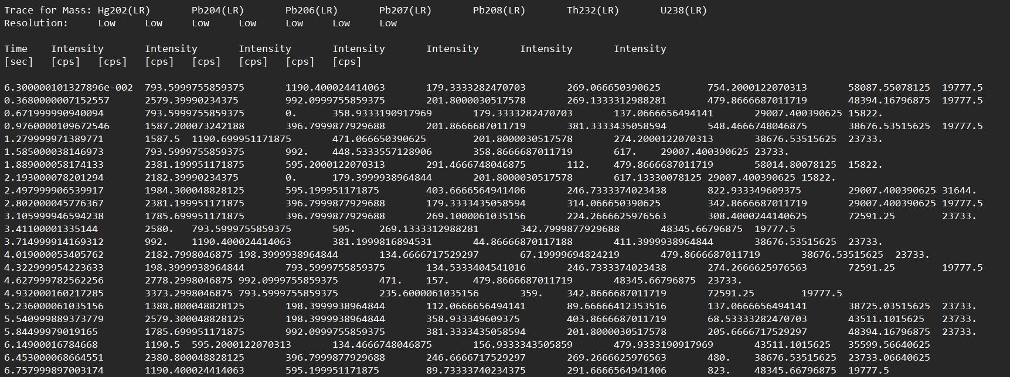
This is what the raw data looks like

Slide 38
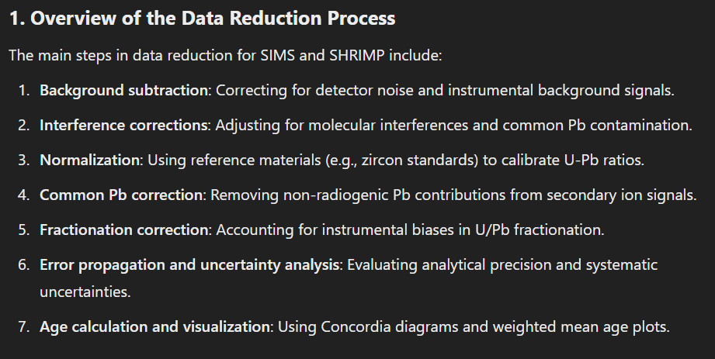

Slide 39
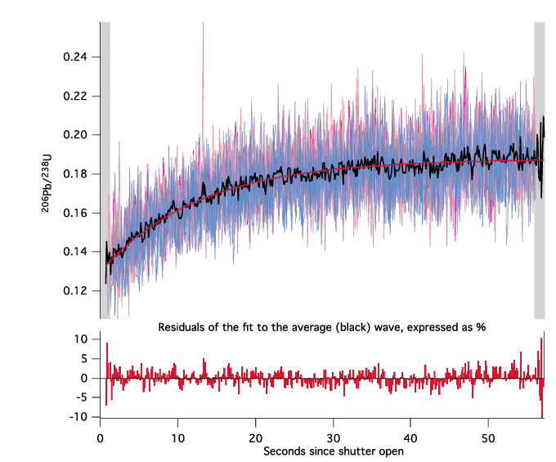
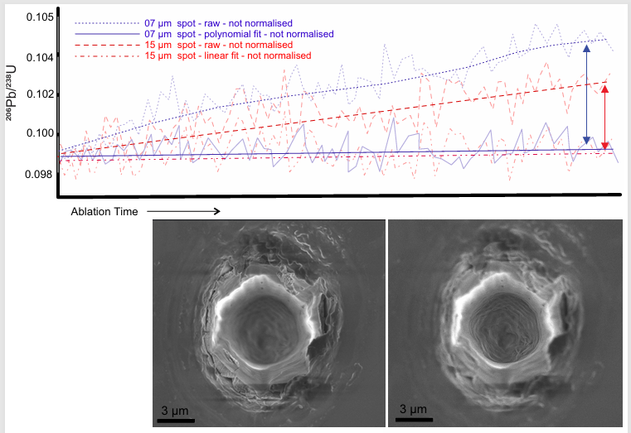
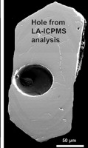
PATONET AL. 2012
LANA & CLEMENS 2025

Slide 40
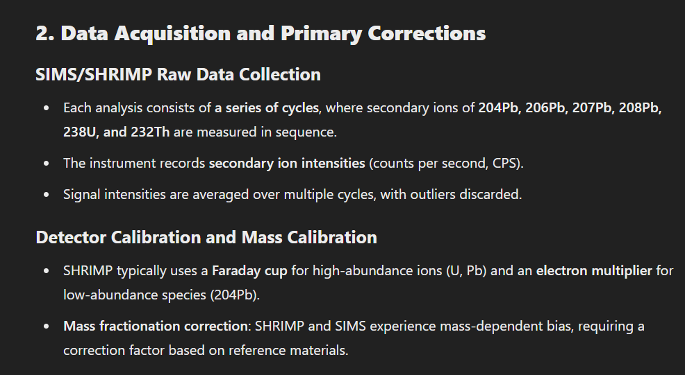

Slide 41
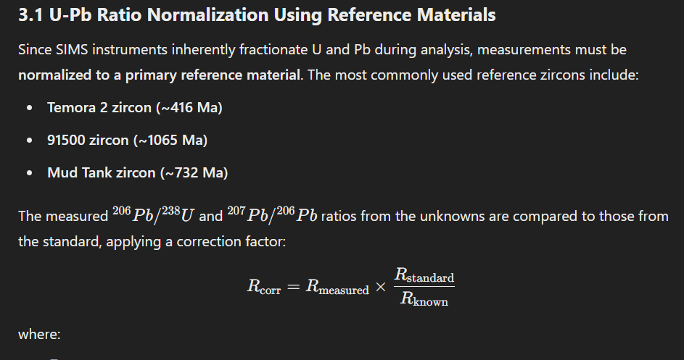

Slide 42
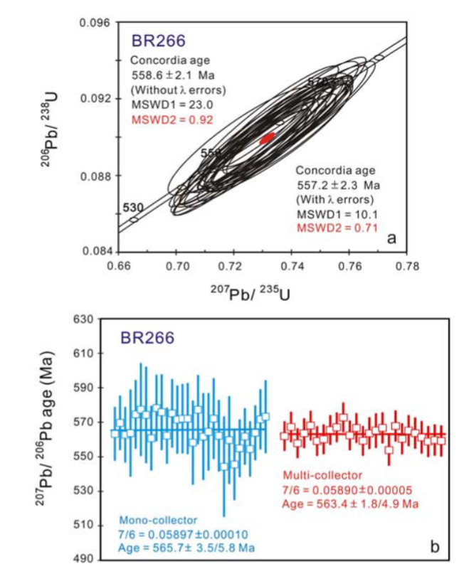


Slide 43


Slide 44



Slide 45


Slide 46




Slide 47


Slide 48

ID TIMS
Isotope dilution thermal ionization mass spectrometry (ID-TIMS) is a technique that uses a thermal ionization mass spectrometer (TIMS) to measure the age of rocks and minerals. It is considered the gold standard of geochronology
Notes:
Isotope Dilution Thermal Ionization Mass Spectrometry (ID-TIMS) remains the gold standard in geochronology due to its unparalleled precision in isotopic measurements.
By utilizing thermal ionization for isotope analysis, this technique provides highly accurate age determinations for rocks and minerals, making it a cornerstone in high-precision geochemistry.
Unlike in situ methods like SIMS and SHRIMP, ID-TIMS requires complete sample digestion but offers superior analytical precision, making it indispensable for absolute age dating

Slide 49

TIMS development: TIMS was developed in the mid-20th century by mass spectrometry pioneers.
ID-TIMS application: ID-TIMS is used to determine the age of minerals, such as zircon, with high precision and accuracy.
ID-TIMS use in geochronology: ID-TIMS is used to determine the age of rocks and minerals, which helps to understand the timing of geological events.
Notes:
Thermal Ionization Mass Spectrometry (TIMS) has played a pivotal role in high-precision isotope geochemistry since its development in the mid-20th century.
The origins of TIMS trace back to the early advancements in mass spectrometry, when researchers sought to improve the accuracy of isotopic measurements.
By the 1950s and 1960s, pioneers in radiogenic isotope geochemistry recognized its potential for dating geological materials, leading to the refinement of isotope dilution techniques and the development of ID-TIMS.
The method gained traction due to its unparalleled precision in U-Pb, Rb-Sr, Sm-Nd, and Pb-Pb dating systems, fundamentally transforming our understanding of Earth's history.
Unlike in situ techniques like SIMS and SHRIMP, TIMS requires complete dissolution of minerals, eliminating matrix effects and ensuring high analytical accuracy. T
Today, ID-TIMS remains the gold standard for absolute age determination, allowing geologists to reconstruct the timing of magmatic, metamorphic, and sedimentary processes with unprecedented detail."

Slide 50



Slide 51


The filaments used are made from tantalum (Ta), tungsten (W), platinum (Pt) or rhenium (Re).
Conventionally, there are two filaments used in TIMS. One filament is for the sample and is called the sample filament.
Subsequently, these evaporated analytes land on the other filament, also known as the ionization filament, where it is ionized.
Two filaments in thermal ionization mass spectrometry
The single filament method is also possible. Once the sample evaporates, the analytes can settle back down onto the same filament to get ionized.

Slide 52
TIMS (Thermal Ionization Mass Spectrometry) is one of the most precise methods for U-Pb, Sr, Nd, Hf, and Pb isotope geochronology.
Unlike SIMS and SHRIMP, TIMS requires chemical separation and total sample digestion, making it a high-precision bulk analysis technique.

Slide 53



Slide 54


Slide 55

U-Pb Separation Using Ion Exchange Chromatography
Step 1: Load the Sample onto the Column, The dissolved sample (in 6N HCl) is pipetted onto the resin bed. U and Pb ions interact with the resin beads.
Step 2: Pb Elution (First Fraction) - Pb does not strongly bind to the resin in HCl and is eluted first. A small amount of 1N HBr or 6N HCl is used to wash out matrix elements. Pb is collected in clean Teflon beakers and dried down for analysis.
Step 3: U Retention and Elution (Second Fraction) - U forms strong anionic complexes (UO₂Cl₄²⁻) in HCl, binding strongly to the resin. To elute U, a reducing agent (e.g., H₂O₂ or HNO₃) is used to change U to a neutral state. U is then collected in a separate fraction.

Slide 56


Slide 57
HANDLING DATA

Slide 58


Slide 59


Slide 60




Slide 61



Slide 62




Slide 63


