Slide 1
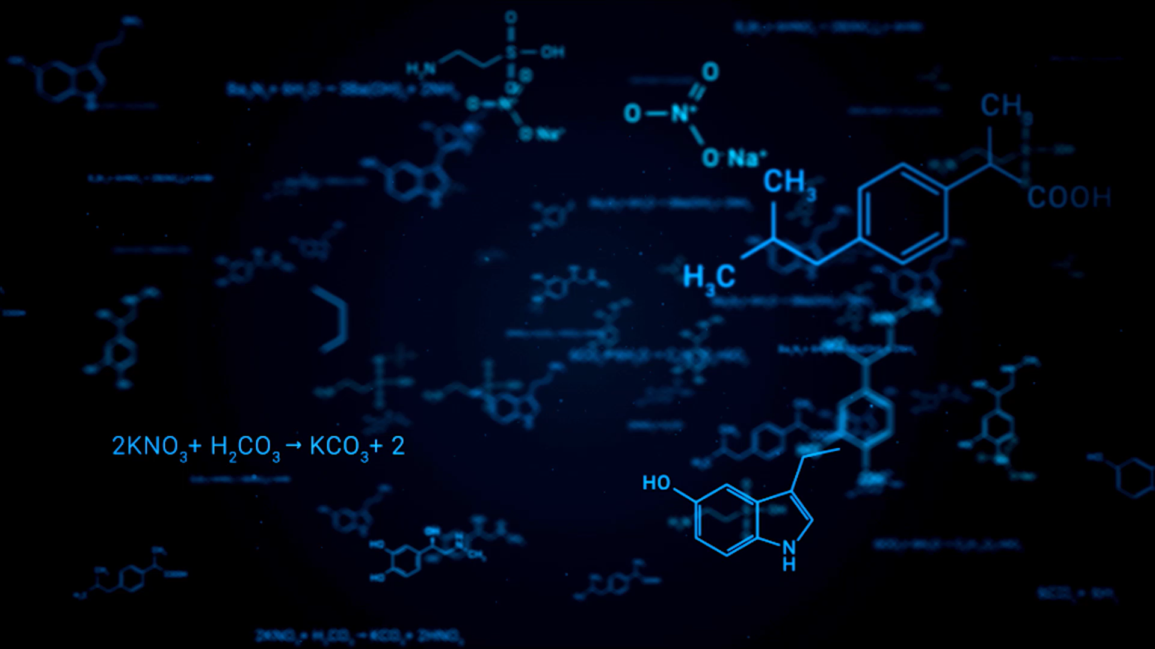
Stable Isotopes
Cris Lana

Slide 2
What are stable Isotopes?
They do not decay over time.
They are energetically stable and remain “unchanged” in nature.
Common examples:
¹²C and ¹³C (Carbon isotopes)
¹⁶O, ¹⁷O, and ¹⁸O (Oxygen isotopes)
¹H and ²H (Deuterium)
.

Slide 3
Used to study biological, environmental, and geological processes through isotopic fractionation
What are stable Isotopes?
Their ratios (e.g. ¹³C/ ¹²C) vary in predictable ways depending on temperature, metabolism, and environment.
Stable isotopes act as natural tracers — they record physical, chemical, and biological processes.

Slide 4
Why Are Stable Isotopes Important?
By measuring isotope ratios, scientists can:
Reconstruct past climates (ice cores, shells, fossils).
Trace sources of water or nutrients in ecosystems.
Study food webs and diet in modern and ancient organisms.
Identify diagenetic or metamorphic changes in rocks and minerals.

Slide 5
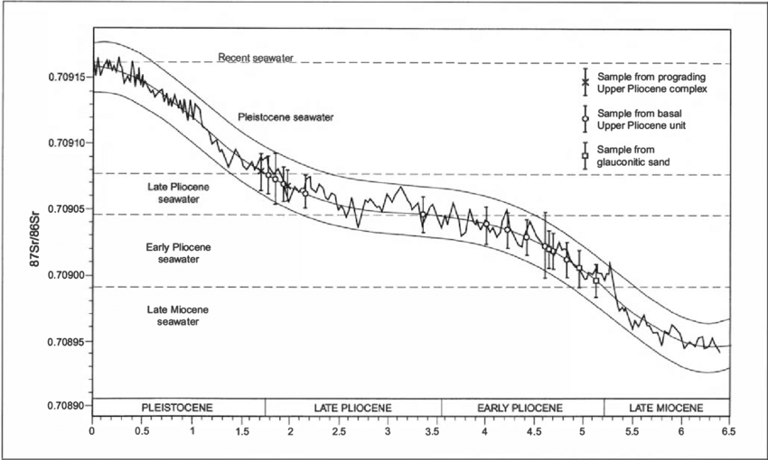
Stable isotopes are powerful tools for understanding Earth’s systems through time.

Slide 6
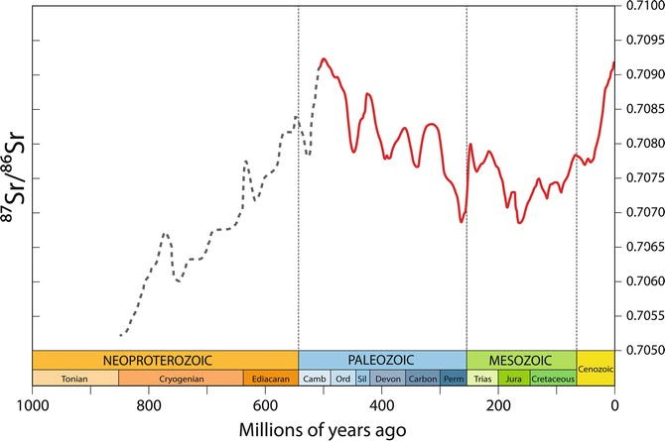

Slide 7
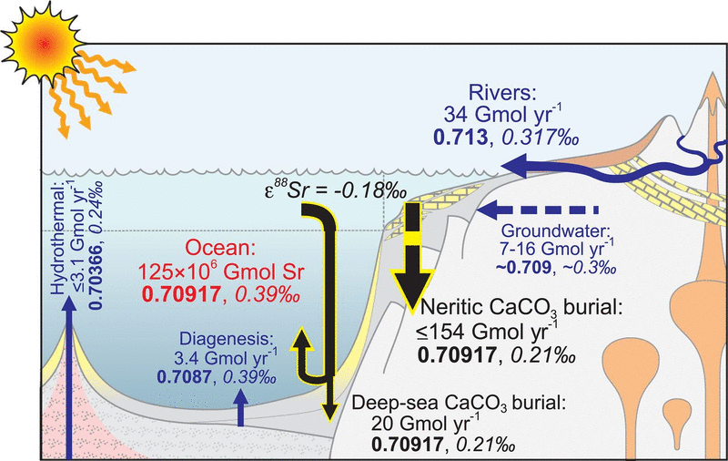
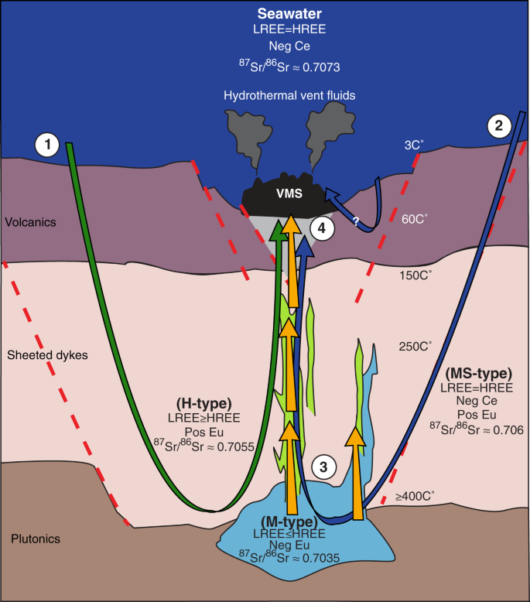

Slide 8
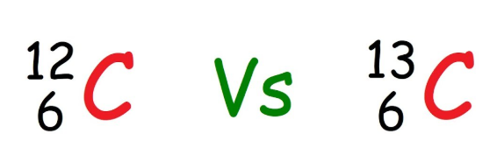
Isotopes behave chemically almost identically.
BUT their physical properties (mass, diffusion, reaction rates) differ slightly — leading to isotopic fractionation.
Understanding Fractionation = Understanding Chemical Processes
What is Fractionation then?

Slide 9
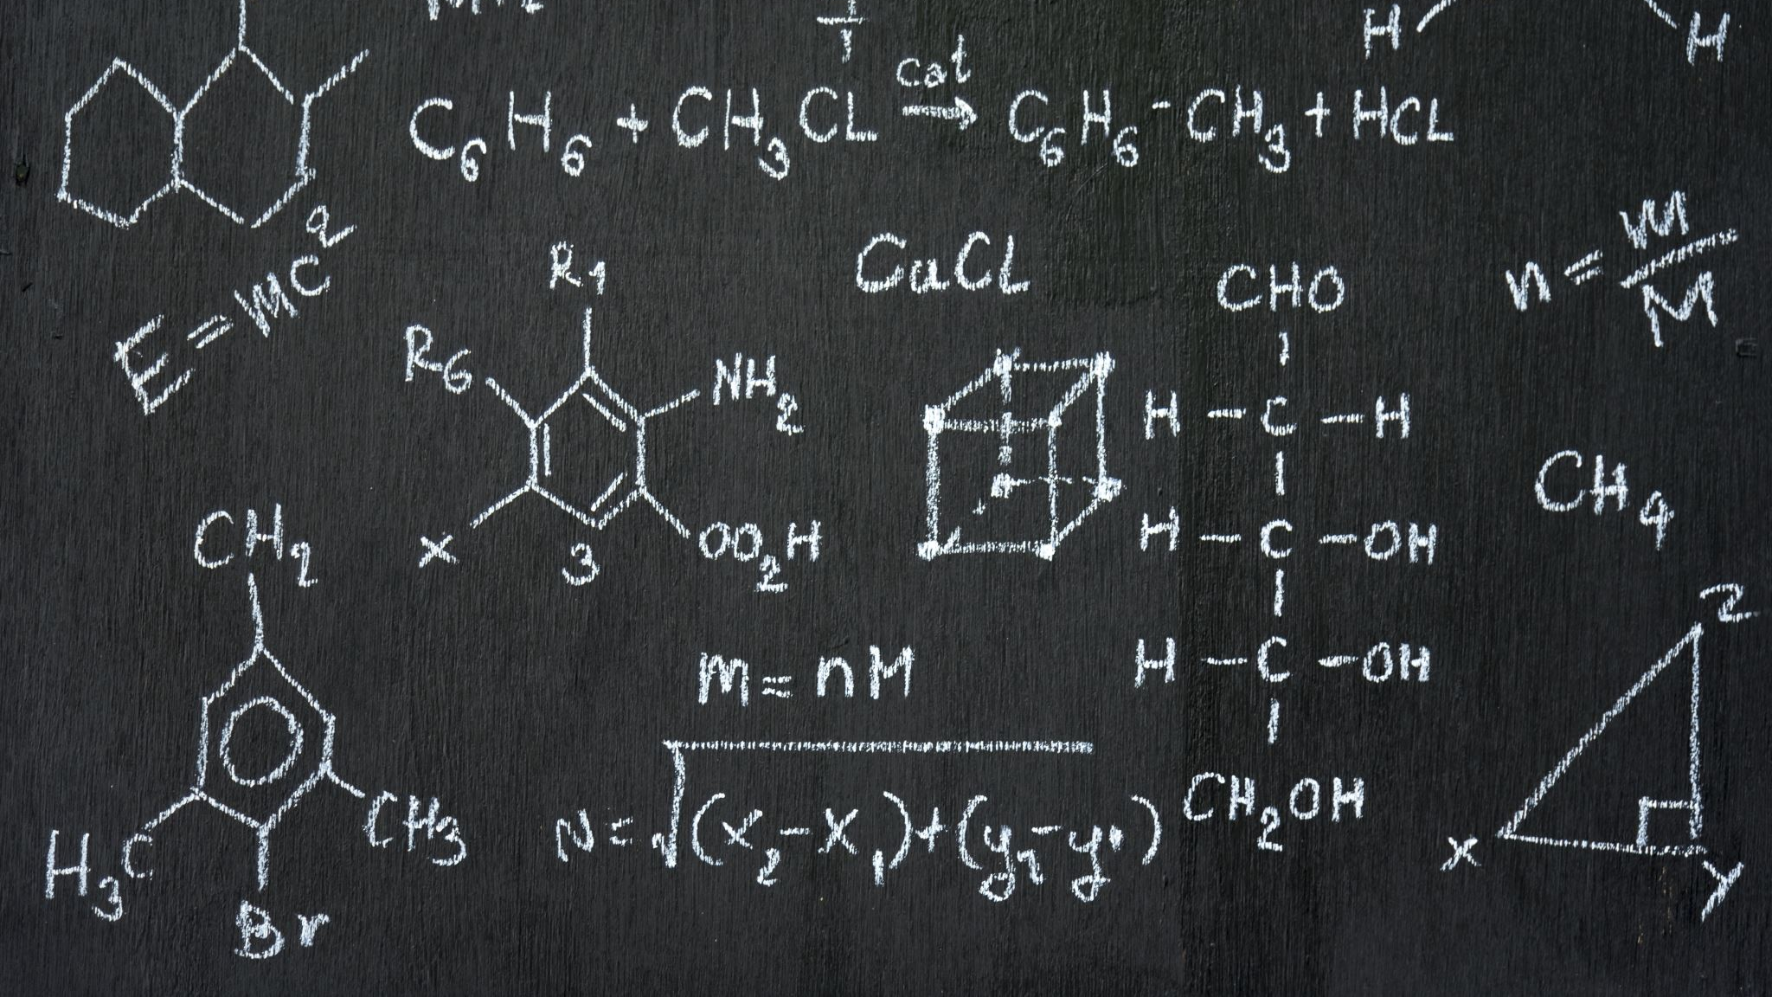
Fractionation?
We will see:
1) What is fractionation
2) Types of fractionation
3) How to work with fractionation

Slide 10
Fractionation
¹²C and ¹³C are both carbon — same number of protons and electrons, so they form the same chemical compounds.
But the extra neutron in ¹³C makes it heavier — this subtle difference changes how fast they react, diffuse, or evaporate. Those small differences are what we call isotopic fractionation — and they tell us about how natural systems work
Lighter isotopes form weaker bonds → react faster (kinetic effects)
Heavier isotopes prefer condensed phases (equilibrium effects)

Slide 11
Fractionation occurs during phase changes, reactions, and biological processes

Slide 12
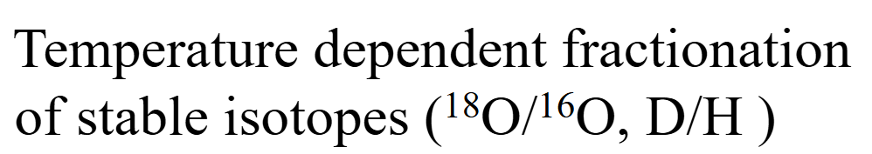
How does it work?

Slide 13
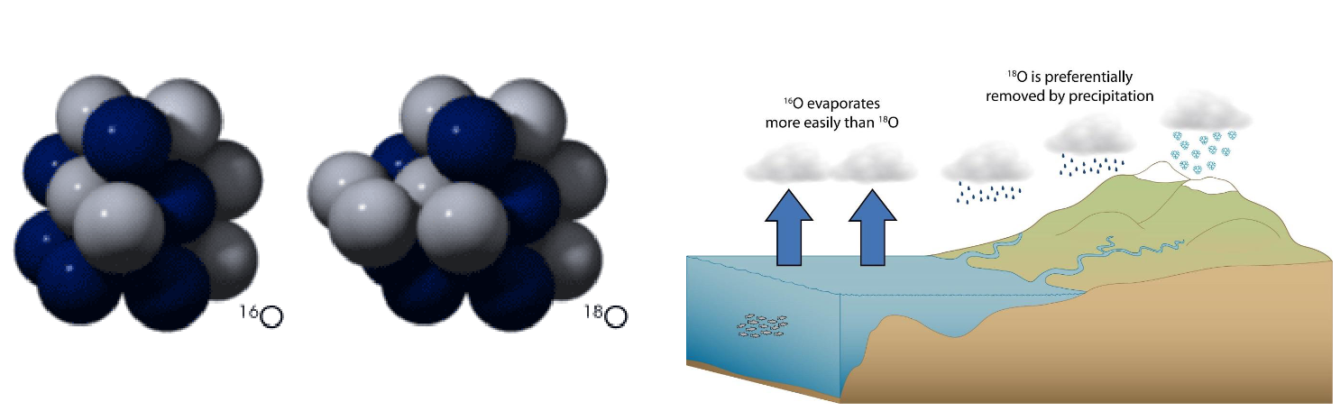

Slide 14
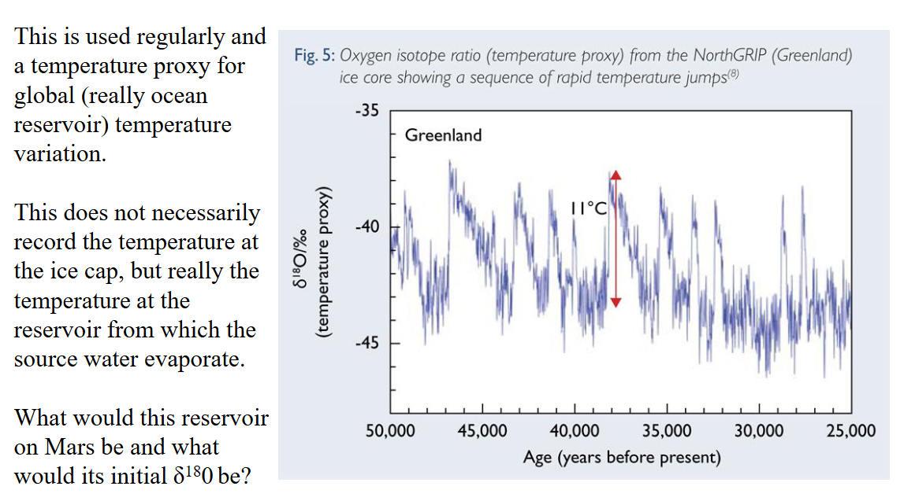
How can we generate this type of data?

Slide 15
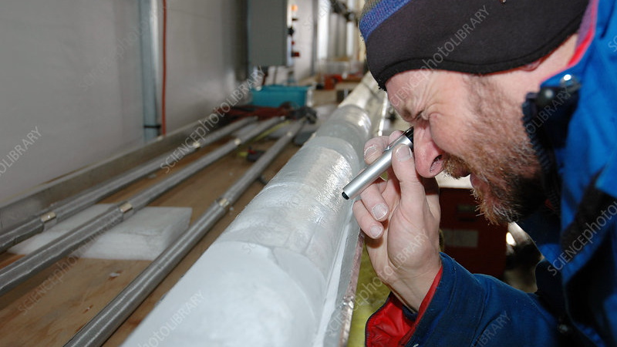

Slide 16
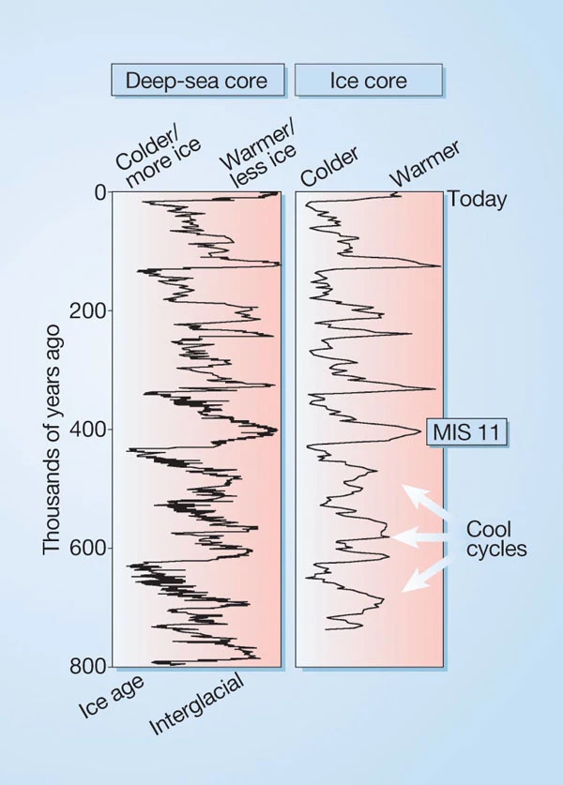
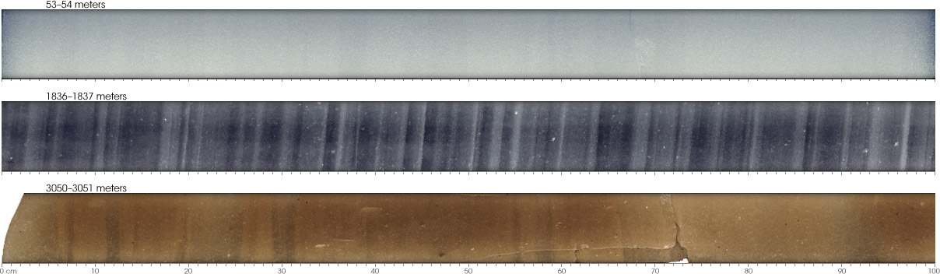

Slide 17
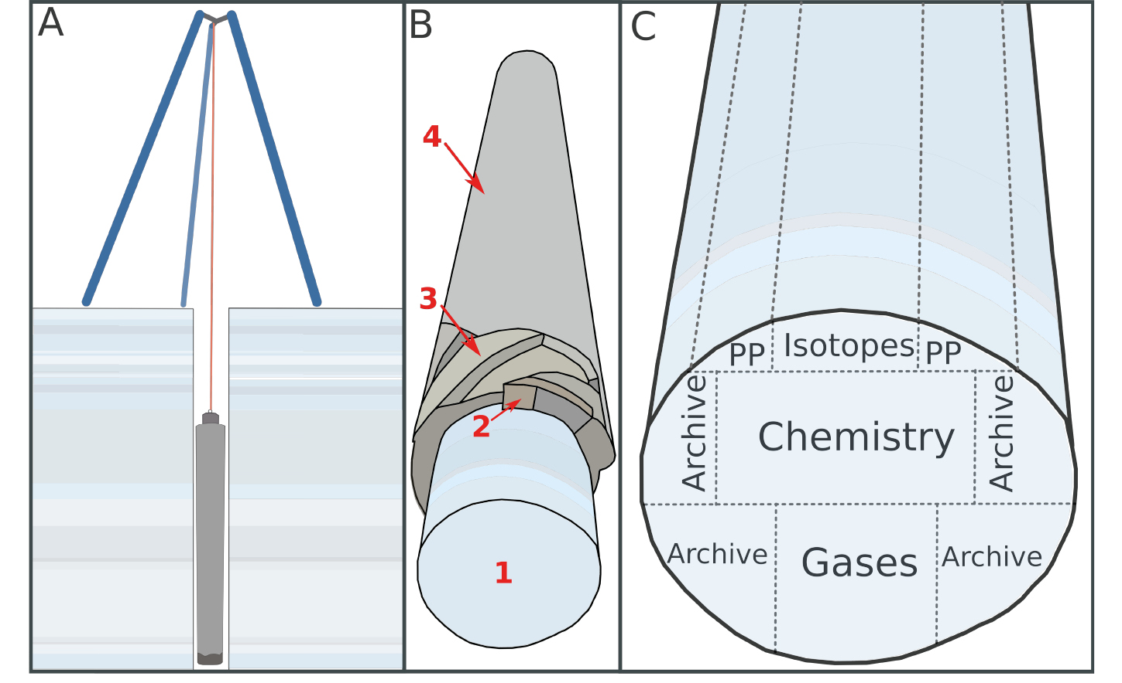

Slide 18
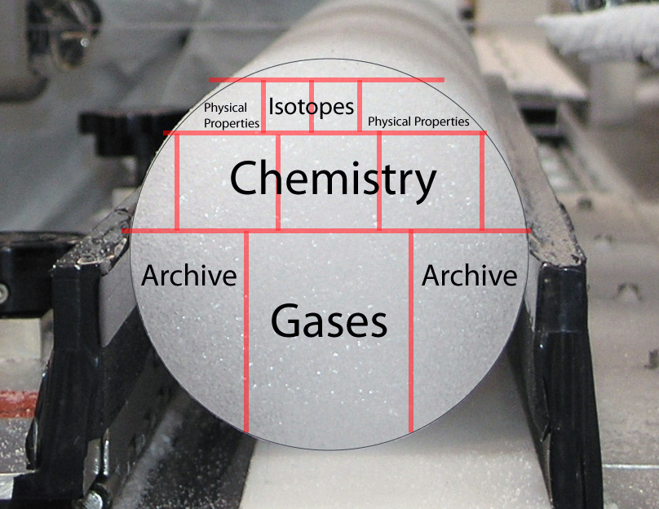

Slide 19
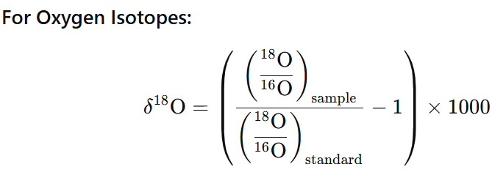
Delta (δ) notation
On Earth, we use the Standard Mean Ocean Water (SMOW) as the reference composition for δD and δ¹⁸O values — based on the D/H and ¹⁸O/¹⁶O ratios of ocean water
Stable isotope measurements (e.g. O, H, and D) must be expressed relative to a reference standard.
Standard Mean Ocean Water (SMOW)

Slide 20
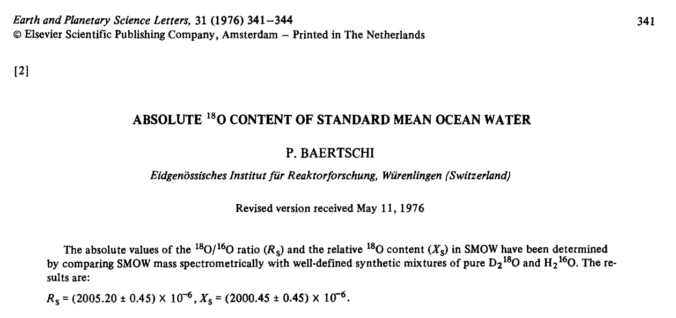

Slide 21
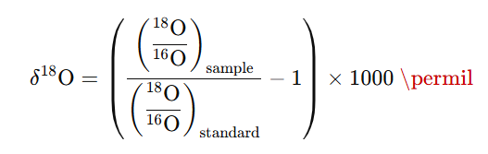
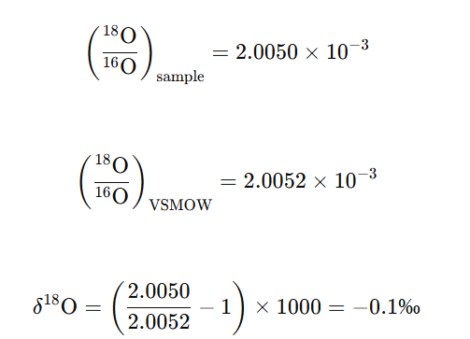
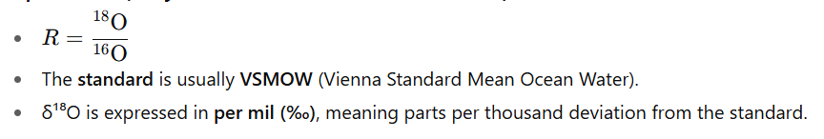
Example

Slide 22
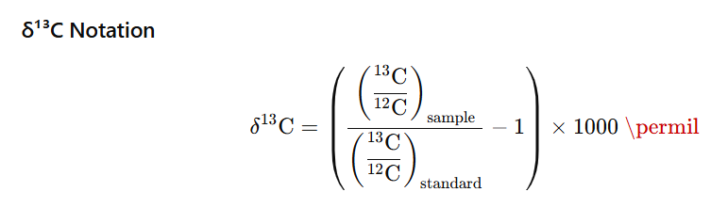
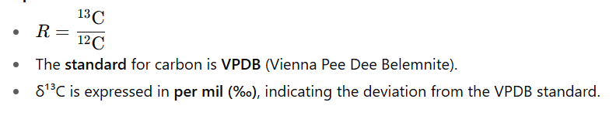
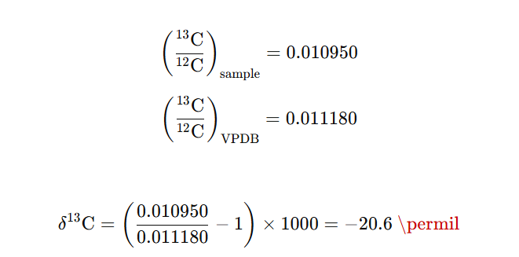
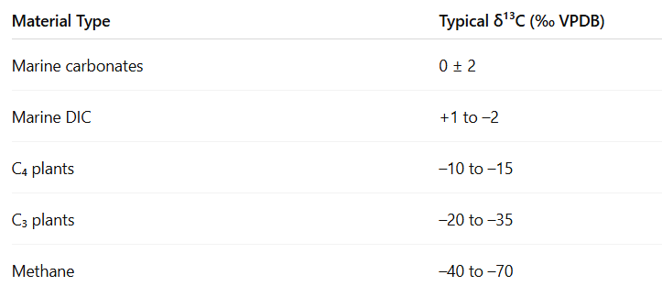

Slide 23
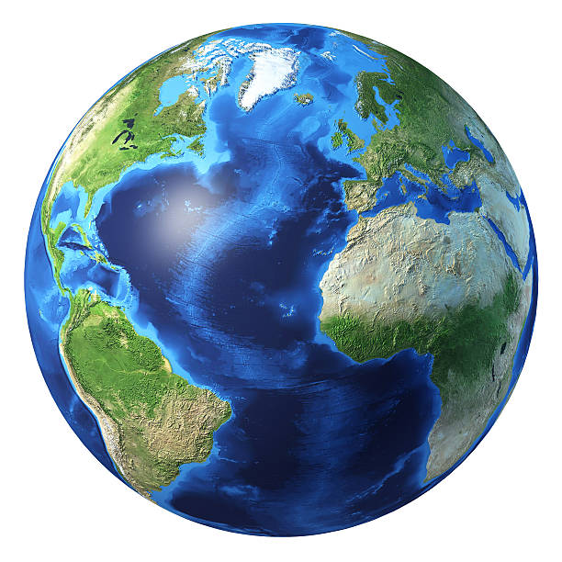
Delta (δ)
If I collect water from the Atlantic Ocean. What will be my δ¹⁸O?

Slide 24
δ¹⁸O = ~0‰ (by definition, because SMOW ≈ mean ocean water).
But local variations exist:
Tropical Atlantic: slightly positive (~+0.2 to +0.5‰).
Polar or high-latitude waters: slightly negative (~–0.5 to –1.0‰).
Why?

Slide 25
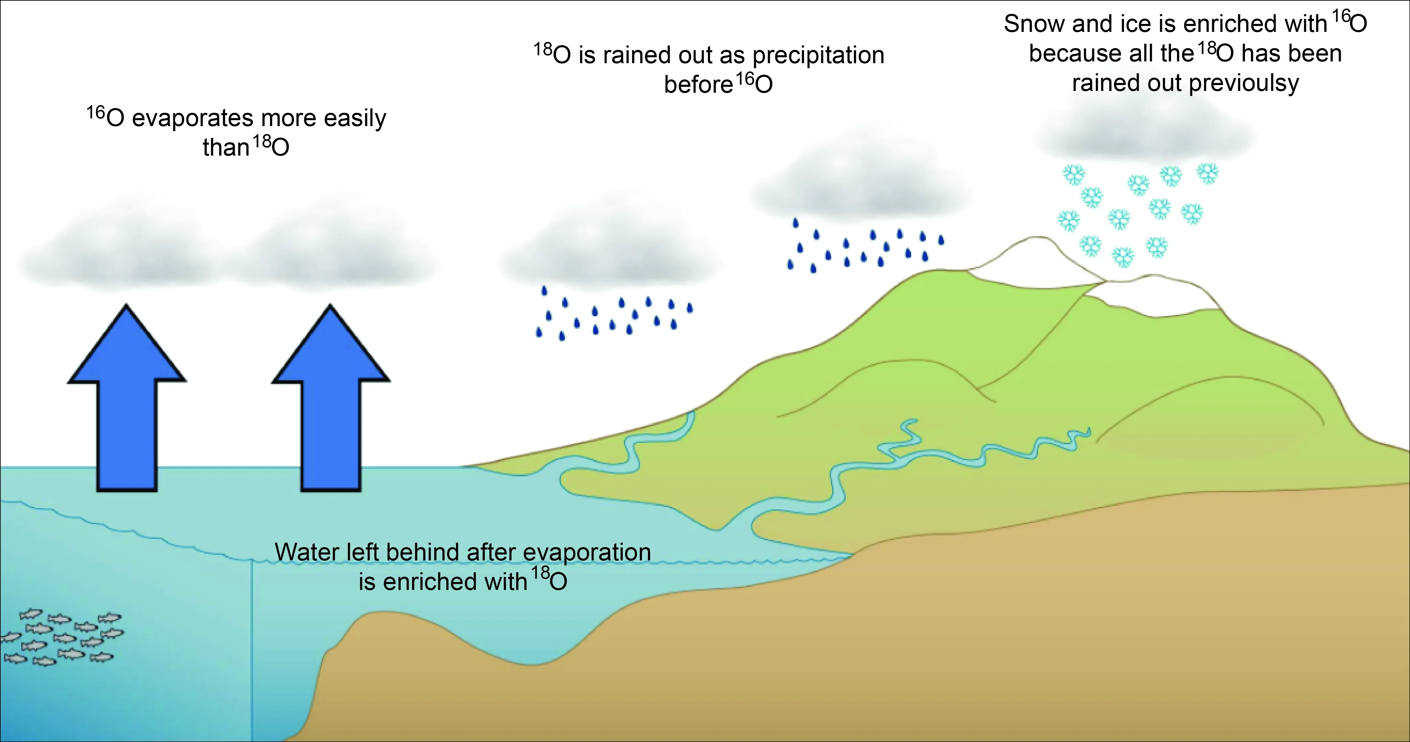
Evaporation and Condensation
Evaporation prefers lighter isotopes (¹⁶O) — water vapour becomes isotopically light – they form clouds over the ocean in the tropics.
The remaining ocean water in the tropics becomes enriched in ¹⁸O → δ¹⁸O increases (positive).

Slide 26
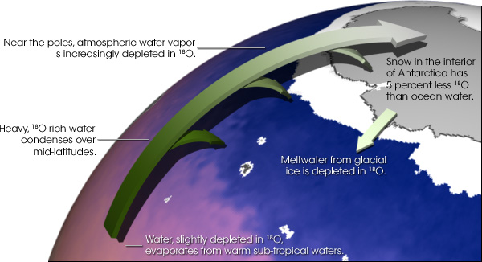
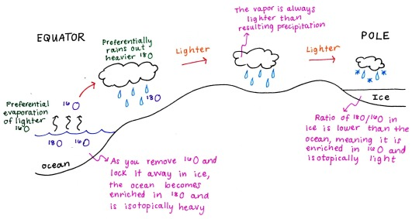

Slide 27
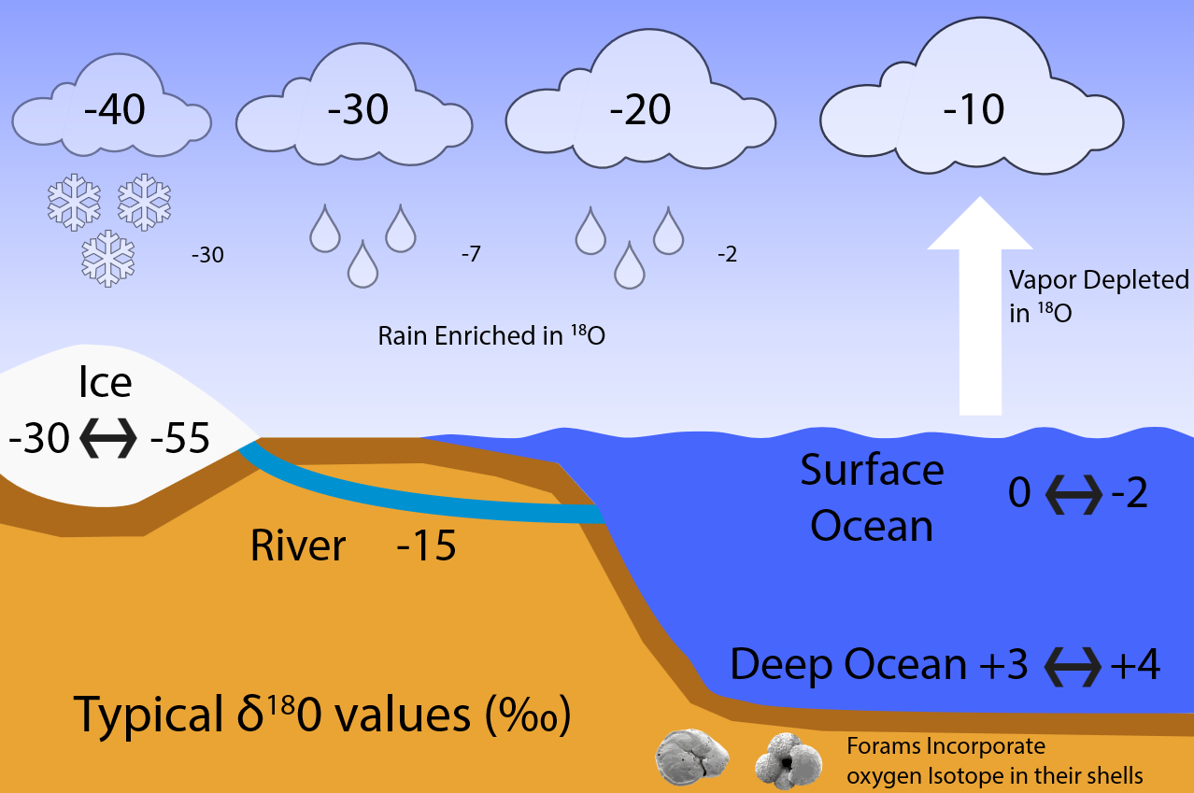
Rainout and Cooling Toward Poles
As moist air moves poleward, ¹⁸O condenses and rains out first, leaving residual vapour progressively lighter.
Polar precipitation and surface waters are depleted in ¹⁸O → δ¹⁸O decreases (negative).

Slide 28
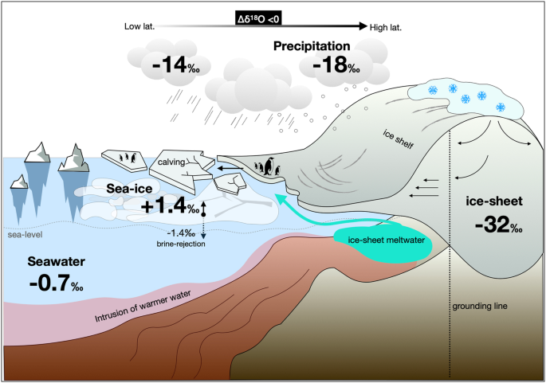
Fractionation occurs during phase changes, reactions in natural processes (biological, geological)

Slide 29
Types of isotope fractionation
There are two main types of isotope fractionation, each driven by different physical or chemical mechanisms:

Slide 30
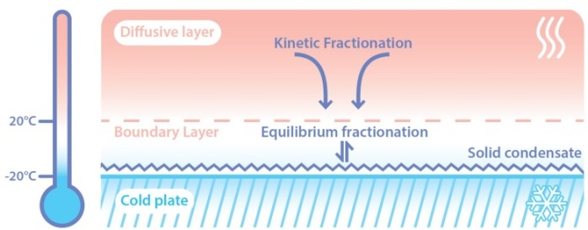
Equilibrium Fractionation
Occurs when two or more substances (phases) are in isotopic equilibrium
We have an isotope exchange until a thermodynamic balance is achieved.
Cause: Heavier isotopes preferentially form stronger bonds, favouring the phase or compound with lower energy (usually the condensed phase).

Slide 31
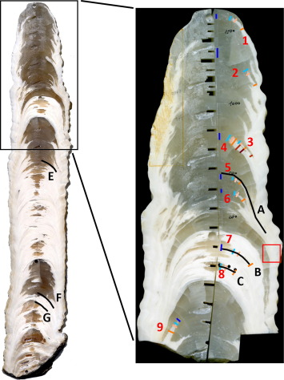
Oxygen isotope fractionation: calcite ↔ water
System
    Mineral: CaCO₃ (calcite)
    Fluid: H₂O
    Isotopes: ¹⁸O / ¹⁶O
This is true equilibrium fractionation because:
  Isotopes exchange between two coexisting phases
  Given enough time, they reach thermodynamic equilibrium
  Fractionation depends only on temperature, not reaction rate

Slide 32
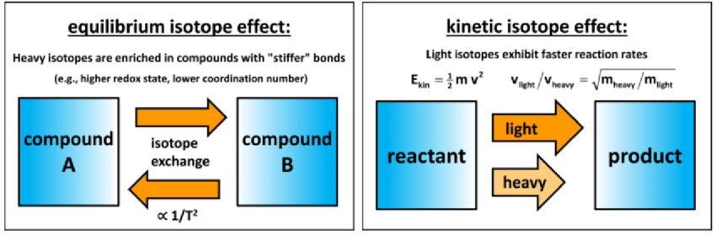
Kinetic Fractionation
Definition: Occurs in unidirectional or incomplete reactions, where isotopic equilibrium is not reached.
Cause: Lighter isotopes react or diffuse faster than heavier ones, leading to isotopic disequilibrium.

Slide 33
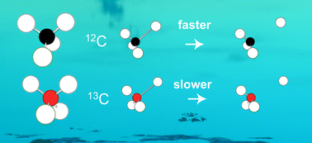
Kinetic Fractionation
Biological and chemical reactions preferentially use ¹²C, leaving the remaining material enriched in ¹³C
Both reactions show a molecule being broken down (for instance, CO₂ formation or an organic reaction), but the reaction with ¹²C proceeds faster (indicated by “faster →”) than the one with ¹³C (“slower →”).
Biological materials are typically depleted in ¹³C compared to inorganic carbonates

Slide 34
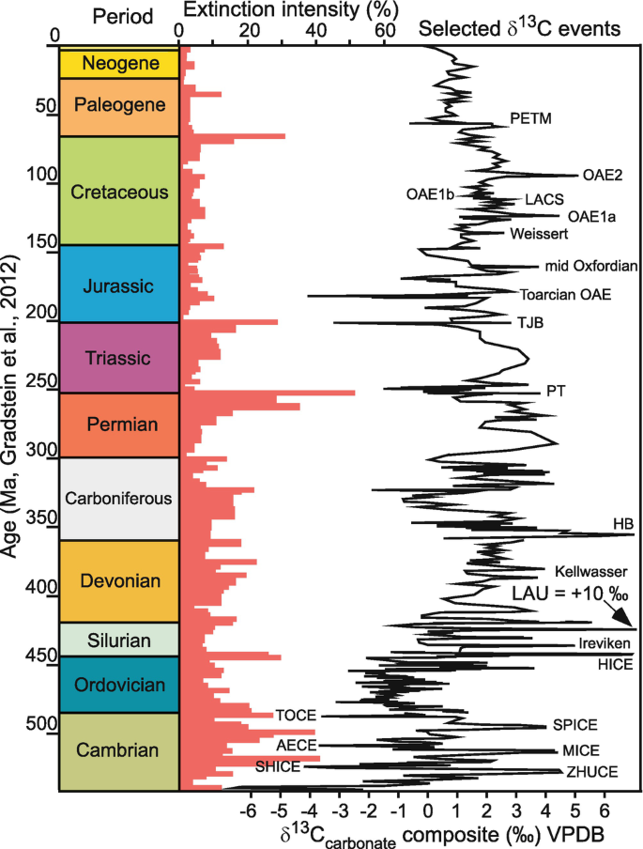
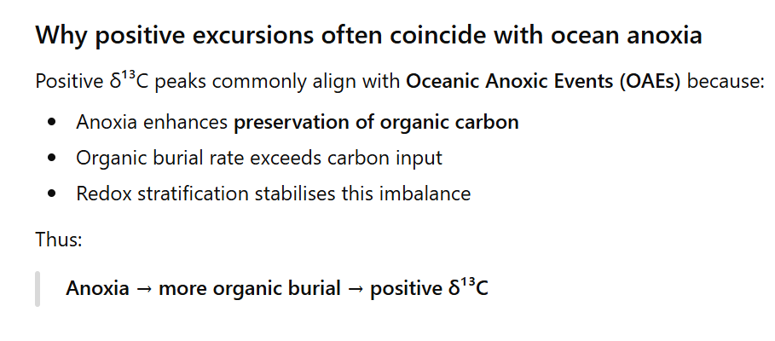
Positive δ¹³C excursions reflect periods of enhanced burial of ¹²C-rich organic matter, which enriches the oceanic carbon reservoir in ¹³C and records major reorganisations of the global carbon cycle.

Slide 35
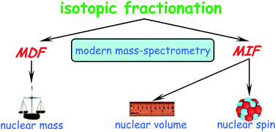
Mass-independent isotope fractionation (MIF) or Non-mass-dependent fractionation (NMD)
Refers to any chemical or physical process that acts to separate isotopes, where the amount of separation does not scale in proportion with the difference in the masses of the isotopes.
They are less common
Occurring mainly in photochemical and under very specific type of chemical reactions - spin-forbidden reactions

Slide 36
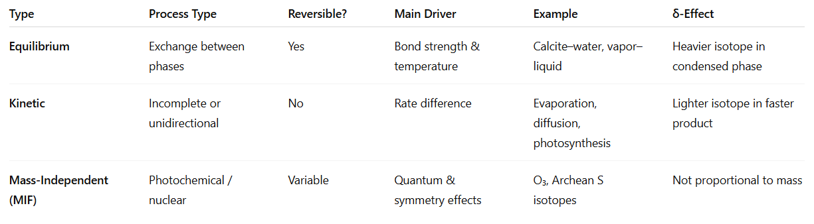
SUMMARY TABLE

