Slide 1
Trace Elements via LA-ICP-MS
Cris lana

Slide 2
1. Introduction to LA-ICP-MS Trace Element Analysis
Principles of Laser Ablation ICP-MS for Elemental Determination
Spatial resolution vs. analytical precision: spot sizes, ablation modes (spot / line / map)
Overview of detection limits, signal response, and sensitivity factors

Slide 3


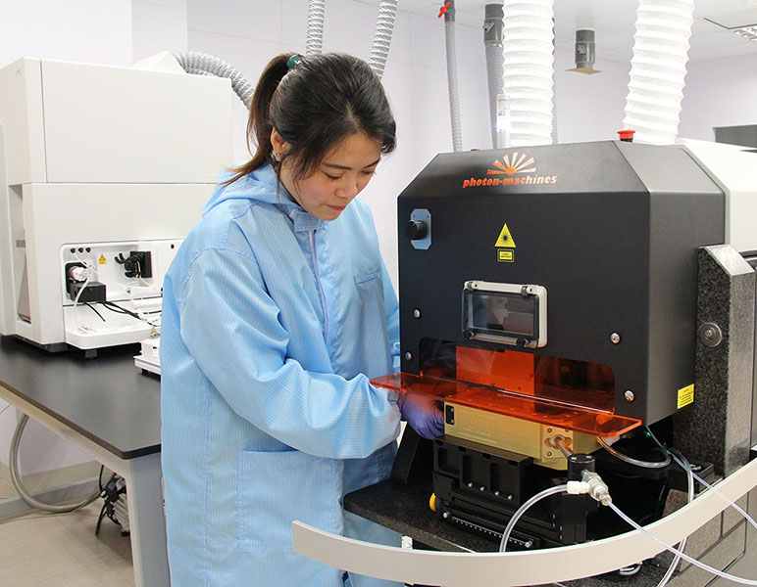
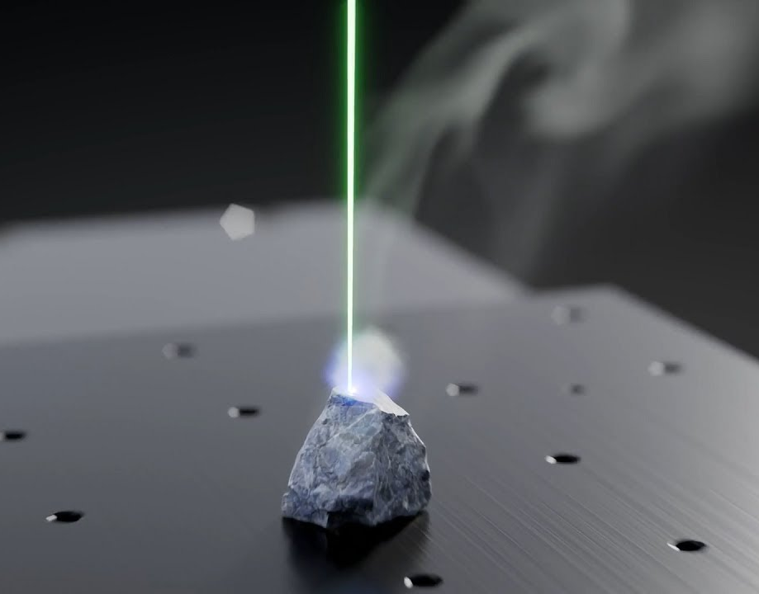
Principles of Laser Ablation ICP-MS for Elemental Determination
LA-ICP-MS = Laser Ablation + Inductively Coupled Plasma Mass Spectrometry
Uses a focused UV laser to ablate solid material → aerosol is carried by He/Ar gas to the ICP torch

Slide 4
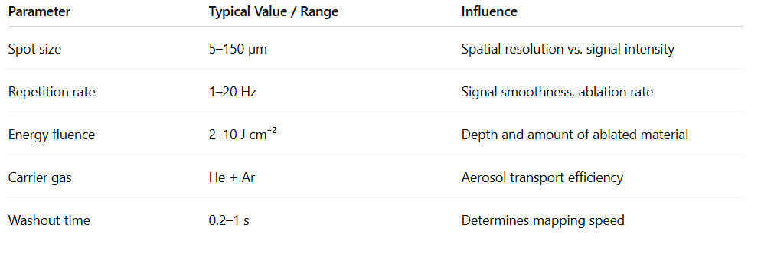

Slide 5

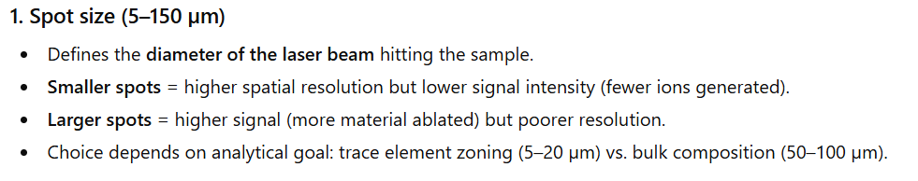
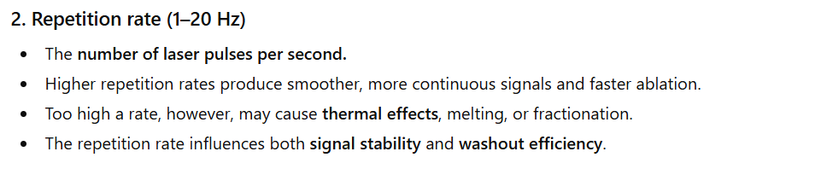
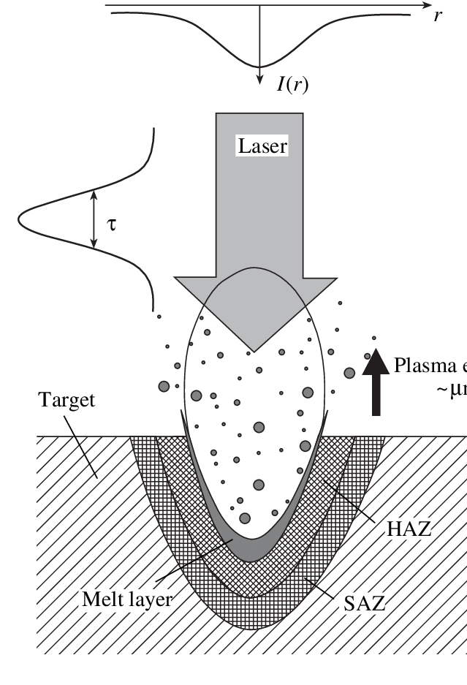
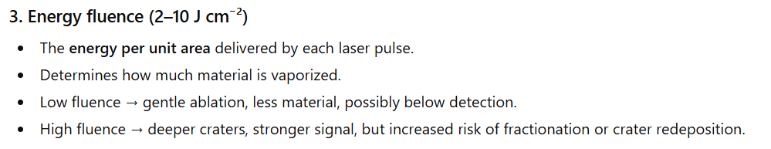

Slide 6
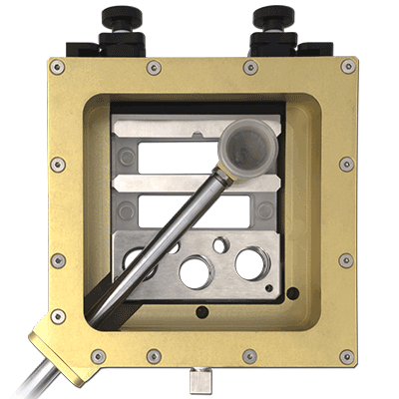
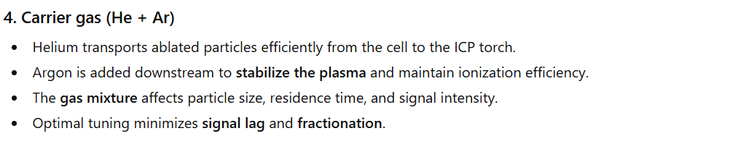
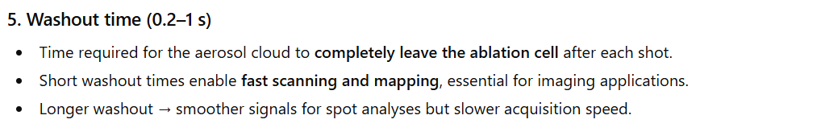

Slide 7
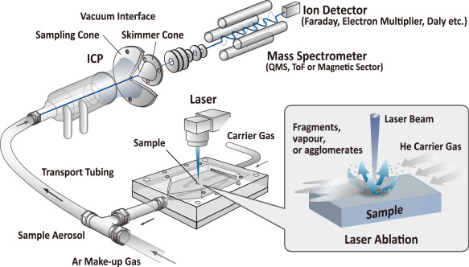

Slide 8
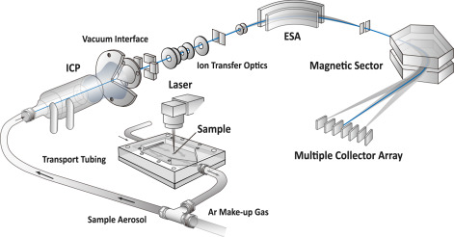

Slide 9
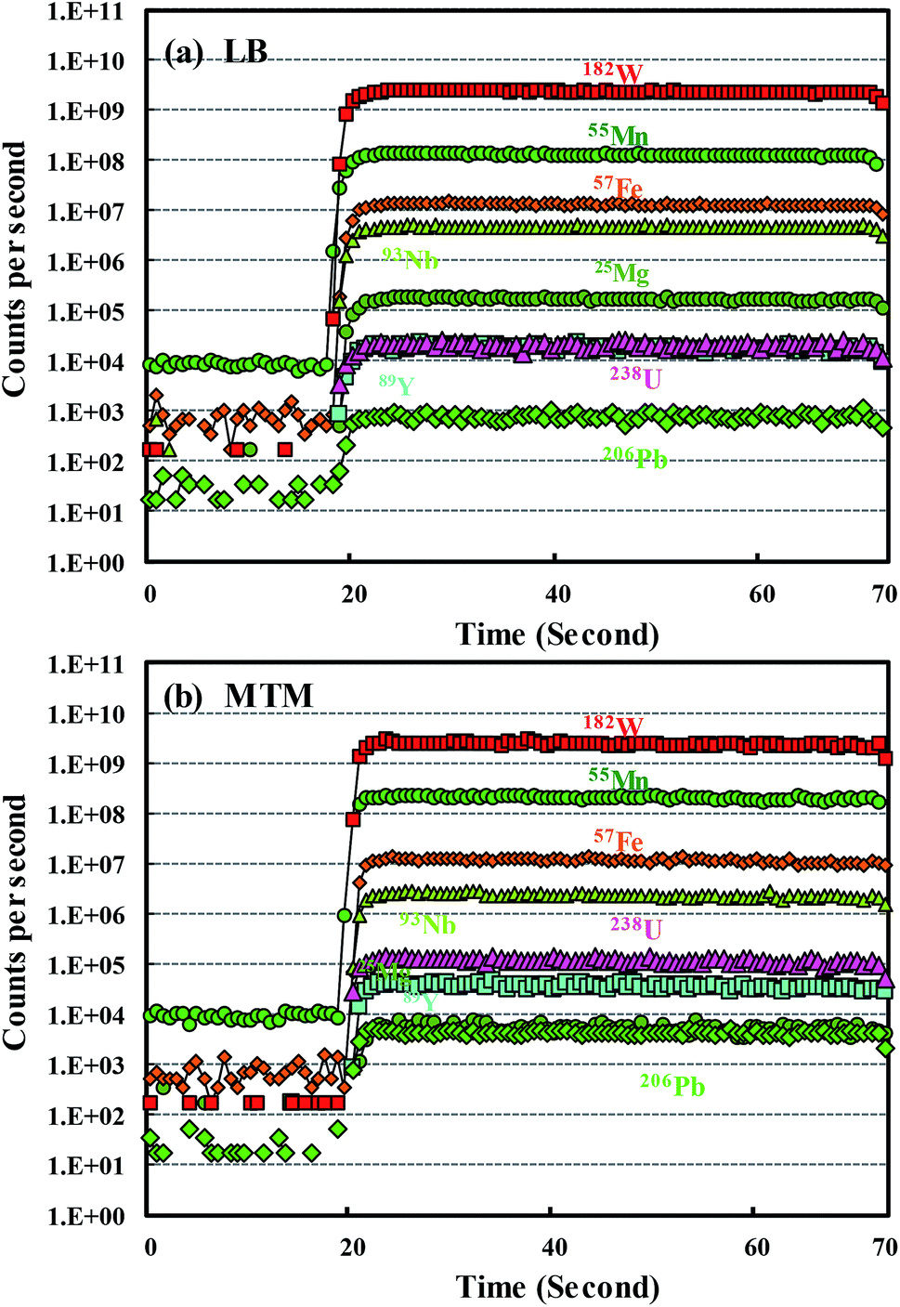
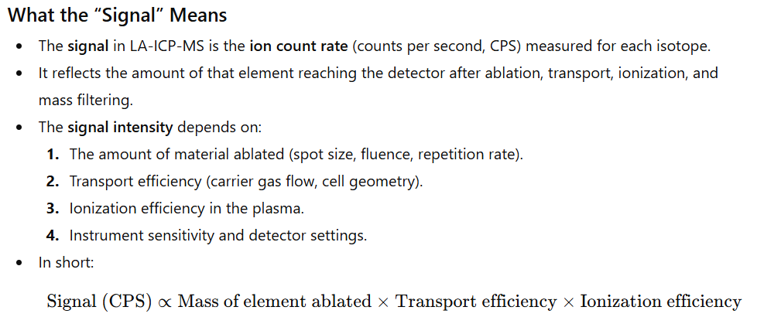

Slide 10
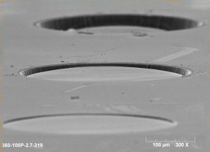
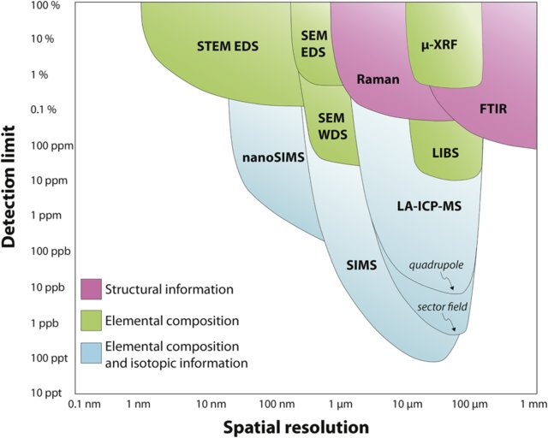
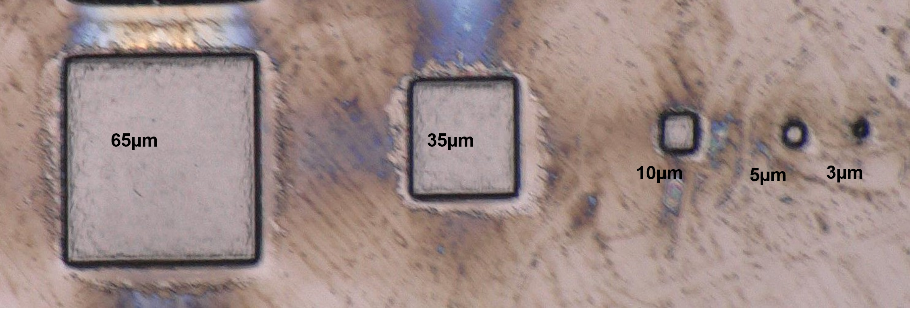

Slide 11
2. Calibration and Quantification Approaches
Internal standards: Si, Ca, ⁴³Ca, ²⁹Si – choosing the best element
External calibration: use of NIST SRM 610/612, USGS BCR-2G, BHVO-2G, MPI-DING glasses
Matrix effects and the importance of matrix-matched standards
Quantification equations (ppm = (C_std × I_sam / I_std) × (IS_std / IS_sam))
Error propagation and precision vs. accuracy considerations

Slide 12
Data Processing Workflows
Pre-processing: background subtraction, smoothing, ratio calculation
Quantification: use of certified reference materials
Normalization methods (internal, quantitative, combined)
ROI extraction and statistical summaries
Visualization tools: heatmaps, RGB maps, contour plots

