Slide 1
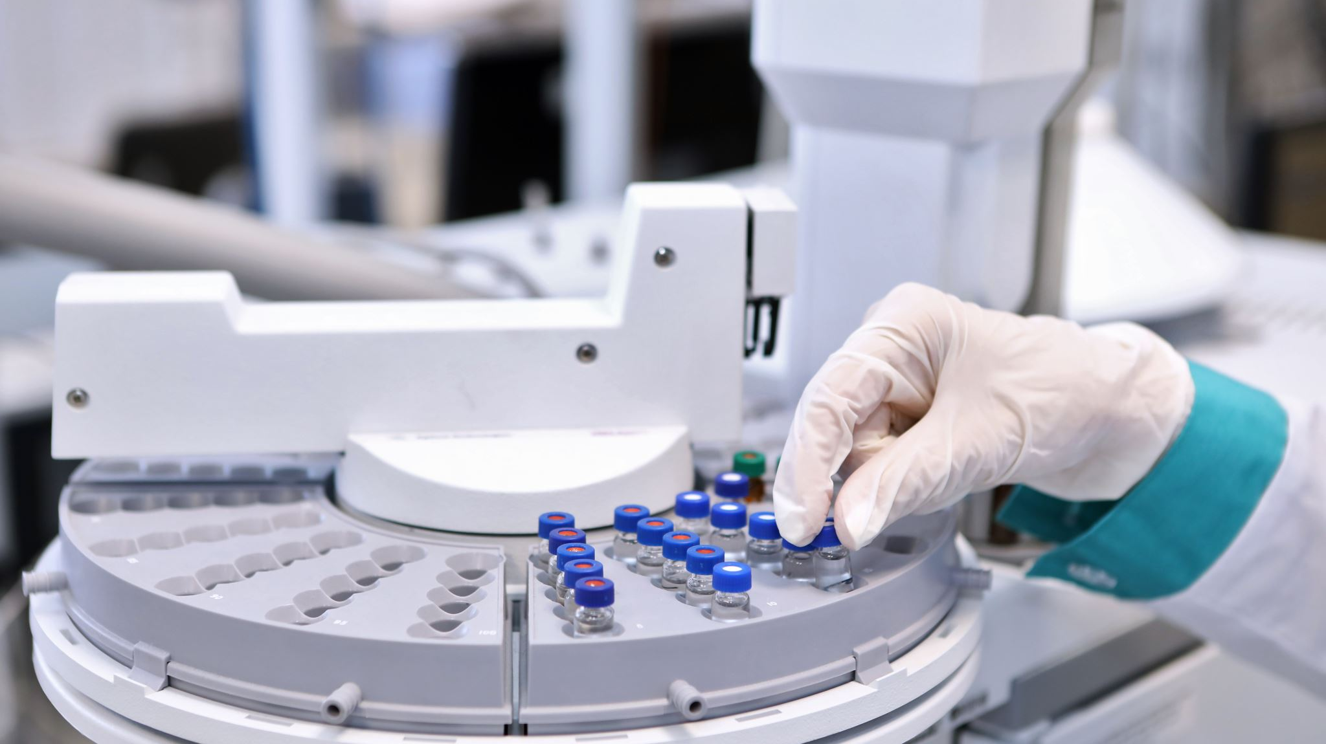
Inductively Coupled Plasma–Mass Spectrometry (ICP‑MS): Principles, Instrumentation & Applications
Cristiano Lana

Slide 2
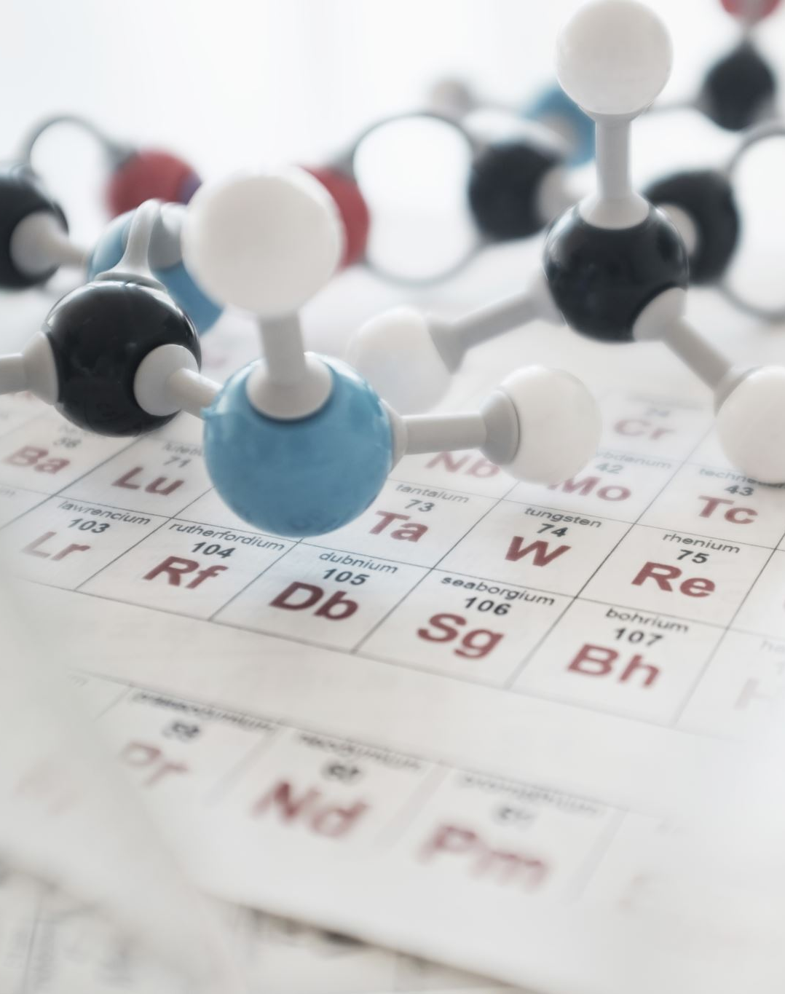
By the end of this lecture, you should be able to:
Understand the basic principles of ICP-MS and why it is such a powerful analytical technique.
Describe how an ICP-MS works, from sample introduction and plasma ionisation to mass separation and detection.
Understand how isotope ratios are measured and why high-precision isotope analysis is useful.
Recognise the broad applications of ICP-MS and isotope geochemistry, from geochronology to environmental and water studies.
Understand how Sr isotopes (⁸⁷Sr/⁸⁶Sr) can trace water sources, water–rock interaction, groundwater recharge, and mixing between different waters.
Understand the basic preparation of water samples for elemental and Sr isotope analysis.

Slide 3
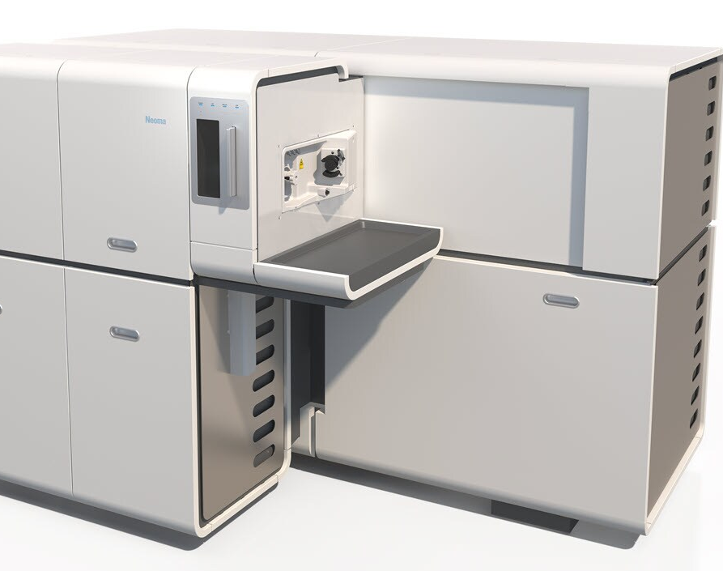
MC-ICP‑MS is a high‑temperature ionization technique coupled to a mass spectrometer that enables ultra‑trace elemental and isotopic analysis with detection limits down to parts‑per‑trillion.
Its power comes from the ICP’s ability to generate ions efficiently and the MS’s ability to separate them by mass‑to‑charge ratio.

Slide 4
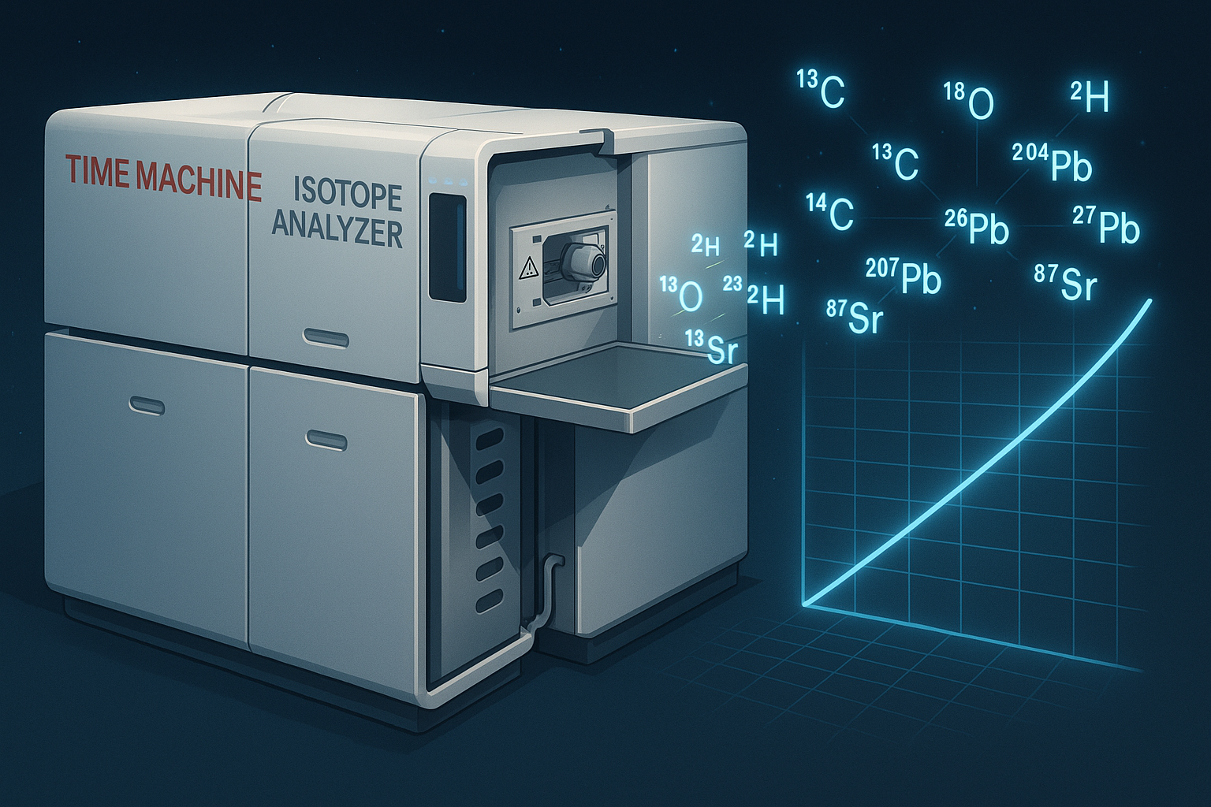
Extreme sensitivity (ppt level)
Multi‑element capability across the periodic table
Isotope ratio measurements for geochemistry, environmental tracing, and nuclear science
Broad applications: environmental monitoring, food safety, clinical toxicology, geology, nanomaterials, and more

Slide 5
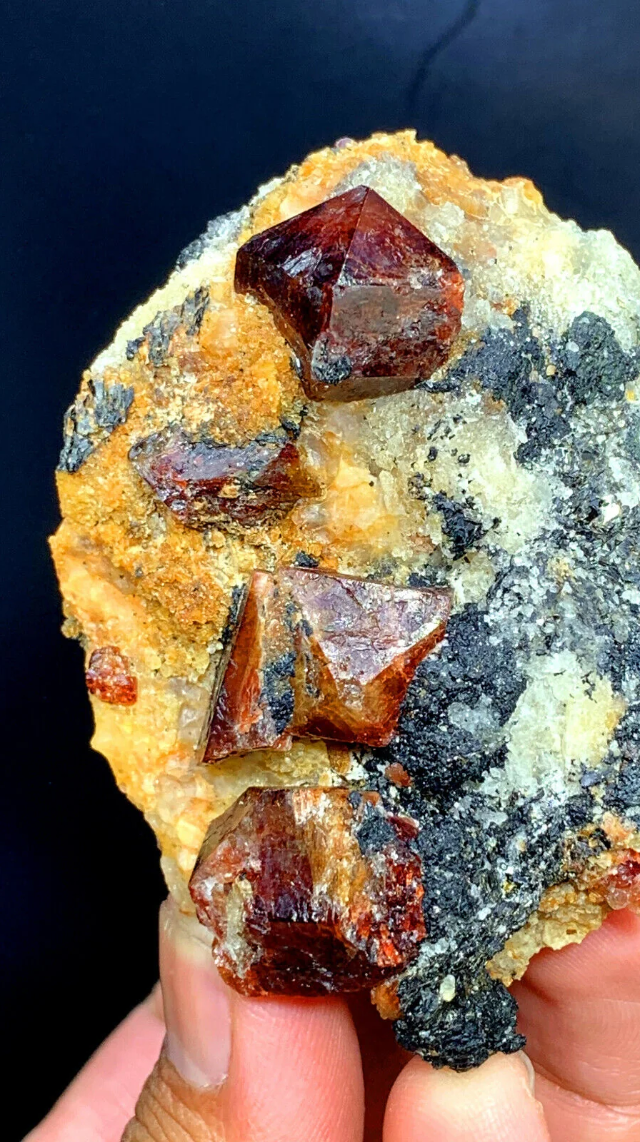
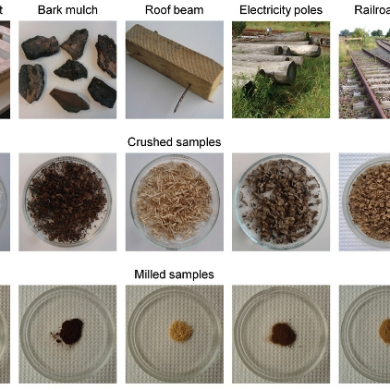
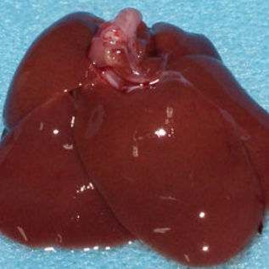
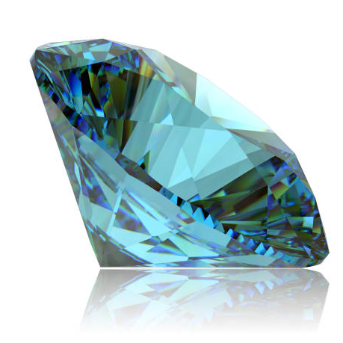
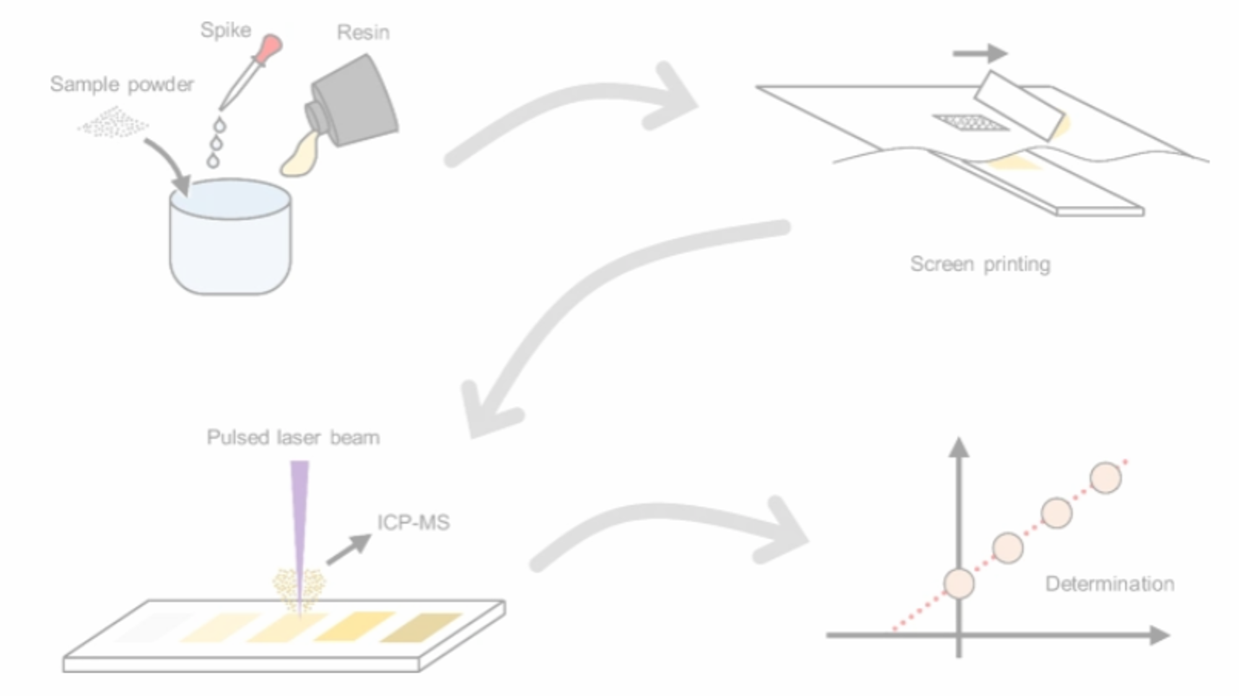
It works with tiny amounts of samples – either powder milled from solid samples (rock, tablets, ceramic) or tiny drill holes created by laser ablation
Notes:
What makes this instrument truly special is that it doesn’t need a mountain of material.
Just a speck of powder, a grain from a rock, or even a laser hole thinner than a human hair and it allows us to measure isotopes with great precision
If you want to know where a gemstone is coming from,
or if you want to understand about chemical contaminations inside your system and you want to know where these chemicals come from we use isotopes

Slide 6
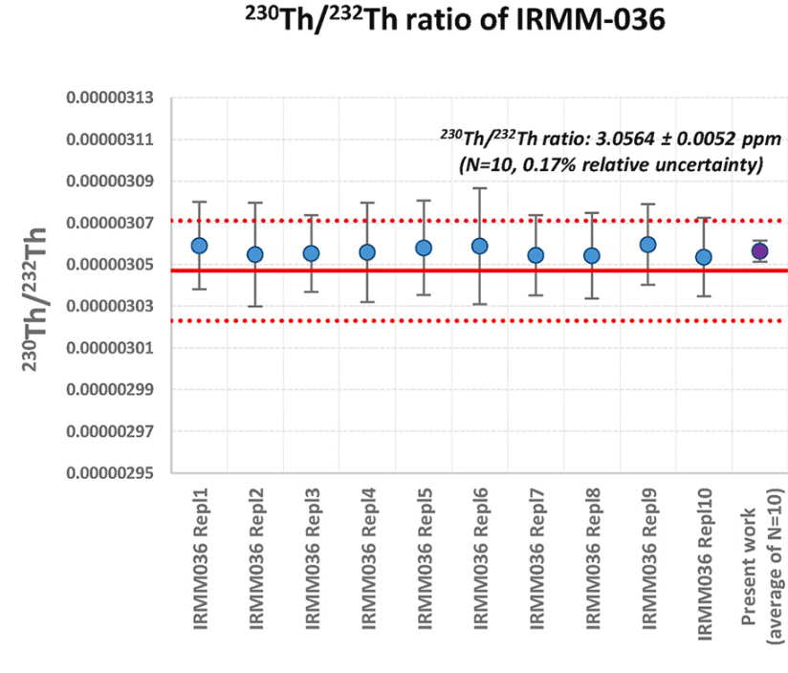

Slide 7
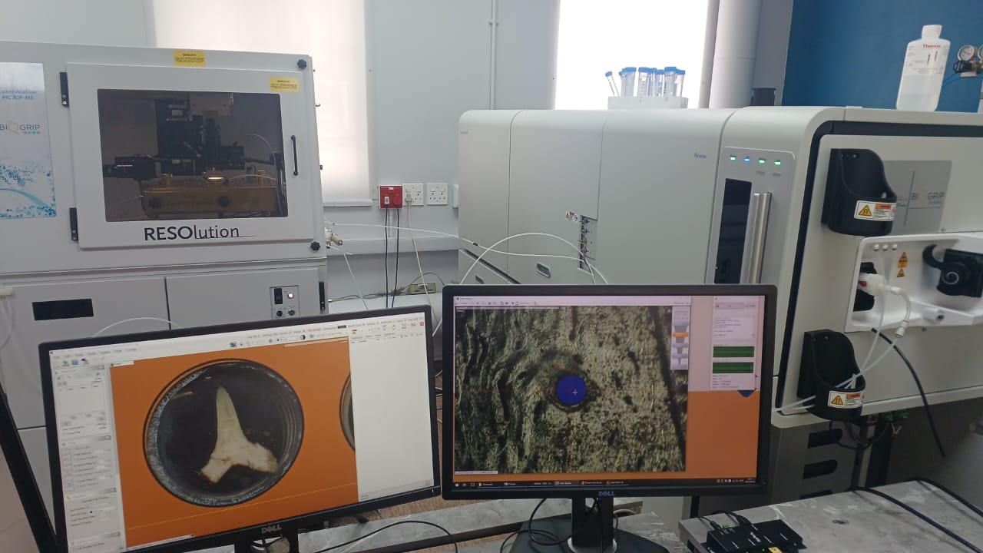
Notes:
This is to show the real scale of what we’re working with.
Here in the background is our laser ablation system, which allows us to analyse samples with extraordinary precision.
The samples themselves sit behind that glass window. It’s a secure environment where the laser beam drills into the sample. That tiny pit releases just enough material to be carried into the mass spectrometer for isotopic analysis.
Up here in the front you can see the computer screen showing the sample under analyses — in this case, a shark tooth about the size of your fingernail. And on the right screen, we’ve zoomed into just a tiny part of that tooth. You can see the laser spot — only about 100 microns wide, roughly the thickness of your hair.
From that tiny pit, we can extract enough material to analyse and tell the story recorded inside the tooth.
We can find out for example the age to the tooth. We can also find out whether this shark lived 100 % of its time in the ocean or had contact with fresh water. We can also tell the temperature of the water and finally the chemistry and redox state of the of water.

Slide 8
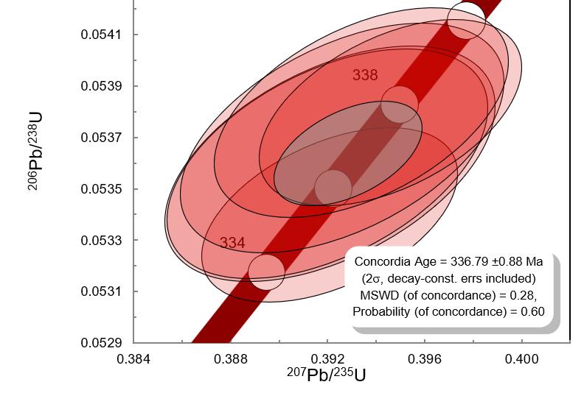
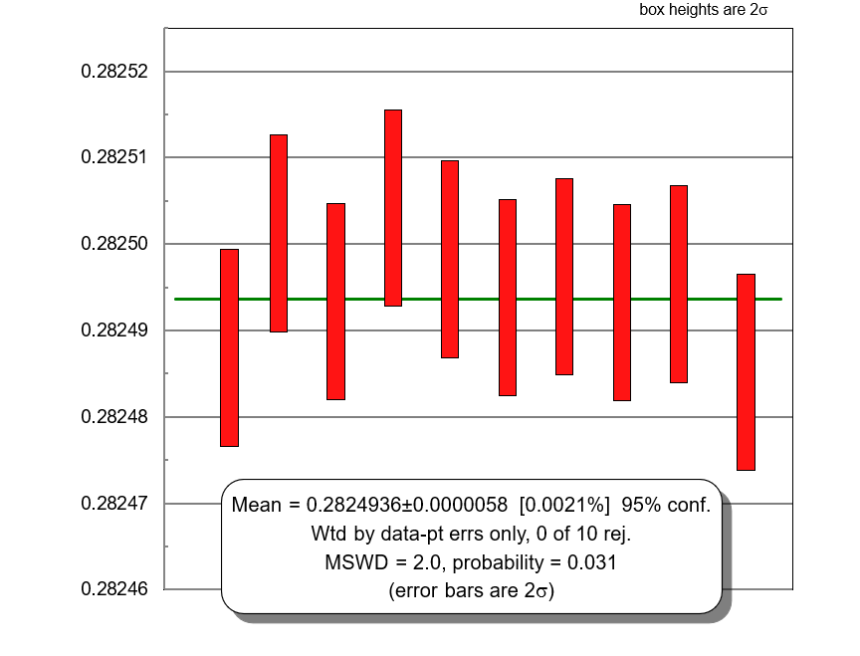
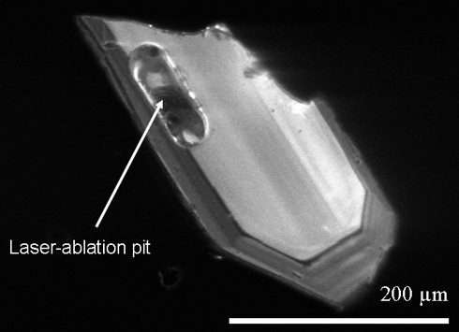
¹⁷⁷Hf/¹⁷⁶Hf
Notes:
This is what we do in the lab today.
On the bottom left, you see a zircon crystal. The zircon is about 300 um long and the laser pit a much smaller than that.
The pit samples pinprick of material — and from that, we can pull out an age of 337 plus minus 0.9 million years.
On the right is another story — hafnium isotopes. Notice how tiny the error bars are. This tells where it comes from
So, from a hole thinner than your own hair, we can reconstruct hundreds of millions of years of Earth’s history, with precision down to less than million years

Slide 9
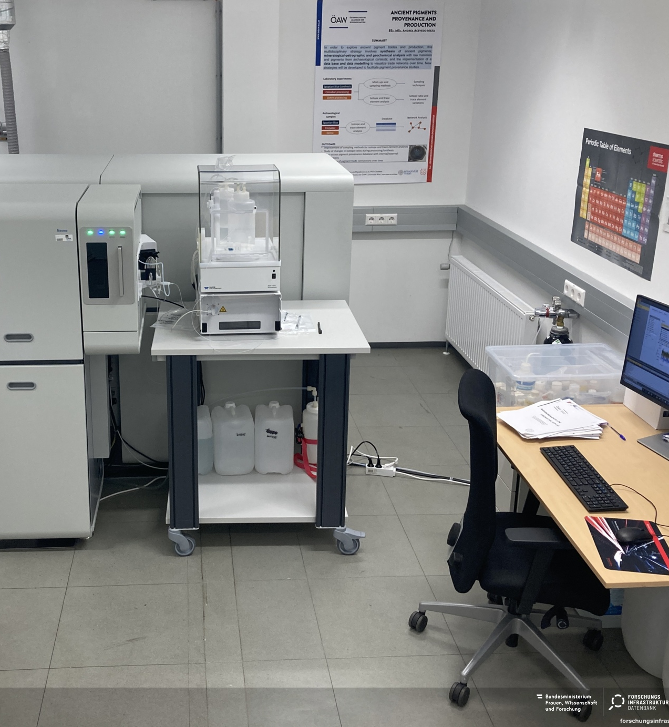
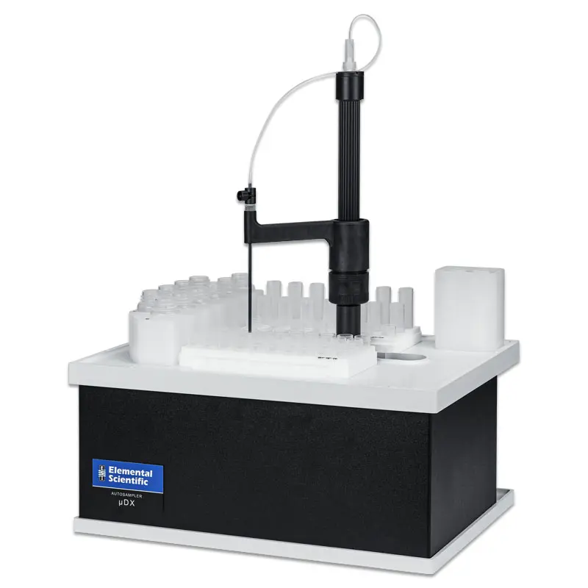

Slide 10
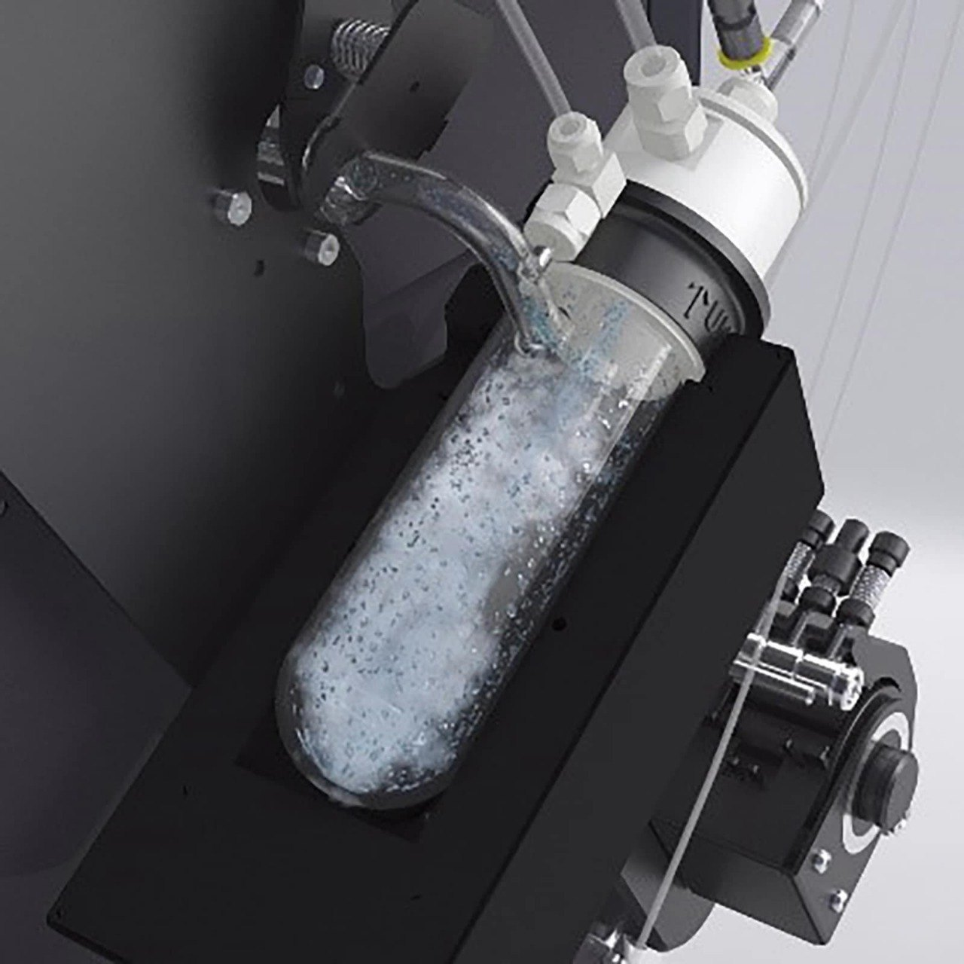
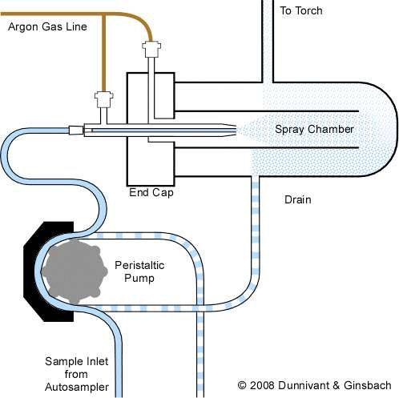

Slide 11
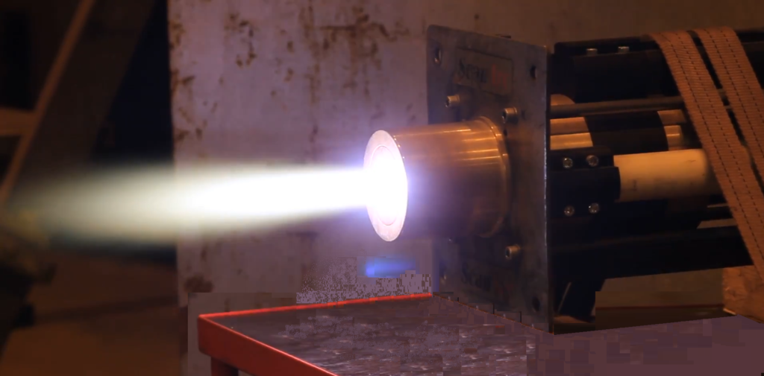

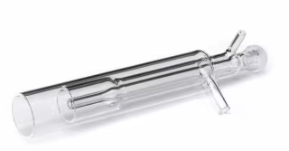
Plasma Generation
Argon gas is ionized by a radiofrequency (RF) field, forming a 6000–8000 K plasma.
The plasma efficiently atomizes and ionizes the sample.

Slide 12
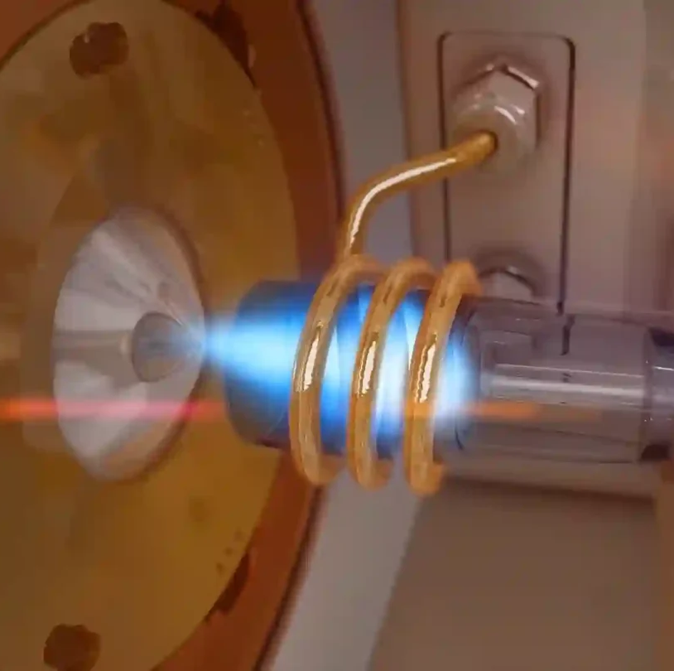
Plasma Formation:
Argon gas is introduced into the torch and flows through the outer tube.
An RF coil wrapped around the torch applies an oscillating electromagnetic field, which energizes the argon gas atoms, stripping electrons from them and forming a plasma – a highly ionized, electrically conductive gas.
The plasma is sustained by the RF energy, and its temperature is high enough to atomize and ionize the aerosolized sample.

Slide 13
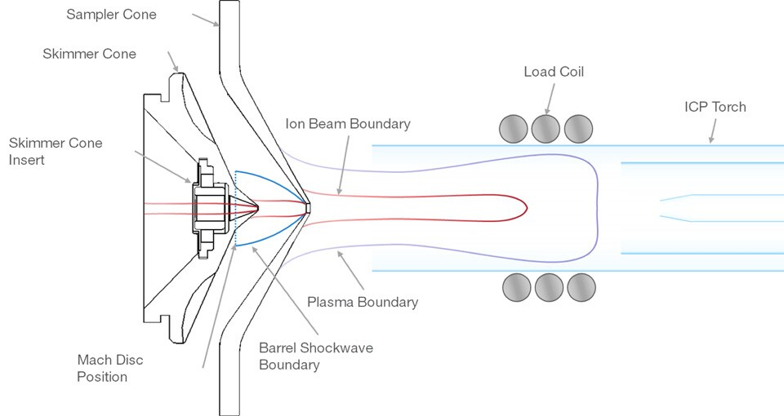

Slide 14
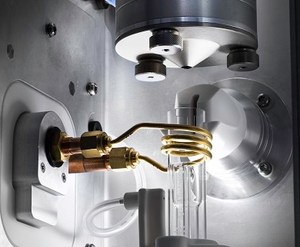

Slide 15
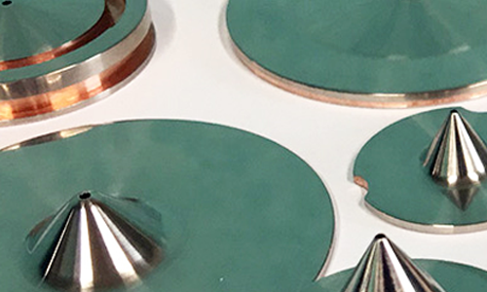
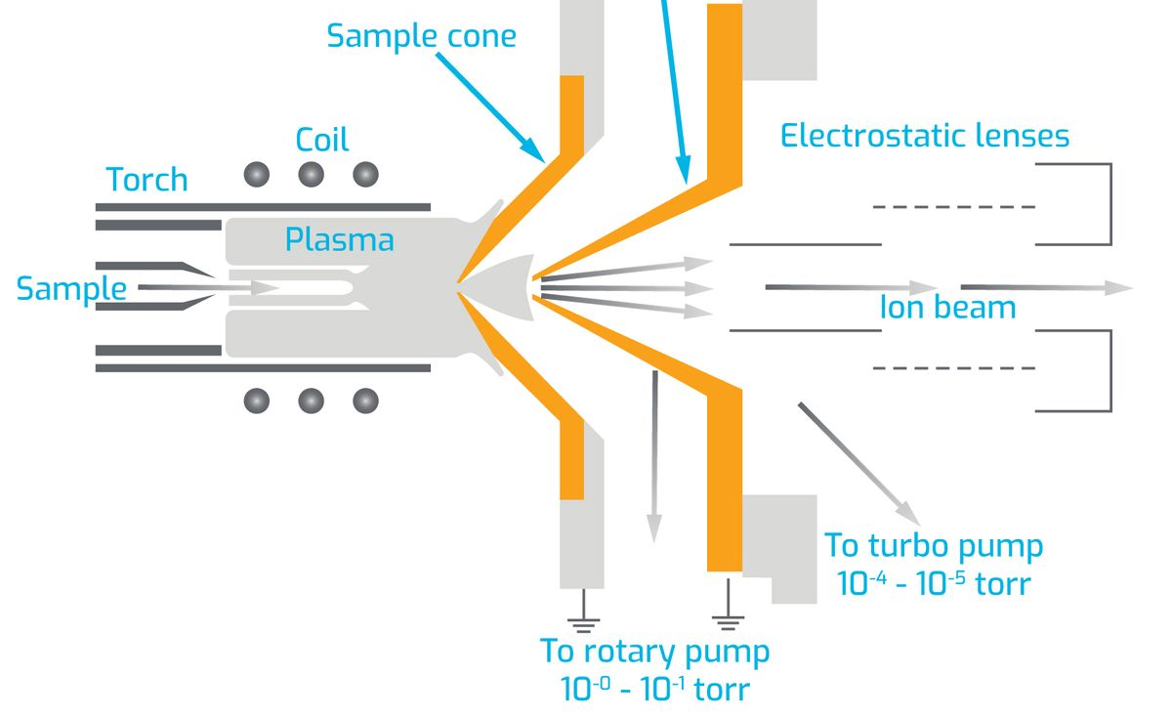
Interface Region
Plasma at atmospheric pressure must be coupled to MS under vacuum.
Two cones:
  Sampler cone (~1 mm orifice)
  Skimmer cone

Slide 16

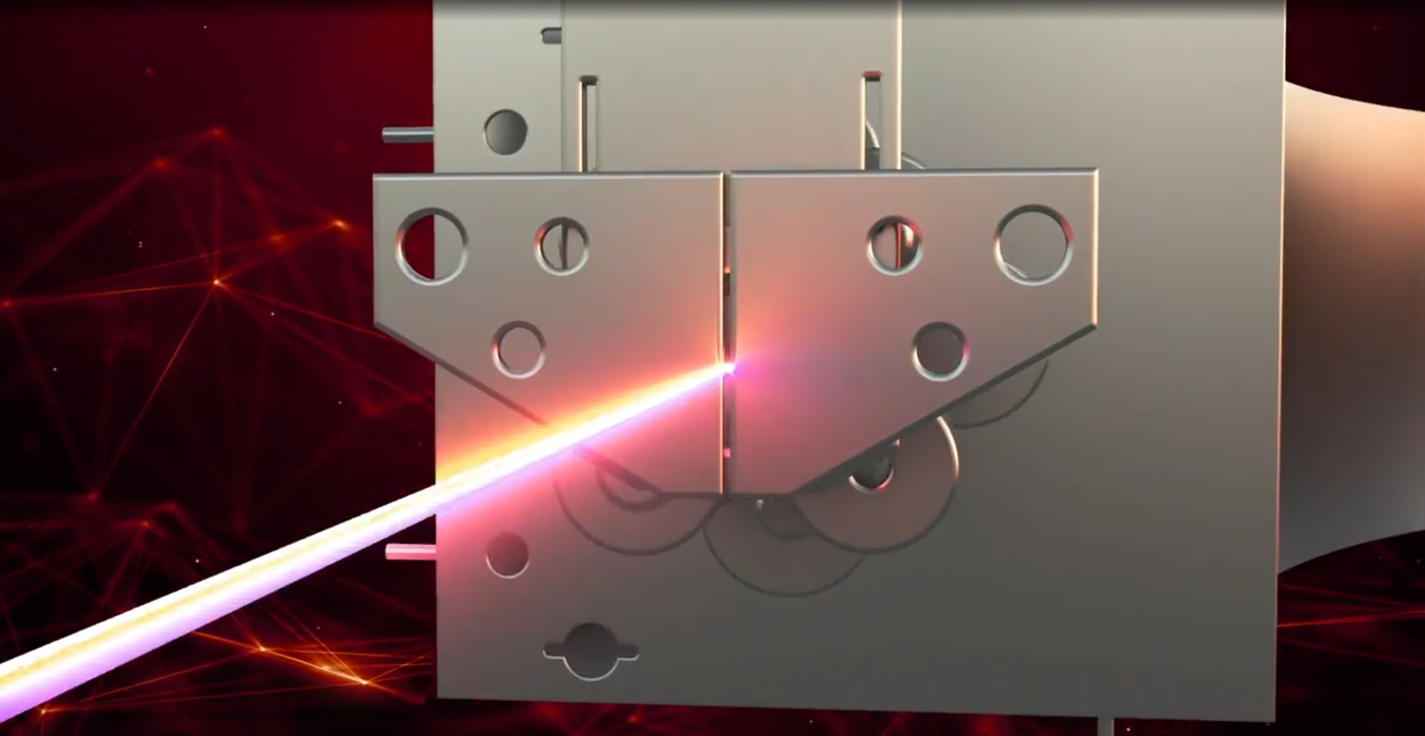
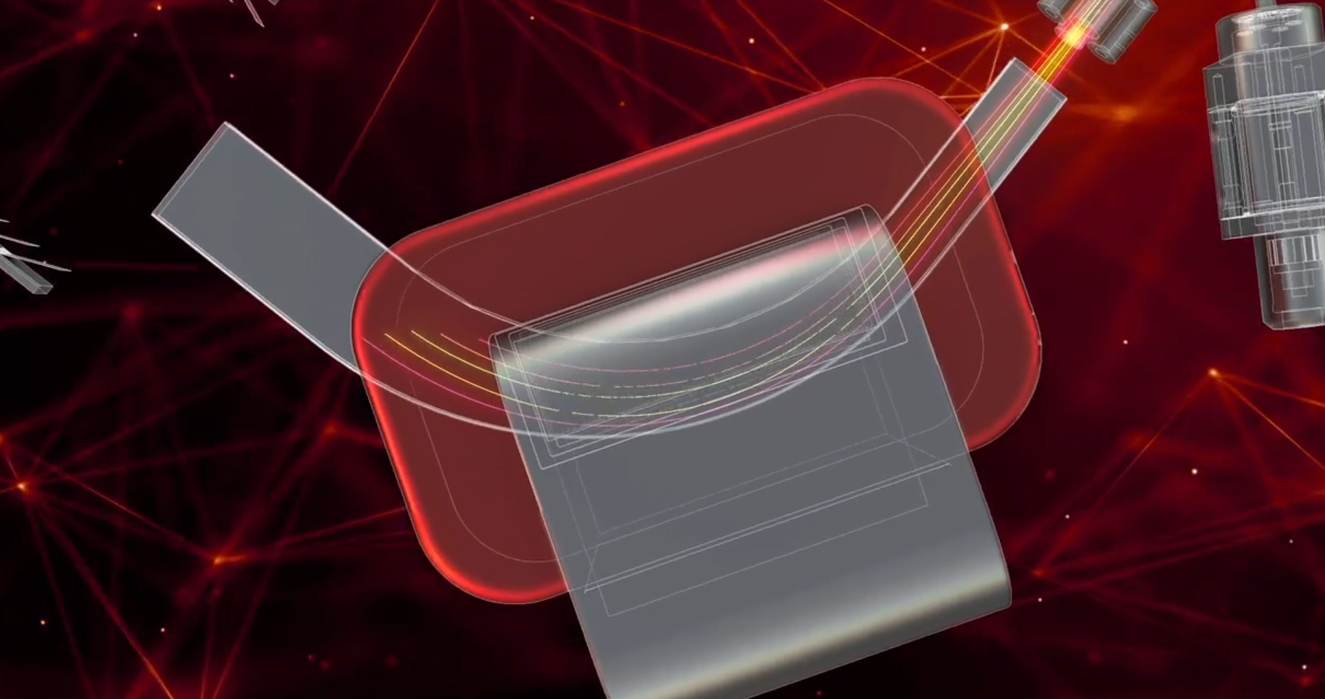
Once we have the ion beam, the next step is to bend and separate them.
Magnets act like precision filters — steering lighter and heavier isotopes along different trajectories.
Notes:
Different isotopes take slightly different paths, like runners in separate lanes of a race.”
Magnets act like precision filters — steering lighter and heavier isotopes along different trajectories.
What looks like a rainbow of ions is in fact the isotopic fingerprint of the sample.”

Slide 17
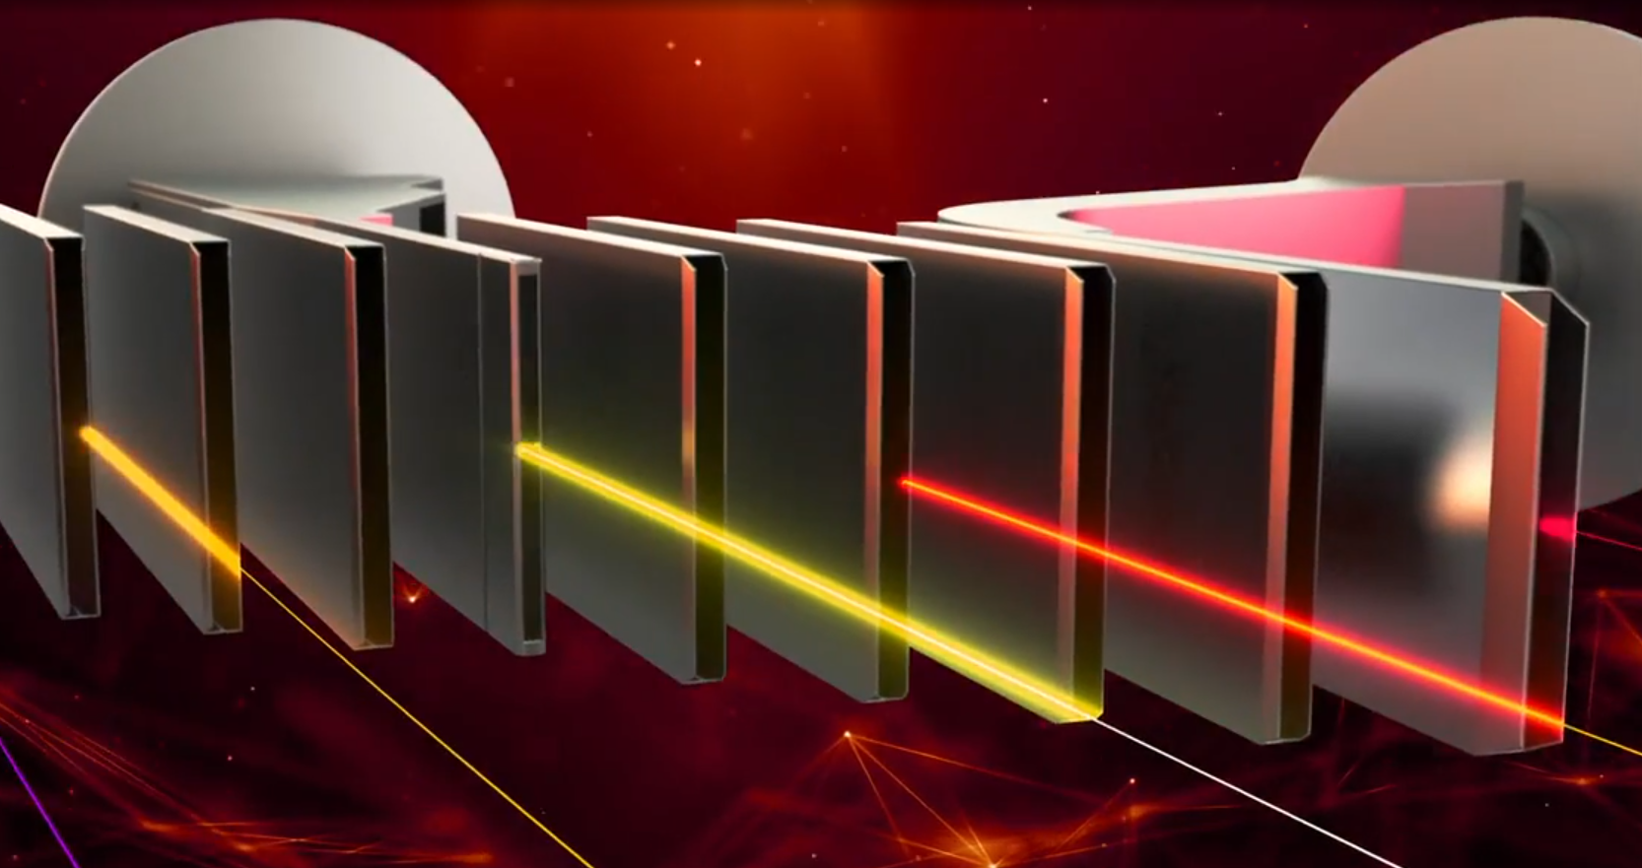
238U
235 U
232 Th
208Pb
207Pb
206Pb
204Pb
Notes:
And“At the end of the journey INSIDE THE MACHINE, this rainbow of ions hit different detector and every beam is counted, and from those counts, we build isotope ratios.”

Slide 18
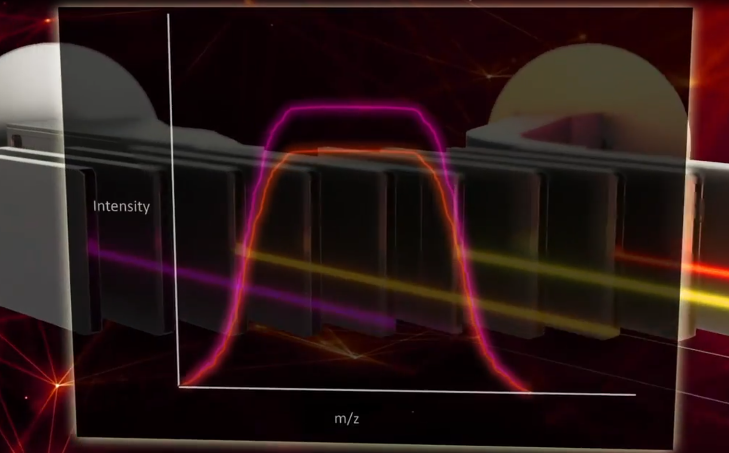
Every peak is an isotope speaking to us.
Notes:
What you see here is signal created by the electron signals generated by the detectors in action, measuring the beams. We see here the intensity rising as the beam strikes the plate, then dropping off again. Every peak is an isotope speaking to us.”
So those metal plates convert each ion into a measurable pulse of electricity, which becomes the data we interpret.”
From these signals, we calculate isotope ratios with extraordinary precision. And those ratios, in turn, allow us to measure time, trace processes, and decode Earth’s history.”

Slide 19
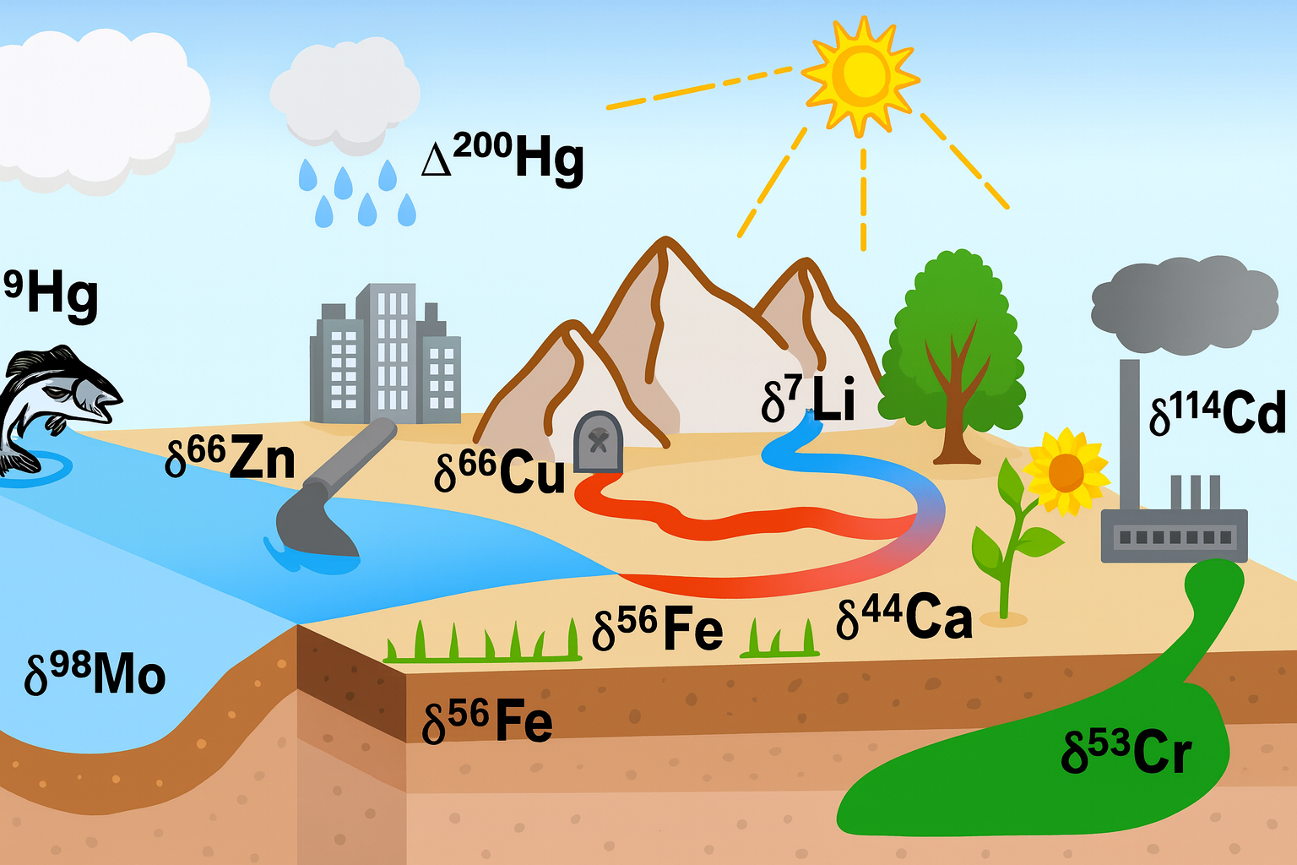
Beyond Geochronology, isotopes trace the movement of elements through water, soil, life, and atmosphere.
Each element here — like zinc, copper, lithium, calcium, iron, or mercury — carries a slightly different isotopic signature depending on where it comes from and what processes it’s been through.
Notes:
So different isotopes act like tracers moving through Earth’s surface.
Each element here — like zinc, copper, lithium, calcium, iron, or mercury — carries a slightly different isotopic signature depending on where it comes from and what processes it’s been through.
For example, rain and rivers carry lithium and magnesium isotopes off the mountains, factories release cadmium and chromium isotopes into soils and water, and fish record mercury isotopes from pollution in the ocean.
By measuring these tiny variations, we can track pollution, study how nutrients cycle through ecosystems, and even understand how our landscapes respond to climate change.

Slide 20

Tracer of water origin
Sr isotopes vary with geology
Rivers, groundwater, seawater, and precipitation have distinct signatures.
Both its concentration and its isotopic composition (⁸⁷Sr/⁸⁶Sr) reveal water origin, mixing, and geochemical processes.
Indicator of water–rock interaction
Sr is released from carbonates, silicates, and evaporites at different rates.
Useful in hydrology, ecology, and forensics — e.g., tracking groundwater recharge, river mixing, or even food provenance.

Slide 21
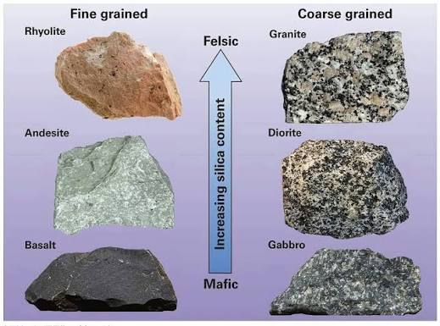
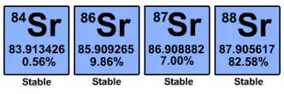
The Principle Behind Strontium Isotopes
Isotope makeup: Strontium has four stable isotopes (⁸⁴Sr, ⁸⁶Sr, ⁸⁷Sr, and ⁸⁸Sr).
Radiogenic signature: The isotope ⁸⁷Sr is formed by the radioactive decay of rubidium (⁸⁷Rb).
⁸⁴Sr — stable, non-radiogenic
⁸⁶Sr — stable, non-radiogenic
⁸⁷Sr — stable but radiogenic (it can be produced by decay of ⁸⁷Rb)
⁸⁸Sr — stable, non-radiogenic

Slide 22
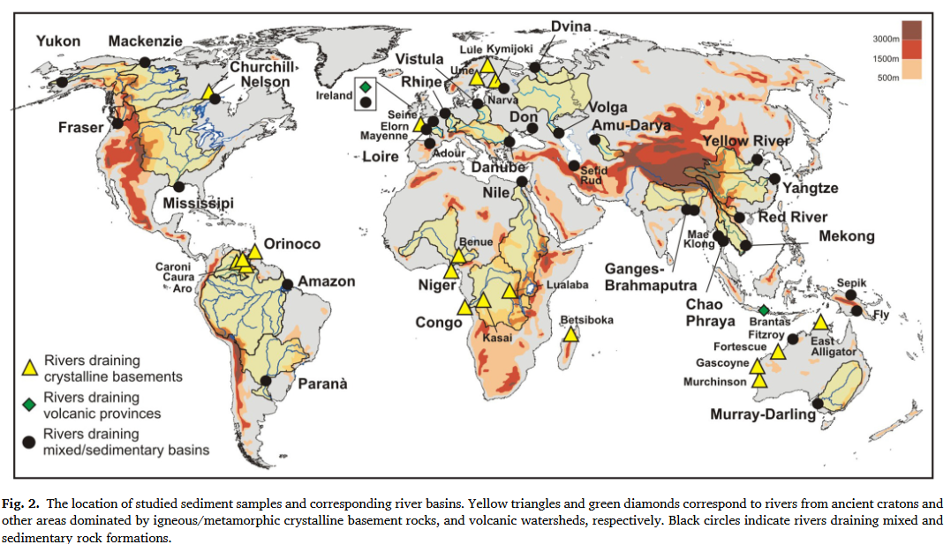
Bedrock Geology: The ⁸⁷Sr/⁸⁶Sr ratio in a river depends heavily on the rocks in its drainage basin.
Unradiogenic strontium (low ⁸⁷Sr/⁸⁶Sr, typically ≈ 0.703 - 0.708) comes from young volcanic rocks or marine carbonates.
Radiogenic strontium (high ⁸⁷Sr/⁸⁶Sr, often > 0.715) comes from ancient continental crust, granites, and old silicate minerals rich in rubidium, like micas and potassium feldspars.
Weathering Processes: Chemical weathering breaks down rocks and releases dissolved strontium into the water.
The balance between carbonate weathering (fast, low ⁸⁷Sr/⁸⁶Sr) and silicate weathering (slower, higher ⁸⁷Sr/⁸⁶Sr) dictates the final isotopic signature of the river

Slide 23
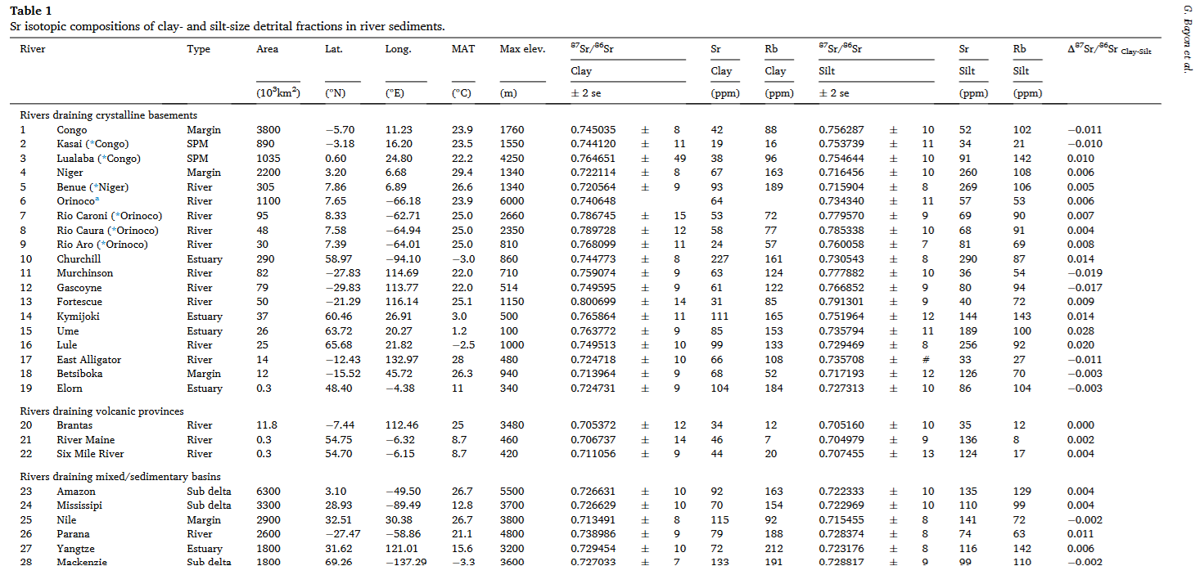

Slide 24
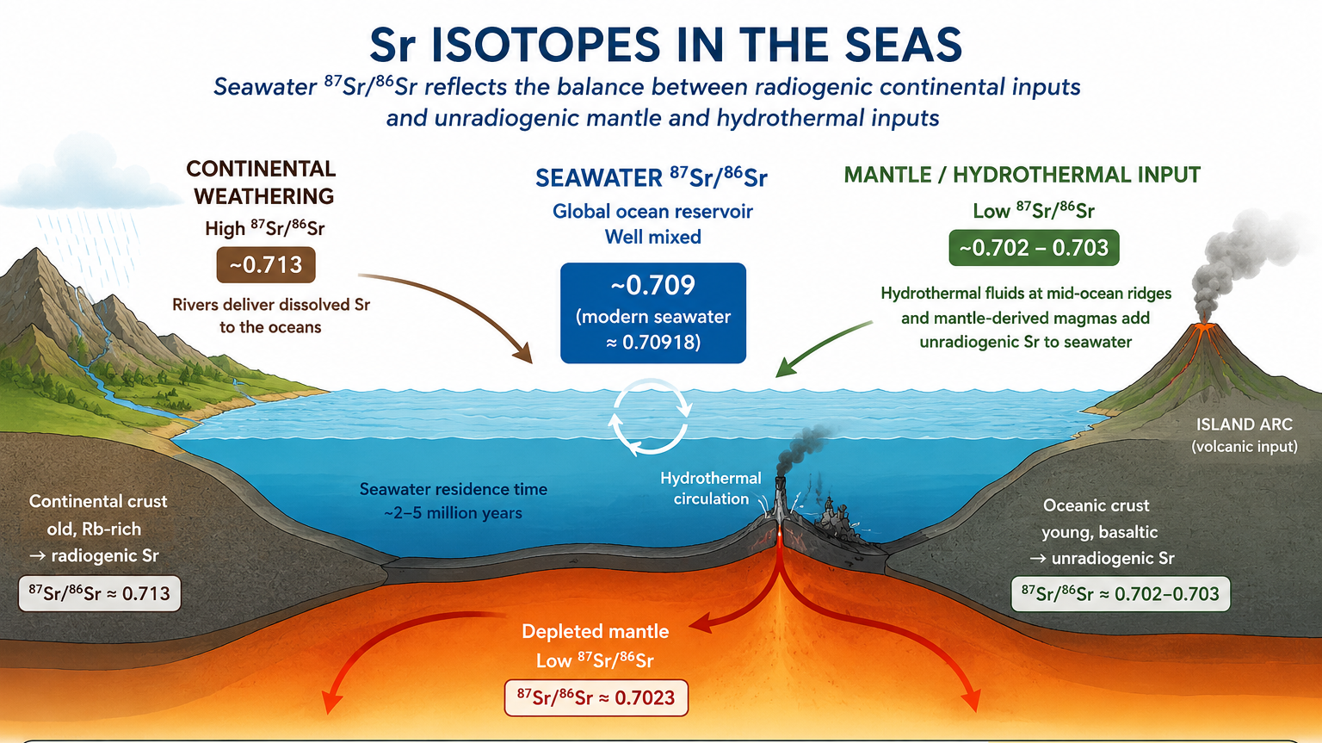
0.730

Slide 25
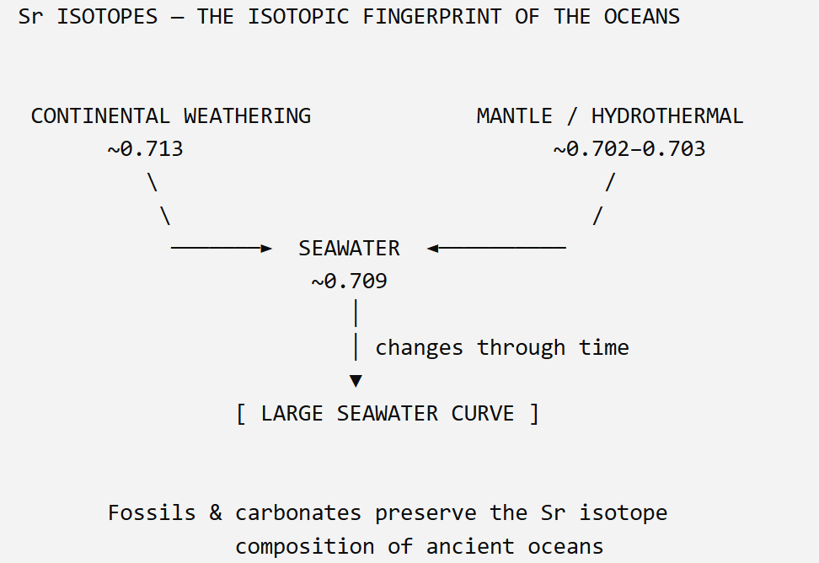
Sr Isotopes
Why Sr isotopes are useful: seawater 87Sr/86Sr reflects the balance between radiogenic continental weathering and unradiogenic mantle/hydrothermal inputs.

Slide 26
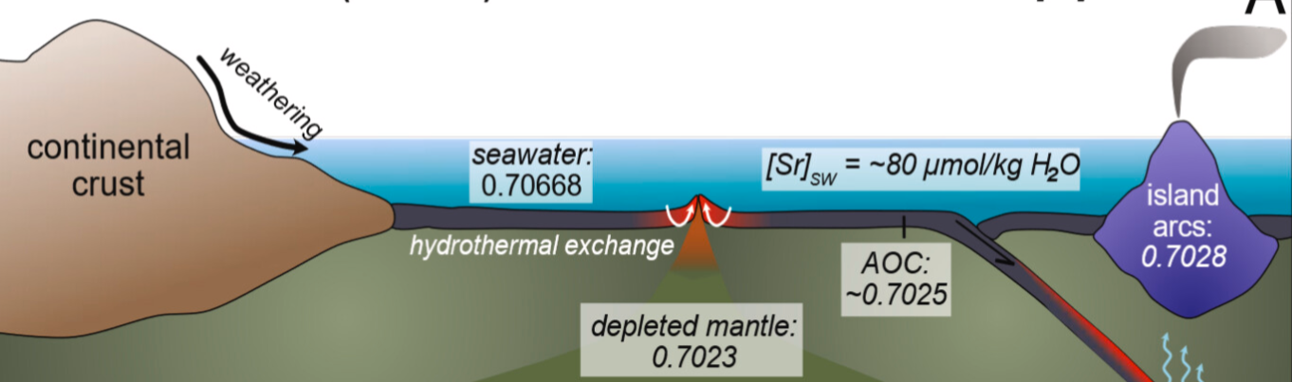
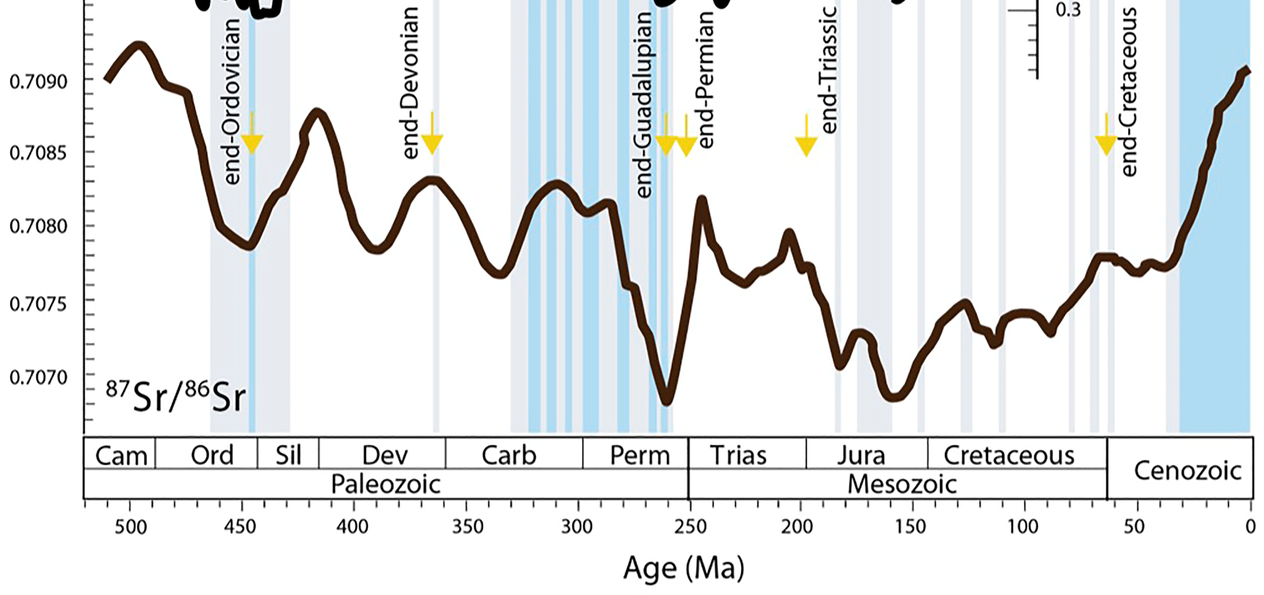
Sr Isotopes
0.713
0.730

Slide 27
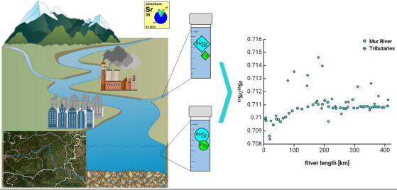

Slide 28
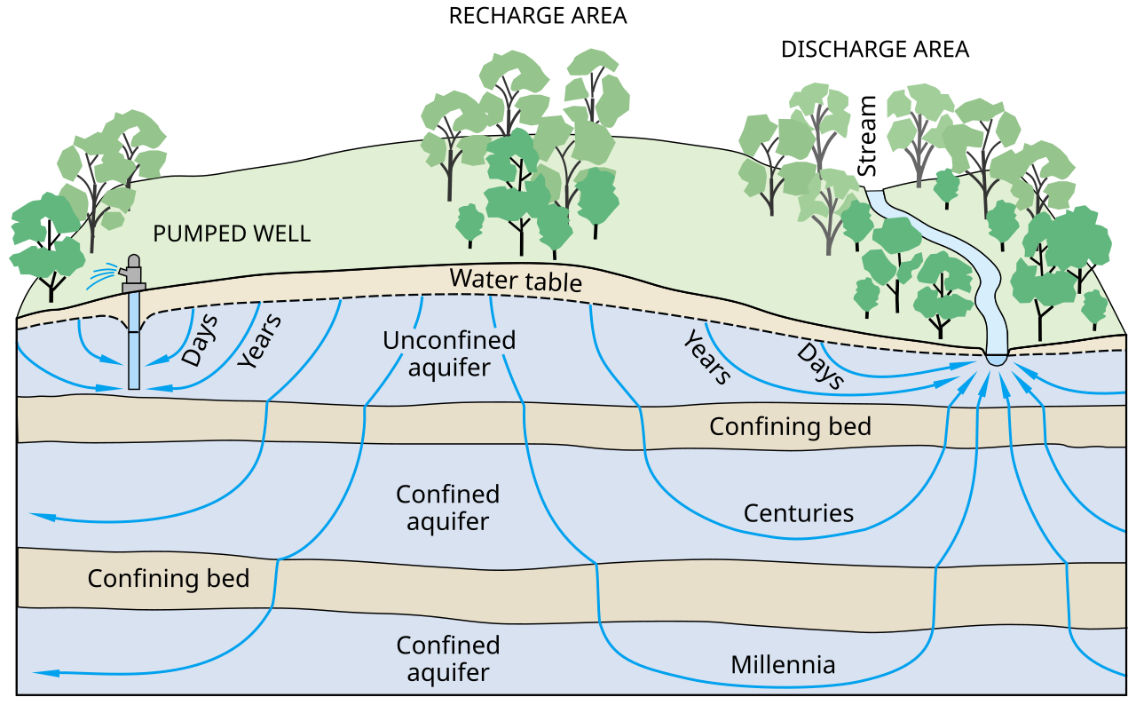
Sr isotopes behave conservatively in natural waters
They do not fractionate during physical processes like evaporation or precipitation.
This makes them excellent tracers.
1. Rainwater
Very low Sr concentration
⁸⁷Sr/⁸⁶Sr reflects marine aerosols or continental dust
Typically narrow range, depending on region
Minimal interaction with geology → “unmodified” signature
2. River Water
Intermediate Sr concentration
⁸⁷Sr/⁸⁶Sr reflects catchment geology
Influenced by weathering of silicates vs carbonates
Mixing of tributaries produces distinct isotopic gradients
Supported by tidal mixing studies in mountainous rivers
3. Groundwater
Highest Sr concentration (due to prolonged water–rock interaction)
⁸⁷Sr/⁸⁶Sr strongly reflects aquifer lithology
Often significantly different from local rivers and rainfall
Demonstrated in Cape Town groundwater recharge studies

Slide 29
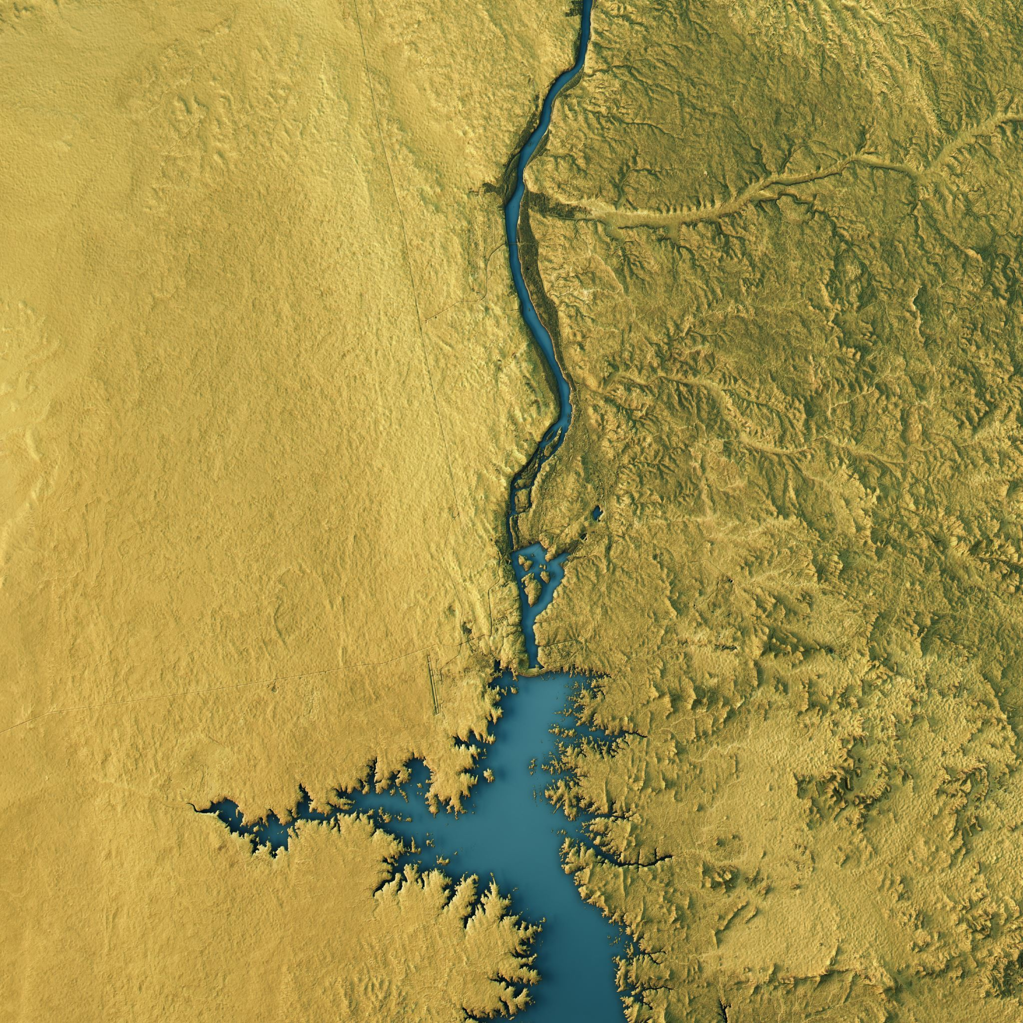
Groundwater vs River Water
Hydrology studies show Sr isotopes can trace river–groundwater interaction, identifying mixing zones and flow direction.
River–groundwater mixing studies use Sr isotopes to quantify contributions and trace element migration.
87Sr/86Sr is widely recognized as a sensitive tracer for continental weathering and the origins of dissolved solutes because significant isotopic differences commonly exist between natural and anthropogenic Sr sources in river systems

Slide 30

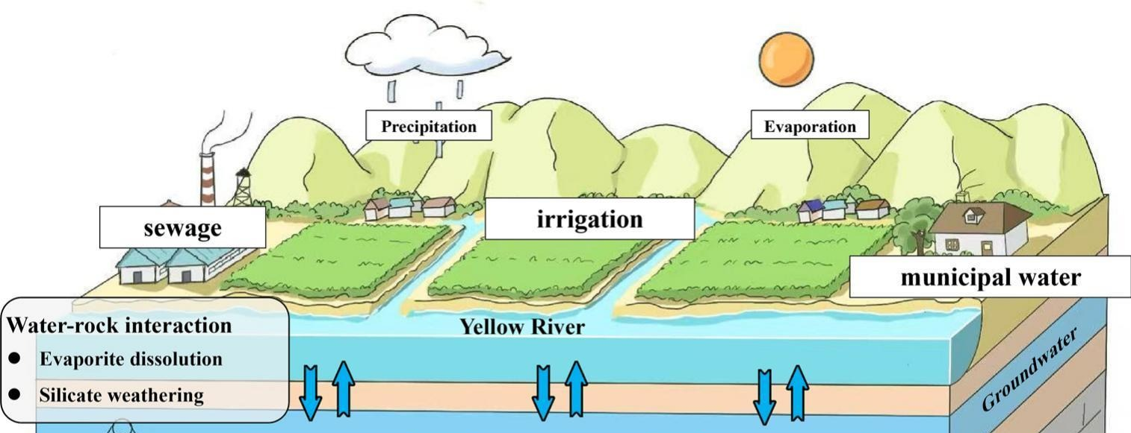
Sr isotopes (⁸⁷Sr/⁸⁶Sr) were used as a sensitive tracer to identify and quantify the sources of dissolved solutes in a river–groundwater system, revealing that both natural weathering and multiple anthropogenic inputs jointly control Sr in the Yellow River Basin.

Slide 31
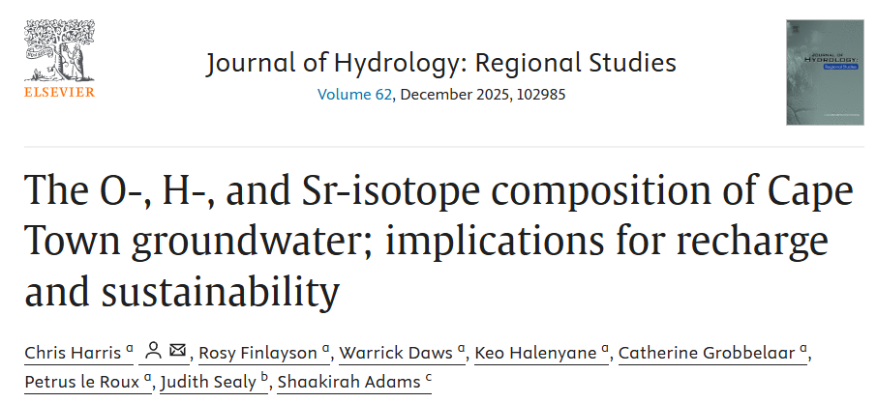
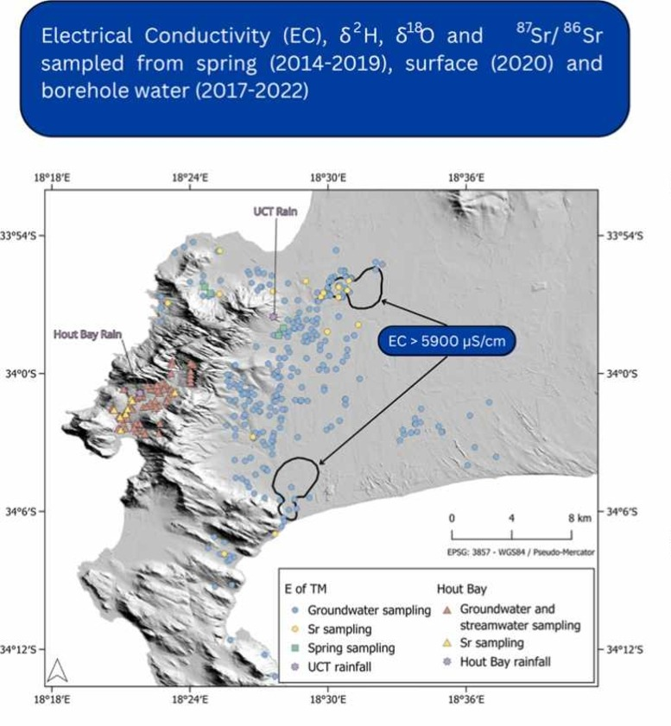
Groundwater vs Rain
Cape Town groundwater research demonstrates that Sr isotopes clearly separate groundwater from rainfall, helping identify recharge sources.
Groundwater has a distinct Sr signature compared to rain, allowing identification of recharge pathways.

Slide 32
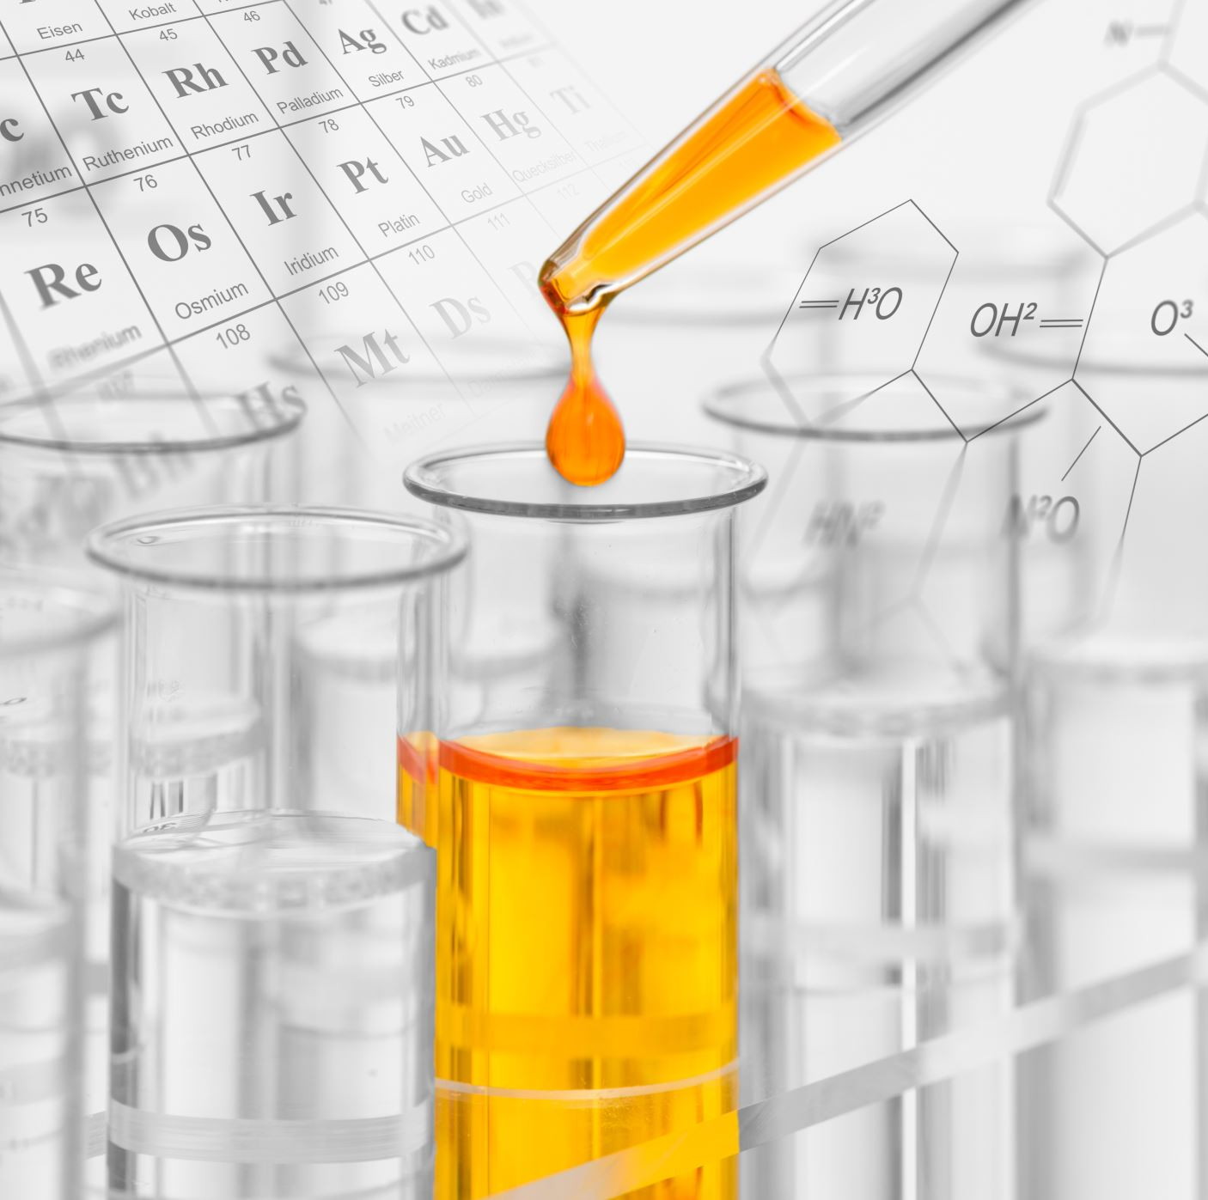
Sample Preparation for Water
Based on recent protocols:
Filter water through 0.45 µm membranes.
Acidify to pH 1–2 with ultrapure HNO₃.
For isotope work:
  Either inject directly into HPIC for Sr isolation (no dry‑down needed).
  Or use Sr‑specific resin (e.g., Eichrom Sr‑Spec).

Slide 33
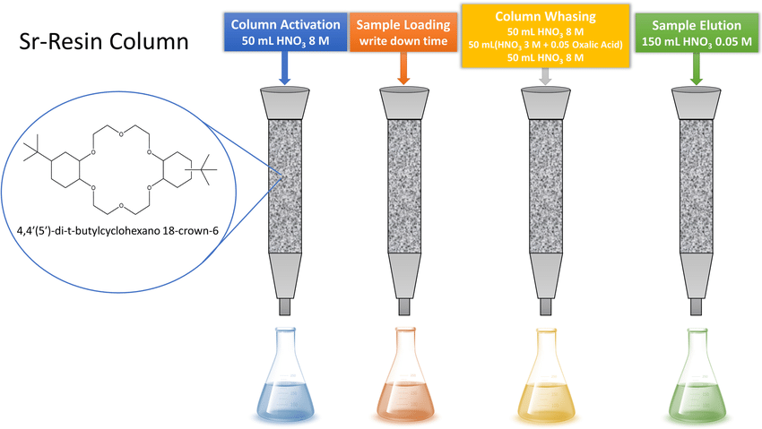
Sr Isotope Analysis – Water Sample Preparation
Sample concentration
  Start with 30 g of lake water
  Evaporate to dryness at 140°C
Sample digestion
  Add 0.25 mL HNO₃ + 0.75 mL H₂O₂
  Predigest for 12 h at 25°C
  Evaporate to dryness at 70°C
Acid dissolution
  Dissolve residue in 2 mL of 3 M HNO₃
  Leave for 12 h
  Prepare an aliquot containing approximately 5 µg Sr
Prepare for chemical separation
  Evaporate aliquot to dryness at 120°C
  Redissolve in 1 mL of 3 M HNO₃
Sr separation by ion-exchange chromatography
  Load sample onto Sr-specific resin
  Wash away the sample matrix
  Elute and collect the purified Sr fraction
Final preparation & analysis
  Evaporate purified Sr fraction to dryness
  Redissolve in 2% HNO₃
  Measure ⁸⁷Sr/⁸⁶Sr by MC-ICP-MS

Slide 34
Sr-Resin Column Chemistry
1. Column activation
The Sr-resin is first conditioned with HNO₃.
This prepares the resin for the sample and establishes the correct chemical conditions for Sr retention.
2. Sample loading
The dissolved water sample is added to the column.
The Sr-specific resin strongly retains the Sr.
The resin therefore acts like a chemical trap for Sr.
3. Column washing
The column is washed with selected acid solutions.
Sr remains attached to the resin, while most other elements pass through the column.
This step removes the sample matrix and potential interferences, especially elements that could compromise the isotope measurement.
4. Sr elution
The chemical conditions are changed so that the resin no longer strongly retains Sr.
Sr is released from the resin and moves down the column.
This solution is collected as the purified Sr fraction.

Slide 35
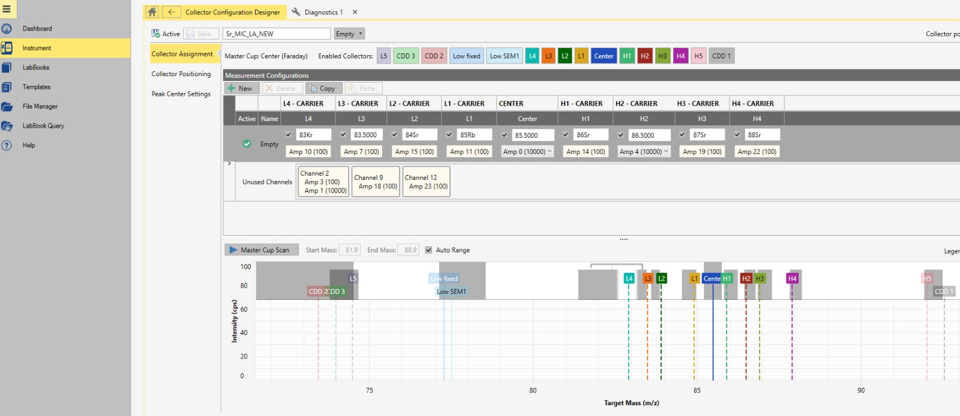
Sr Isotopes

